Slide 1
Income/wealth inequality in Quesnay, Smith, Ricardo and Marx

Slide 2
Functional income distribution
1723
Smith
1790
Ricardo
1772
1823
Marx
Inter-personal income distribution
1818
1883
1848
Pareto
1923
Dalton
1887
1962
Methodology
Gini
1884
1965
Kuznets
1901
1985
Theories of change of income distribution
Tinbergen
1903
1984
Atkinson
Empirics without politics
1944
2017
Empirics with politics
1971
Piketty

Slide 3
Dominant form of property | Dominant form of labor | Corresponding stage of political economy | Its sphere of reference and its view of surplus value
Landed property that has reached a relatively high degree of accumulation of wealth | Serfdom | Monetary system | Circulation; has no definite view on surplus value
Commercially interested and colonially expanding—therefore nation- conscious landed property | Feudally bound labor, making the first steps toward political emancipation | Mercantile system | Circulation; surplus value is identified with surplus-money. The balance of trade surplus.
Modernized landed property—by the advancement of commercial capital and by the accomplishments of the manufacture system | Agricultural labor, still submitted to political determination | Physiocracy | Agricultural production; surplus value is grasped as the product of agricultural labor, set in motion by rent-yielding property
Industrial capital freed of all political and natural determination | Politically emancipated industrial labor (day labor, wage labor) | Liberal political economy | Production in general; surplus value is defined as being produced by labor in general, set in motion by capital
From Istvan Meszaros, Marx’s theory of alienation, 1970

Slide 4
The background to Quesnay (1694-1774)

Slide 5
Three Lorenz curves: France in the second half of the XVIII century
French Gini before the Revolution is between 49 and 55. It is probably higher than in England at that time (around 50).
French mean income is between 3.3 and 3.8 times the subsistence against the English which is almost 6 times the subsistence.
Source: Milanovic, The level and distribution…2015

Slide 6
France as an agricultural kingdom
Creation, principally by Quesnay and Mirabeau, of a group (later likened to a “sect”) of “économistes” (later called Physiocrats because of their emphasis on the wealth-creating potential of agriculture).
Quesnay was a medical doctor.
Their objective is to influence economic policy rather than to create a “science” although they often insist on their own scientific approach to economics.
They argue in favor of laissez-faire, laissez-passer. Free trade of grain within the kingdom, but mercantilist in external trade. Wealth of poorer classes is an indication of the wealth of the country.
Influenced by the idea of China: large agricultural kingdom, ruled by a benevolent monarch and a body of noble scholars (physiocrats saw themselves in that role).

Slide 7
Quesnay
Four sources of income and five their social classes: wages (workers), management compensation (tenant-farmers), 10% interest on fixed K (tenant farmers), net product (rents for landlords, taxes for government administration and tithes for the clergy). The three last classes are jointly called propriétaires.
Similarity with the French official nomenclature of clergy, aristocracy and the rest (tiers état).
The first definition of the “surplus”: = net product = income of propriétaires and of the circular flow.
Workers’ wages are at subsistence.
Property-owners are all assumed to get the same income
Tenant-farmers own different amounts of capital (the main source of inequality)

Slide 8
Rudimentary structure outside of agriculture
There are also non-agricultural self-employed workers but they are a “sterile” class because they generate no surplus (for anyone).
Outside agriculture, there are no residual claimants like landlords to collect the surplus (or/and the sector is not “rich” enough to produce a surplus, or there is no such institutionalized relationship).
The propriétaire plays the same role in Quesnay as capitalist does in Ricardo: both are residual claimants and their income is needed if the economy is to grow.

Slide 9
Factoral distribution and social classes in “La philosophie rurale” (1763)
 | Labor | Capital | Land and taxes
Workers | 48.3 | ---- | ----
Tenant farmers | 3.9 | 19.9 | ----
Landlords | --- | ---- | 27.8
Administration | --- | ----
Clergy
Total | 52.2 | 19.9 | 27.8
Only land produces surplus that provides income for the property-owners

Slide 10
The background to Smith (1723-90)

Slide 11
English social structure around the time of Smith’s WoN (1776)
…ancentineq2.xls

Slide 12
Relative incomes: Around 1759: aristocrats-workers gap was 33 to 1; capitalists-workers 11 to 1.
Smith
Ricardo
Based on Bob Allen’s reworking of social tables by King (1688), Massie (1759), Colquhoun (1801), Smee (1846) and Baxter (1867). Allen “Class structure & inequality during the IR” (2017).
…ancentineq2.xls

Slide 13
A period of moderately rising inter-personal inequality
Around 1759, England’s Gini was between 45 and 51, the current level of countries like Chile or Dominican Republic
…ancentineq2.xls

Slide 14
Smith, Ricardo, Marx
For all three authors functional distribution is synonymous with inter-personal distribution.
Clear income ranking: landowners > industrial capitalists > workers
And implicitly everybody within a higher class is richer than anyone who belongs to a lower class
This is especially the case (and is relevant because of their population size) for workers: no worker can be richer than a capitalist
In such a society, inter-personal distribution is subsumed into functional distribution => the reason why none of the three authors addresses inter-personal distribution as a separate topic

Slide 15
Smith
WoN comes only 13 years after “La philosophie rurale” but presents a much more modern view of the economy.
Industry is at the center-stage, not agriculture.
The introduction of tripartite class distribution (major classes) that we still use: owners of land, owners of capital, “owners” of labor (or labor power).
Smith: opulence of a country undistinguishable from the good living standard of the largest social group (workers):
“The high price of labor is to be considered not merely as a proof of the general opulence of society which can afford to pay well al those whom it employs; it is to be regarded as what constitutes the very essence of pubic opulence, or as the very thing in which public opulence properly consists.” (WN, 567).

Slide 16
Difference between TMS (1759) and WoN (1776)
TMS is about our relations with those who are close to us (family, friends, peers). Moralistic and religious tenor.
Smith as a moral philosopher.
TMS is often thought “softer” than the WoN (especially because of Amartya Sen’s reading of it).
But in matters of distribution it is much harsher.
Emphasis on the acceptance of an immutable class structure. The famous paragraph where the Invisible Hand is mentioned first is an argument for quasi religious acceptance of hierarchy of wealth.
“They [the big proprietors] are led by an invisible hand [through their spending] to make nearly the same distribution of the necessaries of life, which would have been made, had the earth been divided into equal portions among all its inhabitants, and thus without intending it, without knowing it, advance the interest of the society, and afford means to the multiplication of the species. When Providence divided the earth among a few lordly masters, it neither forgot nor abandoned those who seemed to have been left out in partition.“ (TMS, part IV.I.10).

Slide 17
The rich are derided for their behavior (“fatuity of wealth accumulation”) and spending pattern but their status or wealth are not questioned.
Clear theistic (or moral philosophy) elements incl. rejection of Mandeville (“pernicious system”)
TMS often makes Smith look not only conservative, but outright reactionary, akin to some most reactionary Calvinist theologians.
The poor should accept their position because it is a divine will and that’s how societies are structured. But the rich are not necessarily virtuous.

Slide 18
Stern realism and self-interest of the WoN
WoN is about economic interactions which are by definition relations with strangers. (Like the difference between organic and mechanical communities.)
“WoN was built on the granite of self-interest” (George Stigler), not on altruism and empathy
Indeed, for the WoN to stand firm and tall, self-interest is enough. Smith displayed a praiseworthy economy of assumptions.
It is more realistic, even cynical. It has a different view of human nature.
“The laws concerning corn may everywhere be compared to the laws concerning religion. The people feel themselves so much interested in what relates either of their subsistence in this life, or to their happiness in a life to come, that government must yield to their prejudices, and, in order to preserve the public tranquility, establish that system which they approve of. It is upon this account, perhaps, that we so seldom find a reasonable system established with regard to either of those two capital objects”. (Book 4, Ch 5; p. 682-3)
“I have never known much good done by those who affected to trade for the public good. It is an affectation, indeed, not very common among merchants, and very few words need be employed in dissuading them from it” (Book 3, Ch. 2, p. 572).

Slide 19
Much more “leftist” re. inequality than TMS
But regarding inequality:
It is much more “leftist”. Does not accept the ethical validity of the natural hierarchy. Social classes are in conflict over the distribution of net product.
Incomes of the rich are often unjust.
TMS ridicules spending patterns of the rich, but does not question their right to high incomes; WoN does.

Slide 20
Income of the rich (i.e., capitalists) is often the product of monopoly, price fixing, plunder.
People of the same trade seldom meet together, even for merriment and diversion, but the conversation ends in a conspiracy against the public, or in some contrivance to raise prices. It is impossible indeed to prevent such meetings, by any law which either could be executed, or would be consistent with liberty and justice. But though the law cannot hinder people of the same trade from sometimes assembling together, it ought to do nothing to facilitate such assemblies; much less to render them necessary. (WoN, Book I, Chapter 10).
Merchant companies (East India and VOC) and merchant republics come for a particular critique.
“The government of an exclusive company of merchants is, perhaps, the worst of all governments for any country whatever”. (Book IV, Ch. 7, p. 722).
“The crusaders were “the most destructive frenzy that ever befell the European nations” and they were spurred on by the merchant republics of Venice, Genoa and Pisa for whom the crusade “was a source of opulence”. (Book III, Ch. 3, p. 513).

Slide 21
The rich must not be allowed to rule the state
“The difference between the genius of the British constitution which protects and governs North America, and that of the mercantile company which oppresses and domineers in the East India, cannot be perhaps better illustrated than by the different state of those economies.” (Book I, Chapter 7, p. 176).
The bottom line: the rule by the rich is not in the social interest.
“But the mean rapacity, the monopolizing spirit of merchants and manufacturers, who neither are, nor ought to be, the rulers of mankind, though it cannot perhaps be corrected may very easily be prevented from disturbing the tranquility of anybody but themselves.” (Book IV, Ch 3; p. 621)
They [the capitalists] are "an order of men, whose interest is never exactly the same with that of the publick, who have generally an interest to deceive and even to oppress the publick, and who accord­ingly have, upon many occasions, both deceived and oppressed it“ (Book I, Ch. 11).

Slide 22
Nobility: usurpation
”Entails are thought necessary for maintaining this exclusive privilege of the nobility to the great offices and honours of their country; and that order having usurped one unjust advantage over the rest of their fellow-citizens, lest their poverty should render it ridiculous, it is thought reasonable that they should have another” (Book III; Ch. 2).

Slide 23
Economic criticism of the rich (property-owners)
The self-interest of some (large industrialists, monopolists, government officials, protected traders) is deeply pernicious for the society and has to be kept in check.
The main point of contrast with TMS and some later “economic harmonies” interpretation of Smith is the questioning of justice of high incomes.
Two versions of capitalism: competitive one where incomes are “just”, and crony or business capitalism where incomes are often the product of a swindle or monopoly.
No doubt that Smith sees the latter as the “really existing” capitalism (or as he called it, ”the commercial society”)
The toothless moral critique of the rich from TMS now becomes a critique based on political economy: incomes that detract from the “natural progress of opulence”

Slide 24
Views re. labor incomes
A realistic view of top classes’ incomes is combined with an emphasis on the importance of the welfare of lower classes
Advanced society cannot be a society where workers are badly paid
Contrasts Spain & Portugal which exhibit high wealth of a small ruling class with poverty of others with the Netherlands:
“Have the exorbitant profits of the merchants of Cadiz and Lisbon augmented the capital of Spain and Portugal? Have they alleviated the poverty, have they promoted the industry of those two beggarly countries?” (Book IV, Ch. 7).
If the welfare of the majority (which means workers) becomes the criterion of how well a society is doing, we are having an entirely new and very modern view of what a “good society” means.

Slide 25
Real wage
Subsistence wage will be always in Smith, Ricardo and Marx, a “relative subsistence”.
“Under necessities…I comprehend not only those things that nature, but those things that the established rules of decency, have rendered necessary to the lowest ranks of people.” (Book V, Ch, 2)
But this will be used almost always to distinguish the level of real wages between countries (Smith mentions that English real wages are much higher than Indian). However, in dynamic analysis of a single country real wage would be taken as a constant.
Advancing countries are those with higher wages and low rate of interest. (Country’s growth rate –not income level– is linked to the level of wages.)

Slide 26
The background to Ricardo (1772-1823)

Slide 27
High inequality and increasing incomes
ancient_inq2.xls

Slide 28
Ricardo
Functional income distribution (3 classes) at the center of The Principles
The famous quote: “To determine the laws which regulate this distribution, is the principal problem in Political Economy”
Distribution not important per se, but as a way to accelerate economic growth
The first integration of income distribution and growth.
The main idea is simple, and a “modeler’s dream”.
If Corn Laws are not abolished, increase in population with an unchanged amount of arable land, will increase the price of corn (grain) and raise rents (which are determined by the MPs of the least fertile land).
Nominal wage is a function of the price of corn (since the real wage is assumed to be constant): higher price of corn => higher nominal wage
Then profits must go down until they become 0, at which point all growth stops.
Distribution determines growth.
Note: What Ricardo calls “real wage” is what we today call “labor share”

Slide 29
Two states of England
 | Import of corn and growing economy | Corn Laws and stationary economy
Rents | Declining | Increasing
Real wages | Constant | Constant
Profits | Increasing | Declining all the way to 0
Wage share | Decreasing | Increasing
Profit share | Increasing | Decreasing
Investments | Increasing | Nil
Real wages are assumed to be constant throughout. Implicitly they are at some socially-determined subsistence. Ricardo is a very strong Malthusian. Any increase in real wages is bound to bring about the increase in population and ultimately the wage decline to the previous level.
No permanent improvement in workers’ condition is envisaged.

Slide 30
Class conflict
The class conflict, not only between capitalists workers but also between landlords and capitalists is extremely clear and sharp.
Because Ricardo focuses on relative shares of net product, his class conflict is as severe as in Marx.
“However abundant capital may become, there is no other adequate reason for a fall in profits but a rise of wages” (Ch. XXI)
Unlike Smith who believes that prosperity of the most numerous class (workers) is necessary for overall prosperity, in Ricardo, it is capitalists who are the only active agents.
They ensure growth; thus high profits are a sign of progress. This is also different from Smith who sees low profits as a sign of prosperity (the Netherlands) and high profits as a sign of scarcity of capital or lack of security of private property (Ottoman Empire).

Slide 31
Lower inequality as a tool to achieve high growth
Stationary society is the one with high inequality: super rich landlords, impoverished capitalists, subsistence level wages.
Growing economy has lower inequality as landlords’ incomes converge downward to capitalists’ incomes. Wages are constant.
More equal distribution implies higher growth. No Okun’s trade-off.
Growth
Growing economy
Stationary economy
Inequality

Slide 32
Note that inequality in expenditures would be lower than inequality in incomes because capitalists were supposed to spend a significant part of their income on investment. (According to Allen (2005), savings out of profits were about 20%.)

Slide 33
The first criticism of what Schumpeter later called “the Ricardian vice”
[First enunciation of the Ricardian vice]. It is perhaps a well-founded objection to Mr Ricardo that he sometimes reasons upon abstract principles to which he gives too great a generalization. When once fixed in an hypothesis which cannot be assailed, from its being founded upon observations not called in question, he pushes his reasoning to their remotest consequences, without comparing their results with those of actual experience. (J. B. Say, “Treatise on political economy”, 1817; p. xlvii).

Slide 34
The background to Marx (1818-1883)

Slide 35
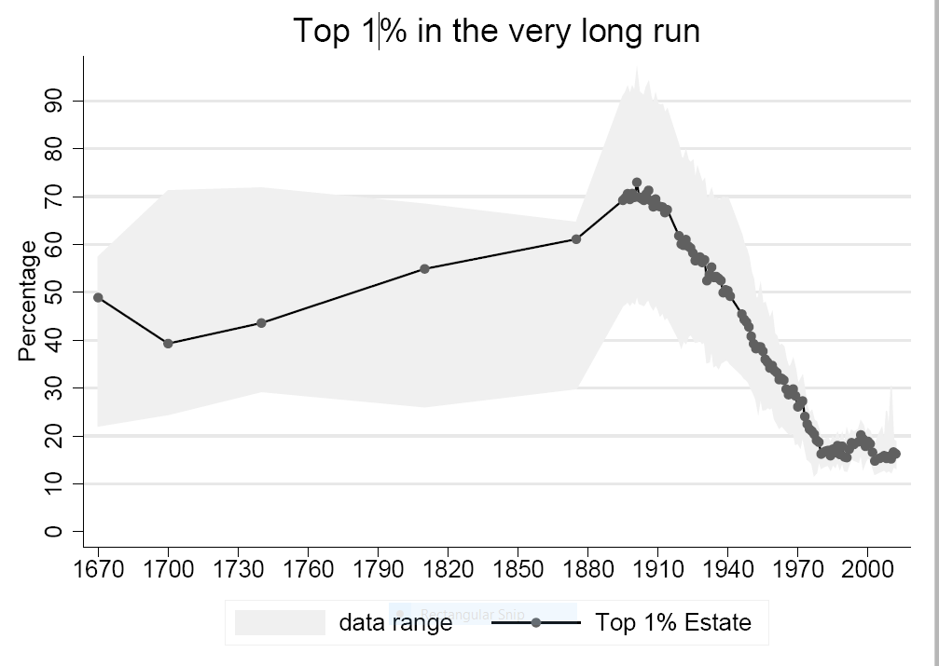
Top 1% of wealth holders in the UK, 1670-2010: increasing wealth concentration during the Industrial Revolution
At the time of Marx’s writing the top 1% own about 60% of British wealth. The share will peak just before the outbreak of World War I.
Alvaredo, Atkinson, and Morelli, 2017

Slide 36
Relative incomes of the three principal classes in the UK
 | Around 1776 (WoN) | Around 1817 (Principles) | Around 186 (Capital)
Landlords (aristocracy) | 33 | 33 | 21
Capitalists | 11 | 23 | 15
Workers | 1 | 1 | 1
Between The Principles and Das Kapital, there was a significant increase in the relative (and real) income of workers’ households. Wage data show the same. In 1867, franchise given to a part of the urban working class (males); in 1884 a further extension of the franchise (60% of adult males).

Slide 37
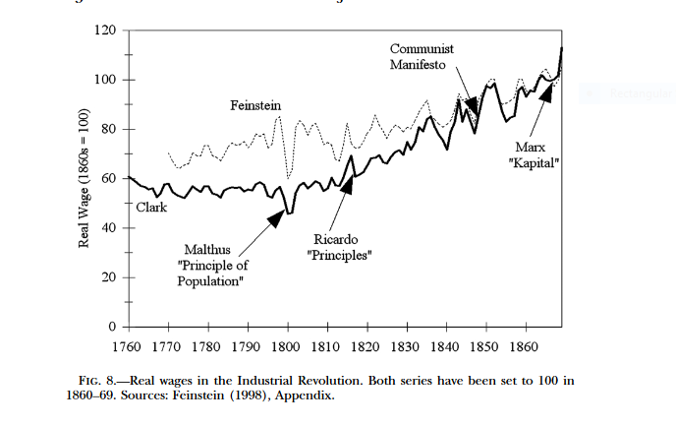
Real wages in England (from Colin Clarke, 2005)

Slide 38
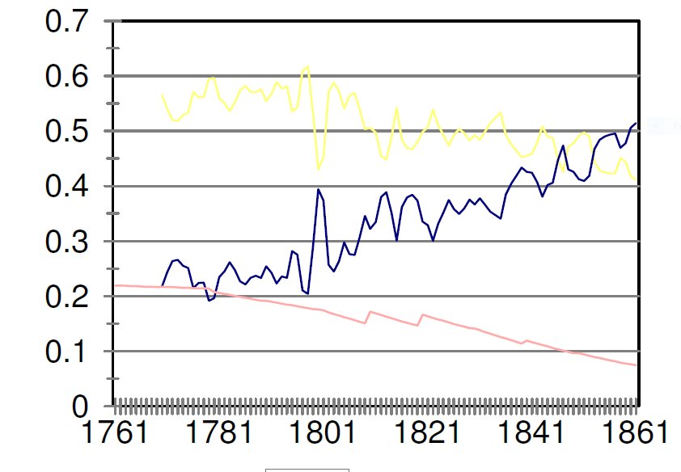
Historical factor shares (Allen, 2005)
Yellow: labor; blue: capital; red: land
Source: “K accumulation, tech. change and the distribution of income during the British IR” Allen (2005)

Slide 39
Marx
“The ‘laws and conditions of the production of wealth’ and ‘the laws of the distribution of wealth’ are the same laws under different forms” (Grundrisse).
Class struggle becomes the centerpiece, not only in capitalism but as an explanation of global history
Class struggle is not only about the distribution of net product, but encompasses issues like length of the workday, trade unions, working conditions etc.
While class conflict is an engine of growth (or not) in Ricardo, here it becomes an engine of history
More precise definition of capital.
Not every machine is capital. Only if used to hire labor and make profit. Thus the existence of hired labor is an essential part of something becoming capital. “Capital is a social form which is acquired by means of reproduction, when they are used by wage labor” (Theories of surplus value, vol. III).

Slide 40
Subsistence is socially-determined
“In production resting on capital, the existence of necessary labor [to produce subsistence for the worker] time is conditional on the existence of superfluous labor time [labor time appropriated by the capitalist]. In the lowest stages of production.. few human needs have yet been produced, hence few to be satisfied. Necessary labor is thus restricted not because labor is productive but because it is not very necessary.” (Grundrisse).

Slide 41
Theory of exploitation
If the entire net income belongs to labor, then the division of that income between labor and capital is not simply an issue of distribution but an issue of exploitation.
Profit is the surplus value. Rate of exploitation: s/v.
Labor is seen as capital (variable capital). For a capitalist it is undistinguishable from constant capital (machinery etc.)
Thus, functional income distribution à la Ricardo goes much further, in a historical direction (historical materialism), redefinition of capital, introduction of exploitation. These are all new “moments”.

Slide 42
Social classes
Like in Ricardo, there are three principal classes with their distinct sources of income.
In “Class struggles in France”, Marx has the following class structure
Capitalists | Financial bourgeoisie
 | Industrial bourgeoisie
Self-employed | Petty bourgeoisie
Laborers | Peasants
 | Proletarians
Declassés | Lumpenproletariat

Slide 43
Labor
The use of complex and simple labor (with the former, in an abstract sense, being reducing to units of simple labor) introduces a differentiation amongst workers.
Marx does not treat workers as interchangeable. This has an implication for inequality because we can no longer, even at first approximation, treat all workers as having the same wage.
Wage is a function of reproduction costs. If costs more to reproduce a skilled workers => his wage will be higher.
Marx’s differentiation among workers might have been influenced by the rising wages and increasing complexity of tasks among workers
But the “reserve army of labor” keeps wages down.

Slide 44
Capital
The return to capital (profit rate) is a function of the organic composition of capital. More K-intensive sectors, or over time, more K-intensive countries, will have lower rate of profit. The “Law of the Tendencial Fall in the Rate of Profit”.
Inter-personal inequality is thus driven by:
1) Class struggle over the distribution of net income,
2) Decreasing rate of profit as the economy develops,
3) Greater complexity of labor and greater variability of wages,
4) Reserve army and the much criticized “immiseration” of labor.

Slide 45
Land
Land ownership plays much less of a role in Marx than Ricardo.
Although Marx introduces “absolute rent” (received even by the marginal plot of land) land ownership now becomes subsumed under general capital ownership
Land appears as just another form in which capital can be held.
The three-class system becomes in reality a two-class system.

Slide 46
Indeterminate distribution
Marx views on distribution, as pieces together from various writings (many published only after his death, including a century after having been written) are not clear.
With a tendency of decreasing rate of profit, and wages being a function of the level development and diversified across skills, one could make a case for shrinking gaps between classes.
But differently, with the reserve army of labor and Marx’s immiseration hypothesis (never clearly explained), one could make a case for widening inequalities that, in underconsumptionist fashion, lead to crises.

Slide 47
Income distribution and economic crises
“The ultimate reason for all real crises remains the poverty and restricted consumption of the masses as opposed to the drive of capitalist production to develop the productive forces as though the society’s absolute capacity for consumption constituted their limit” (Capital vol. III, Ch. 30).

