Slide 1
INEQUALITY ACROSS THE US STATES
Geographic Inequality in Social Provision and Redistribution
Sarah K. Bruch - University of Iowa
Inequality Workshop
The Graduate Center, CUNY
June 9, 2017

Slide 2
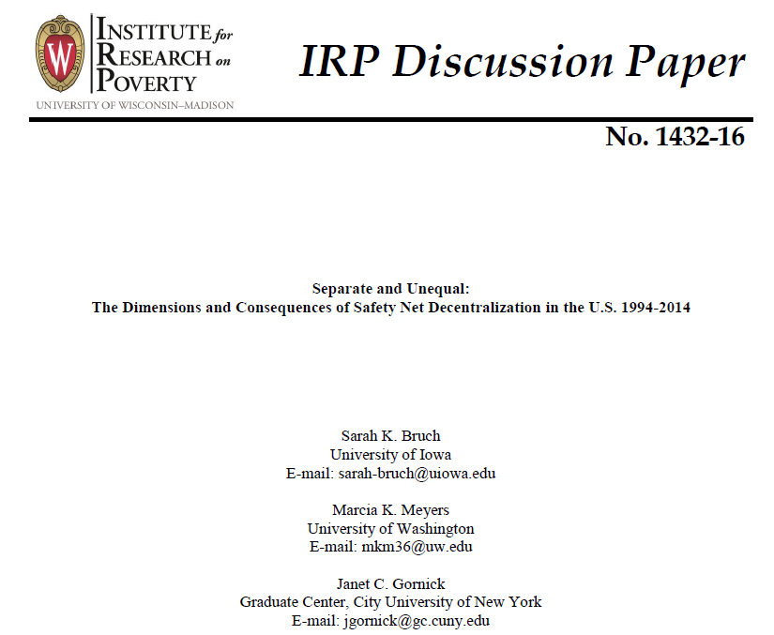

Slide 3
State Variation in Provision & Redistribution
How does social safety net provision vary across US states?
How does economic redistribution vary across US states?

Slide 4
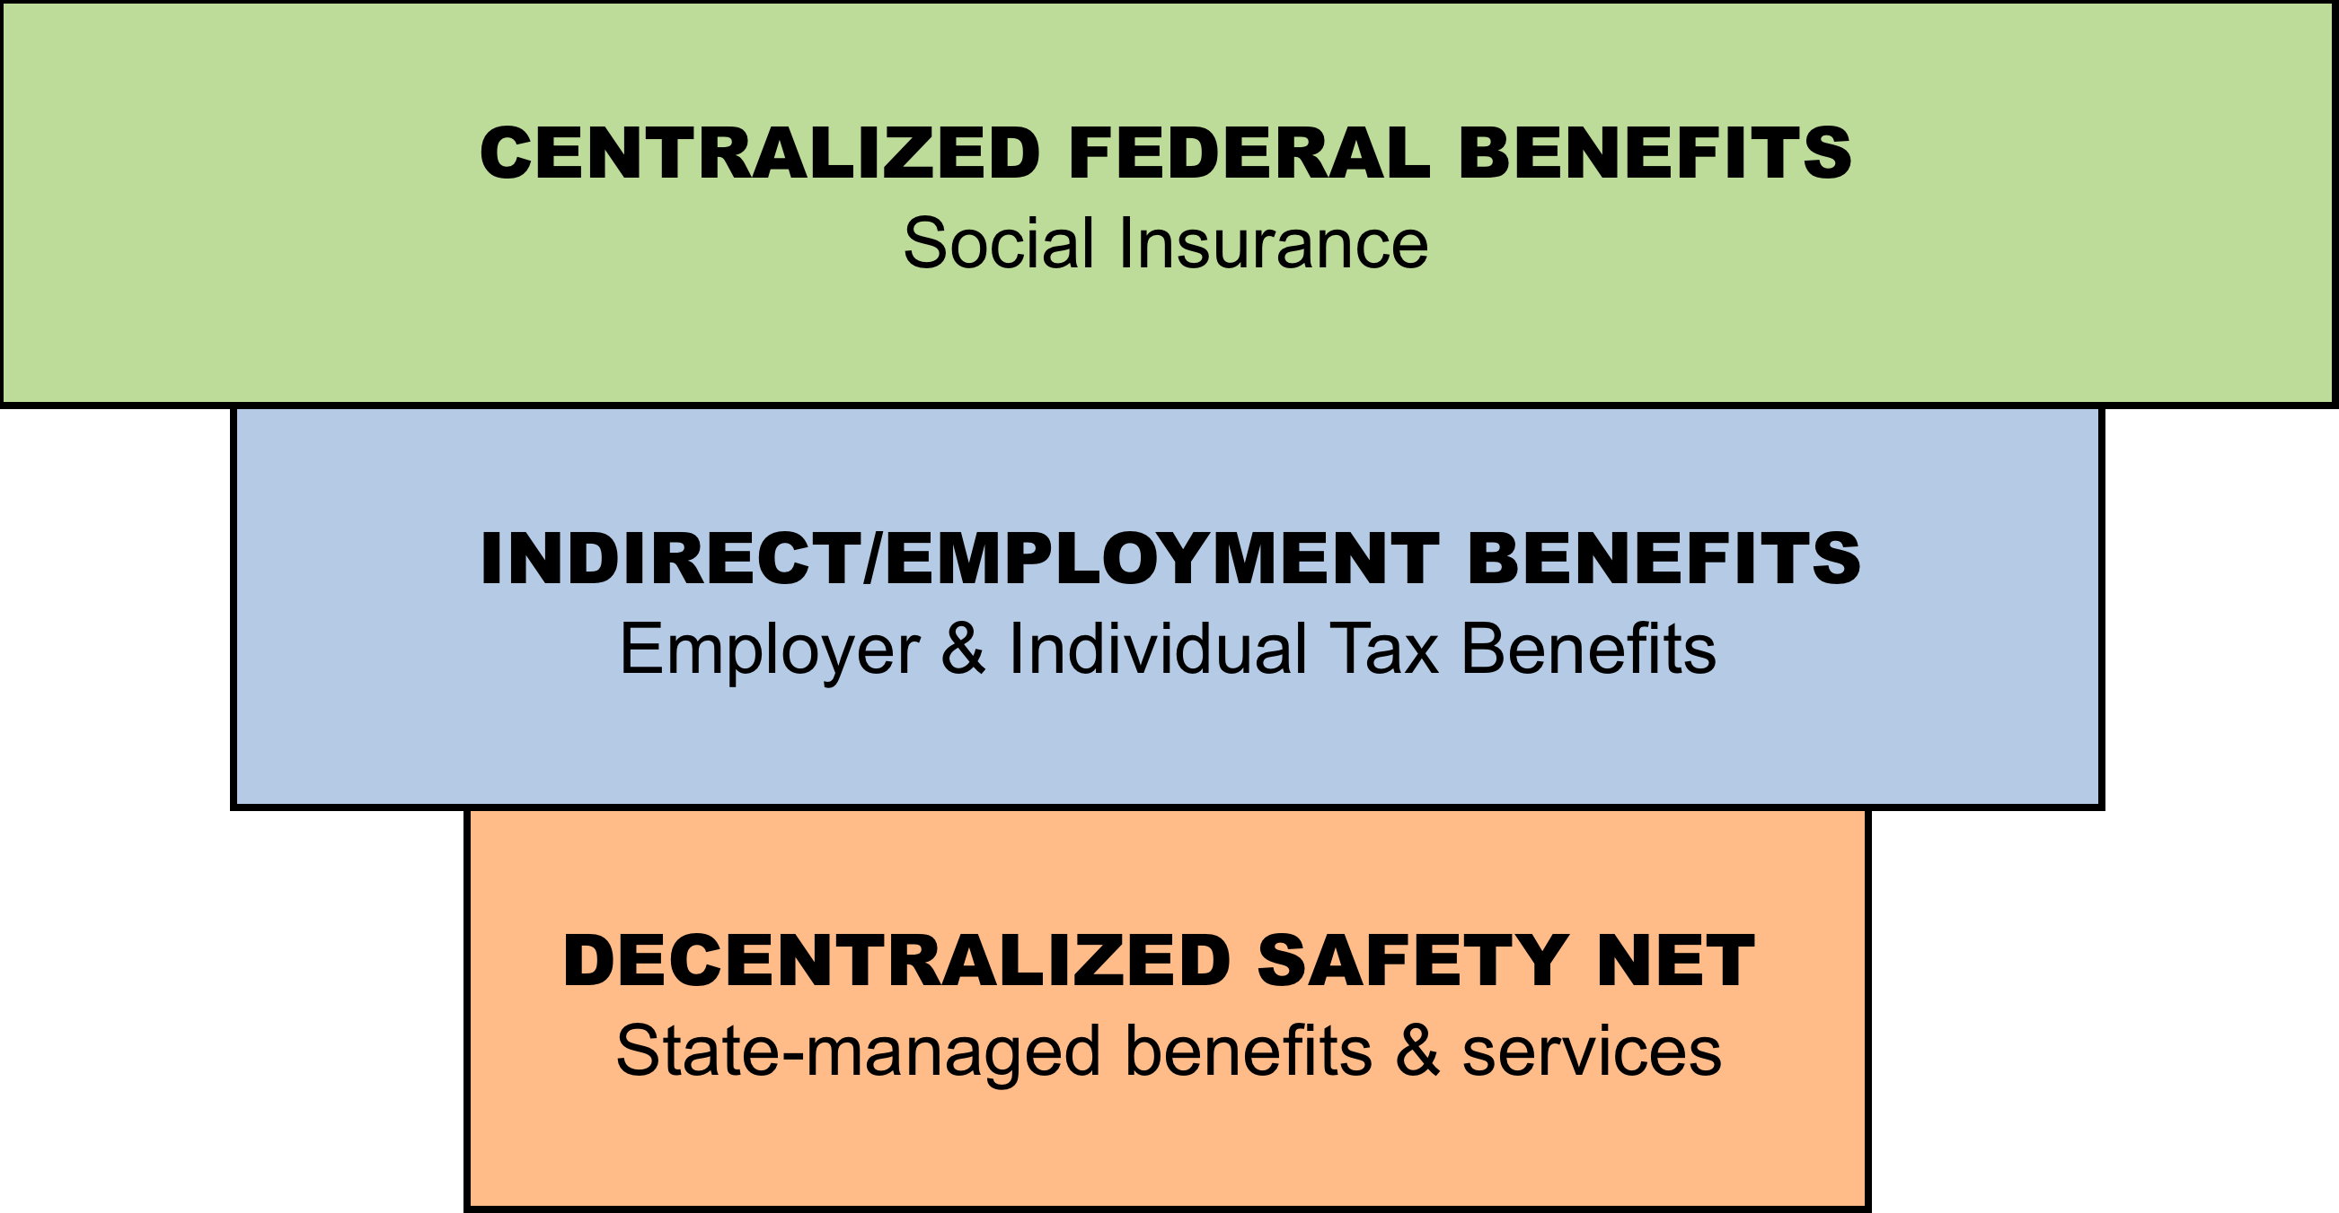
Unequal by Design: Social Provision in the US Welfare State
Discretionary
Targeted
Standardized
Broad Coverage

Slide 5
Motivation
A decentralized state-based social safety net creates fertile ground for unequal responses to citizen needs.
Equity arguments suggest that all citizens should have access to equivalent public assistance when in need, while economic rights arguments claim that access to basic economic resources should have the same standing as citizenship rights (Blank 1997: 193).
Notes:
IRP

Slide 6
Motivation
A decentralized state-based social safety net creates fertile ground for unequal responses to citizen needs.
The most vulnerable victims of the Recession confronted “a jumble of disconnected programs that reach some and reject others, often for reasons of geography or chance rather than difference in need” (Jason DeParle 2009).
Notes:
IRP

Slide 7
State-Level Safety Net
11 programs that provide support for economically vulnerable families with children.
CA: cash assistance (AFDC/TANF)
FS: food assistance (Food Stamps/SNAP)
HI: health insurance (Medicaid and SCHIP)
CS: child support (enforcement and collections)
CC: child care (subsidies – CCBG/CCDF and TANF)
EE: early childhood education (Head Start and public pre-k)
UI: unemployment insurance
WA: work support (JOBS w/ AFDC and TANF work support)
SS: disability assistance (SSI for disabled children)
HS: housing assistance (Section 8)
ST: state income taxes (liability threshold and credits)

Slide 8
Key Dimensions of Safety Net Policies: Adequacy
Adequacy of benefits = what recipients receive on average.
Direct expenditures for recipient benefits
Program caseload or recipients
Adjusted for inflation (in constant $2012)

Slide 9
Key Dimensions of Safety Net Policies: Inclusion
Inclusiveness of receipt = proportion of potentially needy that get assistance.
Program caseload or recipients
Potentially needy population
Potentially needy population estimated with Census household survey data (ASEC/March CPS).

Slide 10
INEQUALITY ACROSS STATES
SOCIAL PROVISION DIFFERENCES

Slide 11
Cross-State Variation: Magnitude and State Discretion
Q1: What is the magnitude of cross-state variation in the adequacy of benefits and inclusiveness of receipt in safety net provision?
Q2: Does the magnitude of cross-state variation correspond to the extent or type of state discretion?

Slide 12
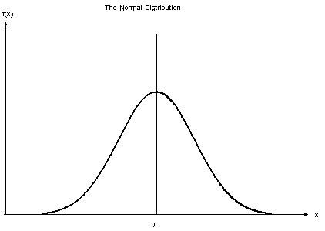
Cross-State Variation: Magnitude
Q1: What is the extent of cross-state variation in the adequacy of benefits and inclusiveness of receipt in safety net provision?
Variation in Levels
Coefficient of Variation (COV)
Standard Deviation
/ Mean
10th percentile
90th percentile

Slide 13
Decentralization Policy Design Features
Structures that Modify State Discretion | Implications for Inequality in Social Provision
Program Financing
State share of financing; options for supplementation; restrictions on use of federal funds; automaticity, incentive & emergency funding | Variation in availability and stability of funding; political and fiscal constraints on funding
Policymaking Authority
Federal mandates or individual entitlements; specificity of rules and regulations for use of Federal funds & receipt of incentives | Variation in eligibility criteria, benefit levels, time limits on receipt, service content & quality
Administrative Authority
Delegation of authority for intake, eligibility certification, benefit determination and service provision; oversight of operations | Variation in vigor of outreach, application burden, accuracy of eligibility determinations, discretion of front-line workers

Slide 14
State Discretion: Program Typology
Program | Financing | Policy | Administration
Supplemental Security Income | Low | Low | Medium
Food Assistance | Low | Medium | Medium
Child Support | Low/Medium | Medium | High
Unemployment Insurance | Low | Medium/High | High
Housing Assistance | Low | Low | Medium
Child Health Insurance | Medium | Medium | Medium
Cash Assistance | Medium | High | High
Child Care | Medium | High | High
Preschool/Early Education | Medium/High | Medium/High | High
Targeted Work Assistance | Medium | High | High
State Income Taxes | High | High | High
Note: Program categorizations are based on qualitative analysis of current policies.

Slide 15
Cross-State Variation: Policy Design Expectations
Adequacy of benefits:
Less cross-state variation in programs for which states have low levels of discretion in financing and policy authority

Slide 16
Cross-State Variation: Policy Design Expectations
Inclusiveness of receipt:
Greater cross-state variation in programs for which states have high levels of authority for policy and administration
More cross-state variation in inclusiveness than adequacy.

Slide 17
Cross-State Differences in Levels of Adequacy
Program | Mean | 10th Percentile | 90th Percentile
Cash Assistance | $3,933 | $1,957 | $5,811
Targeted Work Assistance | $11,365 | $1,318 | $28,953
Food Assistance | $3,124 | $2,727 | $3,438
Unemployment Insurance | $4,782 | $3,266 | $6,247
Supplemental Security Income | $7,260 | $6,929 | $7,462
State Income Taxes | $241 | -$131 | $1,019
Preschool/Early Education | $6,583 | $4,254 | $8,897
Child Care | $5,881 | $4,026 | $8,026
Child Support | $2,861 | $2,251 | $3,677
Child Health Insurance | $2,278 | $1,631 | $3,055
Housing Assistance | $6,617 | $4,766 | $9,663
Note: Values are reported in 2012 constant dollars.
Source: Table 2, Bruch et al. 2016. Separate and Unequal: The Dimensions and Consequences of Safety Net Decentralization in the US 1994-2014. IRP Discussion Paper No. 1432-16.

Slide 18
Cross-State Differences in Levels of Adequacy
Program | Mean | 10th Percentile | 90th Percentile
Cash Assistance | $3,933 | $1,957 | $5,811
Targeted Work Assistance | $11,365 | $1,318 | $28,953
Food Assistance | $3,124 | $2,727 | $3,438
Unemployment Insurance | $4,782 | $3,266 | $6,247
Supplemental Security Income | $7,260 | $6,929 | $7,462
State Income Taxes | $241 | -$131 | $1,019
Preschool/Early Education | $6,583 | $4,254 | $8,897
Child Care | $5,881 | $4,026 | $8,026
Child Support | $2,861 | $2,251 | $3,677
Child Health Insurance | $2,278 | $1,631 | $3,055
Housing Assistance | $6,617 | $4,766 | $9,663
Note: Values are reported in 2012 constant dollars.
Source: Table 2, Bruch et al. 2016. Separate and Unequal: The Dimensions and Consequences of Safety Net Decentralization in the US 1994-2014. IRP Discussion Paper No. 1432-16.

Slide 19
Cross-State Differences in Levels of Adequacy
Program | Mean | 10th Percentile | 90th Percentile
Cash Assistance | $3,933 | $1,957 | $5,811
Targeted Work Assistance | $11,365 | $1,318 | $28,953
Food Assistance | $3,124 | $2,727 | $3,438
Unemployment Insurance | $4,782 | $3,266 | $6,247
Supplemental Security Income | $7,260 | $6,929 | $7,462
State Income Taxes | $241 | -$131 | $1,019
Preschool/Early Education | $6,583 | $4,254 | $8,897
Child Care | $5,881 | $4,026 | $8,026
Child Support | $2,861 | $2,251 | $3,677
Child Health Insurance | $2,278 | $1,631 | $3,055
Housing Assistance | $6,617 | $4,766 | $9,663
Note: Values are reported in 2012 constant dollars.
Source: Table 2, Bruch et al. 2016. Separate and Unequal: The Dimensions and Consequences of Safety Net Decentralization in the US 1994-2014. IRP Discussion Paper No. 1432-16.

Slide 20
Cross-State Differences in Levels of Adequacy
Program | Mean | 10th Percentile | 90th Percentile
Cash Assistance | $3,933 | $1,957 | $5,811
Targeted Work Assistance | $11,365 | $1,318 | $28,953
Food Assistance | $3,124 | $2,727 | $3,438
Unemployment Insurance | $4,782 | $3,266 | $6,247
Supplemental Security Income | $7,260 | $6,929 | $7,462
State Income Taxes | $241 | -$131 | $1,019
Preschool/Early Education | $6,583 | $4,254 | $8,897
Child Care | $5,881 | $4,026 | $8,026
Child Support | $2,861 | $2,251 | $3,677
Child Health Insurance | $2,278 | $1,631 | $3,055
Housing Assistance | $6,617 | $4,766 | $9,663
Note: Values are reported in 2012 constant dollars.
Source: Table 2, Bruch et al. 2016. Separate and Unequal: The Dimensions and Consequences of Safety Net Decentralization in the US 1994-2014. IRP Discussion Paper No. 1432-16.

Slide 21
Cross-State Differences in Levels of Adequacy
Program | Mean | 10th Percentile | 90th Percentile
Cash Assistance | $3,933 | $1,957 | $5,811
Targeted Work Assistance | $11,365 | $1,318 | $28,953
Food Assistance | $3,124 | $2,727 | $3,438
Unemployment Insurance | $4,782 | $3,266 | $6,247
Supplemental Security Income | $7,260 | $6,929 | $7,462
State Income Taxes | $241 | -$131 | $1,019
Preschool/Early Education | $6,583 | $4,254 | $8,897
Child Care | $5,881 | $4,026 | $8,026
Child Support | $2,861 | $2,251 | $3,677
Child Health Insurance | $2,278 | $1,631 | $3,055
Housing Assistance | $6,617 | $4,766 | $9,663
Note: Values are reported in 2012 constant dollars.
Source: Table 2, Bruch et al. 2016. Separate and Unequal: The Dimensions and Consequences of Safety Net Decentralization in the US 1994-2014. IRP Discussion Paper No. 1432-16.

Slide 22
Cross-State Variation in Adequacy
Note: Values are Coefficient of Variation (COV).
Source: Table 2, Bruch et al. 2016. Separate and Unequal: The Dimensions and Consequences of Safety Net Decentralization in the US 1994-2014. IRP Discussion Paper No. 1432-16.

Slide 23
Cross-State Variation in Adequacy
Note: Values are Coefficient of Variation (COV).
Source: Table 2, Bruch et al. 2016. Separate and Unequal: The Dimensions and Consequences of Safety Net Decentralization in the US 1994-2014. IRP Discussion Paper No. 1432-16.

Slide 24
Cross-State Variation in Adequacy
Note: Values are Coefficient of Variation (COV).
Source: Table 2, Bruch et al. 2016. Separate and Unequal: The Dimensions and Consequences of Safety Net Decentralization in the US 1994-2014. IRP Discussion Paper No. 1432-16.

Slide 25
Cross-State Differences in Levels of Inclusion
Program | Mean | 10th Percentile | 90th Percentile
Cash Assistance | 0.19 | 0.06 | 0.37
Targeted Work Assistance | 0.19 | 0.09 | 0.29
Food Assistance | 0.93 | 1.11 | 0.37
Unemployment Insurance | 0.35 | 0.23 | 0.49
Supplemental Security Income | 0.04 | 0.02 | 0.05
State Income Taxes | 0.46 | 0.29 | 0.59
Preschool/Early Education | 0.23 | 0.07 | 0.43
Child Care | 0.17 | 0.08 | 0.28
Child Support | 0.85 | 0.57 | 1.21
Child Health Insurance | 0.85 | 0.68 | 1.00
Housing Assistance | 0.27 | 0.17 | 0.44
Note: Values are proportions of “potentially needy” population receiving assistance.
Source: Table 2, Bruch et al. 2016. Separate and Unequal: The Dimensions and Consequences of Safety Net Decentralization in the US 1994-2014. IRP Discussion Paper No. 1432-16.

Slide 26
Cross-State Differences in Levels of Inclusion
Program | Mean | 10th Percentile | 90th Percentile
Cash Assistance | 0.19 | 0.06 | 0.37
Targeted Work Assistance | 0.19 | 0.09 | 0.29
Food Assistance | 0.93 | 1.11 | 0.37
Unemployment Insurance | 0.35 | 0.23 | 0.49
Supplemental Security Income | 0.04 | 0.02 | 0.05
State Income Taxes | 0.46 | 0.29 | 0.59
Preschool/Early Education | 0.23 | 0.07 | 0.43
Child Care | 0.17 | 0.08 | 0.28
Child Support | 0.85 | 0.57 | 1.21
Child Health Insurance | 0.85 | 0.68 | 1.00
Housing Assistance | 0.27 | 0.17 | 0.44
Note: Values are proportions of “potentially needy” population receiving assistance.
Source: Table 2, Bruch et al. 2016. Separate and Unequal: The Dimensions and Consequences of Safety Net Decentralization in the US 1994-2014. IRP Discussion Paper No. 1432-16.

Slide 27
Cross-State Differences in Levels of Inclusion
Program | Mean | 10th Percentile | 90th Percentile
Cash Assistance | 0.19 | 0.06 | 0.37
Targeted Work Assistance | 0.19 | 0.09 | 0.29
Food Assistance | 0.93 | 1.11 | 0.37
Unemployment Insurance | 0.35 | 0.23 | 0.49
Supplemental Security Income | 0.04 | 0.02 | 0.05
State Income Taxes | 0.46 | 0.29 | 0.59
Preschool/Early Education | 0.23 | 0.07 | 0.43
Child Care | 0.17 | 0.08 | 0.28
Child Support | 0.85 | 0.57 | 1.21
Child Health Insurance | 0.85 | 0.68 | 1.00
Housing Assistance | 0.27 | 0.17 | 0.44
Note: Values are proportions of “potentially needy” population receiving assistance.
Source: Table 2, Bruch et al. 2016. Separate and Unequal: The Dimensions and Consequences of Safety Net Decentralization in the US 1994-2014. IRP Discussion Paper No. 1432-16.

Slide 28
Cross-State Differences in Levels of Inclusion
Program | Mean | 10th Percentile | 90th Percentile
Cash Assistance | 0.19 | 0.06 | 0.37
Targeted Work Assistance | 0.19 | 0.09 | 0.29
Food Assistance | 0.93 | 1.11 | 0.37
Unemployment Insurance | 0.35 | 0.23 | 0.49
Supplemental Security Income | 0.04 | 0.02 | 0.05
State Income Taxes | 0.46 | 0.29 | 0.59
Preschool/Early Education | 0.23 | 0.07 | 0.43
Child Care | 0.17 | 0.08 | 0.28
Child Support | 0.85 | 0.57 | 1.21
Child Health Insurance | 0.85 | 0.68 | 1.00
Housing Assistance | 0.27 | 0.17 | 0.44
Note: Values are proportions of “potentially needy” population receiving assistance.
Source: Table 2, Bruch et al. 2016. Separate and Unequal: The Dimensions and Consequences of Safety Net Decentralization in the US 1994-2014. IRP Discussion Paper No. 1432-16.

Slide 29
Cross-State Differences in Levels of Inclusion
Program | Mean | 10th Percentile | 90th Percentile
Cash Assistance | 0.19 | 0.06 | 0.37
Targeted Work Assistance | 0.19 | 0.09 | 0.29
Food Assistance | 0.93 | 1.11 | 0.37
Unemployment Insurance | 0.35 | 0.23 | 0.49
Supplemental Security Income | 0.04 | 0.02 | 0.05
State Income Taxes | 0.46 | 0.29 | 0.59
Preschool/Early Education | 0.23 | 0.07 | 0.43
Child Care | 0.17 | 0.08 | 0.28
Child Support | 0.85 | 0.57 | 1.21
Child Health Insurance | 0.85 | 0.68 | 1.00
Housing Assistance | 0.27 | 0.17 | 0.44
Note: Values are proportions of “potentially needy” population receiving assistance.
Source: Table 2, Bruch et al. 2016. Separate and Unequal: The Dimensions and Consequences of Safety Net Decentralization in the US 1994-2014. IRP Discussion Paper No. 1432-16.

Slide 30
Cross-State Variation in Inclusion
Note: Values are Coefficient of Variation (COV).
Source: Table 2, Bruch et al. 2016. Separate and Unequal: The Dimensions and Consequences of Safety Net Decentralization in the US 1994-2014. IRP Discussion Paper No. 1432-16.

Slide 31
Cross-State Variation in Inclusion
Note: Values are Coefficient of Variation (COV).
Source: Table 2, Bruch et al. 2016. Separate and Unequal: The Dimensions and Consequences of Safety Net Decentralization in the US 1994-2014. IRP Discussion Paper No. 1432-16.

Slide 32
Cross-State Variation in Inclusion
Note: Values are Coefficient of Variation (COV).
Source: Table 2, Bruch et al. 2016. Separate and Unequal: The Dimensions and Consequences of Safety Net Decentralization in the US 1994-2014. IRP Discussion Paper No. 1432-16.

Slide 33
Cross-State Variation in Adequacy & Inclusion
Note: Values are Coefficient of Variation (COV).
Source: Table 2, Bruch et al. 2016. Separate and Unequal: The Dimensions and Consequences of Safety Net Decentralization in the US 1994-2014. IRP Discussion Paper No. 1432-16.

Slide 34
Cross-State Variation in Adequacy & Inclusion
Note: Values are Coefficient of Variation (COV).
Source: Table 2, Bruch et al. 2016. Separate and Unequal: The Dimensions and Consequences of Safety Net Decentralization in the US 1994-2014. IRP Discussion Paper No. 1432-16.

Slide 35
Cross-State Variation in Adequacy & Inclusion
Note: Values are Coefficient of Variation (COV).
Source: Table 2, Bruch et al. 2016. Separate and Unequal: The Dimensions and Consequences of Safety Net Decentralization in the US 1994-2014. IRP Discussion Paper No. 1432-16.

Slide 36
Cross-State Variation in Adequacy & Inclusion
Note: Values are Coefficient of Variation (COV).
Source: Table 2, Bruch et al. 2016. Separate and Unequal: The Dimensions and Consequences of Safety Net Decentralization in the US 1994-2014. IRP Discussion Paper No. 1432-16.

Slide 37
INEQUALITY ACROSS STATES
CHANGE OVER TIME

Slide 38
Change Over Time: Cross-State Variation
Has there been increasing divergence or convergence in safety net provision across the states?
Notes:
IRP

Slide 39
Change Over Time Adequacy Variation
Program | 1994 | 2014 | Change
Cash Assistance | 0.37 | 0.40 | 0.03
Targeted Work Assistance | 0.46 | 0.87 | 0.41
Food Assistance | 0.10 | 0.10 | 0.00
Unemployment Insurance | 0.30 | 0.24 | -0.06
Supplemental Security Income | 0.05 | 0.03 | -0.02
State Income Taxes | 0.53 | 0.71 | 0.18
Preschool/Early Education | 0.25 | 0.26 | 0.01
Child Care | 0.32 | 0.27 | -0.05
Child Support | 0.21 | 0.18 | -0.03
Child Health Insurance | 0.27 | 0.24 | 0.03
Housing Assistance | 0.24 | 0.27 | 0.03
Note: Values are Coefficient of Variation (COV).
Source: Table 4, Bruch et al. 2016. Separate and Unequal: The Dimensions and Consequences of Safety Net Decentralization in the US 1994-2014. IRP Discussion Paper No. 1432-16.

Slide 40
Change Over Time Adequacy Variation
Program | 1994 | 2014 | Change
Cash Assistance | 0.37 | 0.40 | 0.03
Targeted Work Assistance | 0.46 | 0.87 | 0.41
Food Assistance | 0.10 | 0.10 | 0.00
Unemployment Insurance | 0.30 | 0.24 | -0.06
Supplemental Security Income | 0.05 | 0.03 | -0.02
State Income Taxes | 0.53 | 0.71 | 0.18
Preschool/Early Education | 0.25 | 0.26 | 0.01
Child Care | 0.32 | 0.27 | -0.05
Child Support | 0.21 | 0.18 | -0.03
Child Health Insurance | 0.27 | 0.24 | 0.03
Housing Assistance | 0.24 | 0.27 | 0.03
Note: Values are Coefficient of Variation (COV).
Source: Table 4, Bruch et al. 2016. Separate and Unequal: The Dimensions and Consequences of Safety Net Decentralization in the US 1994-2014. IRP Discussion Paper No. 1432-16.

Slide 41
Change Over Time Inclusion Variation
Program | 1994 | 2014 | Change
Cash Assistance | 0.28 | 0.63 | 0.35
Targeted Work Assistance | 0.47 | 0.37 | -0.10
Food Assistance | 0.15 | 0.15 | 0.00
Unemployment Insurance | 0.30 | 0.29 | -0.01
Supplemental Security Income | 0.36 | 0.34 | -0.02
State Income Taxes | 0.34 | 0.24 | -0.10
Preschool/Early Education | 0.38 | 0.58 | 0.20
Child Care | 0.36 | 0.49 | 0.13
Child Support | 0.39 | 0.29 | -0.10
Child Health Insurance | 0.21 | 0.15 | -0.06
Housing Assistance | 0.38 | 0.39 | 0.01
Note: Values are Coefficient of Variation (COV).
Source: Table 4, Bruch et al. 2016. Separate and Unequal: The Dimensions and Consequences of Safety Net Decentralization in the US 1994-2014. IRP Discussion Paper No. 1432-16.

Slide 42
Change Over Time Inclusion Variation
Program | 1994 | 2014 | Change
Cash Assistance | 0.28 | 0.63 | 0.35
Targeted Work Assistance | 0.47 | 0.37 | -0.10
Food Assistance | 0.15 | 0.15 | 0.00
Unemployment Insurance | 0.30 | 0.29 | -0.01
Supplemental Security Income | 0.36 | 0.34 | -0.02
State Income Taxes | 0.34 | 0.24 | -0.10
Preschool/Early Education | 0.38 | 0.58 | 0.20
Child Care | 0.36 | 0.49 | 0.13
Child Support | 0.39 | 0.29 | -0.10
Child Health Insurance | 0.21 | 0.15 | -0.06
Housing Assistance | 0.38 | 0.39 | 0.01
Note: Values are Coefficient of Variation (COV).
Source: Table 4, Bruch et al. 2016. Separate and Unequal: The Dimensions and Consequences of Safety Net Decentralization in the US 1994-2014. IRP Discussion Paper No. 1432-16.

Slide 43
Change Over Time Inclusion Variation
Program | 1994 | 2014 | Change
Cash Assistance | 0.28 | 0.63 | 0.35
Targeted Work Assistance | 0.47 | 0.37 | -0.10
Food Assistance | 0.15 | 0.15 | 0.00
Unemployment Insurance | 0.30 | 0.29 | -0.01
Supplemental Security Income | 0.36 | 0.34 | -0.02
State Income Taxes | 0.34 | 0.24 | -0.10
Preschool/Early Education | 0.38 | 0.58 | 0.20
Child Care | 0.36 | 0.49 | 0.13
Child Support | 0.39 | 0.29 | -0.10
Child Health Insurance | 0.21 | 0.15 | -0.06
Housing Assistance | 0.38 | 0.39 | 0.01
Note: Values are Coefficient of Variation (COV).
Source: Table 4, Bruch et al. 2016. Separate and Unequal: The Dimensions and Consequences of Safety Net Decentralization in the US 1994-2014. IRP Discussion Paper No. 1432-16.

Slide 44
STATE CHANGE OVER TIME
SOCIAL PROVISION

Slide 45
State Change Over Time in Safety Net Benefits

Slide 46
State Change Over Time in Safety Net Benefits

Slide 47
CURRENT SNAPSHOT
REDISTRIBUTION

Slide 48
Data: Annual Social and Economic Supplement (CPS)
Estimate series of Gini coefficients: market income; centralized/federal transfers; decentralized transfers; state taxes; federal taxes.
Household level income measures: adjusted for household size (square root of hh size) inflation (CPI-U-RS), and cost of living differences across states (BEA all items RPP).
Dollar figures reported are per equivalized person in the household in 2012 dollars.
Household type: working-aged households (head age 18-64) with children
Use three year moving average estimates at state level

Slide 50
No inequality reduction
0.05 inequality reduction
0.10 inequality reduction
0.15 inequality reduction

Slide 51
Centralized
transfers
overall reduction
Decentralized transfers
State taxes
Federal taxes
Notes:
Do over time graph?

Slide 52
Conclusions
The decentralized nature of the social safety net for economically vulnerable families with children is one of the most important and least carefully studied structural features of the U.S. welfare state.
The extent of cross-state variation in safety net provision is substantively large and meaningful for economically needy families.
This represents a form of geographic inequality in the treatment of similar needs and claims.
Notes:
IRP

Slide 53
Conclusions
Policy design in the 11 major safety net programs shapes the extent the extent to which financing, policy and administrative authority are devolved in each program.
The extent and type of devolved authority is correlated with the magnitude of state variation.
Following the devolution of greater authority under PRWORA, states diverged and inequalities increased in several TANF-related programs.
Notes:
Make backslides with measure definitions

