Slide 1
INEQUALITY ACROSS THE US STATES
Geographic Inequality in Social Provision and Redistribution
Sarah K. Bruch - University of Iowa
Inequality Workshop
The Graduate Center, CUNY
June 5, 2015

Slide 2
Motivation
Leveraging variation but also normative concerns.
Subnational variation in social provision and redistribution is a form of inequality.
State inequalities in social provision results in unacceptably different social contracts for economically vulnerable families.

Slide 3
Why do we have subnational variation in provision and redistribution?
Part of the answer is about policy design – the degree of decentralization.

Slide 4
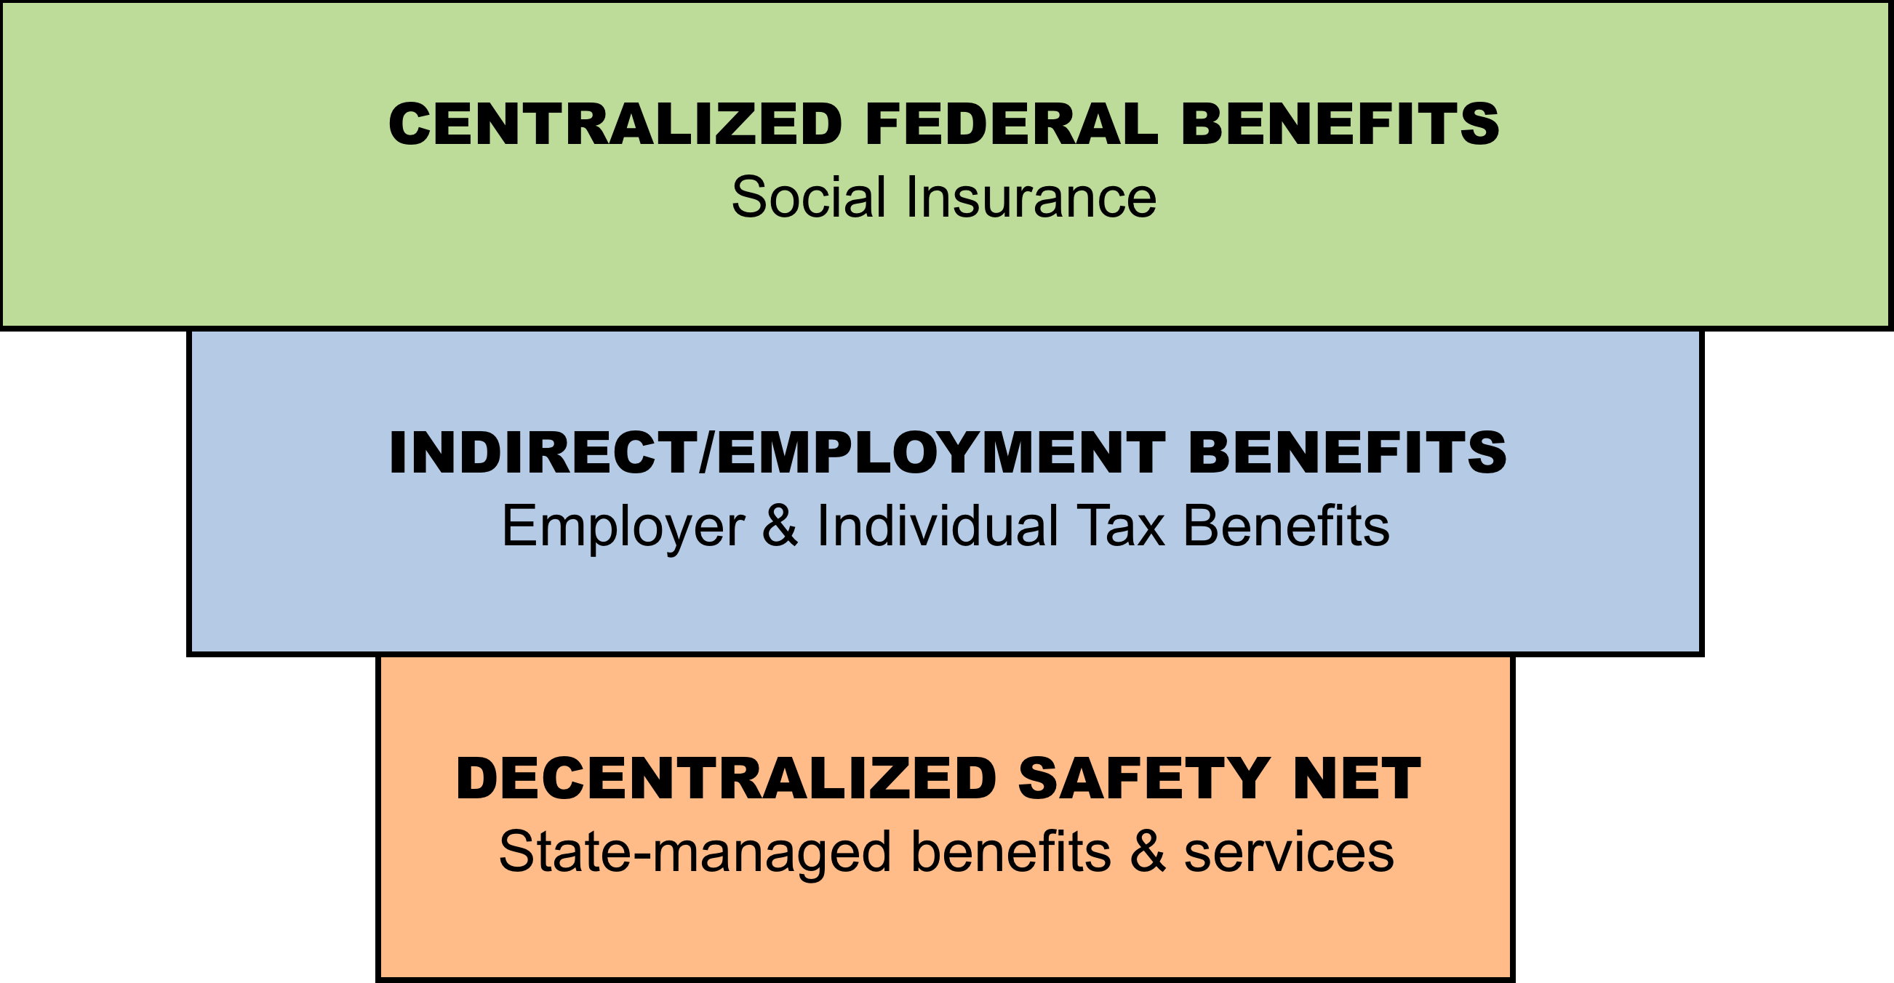
Unequal by Design: Social Provision in the US Welfare State
Discretionary
Targeted
Standardized
Broad Coverage

Slide 5
Key Dimensions of Safety Net Policies
Adequacy of benefits = what recipients receive on average.
Direct expenditures for recipient benefits
Program caseload or recipients
Adjusted for inflation (in constant $2012)
Adjusted for cost-of-living differences across states.
Value add of measure: vs. max benefit or aggregate spending

Slide 6
Key Dimensions of Safety Net Policies
Inclusiveness of receipt = proportion of potentially needy that get assistance.
Program caseload or recipients
Potentially needy population
Potentially needy population estimated with the Annual Social and Economic Supplement (March CPS).
Adjusted for cost of living differences across states.
Value add of measure: vs. caseloads

Slide 7
Defining the State-Level Safety Nets
Include programs in which states have some policymaking authority, or financial or administrative responsibility.
Program Funding
Partial/joint funding of programs & block grant structure
Implication = Variation in availability and stability of funding
Program Administration
Flexibility in administering programs
Implication = Variation in outreach, application, and accessibility.
Policymaking Authority
Authority to make rules regarding eligibility and benefits
Implication = Variation in eligibility criteria and benefit levels.

Slide 8
State-Level Safety Net
11 programs that provide support for economically vulnerable families with children.
CA: cash assistance (AFDC/TANF)
FS: food assistance (Food Stamps/SNAP)
HI: health insurance (Medicaid and SCHIP)
CS: child support (enforcement and collections)
CC: child care (subsidies – CCBG/CCDF and TANF)
ECE: early childhood education (Head Start and public pre-k)
UI: unemployment insurance
WA: work support (JOBS w/ AFDC and TANF work support)
SS: disability assistance (SSI for disabled children)
HS: housing assistance (Section 8)
ST: state income taxes (liability threshold and credits)

Slide 9
Snapshot of current
SOCIAL PROVISION

Slide 10
Adequacy of Safety Net Benefits (2013)
2013 Poverty thresholds:
2p/1k = $16,057
3p/2k = $18,769
4p/2k = $23,624

Slide 11
Inclusiveness of Safety Net Benefits (2013)

Slide 12
INEQUALITY ACROSS STATES
SOCIAL PROVISION

Slide 13
Inequality in the Adequacy of Safety Net Benefits
Note: Colored box indicates IQR (25th & 75th percentiles), w/ median highlighted; the length of the whiskers are at 1.5 times the IQR; values outside of that range are represented by dots.

Slide 14
Inequality in the Adequacy of Safety Net Benefits
Cash Assistance
25th = $3,162
75th = $5,020
Note: Colored box indicates IQR (25th & 75th percentiles), w/ median highlighted; the length of the whiskers are at 1.5 times the IQR; values outside of that range are represented by dots.
Notes:
Give substantive meaning to the levels of inequality in social provision we are talking about across states – if the differences are small, then it doesn’t really matter much, but if they are substantively large, then they are meaningful differences for families. What this table is showing is the adequacy of benefits and inclusiveness of coverage for states at the 25th, 50th and 75th percentiles of the distribution for each program.

Slide 15
Inequality in the Adequacy of Safety Net Benefits
Food Assistance
25th = $3,071
75th = $3,728
Note: Colored box indicates IQR (25th & 75th percentiles), w/ median highlighted; the length of the whiskers are at 1.5 times the IQR; values outside of that range are represented by dots.
Notes:
Give substantive meaning to the levels of inequality in social provision we are talking about across states – if the differences are small, then it doesn’t really matter much, but if they are substantively large, then they are meaningful differences for families. What this table is showing is the adequacy of benefits and inclusiveness of coverage for states at the 25th, 50th and 75th percentiles of the distribution for each program.

Slide 16
Inequality in the Adequacy of Safety Net Benefits
Unempl. Ins.
25th = $4,131
75th = $5,758
Note: Colored box indicates IQR (25th & 75th percentiles), w/ median highlighted; the length of the whiskers are at 1.5 times the IQR; values outside of that range are represented by dots.
Notes:
Give substantive meaning to the levels of inequality in social provision we are talking about across states – if the differences are small, then it doesn’t really matter much, but if they are substantively large, then they are meaningful differences for families. What this table is showing is the adequacy of benefits and inclusiveness of coverage for states at the 25th, 50th and 75th percentiles of the distribution for each program.

Slide 17
Inequality in the Adequacy of Safety Net Benefits
State Prek/HS
25th = $6,124
75th = $8,143
Note: Colored box indicates IQR (25th & 75th percentiles), w/ median highlighted; the length of the whiskers are at 1.5 times the IQR; values outside of that range are represented by dots.
Notes:
Give substantive meaning to the levels of inequality in social provision we are talking about across states – if the differences are small, then it doesn’t really matter much, but if they are substantively large, then they are meaningful differences for families. What this table is showing is the adequacy of benefits and inclusiveness of coverage for states at the 25th, 50th and 75th percentiles of the distribution for each program.

Slide 18
Inequality in the Adequacy of Safety Net Benefits
Child Care
25th = $4,620
75th = $6,752
Note: Colored box indicates IQR (25th & 75th percentiles), w/ median highlighted; the length of the whiskers are at 1.5 times the IQR; values outside of that range are represented by dots.
Notes:
Give substantive meaning to the levels of inequality in social provision we are talking about across states – if the differences are small, then it doesn’t really matter much, but if they are substantively large, then they are meaningful differences for families. What this table is showing is the adequacy of benefits and inclusiveness of coverage for states at the 25th, 50th and 75th percentiles of the distribution for each program.

Slide 19
Inequality in the Inclusiveness of Safety Net Benefits
Note: Colored box indicates IQR (25th & 75th percentiles), w/ median highlighted; the length of the whiskers are at 1.5 times the IQR; values outside of that range are represented by dots.

Slide 20
Inequality in the Inclusiveness of Safety Net Benefits
Cash Assistance
25th = 0.10
75th = 0.25
Note: Colored box indicates IQR (25th & 75th percentiles), w/ median highlighted; the length of the whiskers are at 1.5 times the IQR; values outside of that range are represented by dots.

Slide 21
Inequality in the Inclusiveness of Safety Net Benefits
Unempl. Ins.
25th = 0.36
75th = 0.49
Note: Colored box indicates IQR (25th & 75th percentiles), w/ median highlighted; the length of the whiskers are at 1.5 times the IQR; values outside of that range are represented by dots.

Slide 22
Variation in the Inclusiveness of Safety Net Benefits
Child Care
25th = 0.11
75th = 0.21
Note: Colored box indicates IQR (25th & 75th percentiles), w/ median highlighted; the length of the whiskers are at 1.5 times the IQR; values outside of that range are represented by dots.

Slide 23
STATE CHANGE OVER TIME
SOCIAL PROVISION

Slide 24
State Change Over Time in Safety Net Benefits

Slide 25
State Change Over Time in Safety Net Benefits

Slide 26
State Change Over Time in Safety Net Benefits

Slide 27
State Change Over Time in Safety Net Benefits

Slide 28
State Change Over Time in Safety Net Benefits

Slide 29
State Change Over Time in Safety Net Benefits

Slide 30
CURRENT SNAPSHOT
REDISTRIBUTION

Slide 31
Data
Annual Social and Economic Supplement (March CPS)
Household level income measures: adjusted for household size (square root of hh size) inflation (CPI-U-RS), and cost of living differences across states (BEA all items RPP).
Dollar figures reported are per equivalized person in the household in 2012 dollars.
Household type: working-aged households (head age 18-64) with children

Slide 33
No inequality reduction
0.05 inequality reduction
0.10 inequality reduction
0.15 inequality reduction

Slide 34
Centralized
transfers
overall reduction
Decentralized transfers
State taxes
Federal taxes

Slide 36
No poverty reduction
0.05 poverty reduction
0.10 poverty reduction
0.15 poverty reduction

Slide 37
overall reduction
Centralized
transfers
Decentralized transfers
State taxes
Federal taxes

Slide 39
Conclusions
Social provision in the US is inadequate in terms of benefit levels and the inclusiveness, and that this varies substantially across states.
States start out and end up in different places in terms of levels of poverty and inequality – and these in part reflect policy choices.
The decentralized structure of the safety net is one of most crucial and least carefully studied structural features of the U.S. welfare state.
Social provision that is inadequate and unequal hampers our ability to address high and rising levels of inequality, insecurity, and poverty.

