Slide 1
INEQUALITY ACROSS THE US STATES
Geographic Inequality in Social Provision and Redistribution
Sarah K. Bruch - University of Iowa
Inequality Workshop
The Graduate Center, CUNY
June 9, 2016

Slide 2
Economic Inequality in the States
Economic inequality, insecurity, and poverty are not just national issues.
There are substantial regional, state, and local variation in the magnitude of and trends in inequality, insecurity, and poverty.

Slide 3
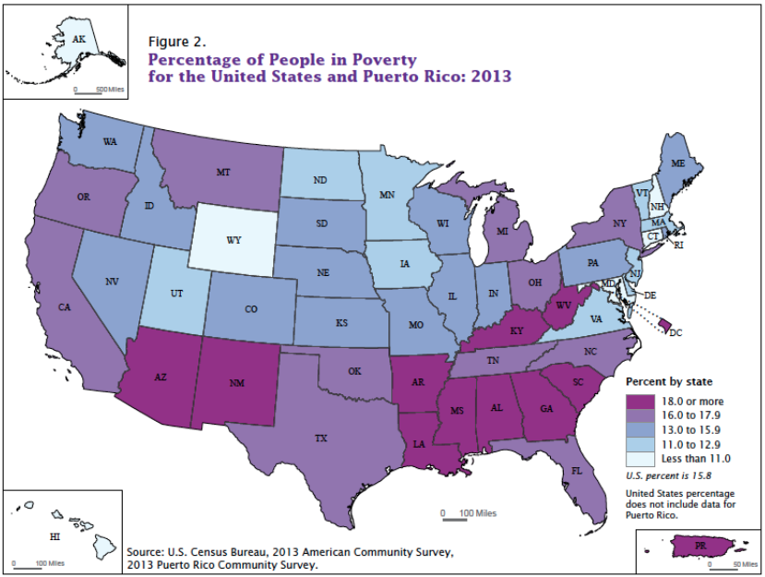
State Variation in Poverty
Source: Bishaw, Alemayehu and Kayla Fonten. 2014. “Poverty: 2012 and 2013 American Community Survey Briefs.” US Census Bureau.

Slide 4
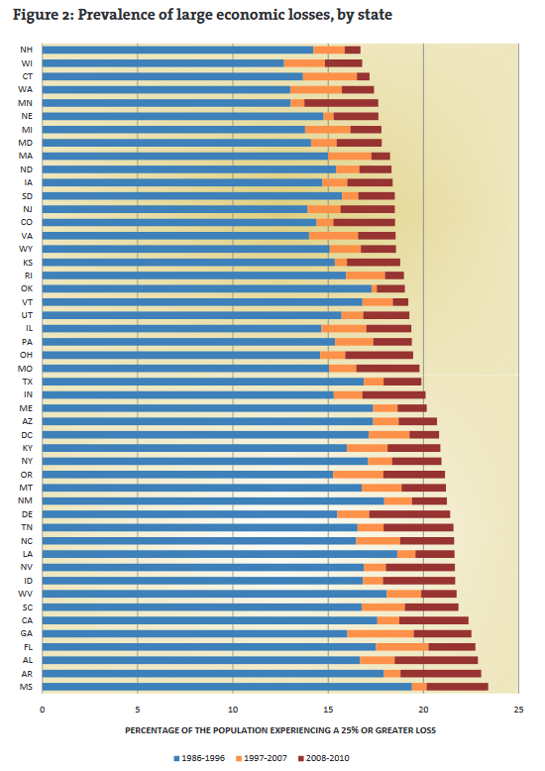
State Variation in
Economic Insecurity
Source: Hacker, Jacob, Gregory A. Huber, Austin Nichols, Phillip Rehm, and Stuart Craig. 2012. “Economic Insecurity Across the American States: New State Estimates from the Economic Security Index.”

Slide 5
State Variation in Inequality
Two most used measures and data to calculate income inequality at state level:
  Top income shares using income tax data
  Summary inequality measures such as Gini coefficient using Census-based household surveys
This matters not just as a data and measurement issue, but more substantively because the ranking of states is different.

Slide 6
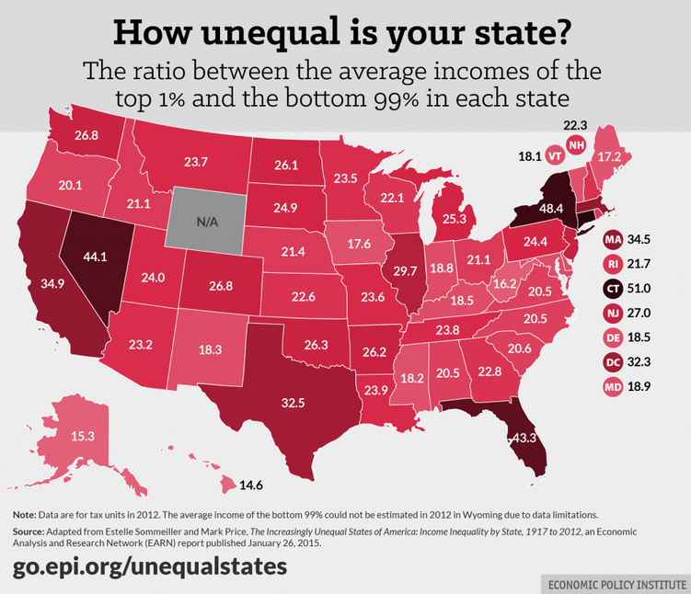
State Variation in Inequality: Income Shares
Source: Sommeiller, Estelle and Mark Price. 2015. “The Increasingly Unequal States of America: Income Inequality by State, 1917 to 2012.” EPI EARN Report.

Slide 7
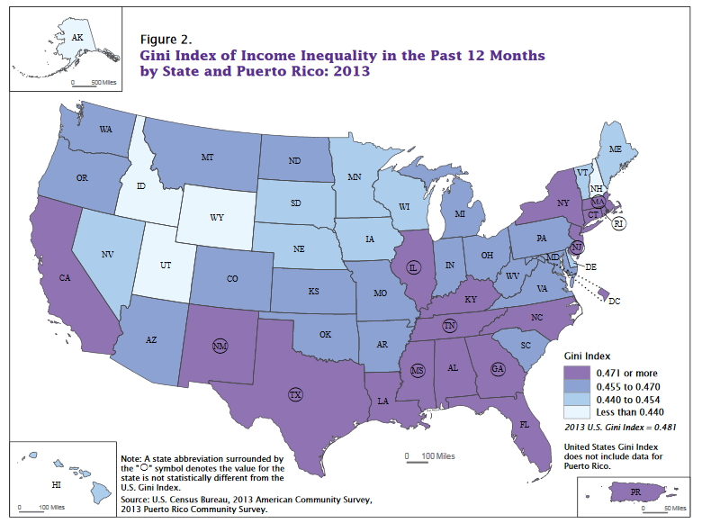
State Variation in Inequality: Gini Index
Source: Noss, Amanda. 2014. “Household Income: 2013.” American Community Survey Briefs. US Census Bureau.
Notes:
When use income shares, then south does not stand out as having high inequality… whereas if you use the Gini then the south looks worse.
This difference is based on differences in the shape of the income distribution - the south does not have very high top incomes, has low median incomes, and high poverty rates…
so the distribution that is causing the high inequality in the south looks different than the distribution that is causing high inequality in states like NY or CT.
South has high inequality because of bottom of distribution; NE has high inequality because of top of distribution.

Slide 8
What Explains State Variation in Inequality?
Economic factors
  Macro-economic conditions
  Employment conditions, industry mix, etc.
Demographic factors
  Age and family profiles
Political and policy factors
  Policies condition the effects of other factors.
    “inequality as policy” (John Schmitt 2009)
    “inequality is a choice” (Joseph Stiglitz 2015)
    “inequality reflects political decisions” (Robert Reich 2015)
Focus in particular on the role of the social safety net and redistributive policies.
Notes:
People tend to point to the same types of factors that are examined at the national level

Slide 9
Motivation: Why Care about State Variation?
Instrumental concerns
Potential negative consequences.
Gain leverage variation to examine causes and consequences.
Normative concerns
Differential access to policies and programs that provide economic security.
Variation in redistribution between and within social demographic groups.
  A more basic question, it seems, is what kind of stratification system is promoted by social policy. The welfare state is not just a mechanism that intervenes in, and possibly corrects, the structure of inequality; it is, in its own right, a system of stratification. It is an active force in the ordering of social relations (Esping-Andersen 1990: 23).

Slide 10
Why is there State Variation in Provision and Redistribution?
A big part of the answer is about how the US welfare state is structured, and in particular, the degree of decentralization in transfer and tax policies.
Tiered Transfer Provision
Transfers and services for different target populations are managed, delivered and financed by national, state, and/or local governments.
Taxes
Are collected and distributed at national, state, and local levels.

Slide 11
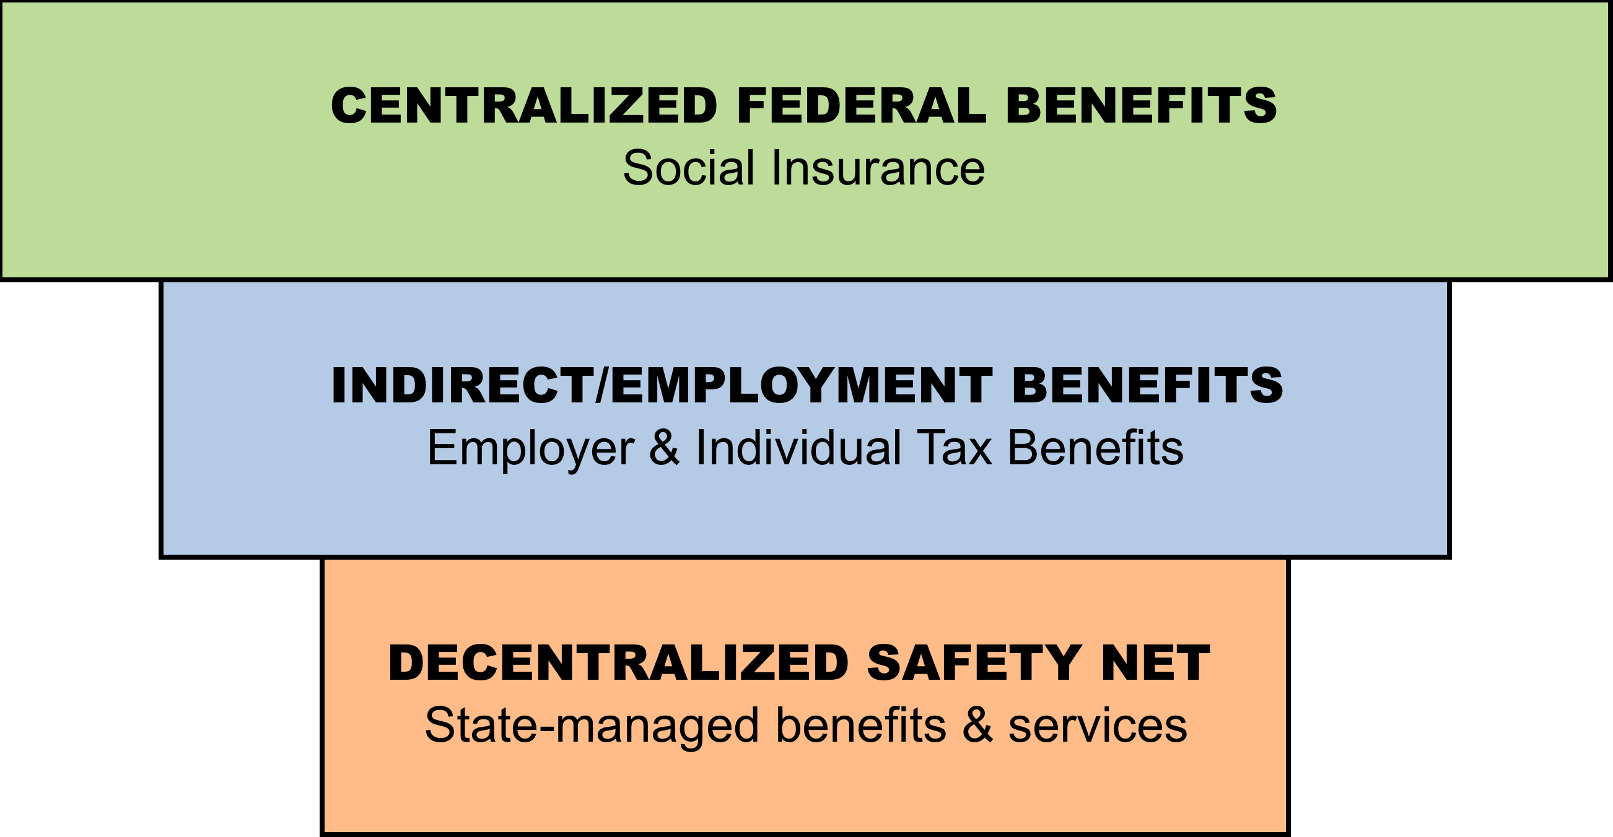
Unequal by Design:
Social Provision in the US Welfare State
Discretionary
Targeted
Standardized
Broad Coverage

Slide 12
Key Dimensions of Safety Net Policies: Adequacy
Adequacy of benefits = what recipients receive on average.
Direct expenditures for recipient benefits
Program caseload or recipients
Adjusted for inflation (in constant $2012)
Adjusted for cost-of-living differences across states (BEA RPPs).
Value add of measure: vs. max benefit or aggregate spending

Slide 13
Key Dimensions of Safety Net Policies:
Inclusion
Inclusiveness of receipt = proportion of potentially needy that get assistance.
Program caseload or recipients
Potentially needy population
Potentially needy population estimated with Census household survey data (ASEC/March CPS).
Adjusted for cost of living differences across states.
Value add of measure: vs. caseloads

Slide 14
Defining the Decentralized State-Level
Safety Nets
Include programs in which states have some policymaking authority, or financial or administrative responsibility.
  Program Funding
    Partial/joint funding of programs & block grant structure
    Implication = Variation in availability and stability of funding
  Program Administration
    Flexibility in administering programs
    Implication = Variation in outreach, application, and accessibility.
  Policymaking Authority
    Authority to make rules regarding eligibility and benefits
    Implication = Variation in eligibility criteria and benefit levels.

Slide 15
State-Level Safety Net
11 programs that provide support for economically vulnerable families with children.
  CA: cash assistance (AFDC/TANF)
  FS: food assistance (Food Stamps/SNAP)
  HI: health insurance (Medicaid and SCHIP)
  CS: child support (enforcement and collections)
  CC: child care (subsidies – CCBG/CCDF and TANF)
  EE: early childhood education (Head Start and public pre-k)
  UI: unemployment insurance
  WA: work support (JOBS w/ AFDC and TANF work support)
  SS: disability assistance (SSI for disabled children)
  HS: housing assistance (Section 8)
  ST: state income taxes (liability threshold and credits)

Slide 16
INEQUALITY ACROSS STATES
SOCIAL PROVISION DIFFERENCES

Slide 17
Inequality in the Adequacy of Safety Net Benefits
Note: Colored box indicates IQR (25th & 75th percentiles), w/ median highlighted; the length of the whiskers are at 1.5 times the IQR; values outside of that range are represented by dots.

Slide 18
Inequality in the Adequacy of Safety Net Benefits
Cash Assistance
25th = $3,187
75th = $5,002
Note: Colored box indicates IQR (25th & 75th percentiles), w/ median highlighted; the length of the whiskers are at 1.5 times the IQR; values outside of that range are represented by dots.

Slide 19
Inequality in the Adequacy of Safety Net Benefits
Food Assistance
25th = $2,930
75th = $3,523
Note: Colored box indicates IQR (25th & 75th percentiles), w/ median highlighted; the length of the whiskers are at 1.5 times the IQR; values outside of that range are represented by dots.

Slide 20
Inequality in the Adequacy of Safety Net Benefits
State Prek/HS
25th = $5,686
75th = $7,836
Note: Colored box indicates IQR (25th & 75th percentiles), w/ median highlighted; the length of the whiskers are at 1.5 times the IQR; values outside of that range are represented by dots.

Slide 21
Inequality in the Inclusiveness of Safety Net Benefits
Note: Colored box indicates IQR (25th & 75th percentiles), w/ median highlighted; the length of the whiskers are at 1.5 times the IQR; values outside of that range are represented by dots.

Slide 22
Inequality in the Inclusiveness of Safety Net Benefits
Cash Assistance
25th = 0.10
75th = 0.24
Note: Colored box indicates IQR (25th & 75th percentiles), w/ median highlighted; the length of the whiskers are at 1.5 times the IQR; values outside of that range are represented by dots.

Slide 23
Inequality in the Inclusiveness of Safety Net Benefits
Unempl. Ins.
25th = 0.28
75th = 0.43
Note: Colored box indicates IQR (25th & 75th percentiles), w/ median highlighted; the length of the whiskers are at 1.5 times the IQR; values outside of that range are represented by dots.

Slide 24
Inequality in the Inclusiveness of Safety Net Benefits
Child Care
25th = 0.09
75th = 0.21
Note: Colored box indicates IQR (25th & 75th percentiles), w/ median highlighted; the length of the whiskers are at 1.5 times the IQR; values outside of that range are represented by dots.

Slide 25
INEQUALITY ACROSS STATES
CROSS-NATIONAL COMPARISON

Slide 26
Adequacy of Benefits Comparison
Child Care
25th = 0.09
75th = 0.21

Slide 27
Adequacy of Benefits Comparison
Child Care
25th = 0.09
75th = 0.21

Slide 28
Adequacy of Benefits Comparison
Child Care
25th = 0.09
75th = 0.21

Slide 29
Inclusiveness of Receipt Comparison
Child Care
25th = 0.09
75th = 0.21

Slide 30
Inclusiveness of Receipt Comparison
Child Care
25th = 0.09
75th = 0.21

Slide 31
Inclusiveness of Receipt Comparison
Child Care
25th = 0.09
75th = 0.21

Slide 32
INEQUALITY ACROSS STATES
CHANGE OVER TIME

Slide 33
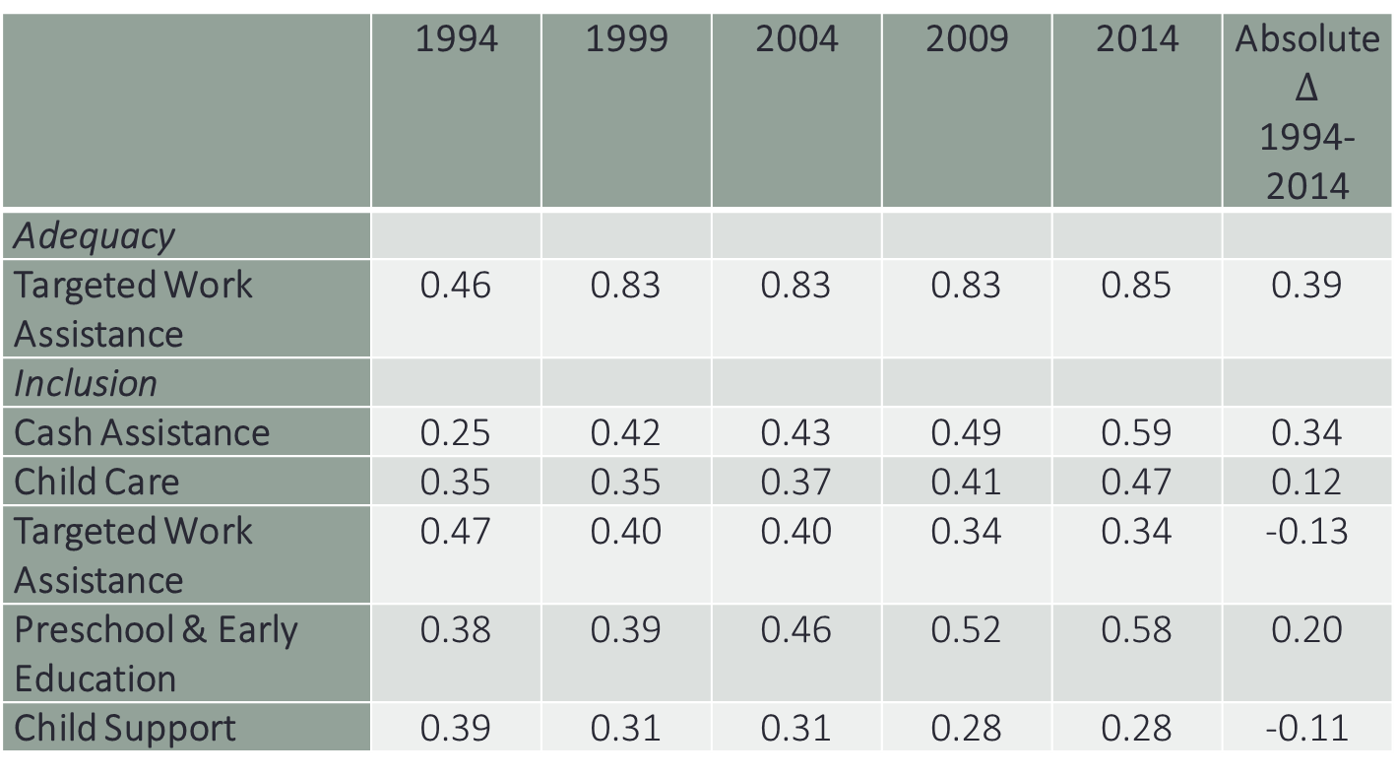
Social Provision Divergence & Convergence
1994-2014 using COV
 | 1994 | 1999 | 2004 | 2009 | 2014 | Absolute $∆$ 1994-2014
Adequacy
Targeted Work Assistance | 0.46 | 0.83 | 0.83 | 0.83 | 0.85 | 0.39
Inclusion
Cash Assistance | 0.25 | 0.42 | 0.43 | 0.49 | 0.59 | 0.34
Child Care | 0.35 | 0.35 | 0.37 | 0.41 | 0.47 | 0.12
Targeted Work Assistance | 0.47 | 0.40 | 0.40 | 0.34 | 0.34 | -0.13
Preschool & Early Education | 0.38 | 0.39 | 0.46 | 0.52 | 0.58 | 0.20
Child Support | 0.39 | 0.31 | 0.31 | 0.28 | 0.28 | -0.11
Child Care
25th = 0.09
75th = 0.21

Slide 34
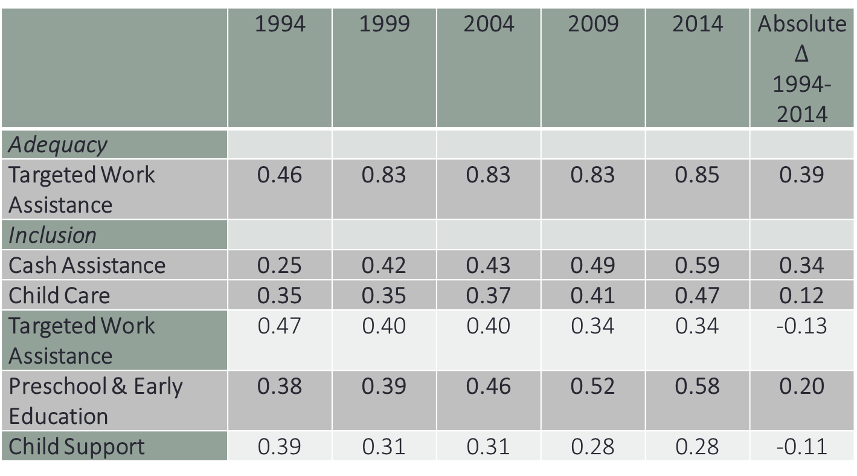
Social Provision Divergence 1994-2014 using COV
 | 1994 | 1999 | 2004 | 2009 | 2014 | Absolute $∆$ 1994-2014
Adequacy
Targeted Work Assistance | 0.46 | 0.83 | 0.83 | 0.83 | 0.85 | 0.39
Inclusion
Cash Assistance | 0.25 | 0.42 | 0.43 | 0.49 | 0.59 | 0.34
Child Care | 0.35 | 0.35 | 0.37 | 0.41 | 0.47 | 0.12
Targeted Work Assistance | 0.47 | 0.40 | 0.40 | 0.34 | 0.34 | -0.13
Preschool & Early Education | 0.38 | 0.39 | 0.46 | 0.52 | 0.58 | 0.20
Child Support | 0.39 | 0.31 | 0.31 | 0.28 | 0.28 | -0.11
Child Care
25th = 0.09
75th = 0.21

Slide 35
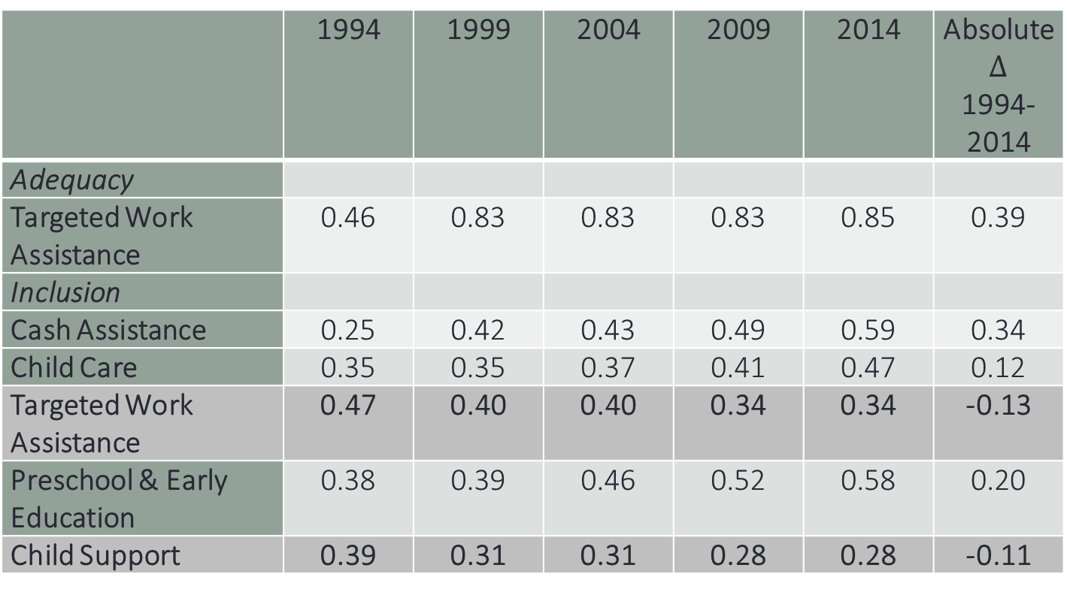
Social Provision Convergence 1994-2014 using COV
 | 1994 | 1999 | 2004 | 2009 | 2014 | Absolute $∆$ 1994-2014
Adequacy
Targeted Work Assistance | 0.46 | 0.83 | 0.83 | 0.83 | 0.85 | 0.39
Inclusion
Cash Assistance | 0.25 | 0.42 | 0.43 | 0.49 | 0.59 | 0.34
Child Care | 0.35 | 0.35 | 0.37 | 0.41 | 0.47 | 0.12
Targeted Work Assistance | 0.47 | 0.40 | 0.40 | 0.34 | 0.34 | -0.13
Preschool & Early Education | 0.38 | 0.39 | 0.46 | 0.52 | 0.58 | 0.20
Child Support | 0.39 | 0.31 | 0.31 | 0.28 | 0.28 | -0.11
Child Care
25th = 0.09
75th = 0.21

Slide 36
STATE CHANGE OVER TIME
SOCIAL PROVISION

Slide 37
State Change Over Time in Safety Net Benefits

Slide 38
State Change Over Time in Safety Net Benefits

Slide 39
CURRENT SNAPSHOT
REDISTRIBUTION

Slide 40
Data: Annual Social and Economic Supplement (CPS)
Use three year moving average estimates
Household level income measures: adjusted for household size (square root of hh size) inflation (CPI-U-RS), and cost of living differences across states (BEA all items RPP).
Dollar figures reported are per equivalized person in the household in 2012 dollars.
Estimate series of Gini coefficients: market income; centralized/federal transfers; decentralized transfers; state taxes; federal taxes.
Household type: working-aged households (head age 18-64) with children

Slide 42
No inequality reduction
0.05 inequality reduction
0.10 inequality reduction
0.15 inequality reduction

Slide 43
Centralized
transfers
overall reduction
Decentralized transfers
State taxes
Federal taxes

Slide 44
Conclusions
Economic inequality, social provision and redistribution vary across the US states.
The magnitude of this variation is substantively large in terms of the:
Differences in absolute levels of assistance received by economically vulnerable families.
Comparison to a similar set of European countries’ social policies.
States start out and end up in different places in terms of levels of inequality – and these in part reflect policy choices.
The decentralized structure of the safety net is one of most crucial and least carefully studied structural features of the U.S. welfare state.
  Social provision that is inadequate and unequal hampers our ability to address high and rising levels of inequality, insecurity, and poverty.

Slide 45
Social Provision Change 1994-2014
Child Care
25th = 0.09
75th = 0.21

