Slide 1
Inequality, Gender, Work, and Care
Nancy Folbre
Political Economy Research Institute
University of Massachusetts Amherst
folbre@econs.umass.edu
June 8, 2017

Slide 2
Theory
Why is unpaid work relevant to inequality?
Why is a “care penalty” evident in both paid and unpaid work?
Notes:
Disregard for unpaid work is the most poignant example of a care penalty….

Slide 3
Empirical Research
How can “care penalties” be measured?
Why does industry and sector
(public, private not-for-profit, vs. private for-profit) matter?

Slide 4
Unpaid Work Influences:
Gender differences in labor market attachment, experience and earnings.
Gender differences in leisure time (especially among parents).
Cultural norms that shape gender segregation in paid work.
Family living standards.
Human capabilities.

Slide 5
According to the American Time Use Survey,
unpaid work represents about one-half
of all work performed in the U.S. today.
(Work is defined as an activity that someone
else could, in principle, be paid to perform).
This is an under-estimate, because it ignores
supervisory or “on-call” care for dependents.

Slide 6
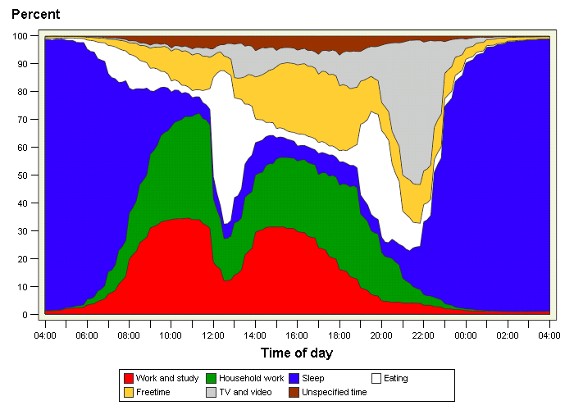

Slide 7
Compare Two Families
Each includes two married adults and two children under 5 and
total family income of $50,000
Family A: One adult works 40 hours a week in paid employment
(earning $50,000); the other adult devotes 40 hours a week to unpaid work including child care.
Family B: Two adults both work 40 hours a week in paid employment (earning $25,000 each); they each devote 10 hours a week to unpaid work but must purchase child care.
Which has the higher standard of living?

Slide 8
Valuation of Non-Market Work
Multiply number of hours of work times a replacement cost estimate such as the federal minimum wage.
Far less variation across both individuals and families than in market income.
Therefore, valuation of non-market work typically has an equalizing effect on the distribution of “extended income.”

Slide 9
The greater the relative value of non-market work, the greater the equalizing effect.
The relative value of non-market work in the U.S. has declined substantially over time.
Hence, its “invisible” equalizing effect has diminished over time.
Trends in the distribution of family market income
in the U.S since 1950 understate increases in inequality.

Slide 10
Why Care Penalties?
Like environmental assets and ecological services,
the supply of care is significantly shaped by non-market factors and
easily taken for granted.
A long history of patriarchal
institutions has increased the supply of care and lowered its cost to men.

Slide 11
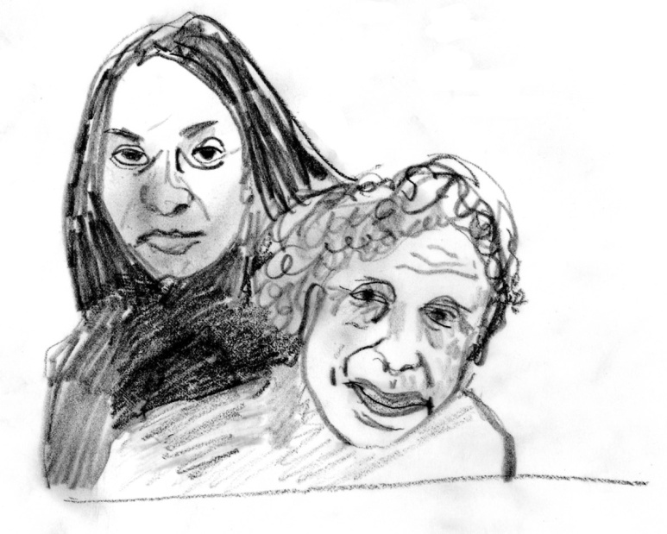
Five More Specific Reasons
1 . Relational vulnerability
Care and femininity
Prisoner of Love
Chicken games
“I love them. That’s all.
You can’t help it.”

Slide 12
2. Weak formal bargaining power
Asymmetric contracts (“to honor and obey”)
No private contracting allowed other than “mutual
support” and pre-nuptial agreements re property.
Poor enforcement of child support
Poor provision of public care services.
Low levels of unionization and occupational licensing
(except for nurses and teachers).

Slide 13
3. Personal characteristics of providers
Paid care providers are often women of color and immigrants with little bargaining power (exacerbated by social policy)
Many are single parents.
Intersectionality means that affluent women can benefit from purchasing low-cost care services.

Slide 14
4. Characteristics of Consumers
They are often dependents and lack agency (ability to choose).
Even if they have agency, it is difficult to obtain perfect
information.
Even if they have agency and information they lack money.
In other words: Little consumer sovereignty.

Slide 15
5. Characteristics of the Service Itself
Social spillovers/externalities. The marginal social product of labor far greater than marginal private product.
Team production (especially over time) makes it difficult to identify individual contributions.
Person-specific effects and lack of standardized quality measures make it difficult for providers to claim the actual value of their contribution.

Slide 16
Measurement of Care Penalties
How much longer is women’s total work day in the home (bargaining models with time-use data)
How much does time out of paid employment or scheduling constraints affect women’s earnings relative to men?
How does explicit discrimination against caregivers (e.g. mothers of young children) affect women’s wages?
How does employment in a care job (defined by occupation or occupation/industry affect earnings?
How does employment in a care industry affect earnings?

Slide 17
In Paid Employment
Workers in occupations that entail care for others earn lower pay, net of other personal and job characteristics.
Best evidence: fixed-effects analysis of longitudinal data
from the NLSY in the US on entry into care occupations.
(Budig, Hodges, England, 2017).
Also, workers in care INDUSTRIES (health, education and social services) pay a penalty—especially professionals and managers.
(Folbre and Smith, 2017).

Slide 18
Employment in Health, Education,
Social Services in the U.S. in 2015
 | Care Industries
Total | 25%
Women | 38%
Private For-Profit | 16%
Women | 28%
Public | 50%
Women | 63%
Source: Author’s calculations, March Current Population Survey

Slide 19
Annual Earnings at the 10th, 50th, and 90th
Percentiles by Type of Industry
(based on Table 2)
 | Earnings |  |  | Earnings Ratios
 | P10 | P50 (Median) | P90 | P10/P50 | P50/P90
Care industries | $10,000 | $37,000 | $82,000 | 27% | 45%
Other industries | $8,000 | $35,000 | $100,000 | 23% | 35%

Slide 20
Educational Attainment
 | Care Industries |  | Other Industries
 | Women | Men | Women | Men
High school degree or less | 20% | 17% | 37% | 42%
College degree or more | 50% | 60% | 31% | 30%

Slide 21
Occupation/ Industry Interactions
(controlling for other individual and job characteristics)
Penalties for Working in a Care Industry
Managers: -14%
Professionals in non-care occupations: -20%
Professionals in care industries: -22%
Premia for Managers
In care industries: 26%
In other industries: 37%
Premia for Professionals
In care industries: 16%
In other industries: 31%

Slide 22
Workers with High
Bargaining Power May be Overpaid
A large share of the top 10% of earners in the U.S. work in the industry known as financial services.

Slide 23
Let’s Go Down the Same List for Them
Unencumbered by relational concerns.
Some formal bargaining power in terms of licensing.
Predominantly white, native-born men.
Relatively rich consumers
Standardized measure of success (dollars!) and performance pay; social value lower than private value
PLUS, considerable industry-level market power (oligopoly)

Slide 24
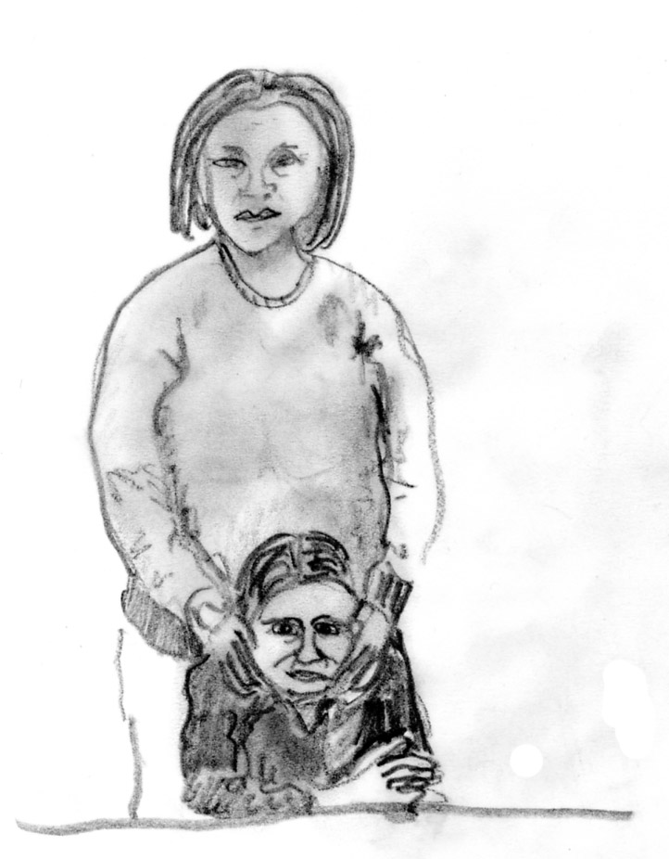
In Sum
Bargaining power exerts an effect on earnings inequality independent
of “marginal productivity”
and “human capital.”

