Slide 1


Inequality Across Cohorts
Louis Chauvel
Pr Dr at University of Luxembourg
louis.chauvel@uni.lu
http://www.louischauvel.org
CUNY-LIS June 2016
IRSEI
Institute for Research
on Socio-Economic
Inequality

Slide 2
inequality across birth cohorts
Linking social generations
and welfare regime dynamics
Louis Chauvel
Pr Dr at University of Luxembourg
louis.chauvel@uni.lu
http://www.louischauvel.org
CUNY-LIS June 2016
IRSEI
Institute for Research
on Socio-Economic
Inequality

Slide 3



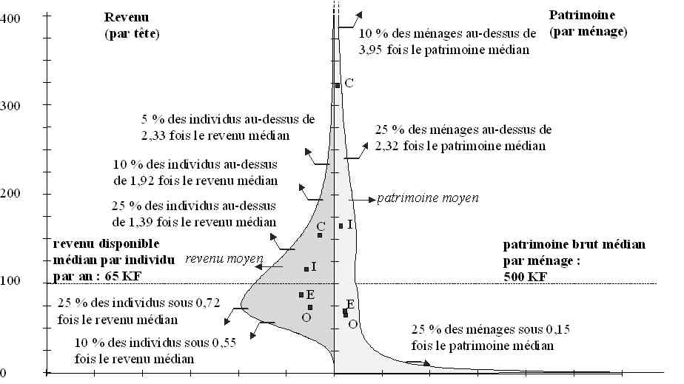





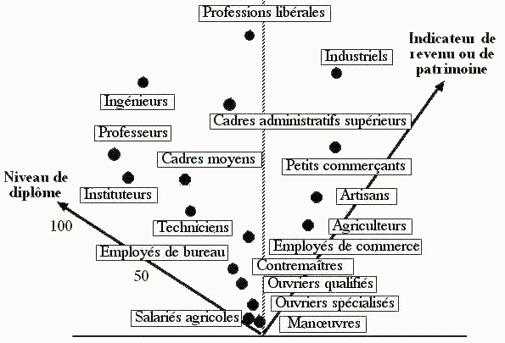
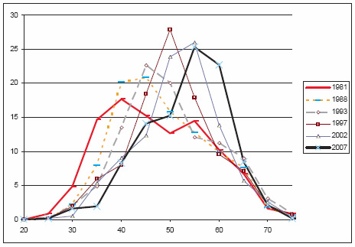


English Abstract in
Chauvel L. 2010,
The Long-Term Destabilization of Youth, Scarring Effects,
and the Future of the Welfare Regime in Post-Trente Glorieuses France
French Politics Culture & Society 11/2010; 28(3):74-96.
路易•肖韦尔
New edition
19 août 2014
社会学教授
法国大学研究院成员
欧洲社会学协会秘书长
http://www.louischauvel.org/frenchpolcultsoc.pdf

Slide 4
3 PARTS (very ambitious ….)
1- Theory of Cohort inequalities: France as an extreme case
2- Welfare regimes and international comparisons with the LIS
3- A new method for inequality analysis
and implementation in cohort analysis
Notes:
Louis

Slide 5
inequality across birth cohorts
PART 1:
Theory of Cohort inequalities:
France as an extreme case
Louis Chauvel
Pr Dr at University of Luxembourg
louis.chauvel@uni.lu
http://www.louischauvel.org
CUNY-LIS June 2015
IRSEI
Institute for Research
on Socio-Economic
Inequality

Slide 6


Generation Limbo: Waiting It Out - New York Times
www.nytimes.com/.../recent-college-graduates-wait-for-their-real-car...
Aug 31, 2011 – The Limbo Generation, college graduates who entered the job market after the economic downturn, take dead-end jobs while waiting to start ...

Slide 7

The Guardian 2016

Slide 8


Slide 9


A Japanese version of the debate :
Yamada Masahiro 山田昌弘
(東京学芸大学 教授)
parasite single
(パラサイトシングル parasaito shinguru)
Freeter (フリーター furita)
Hikikomori (引きこもり)
Genda Yuji 玄田有史
(東京大学教授)
NEET (Not in Employment, Education or Trainingニート）
« The Endless Ice Age » => www.louischauvel.org/gendayuji.pdf

Slide 10


Slide 11




  1. From theory to datacrunching:
  Social generations and cohort analysis
  Theory of social generations (Karl Mannheim)
  1968 gap of generations (Margaret Mead)
  Demographic metabolism (Norman Ryder)
  The methodology of APC analysis (Yang Yang)
  Examples:
  * suicide in France
  * consumption in China
  * political participation
  * etc. , etc. , etc.
Karl Mannheim
1893-1947
Margaret Mead
1901-1978
Norman Ryder
1923-2010
Yang Yang
1970?-
www.louischauvel.org/ryder2090964.pdf

Slide 12

  Important references
  www.louischauvel.org/TheMannheim.pdf
  www.louischauvel.org/TheMead.pdf
  www.louischauvel.org/TheRyder.pdf
  http://davidcard.berkeley.edu/papers/vietnam-war-college.pdf
  www.louischauvel.org/TheYANGASR2008.pdf
http://www.louischauvel.org/frenchpolcultsoc.pdf
Margaret Mead
1901-1978

Slide 13
Socialization versus individual and collective history
    Life course and socialization
    Primary and secondary socialization
    The « transitionnal socialization »
    Long term impact of the « transitionnal socialization » :
    « scar effect »
    History and the constitution of a Generationengeist (spirit of generations) and of a Generationenlage (situation of generation)
Primary socialization Until end of compulsory secondary education (?) | Transitionnal socialization | Secondary socialization « adulthood »
16-18 y.o.
      25-30 y.o.

Slide 14
Material-objective or political-cultural generations?... Or all of that
    Karl Mannheim
    The impact of new social contexts on the young:
    «Mental data are of sociological importance not only because of their actual content, but also because they cause the individuals sharing them to form one group—they have a socializing effect». (…dass sie die Einzelnen zur Gruppe verbinden, „sozialisierend“ wirken )
    (K. Mannheim, Das Problem der Generationen, 1928)
    QUESTION 1
    From cohort to generations ? How generational cristallization ?
    QUESTION 2
    Does the national/Welfare regime context of entry into adulthood has a durable effect on future life chances of generations ?

Slide 15
General question of research on cohort inequalities:
Economic crises and the social integration of new cohorts.
Scarring effects of youth unemployment (Ellwood 1982 / Gangl 2004).
Permanence or resilience of initial trauma and Cumulative advantage/disadvantage (R. Merton 1968, Th. DiPrete 2006)
Or compensation, resilience (Luthar & al. 2000, Bonanno 2004)
Do states differ in how well they could integrate new cohorts or do we see more pronounced insider-outsider dynamics in some countries?
Are some generations sacrificed or do cohorts with a bad start catch up?
Goerres and Vanhuysse (2012: 1)
‘developing an integrated body of knowledge to answer the question of which generations get what, when and how.’
Notes:
Louis

Slide 16
2a. FACTS : Example The French crash test
QUESTION :
are there long term consequences of collective difficulties when entering labor market ?
Unemployment rate for the male and female
20 to 24 year old
Risks of unemployment
12 months after living school (%)

Slide 17
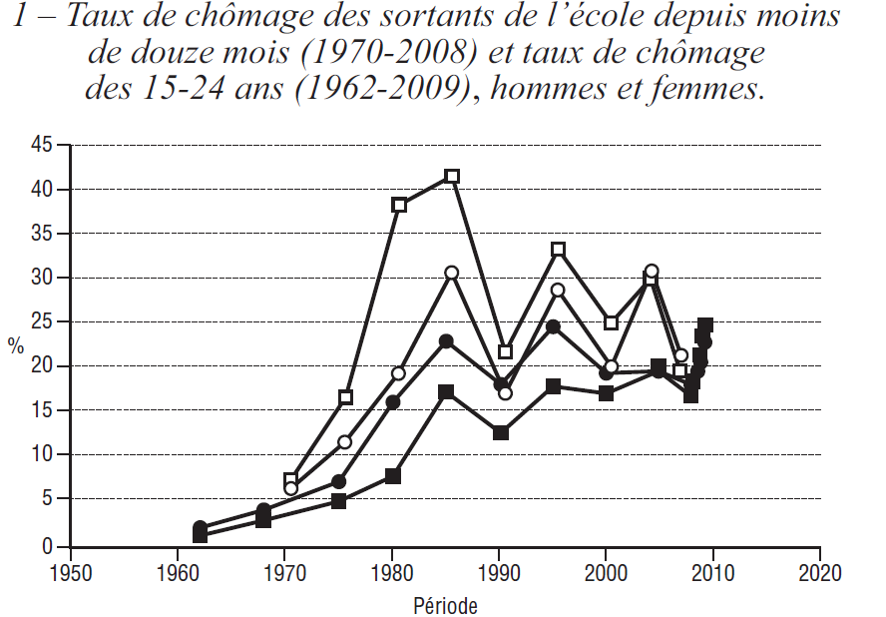

2a. FACTS : Example The French crash test
QUESTION :
are there long term consequences of collective difficulties when entering labor market ?
Unemployment rate for the male and female
Less than 25 year old,
and for those who left school less than 12 month ago
Risks of unemployment
12 months after living school (%)

Slide 18
Young generations as victims of social change
France as a crash test
Multidimensional generational fractures in France
Relative(?) socio-economic decline
Overeducation and educational déclassés
Risks of downward mobility
Dyssocialisation
Recomposition of risks of suicide
Out of the political arena
Not here
Not here
Not here

Slide 19
a. Relative(?) socio-economic decline
France
Lis 1980-2005
Silc 2010
Level of living (=disposable income in eur per CU)
by age group (100= year avarage)
age
year

Slide 20
a. Relative(?) socio-economic decline
France
Lis 1980-2005
Silc 2010
Log level of living (=disposable income per CU)
by age group (0= year avarage)
2010
1980
age

Slide 21
a. Relative(?) socio-economic decline
real housing price index (dotted lines) and real household incomes index
Housing index
Wages
year
Note: y-axis: Housing index and household incomes adjusted for inflation, indexed to year 2000 (y=100).
Source: International House Price Database, Federal Reserve Bank of Dallas. Mack and Martínez-García (2011).

Slide 22
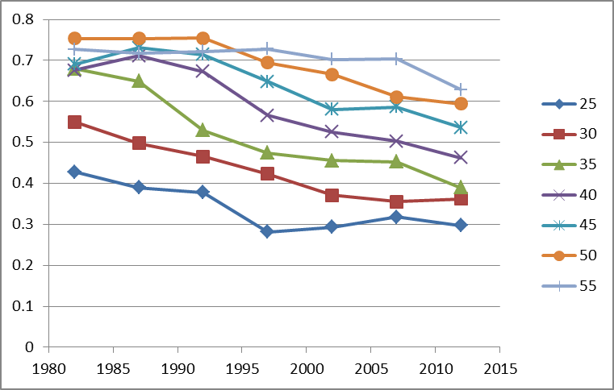
b. Overeducation and educational déclassés
Educational inflation
% of GED (‘bac’) (no more no less)
holders accessing middle class jobs (service cl h+l) 1970-2012
Age
Year
French labor force surveys 1970-2012

Slide 23
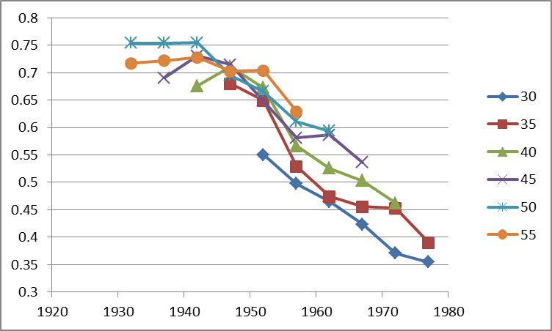
b. Overeducation and educational déclassés
Educational inflation
% of GED (‘bac’) (no more no less)
holders accessing middle class jobs (service cl h+l) 1970-2012
Age
Birth cohort
French labor force surveys 1970-2012

Slide 24
e. Recomposition of risks of suicide
Cohort born
in 1960
Source : WHO mortality data .
1985
Log[rsuicide(age)/rsuicide(total)]
2005
Cohort born
in 1945
Age

Slide 25
f. Out of politics
Desequilibrium in political representation
Age distribution of French Députés (National Parliament) 1981-to-2012 (for 100.000 citizens)
Source : Trombinoscopes de l’Assemblée Nationale.
Age

Slide 26
First conclusions:
“As happy as God in France?”
(Hypothesis might be true(?) But avoid generalization to the young plz.)
Interpreting the French case:
    Esping-Andersen Typology of Welfare states:
    France = “corporatist-conservative” welfare regime, stabilization of social relations
    Protection of insiders (protected male workers) against outsiders
    In case of economic brake :
    « Insiderisation » of insiders, already in the stable labor force
    and « outsiderisation » of new entrants
    In France, young people can wait … decades
    Job seeking = Musical chairs game
    Increasing poverty rates for young people, stable intracohort inequalities
    (after taxes and welfare reallocations)
Strong problem of social welfare sustainability:
Those who pay might experience the collapse of this regime…
Notes:
Louis

Slide 27
inequality across birth cohorts
PART 2:
Comparing cohort inequalities
Louis Chauvel
Pr Dr at University of Luxembourg
louis.chauvel@uni.lu
http://www.louischauvel.org
CUNY-LIS June 2015
IRSEI
Institute for Research
on Socio-Economic
Inequality

Slide 28
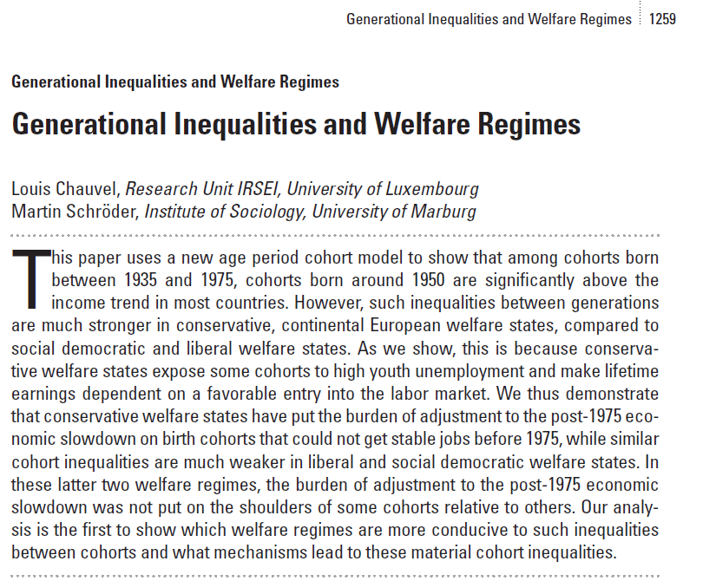

  0- Backgrounds …
A 17 countries comparison of inter-cohort inequalities

Slide 29
  Cohort analysis and socioeconomic inequalities
Presentation
The context of cohort / generation issues
Question
Theory
Facts1 : The French Case
Data / Method : The APC model
Facts2 : Comparative results on intercohort inequalities
Facts3 : Developments: the dynamics of intracohort Ginis
Louis Chauvel and Martin Schröder
“Generational Inequalities and Welfare Regimes”
Social Forces (2014) 92 (4): 1259-1283
Inter cohort inequalities => APCD

Slide 30
Interpreting the French case:
    Esping-Andersen Typology of Welfare states:
    France = “corporatist-conservative” welfare regime, stabilization of social relations
    Protection of insiders (protected male workers) against outsiders
    In case of economic brake :
    « Insiderisation » of insiders, already in the stable labor force
    and « outsiderisation » of new entrants
    In France, young people can wait … decades
    Increasing poverty rates for young people, stable intracohort inequalities
    (after taxes and welfare reallocations)

Slide 31


  Theories of Welfare Regimes
  Decommodification models and welfare regimes
“De-commodification occurs when a service is rendered as a matter of right, and when a person can maintain a livelihood without reliance on the market” (Esping-Anderson, pp. 21-22)
Gosta Esping-Andersen (Danish, born 1947)
Professor @ Universitat Pompeu Fabra (Barcelona).

Slide 32


  Central references
  Pierson Ch. and Castles F.G. (eds) 2006,
  The Welfare State Reader, 2nd ed, Cambridge: Polity Press.
Pierson C., Obinger H., Lewis J., Leibfried S., Castles F.G. (Eds), 2010,
The Oxford Handbook of the Welfare State, Oxford ; Ox Univ Pr.

Slide 33

  Central references
  Schröder, Martin, 2013:
  Integrating Varieties of
  Capitalism and Welfare State Research:
  A Unified Typology of Capitalisms.
  New York: Palgrave.

Slide 34
 | Liberal (=Residual) Theoretical equality of opportunity | Corporatist (=Conservative) Maintaining social order | Social-demo. (=Universalistic) decommodification defamilialistion destartification
Degree / Model of decommodification | Free Market as the central institution | Intermediate level of decommo-dification | Collective social consumption promoted
System of social stratification | Protection of the (good) poor, but stigmatization of “free riders”: Strong economic inequalities but more permeable boundaries between social classes | Solidarity between equals: Intermediate degree of inequality but social boundaries strongly impermeable | Economic, gender, inequality is minimal and strong “fluidity” (net mobility, equality of opportunities & outcomes) between classes
Typical countries | US UK | Germany (France) | Sweden

Slide 35
3b. Three (+1) modalities Esping-Andersen Typology of Welfare states :
    Conservative model (Continental Europe) : FRANCE
    Preservation of (old) social balance, with social insurance excluding unemployed => strong intercohort inequalities and less intracohort inequalities than in the Liberal model
    <Familialistic Model (Mediterranean Europe) : ITALY>
    <Conservative + family and local and clientelistic solidarities>
    Liberal model : (Anglo-saxon world) : US
    Market as a central institution, residual welfare state against market failures
    HL0 : more intracohort inequalities
    HL1 : less intercohort inequality (competition between generations)
    « Social-democrat » Model (Nordic Europe) : DENMARK
    Citizenship and broad participation to discussions and bargaining around social reforms between social groups (gender, generations, etc.) for a long-term development
    HD0 : less intracohort inequalities
    HD1 : residual intercohort inequalities (positive compromise between generations)

Slide 36
3. Methodology I : the base ➔ A = P – C
BUT ! How to distinguish durable scarring effects and fads ???
Hysteresis = stability versus Resilience = resorption of scars

Slide 37
Statistical background: Age Period Cohort models
Separate the effects of age, period of measurement and cohort.
Problematic colinearity:
cohort (date of birth) = period (date of measurement) - age
(Ryder 1965, Mason et al. 1973, Mason / Fienberg 1985, Mason / Smith 1985,
Yang Yang et al. 2006 2008, Smith 2008, Pampel 2012)
Notes:
Louis

Slide 38

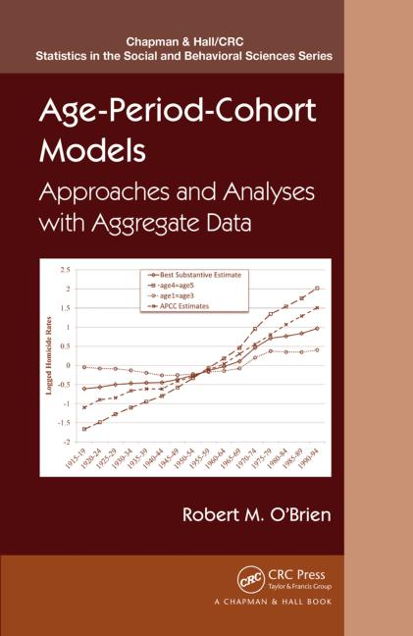
APC literature: Gospels & Bibles 1970-1980s
MASON K. O., MASON W. M., WINSBOROUGH H. H., POOLE K., 1973, “Some methodological issues in cohort analysis of archival data”, American sociological review, 38, pp. 242-258.
GLENN N. D., 1976, “Cohort analysts’ futile quest : statistical attempts to separate age, period, and cohort effects”, American sociological review, 41, pp. 900-905.
Adams, J. 1978. “Sequential Strategies and the Separation of Age, Cohort, and Time-of-Measurement Contributions to Developmental Data.” Psychological Bulletin 85: 1309-16.
HASTINGS D. W., BERRY L. G., 1979, Cohort analysis : a collection of interdisciplinary readings, Oxford (Ohio), Scripps Foundation for Research in Population Problems.
Rodgers, W.L. 1982. “Estimable Functions of Age, Period, and Cohort Effects.” American Sociological Review 47:774-87.
Holford, T.R. 1983. “The Estimation of Age, Period, and Cohort Effects for Vital Rates.” Biometrics 39:311-24.
Mason W.M. and H.L. Smith. 1985. “Age-Period-Cohort Analysis and the Study of Deaths from Pulmonary Tuberculosis.” Pp.151-228 in Cohort Analysis in Social Research: Beyond the Identification Problem, edited by W.M. Mason and S.E. Fienberg. New York: Springer-Verlag.
MASON W. M., FIENBERG S. E., 1985, Cohort analysis in social research : beyond the identification problem, Berlin, Springer Verlag.
Clayton, D. and E. Schifflers. 1987a. “Models for Temporal Variation in Cancer Rates I: Age-Period and Age-Cohort Models.” Statistics in Medicine 6:449-67.
Clayton, D. and E. Schifflers. 1987b. “Models for Temporal Variation in Cancer Rates II: Age-Period-Cohort Models.” Statistics in Medicine 6:468-81.
Hout M. and A.M. Greeley, 1989, “The Cohort Doesn't Hold: Comment on Chaves”, Journal for the Scientific Study of Religion, n. 29, pp.519-524.

Slide 39
APC literature 2008-2013
Yang, Y. and Land, K.C. (2008). Age–period–cohort analysis of repeated cross-section surveys. Fixed or random effects? Sociological Methods & Research 36(3):297–326.
Smith, H.L. (2008). “Advances in Age-Period-Cohort Analysis.” Sociological Methods & Research 36-3:287-96.
Yang Y., Schulhofer-Wohl, S., Fu, W. and Land, K. (2008). “The Intrinsic Estimator for Age-Period-Cohort Analysis: What It is and How to Use it?” American Journal of Sociology, 113:1697-1736.
O’Brien, R.M. 2011a. “Constrained Estimators and Age-Period-Cohort Models.” Sociological Methods & Research 40:419-52.
Hui Zheng, Yang Yang and Kenneth C. Land, 2011, Variance Function Regression in Hierarchical Age-Period-Cohort Models: Applications to the Study of Self-Reported Health, Am Sociol Rev. 2011 December; 76(6): 955–983.
Wilson, J.A., Zozula, C. and Gove, W.R. (2011). Age, Period, Cohort and Educational Attainment: The Importance of Considering Gender. Social Science Research 40:136-49.
Pampel, F.C. and Hunter, L.M. (2012). Cohort Change, Diffusion, and Support for Environmental Spending in the United States. American journal of sociology 118(2):420-448.
Campbell Colin, Jessica Pearlman (2013), Period effects, cohort effects, and the narrowing gender wage gap, Social Science Research, Volume 42, Issue 6, p.1693–1711
Yang Y. and Land, K.C. (2013), Age-period-cohort analysis. New models, methods, and empirical applications. CRC Press, Taylor & Francis Group, Boka Raton, FL
Fienberg, S. E. (2013). Cohort analysis’ unholy quest: A discussion. Demography, 50, 1981–1984.
Luo, L. (2013). Assessing Validity and Application Scope of the Intrinsic Estimator Approach to the Age-Period-Cohort Problem. Demography 50(6):1945-67.
Dassonneville, R. (2013). Questioning generational replacement. An age, period and cohort analysis of electoral volatility in the Netherlands, 1971–2010. Electoral Studies 32(1):37-47

Slide 40
APC literature (2014-2015)
Grasso, M.T. (2014). Age, Period and Cohort Analysis in a Comparative Context: Political Generations and Political Participation Repertoires in Western Europe. Electoral Studies, 33:63–76.
Chancel L. (2014). Are Younger Generations Higher Carbon Emitters than their Elders?: Inequalities, Generations and CO2 Emissions in France and in the USA. Ecological Economics, 100:195–207.
Phillips, J. A. (2014). A changing epidemiology of suicide? The influence of birth cohorts on suicide rates in the United States. Social Science & Medicine, 114, 151-160.
Schwadel, P. and Garneau, C. R. H. (2014), An Age–Period–Cohort Analysis of Political Tolerance in the United States. The Sociological Quarterly, 55: 421–452
Chauvel, L. and Schröder M., (2014). Generational inequalities and welfare regimes. Social forces 92 (4):1259-1283.
Chauvel, L. and Smits F.. (2015). The endless baby-boomer generation: Cohort differences in participation in political discussions in nine European countries in the period 1976-2008. In: European Societies.
Reither, E. N., Masters, R. K., Yang, Y. C., Powers, D. A., Zheng, H., & Land, K. C. (2015). Should age-period-cohort studies return to the methodologies of the 1970s? Social Science & Medicine.
Harper S. Invited commentary: A-P-C . . . It’s easy as 1-2-3! Am J Epidemiol. 2015 online publication
O’Brien RM, 2015, Model Misspecification when Eliminating a Factor in Age-Period-Cohort Models, ASA 2015 Chicago mimeo.

Slide 41
Our method A: APCD
APCD (detrended): are some cohorts above or below a linear trend of long-run economic growth? Basically, the APCD is a ‘bump detector’.
ssc install apcd
=> available ado file
PLZ see more on www.louischauvel.org/apcdex.htm
Notes:
Louis

Slide 42
4. Data
Dependent variable
We want to explain the living standards of members of different cohorts:
Variable “dpi” (disposable income) from the Luxembourg Income Study.
Logged and divided by the square root of household members and adjusted for inflation: reflects household-equalized real disposable income after taxes and transfers.
Independent variables
Cohort-membership of respondent (date of birth).
Plus controls for: age, period of measurement,
education (ISCED code), sex, partner in household, # of children, immigrant-status.
Main interest
How much does the mere date of birth (cohort membership) influence living standards?
Notes:
Martin

Slide 43
clear all
capture ssc install apcd
set linesize 100
gen d3=.
foreach gogo in fr it no us {
qui {
if "`gogo'"== "fr" local fifi " fr84 fr89 fr94 fr00 fr05 "
if "`gogo'"== "it" local fifi " it86 it91 it95 it00 it04 "
if "`gogo'"== "no" local fifi "no86 no91 no95 no00 no04 "
if "`gogo'"== "us" local fifi "us86 us91 us94 us00 us04 "
foreach toto in `fifi' {
local perso "$`toto'p"
local house "$`toto'h"
qui use hid ppopwgt age sex relation educ nchildren immigr educ_c pi deflat partner pmi ptime using `perso' , clear
qui joinby hid using `house'
keep hid ppopwgt age sex relation educ pi deflat year iso2 hpopwgt dpi ///
deflator nchildren immigr educ_c hmi hmx* npers partner pmi ptime
local save "t`toto'"
qui save `save' , replace
}
clear all
foreach toto in `fifi' {
local save "t`toto'"
qui append using `save'
}
qui recode year (1977/1982=1980) (1983/1987=1985) (1988/1992=1990) (1993/1997=1995) (1998/2002=2000) (2003/2008=2005)
qui gen age5=int((age-3)/5)*5+3
qui gen pweight = int(ppop)
qui keep if age >= 20 & age < 65
gen page=floor(age/5)*5
keep if (page >= 25 & page <= 64)
gen year5=year
replace year =int((year-1980)/5)
gen educ2=int(educ)
}
di "`gogo'"
gen ldpi=ln(dpi/sqrt(npers))
keep if age5>=25 & age5<60
xi: apcd ldpi [pw= pweight] if year5>=1985 & age5>=25 & age5<60 , age(page) period(year5)
}

Slide 44
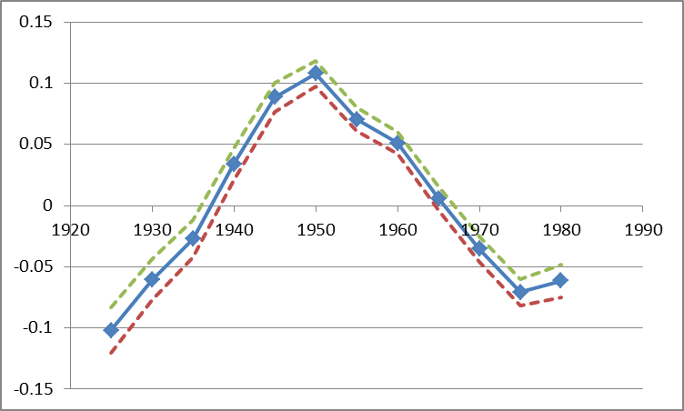
France : APCD (detrended) cohort coefficient of disposable per uc income
cohorts
Luxembourg Income Study microdata – 1980s to 2010s
Notes:
Martin
These figures show: how much different cohorts (people with different dates of birth) are below or above the long-run trend of economic growth, before and after controls are introduced.
Germany: Fortunate cohorts can have a living standards around 8 percent above of what one would expect when every cohort‘s income would have been proportionate with general trends of economic growth. But much of this is due to their better education etc. After this is controlled, only the cohorts born around 1945/50 are about 5 percent above the trend.
France: Fortunate cohort‘s living standard about 10 percent above the trend, unfortunate ones almost 10 percent below it. Even worse after controls are introduced (right side).
US: cohort‘s living standard does not diverge very much from the trend.
But how does this compare when set in relation to overall increases in living standards? APCT

Slide 45
APCD (detrended) cohort coefficient of disposable per uc income, w controls
ca de dk es
fi fr il it
nl no uk us
Luxembourg Income Study microdata – 1980s to 2010s
Notes:
Martin
These figures show: how much different cohorts (people with different dates of birth) are below or above the long-run trend of economic growth, before and after controls are introduced.
Germany: Fortunate cohorts can have a living standards around 8 percent above of what one would expect when every cohort‘s income would have been proportionate with general trends of economic growth. But much of this is due to their better education etc. After this is controlled, only the cohorts born around 1945/50 are about 5 percent above the trend.
France: Fortunate cohort‘s living standard about 10 percent above the trend, unfortunate ones almost 10 percent below it. Even worse after controls are introduced (right side).
US: cohort‘s living standard does not diverge very much from the trend.
But how does this compare when set in relation to overall increases in living standards? APCT

Slide 46
Conclusion
France is a very problematic case of young cohort economic slowdown
Italy, Spain, share very similar problems
=> there, the young get worse and the new seniors get relatively better
Reason: In conservative welfare state, the protection of insiders (the old) against outsiders (the young) produces strong difficulties in case of eco slow down, and then massive scarring effects
US not so bad? See closer in the details = suicide rates in the US!!!
See full paper here :
https://paa.confex.com/paa/2016/meetingapp.cgi/Paper/6950
Notes:
Louis
Controlling for education, household composition, immigration status etc, we find that French cohorts born very early or late or strongly disadvantaged.
Unsurprising for pre-1930 cohorts in France: E.g. entering the working market in 1940 is not a great moment to enter the working market. But more disquieting is our finding about cohorts that have been born recently.

Slide 47
Notes:
Martin
These figures show: how much different cohorts (people with different dates of birth) are below or above the long-run trend of economic growth, before and after controls are introduced.
Germany: Fortunate cohorts can have a living standards around 8 percent above of what one would expect when every cohort‘s income would have been proportionate with general trends of economic growth. But much of this is due to their better education etc. After this is controlled, only the cohorts born around 1945/50 are about 5 percent above the trend.
France: Fortunate cohort‘s living standard about 10 percent above the trend, unfortunate ones almost 10 percent below it. Even worse after controls are introduced (right side).
US: cohort‘s living standard does not diverge very much from the trend.
But how does this compare when set in relation to overall increases in living standards? APCT

Slide 48
APCD (detrended) cohort coefficient
R = 0.4660
R = 0.8459 in it+es+de+fr
Investment variation (%) when the cohort is 20 yo
Penn world tables
Notes:
Martin
These figures show: how much different cohorts (people with different dates of birth) are below or above the long-run trend of economic growth, before and after controls are introduced.
Germany: Fortunate cohorts can have a living standards around 8 percent above of what one would expect when every cohort‘s income would have been proportionate with general trends of economic growth. But much of this is due to their better education etc. After this is controlled, only the cohorts born around 1945/50 are about 5 percent above the trend.
France: Fortunate cohort‘s living standard about 10 percent above the trend, unfortunate ones almost 10 percent below it. Even worse after controls are introduced (right side).
US: cohort‘s living standard does not diverge very much from the trend.
But how does this compare when set in relation to overall increases in living standards? APCT

Slide 49
inequality across birth cohorts
PART 3: Final tool
Logitrank = a new method
to compare inequalities
Louis Chauvel
Pr Dr at University of Luxembourg
louis.chauvel@uni.lu
http://www.louischauvel.org
CUNY-LIS June 2015
IRSEI
Institute for Research
on Socio-Economic
Inequality

Slide 50
The Intensity and Shape of Inequality
The alpha-beta-gamma method
for the analysis of economic inequality
a 232 samples comparison
http://orbilu.uni.lu/handle/10993/18773

Slide 51
My aims
0. Vilfredo Pareto’s Legacy
New developments on old graphs (Champernowne/Fisk’s logit-log graph)
Methodology :
The isograph
Curvatures on the CF Graph
α β γ
Data : 232 LIS datasets
Analysis and comparisons with other indicators
Sub products
a. => the strobiloid
b. => volatility analysis
c. => etc.

Slide 52

0. Vilfredo Pareto’s Legacy
1896
Vilfredo Pareto
1848-1922
Pervasive and almost everywhere …
Aaron Clauset, Cosma Rohilla Shalizi, and M. E. J. Newman 2009
Power-Law Distributions in Empirical Data , SIAM Rev., 51(4), 661–703. (43 pages) Society for Industrial and Applied Mathematics

Slide 53
  Consider
  Y = log(M) where M is the “medianized” equivalized income
  X = log (p / (1- p) ) where p is the “fractional rank” ( 0 < p < 1)
  We graph ln(M) by logit(p) => almost a straight line
  1- From Pareto log-log to Pen’s Parade, and to logit-log
Luxembourg :
Logit-log graph
euros EU-Silc
Y = Ln(M) medianized income
If this is a perfect
straight line
α = Gini index
(Dagum 1975)
Slope
α ≈ 0.28
Kleiber & Kotz
2003
X = Logit (p) ) logitrank

Slide 54
  Methodology-b Logit rank (=logistic quantile)
(Logit rank) What’s that?
It is not totally new ex : John Copas, The Effectiveness of Risk Scores: The Logit Rank Plot Journal of the Royal Statistical Society. Series C (Applied Statistics), Vol. 48, No. 2 (1999), pp. 165-183
(it looks like the Positional status index, PSI, of Tony Tam)
We express the rank of an individual as a proportion p € [0,1] of the cumulative population below her/him on the scale of resource (earning, income, wealth)
<randomization of ex-eaquo>
Logitrank = ln( p / (1-p) )
We know that (for median adjusted income)
ln(medincome) ≈ α Logitrank where α is the Gini coeff of income
(Champernowne 1937 Fisk 1961 Kleiber & Kotz 2003)
Properties: inflation neutral, inequality shape neutral,
implemented in Stata:
ssc install abg

Slide 55
  Logit-rank transformation is a convenient tool to transform ordinal variables in
  ]–infinite ; + infinite[ standardized distribution
  In the context of distributional analysis, it provides a “net of distributional change” relative reference position of individuals and of groups
  It is more convenient than percentiles levels [between 0 and 1] that present border issues
  Useful in income volatility analysis and in contexts where “positional” aspects are central
  Logit-Rank & Applications
2 is close to top decile
4 is close to top 2%
0 is median
…
1 is close to top quartile
3 is close to top vingtile

Slide 56
  Curvatures on the CF Graph
slopes, curvatures and alpha-beta-gamma
Y=Ln (medinc)
β>0
The stronger the slope,
The higher local inequality
(1)
(2)
Slope=
ISO = Y/X
X=Logit(rank)
α
(4)
Higher inequality at the top β>0
(2) Lower inequality at the top β<0
(3) Higher inequality at the bottom γ>0
(4) Lower inequality at the top γ<0
(3)
γ>0

Slide 57
3- Data and measurements :
    Data :
    Lis source of medianized equivalized disposable income after tax and transfers
    271 country/year samples

Slide 58
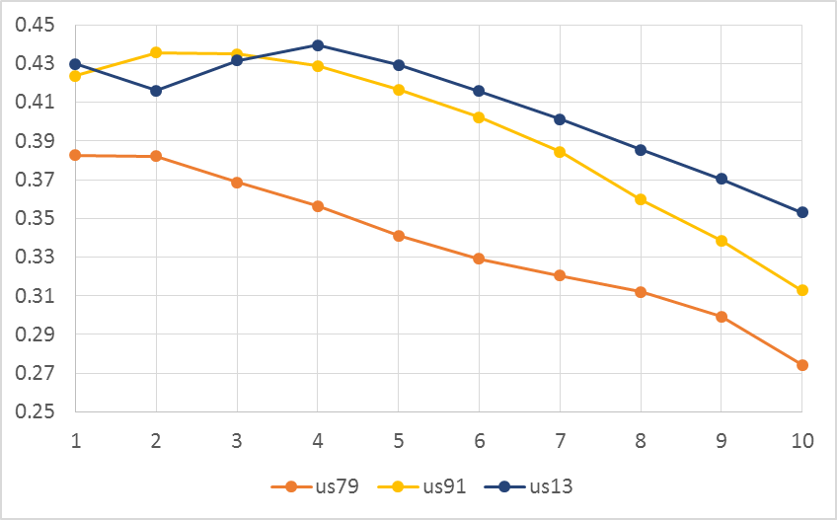
  The Isograph and Metaginis in the USA
Gini = 0.37
Gini = 0.34
Gini = 0.30
Deciles
US-year

Slide 59
2010s
1980s

Slide 60
  5- Subprod : The strobiloid = graphing changing shapes
Luxembourg Income Study microdata – 1980s to 2010s

Slide 61
APCT (trended) cohort coefficient of ALPHA index = polarization
Luxembourg Income Study microdata – 1980s to 2010s
Notes:
Martin
These figures show: how much different cohorts (people with different dates of birth) are below or above the long-run trend of economic growth, before and after controls are introduced.
Germany: Fortunate cohorts can have a living standards around 8 percent above of what one would expect when every cohort‘s income would have been proportionate with general trends of economic growth. But much of this is due to their better education etc. After this is controlled, only the cohorts born around 1945/50 are about 5 percent above the trend.
France: Fortunate cohort‘s living standard about 10 percent above the trend, unfortunate ones almost 10 percent below it. Even worse after controls are introduced (right side).
US: cohort‘s living standard does not diverge very much from the trend.
But how does this compare when set in relation to overall increases in living standards? APCT

Slide 62
Conclusion
Inequality is much more complicated than expected
Diversities of trends and of cohort trends
Diversity of shapes of inequalities
LIS shows potentially massive intracohort inequalities (polarization)
and intercohort imbalances
The problem is with future: the sacrifice of the young lets scars
Scarring effect of inequalities
Notes:
Louis
Controlling for education, household composition, immigration status etc, we find that French cohorts born very early or late or strongly disadvantaged.
Unsurprising for pre-1930 cohorts in France: E.g. entering the working market in 1940 is not a great moment to enter the working market. But more disquieting is our finding about cohorts that have been born recently.

