Slide 1


Inequality Across Cohorts
Louis Chauvel
Pr Dr at University of Luxembourg
louis.chauvel@uni.lu
http://www.louischauvel.org
CUNY-LIS June 2017
IRSEI
Institute for Research
on Socio-Economic
Inequality

Slide 2
4 PARTS
1- Theory of Cohort inequalities
2- Welfare regimes and international comparisons with the LIS
3- Inequalities of education, income, wealth and APC
4- An APC approach to gender inequality in 12 countries
Notes:
Louis

Slide 3
inequality across birth cohorts
PART 1:
Theory of Cohort inequalities:
France as an extreme case
Louis Chauvel
Pr Dr at University of Luxembourg
louis.chauvel@uni.lu
http://www.louischauvel.org
CUNY-LIS June 2017
IRSEI
Institute for Research
on Socio-Economic
Inequality

Slide 4




  1. From theory to datacrunching:
  Social generations and cohort analysis
  Theory of social generations (Karl Mannheim)
  1968 gap of generations (Margaret Mead)
  Demographic metabolism (Norman Ryder)
  The methodology of APC analysis (Yang Yang)
  Examples:
  * suicide in France
  * consumption in China
  * political participation
  * etc. , etc. , etc.
Karl Mannheim
1893-1947
Margaret Mead
1901-1978
Norman Ryder
1923-2010
Yang Yang
1970?-
www.louischauvel.org/ryder2090964.pdf

Slide 5

  Important references
  www.louischauvel.org/TheMannheim.pdf
  www.louischauvel.org/TheMead.pdf
  www.louischauvel.org/TheRyder.pdf
  http://davidcard.berkeley.edu/papers/vietnam-war-college.pdf
  www.louischauvel.org/TheYANGASR2008.pdf
http://www.louischauvel.org/frenchpolcultsoc.pdf
Margaret Mead
1901-1978

Slide 6
Socialization versus individual and collective history
    Life course and socialization
    Primary and secondary socialization
    The « transitionnal socialization »
    Long term impact of the « transitionnal socialization » :
    « scar effect »
    History and the constitution of a Generationengeist (spirit of generations) and of a Generationenlage (situation of generation)
Primary socialization Until end of compulsory secondary education (?) | Transitionnal socialization | Secondary socialization « adulthood »
16-18 y.o.
      25-30 y.o.

Slide 7
Material-objective or political-cultural generations?... Or all of that
    Karl Mannheim
    The impact of new social contexts on the young:
    «Mental data are of sociological importance not only because of their actual content, but also because they cause the individuals sharing them to form one group—they have a socializing effect». (…dass sie die Einzelnen zur Gruppe verbinden, „sozialisierend“ wirken )
    (K. Mannheim, Das Problem der Generationen, 1928)
    QUESTION 1
    From cohort to generations ? How generational cristallization ?
    QUESTION 2
    Does the national/Welfare regime context of entry into adulthood has a durable effect on future life chances of generations ?

Slide 8
General question of research on cohort inequalities:
Economic crises and the social integration of new cohorts.
Scarring effects of youth unemployment (Ellwood 1982 / Gangl 2004).
Permanence or resilience of initial trauma and Cumulative advantage/disadvantage (R. Merton 1968, Th. DiPrete 2006)
Or compensation, resilience (Luthar & al. 2000, Bonanno 2004)
Do states differ in how well they could integrate new cohorts or do we see more pronounced insider-outsider dynamics in some countries?
Are some generations sacrificed or do cohorts with a bad start catch up?
Goerres and Vanhuysse (2012: 1)
‘developing an integrated body of knowledge to answer the question of which generations get what, when and how.’
Notes:
Louis

Slide 9
FACTS : Example The French crash test
Unemployment rate for the male and female
20 to 24 year old
Risks of unemployment
12 months after living school (%)
QUESTION :
long term consequences of the shock of the 1970?
long term consequences of permanent difficulties of entry in the labor market?

Slide 10

Young generations as victims of social change
France as a crash test
Multidimensional generational fractures in France
Relative(?) socio-economic decline
Overeducation and educational déclassés
Risks of downward mobility
Dyssocialisation
Recomposition of risks of suicide
Out of the political arena
See➔

Slide 11
a. Relative(?) socio-economic decline
France
Lis 1980-2005
Silc 2010
Log level of living (=disposable income per CU)
by age group (0= year average)
2010
1980
age

Slide 12
a. Relative(?) socio-economic decline
real housing price index (dotted lines) and real household incomes index
Housing index
Wages
year
Note: y-axis: Housing index and household incomes adjusted for inflation, indexed to year 2000 (y=100).
Source: International House Price Database, Federal Reserve Bank of Dallas. Mack and Martínez-García (2011).

Slide 13
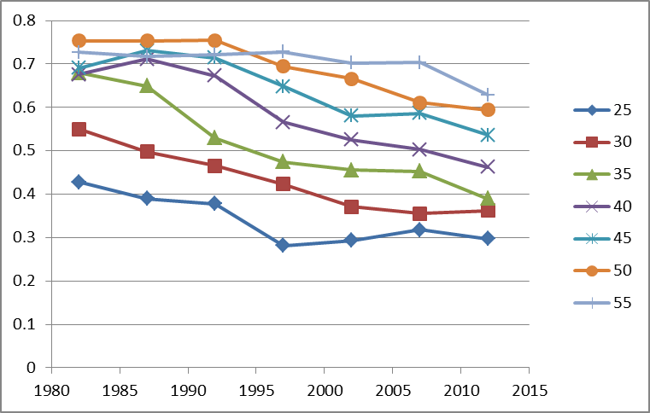
b. Overeducation and educational déclassés
Educational inflation
% of GED (‘bac’) (no more no less)
holders accessing middle class jobs (service cl h+l) 1970-2012
Age
Year
French labor force surveys 1970-2012

Slide 14
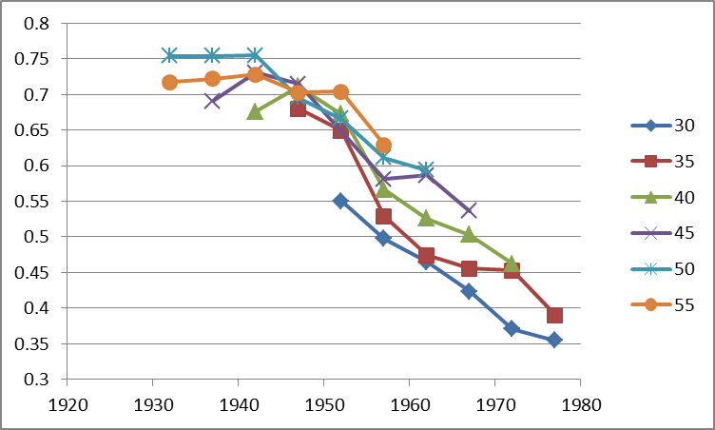
b. Overeducation and educational déclassés
Educational inflation
% of GED (‘bac’) (no more no less)
holders accessing middle class jobs (service cl h+l) 1970-2012
Age
Birth cohort
French labor force surveys 1970-2012

Slide 15
First conclusions:
“As happy as God in France?”
(Hypothesis might be true(?) But avoid generalization to the young plz.)
Interpreting the French case:
    Esping-Andersen Typology of Welfare states:
    France = “corporatist-conservative” welfare regime, stabilization of social relations
    Protection of insiders (protected male workers) against outsiders
    In case of economic brake :
    « Insiderisation » of insiders, already in the stable labor force
    and « outsiderisation » of new entrants
    In France, young people can wait … decades
    Job seeking = Musical chairs game
    Increasing poverty rates for young people, stable intracohort inequalities
    (after taxes and welfare reallocations)
Strong problem of social welfare sustainability:
Those who pay might experience the collapse of this regime…
Notes:
Louis

Slide 16
inequality across birth cohorts
PART 2:
Comparing cohort inequalities
Louis Chauvel
Pr Dr at University of Luxembourg
louis.chauvel@uni.lu
http://www.louischauvel.org
IRSEI
Institute for Research
on Socio-Economic
Inequality

Slide 17
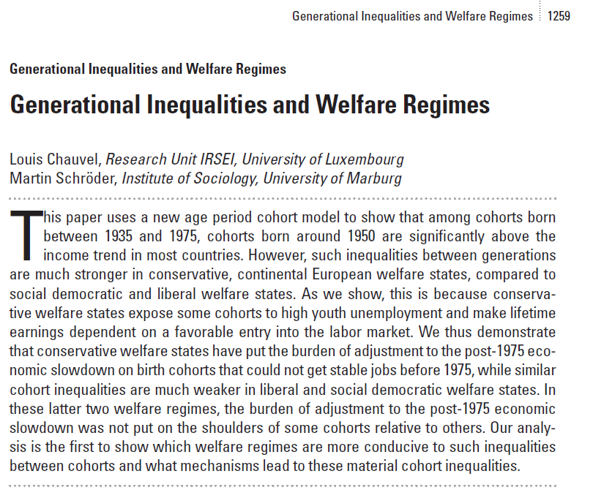

  Backgrounds …
A 17 countries comparison of inter-cohort inequalities
See also : Chauvel, L. and M. Schröder. 2015. The impact of cohort membership on disposable incomes
in West Germany, France, and the United States. European Sociological Review, 31:298-311.

Slide 18
Émile Durkheim (1897),
Le suicide. Étude de sociologie, p.1
Interpreting the French case:
    Esping-Andersen Typology of Welfare states:
    France = “corporatist-conservative” welfare regime, stabilization of social relations
    Protection of insiders (protected male workers) against outsiders
    In case of economic brake :
    « Insiderisation » of insiders, already in the stable labor force
    and « outsiderisation » of new entrants
    In France, young people can wait … decades
    Increasing poverty rates for young people, stable intracohort inequalities
    (after taxes and welfare reallocations)
Emile Durkheim’s Suicide

Slide 19


  Theories of Welfare Regimes
  Decommodification models and welfare regimes
“De-commodification occurs when a service is rendered as a matter of right, and when a person can maintain a livelihood without reliance on the market” (Esping-Anderson, pp. 21-22)
Gosta Esping-Andersen (Danish, born 1947)
Professor @ Universitat Pompeu Fabra (Barcelona).

Slide 20


  Central references
  Pierson Ch. and Castles F.G. (eds) 2006,
  The Welfare State Reader, 2nd ed, Cambridge: Polity Press.
Pierson C., Obinger H., Lewis J., Leibfried S., Castles F.G. (Eds), 2010,
The Oxford Handbook of the Welfare State, Oxford ; Ox Univ Pr.

Slide 21

  Central references
  Schröder, Martin, 2013:
  Integrating Varieties of
  Capitalism and Welfare State Research:
  A Unified Typology of Capitalisms.
  New York: Palgrave.

Slide 22
 | Liberal (=Residual) Theoretical equality of opportunity | Corporatist (=Conservative) Maintaining social order | Social-demo. (=Universalistic) decommodification defamilialistion destartification
Degree / Model of decommodification | Free Market as the central institution | Intermediate level of decommo-dification | Collective social consumption promoted
System of social stratification | Protection of the (good) poor, but stigmatization of “free riders”: Strong economic inequalities but more permeable boundaries between social classes | Solidarity between equals: Intermediate degree of inequality but social boundaries strongly impermeable | Economic, gender, inequality is minimal and strong “fluidity” (net mobility, equality of opportunities & outcomes) between classes
Typical countries | US UK | Germany (France) | Sweden

Slide 23
Three (+1) modalities Esping-Andersen Typology of Welfare states :
    Conservative model (Continental Europe) : FRANCE
    Preservation of (old) social balance, with social insurance excluding unemployed => strong intercohort inequalities and less intracohort inequalities than in the Liberal model
    <Familialistic Model (Mediterranean Europe) : ITALY>
    <Conservative + family and local and clientelistic solidarities>
    Liberal model : (Anglo-saxon world) : US
    Market as a central institution, residual welfare state against market failures
    HL0 : more intracohort inequalities
    HL1 : less intercohort inequality (competition between generations)
    « Social-democrat » Model (Nordic Europe) : DENMARK
    Citizenship and broad participation to discussions and bargaining around social reforms between social groups (gender, generations, etc.) for a long-term development
    HD0 : less intracohort inequalities
    HD1 : residual intercohort inequalities (positive compromise between generations)

Slide 24
Methodology I : the base ➔ A = P – C
BUT ! How to distinguish durable scarring effects and fads ???
Hysteresis = stability versus Resilience = resorption of scars

Slide 25
Statistical background: Age Period Cohort models
Separate the effects of age, period of measurement and cohort.
Problematic colinearity:
cohort (date of birth) = period (date of measurement) - age
(Ryder 1965, Mason et al. 1973, Mason / Fienberg 1985, Mason / Smith 1985,
Yang Yang et al. 2006 2008, Smith 2008, Pampel 2012)
Notes:
Louis

Slide 26


Remember Whelpton and Frost
APC literature: Gospels & Bibles 1970-1990s
MASON K. O., MASON W. M., WINSBOROUGH H. H., POOLE K., 1973, “Some methodological issues in cohort analysis of archival data”, American sociological review, 38, pp. 242-258.
GLENN N. D., 1976, “Cohort analysts’ futile quest : statistical attempts to separate age, period, and cohort effects”, American sociological review, 41, pp. 900-905.
Adams, J. 1978. “Sequential Strategies and the Separation of Age, Cohort, and Time-of-Measurement Contributions to Developmental Data.” Psychological Bulletin 85: 1309-16.
HASTINGS D. W., BERRY L. G., 1979, Cohort analysis : a collection of interdisciplinary readings, Oxford (Ohio), Scripps Foundation for Research in Population Problems.
Rodgers, W.L. 1982. “Estimable Functions of Age, Period, and Cohort Effects.” American Sociological Review 47:774-87.
Holford, T.R. 1983. “The Estimation of Age, Period, and Cohort Effects for Vital Rates.” Biometrics 39:311-24.
Mason W.M. and H.L. Smith. 1985. “Age-Period-Cohort Analysis and the Study of Deaths from Pulmonary Tuberculosis.” Pp.151-228 in Cohort Analysis in Social Research: Beyond the Identification Problem, edited by W.M. Mason and S.E. Fienberg. New York: Springer-Verlag.
MASON W. M., FIENBERG S. E., 1985, Cohort analysis in social research : beyond the identification problem, Berlin, Springer Verlag.
Clayton, D. and E. Schifflers. 1987a. “Models for Temporal Variation in Cancer Rates I: Age-Period and Age-Cohort Models.” Statistics in Medicine 6:449-67.
Clayton, D. and E. Schifflers. 1987b. “Models for Temporal Variation in Cancer Rates II: Age-Period-Cohort Models.” Statistics in Medicine 6:468-81.
Hout M. and A.M. Greeley, 1989, “The Cohort Doesn't Hold: Comment on Chaves”, Journal for the Scientific Study of Religion, n. 29, pp.519-524.
WILMOTH J. R., 1990, “Variation in vital rates by age, period, and cohort”, in C. C. Clogg (ed.), Sociological methodology, Oxford, Basil Blackwell, vol. 20, pp. 295-335.
WILMOTH J. R., 2001, “Les modèles âge-période-cohorte en démographie”, in G. CASELLI, J. VALLIN, G. WUNSCH (eds.), Démographie : analyse et synthèse. I : La dynamique des populations, Paris, Ined, pp. 379-397.

Slide 27
APC literature 2008-2013
Yang, Y. and Land, K.C. (2008). Age–period–cohort analysis of repeated cross-section surveys. Fixed or random effects? Sociological Methods & Research 36(3):297–326.
Smith, H.L. (2008). “Advances in Age-Period-Cohort Analysis.” Sociological Methods & Research 36-3:287-96.
Yang Y., Schulhofer-Wohl, S., Fu, W. and Land, K. (2008). “The Intrinsic Estimator for Age-Period-Cohort Analysis: What It is and How to Use it?” American Journal of Sociology, 113:1697-1736.
O’Brien, R.M. 2011a. “Constrained Estimators and Age-Period-Cohort Models.” Sociological Methods & Research 40:419-52.
Hui Zheng, Yang Yang and Kenneth C. Land, 2011, Variance Function Regression in Hierarchical Age-Period-Cohort Models: Applications to the Study of Self-Reported Health, Am Sociol Rev. 2011 December; 76(6): 955–983.
Wilson, J.A., Zozula, C. and Gove, W.R. (2011). Age, Period, Cohort and Educational Attainment: The Importance of Considering Gender. Social Science Research 40:136-49.
Pampel, F.C. and Hunter, L.M. (2012). Cohort Change, Diffusion, and Support for Environmental Spending in the United States. American journal of sociology 118(2):420-448.
Campbell Colin, Jessica Pearlman (2013), Period effects, cohort effects, and the narrowing gender wage gap, Social Science Research, Volume 42, Issue 6, p.1693–1711
Yang Y. and Land, K.C. (2013), Age-period-cohort analysis. New models, methods, and empirical applications. CRC Press, Taylor & Francis Group, Boka Raton, FL
Fienberg, S. E. (2013). Cohort analysis’ unholy quest: A discussion. Demography, 50, 1981–1984.
Luo, L. (2013). Assessing Validity and Application Scope of the Intrinsic Estimator Approach to the Age-Period-Cohort Problem. Demography 50(6):1945-67.
Dassonneville, R. (2013). Questioning generational replacement. An age, period and cohort analysis of electoral volatility in the Netherlands, 1971–2010. Electoral Studies 32(1):37-47

Slide 28
APC literature (2014-2015)
Grasso, M.T. (2014). Age, Period and Cohort Analysis in a Comparative Context: Political Generations and Political Participation Repertoires in Western Europe. Electoral Studies, 33:63–76.
Chancel L. (2014). Are Younger Generations Higher Carbon Emitters than their Elders?: Inequalities, Generations and CO2 Emissions in France and in the USA. Ecological Economics, 100:195–207.
Phillips, J. A. (2014). A changing epidemiology of suicide? The influence of birth cohorts on suicide rates in the United States. Social Science & Medicine, 114, 151-160.
Schwadel, P. and Garneau, C. R. H. (2014), An Age–Period–Cohort Analysis of Political Tolerance in the United States. The Sociological Quarterly, 55: 421–452
Chauvel, L. and Schröder M., (2014). Generational inequalities and welfare regimes. Social forces 92 (4):1259-1283.
Chauvel, L. and Smits F.. (2015). The endless baby-boomer generation: Cohort differences in participation in political discussions in nine European countries in the period 1976-2008. In: European Societies.
Reither, E. N., Masters, R. K., Yang, Y. C., Powers, D. A., Zheng, H., & Land, K. C. (2015). Should age-period-cohort studies return to the methodologies of the 1970s? Social Science & Medicine.
Harper S. Invited commentary: A-P-C . . . It’s easy as 1-2-3! Am J Epidemiol. 2015 online publication
O’Brien RM, 2015, Model Misspecification when Eliminating a Factor in Age-Period-Cohort Models, ASA 2015 Chicago mimeo.

Slide 29
APC literature (2015-2017)
Chauvel, L. and M. Schröder. 2015. The impact of cohort membership on disposable incomes in West Germany, France, and the United States. European Sociological Review, 31:298-311.
Reither, E. N., Masters, R. K., Yang, Y. C., Powers, D. A., Zheng, H., & Land, K. C. (2015). Should age-period-cohort studies return to the methodologies of the 1970s? Social Science & Medicine.
Harper S. Invited commentary: A-P-C . . . It’s easy as 1-2-3! Am J Epidemiol. 2015 online publication
Lindahl-Jacobsen, R., Rau, R., Jeune, B., Canudas-Romo, V., Lenart, A., Christensen, K., & Vaupel, J. W. (2016). Rise, stagnation, and rise of Danish women’s life expectancy. Proceedings of the National Academy of Sciences, 113(15), 4015-4020.
Chauvel, L., Leist, A. K., & Smith, H. L. (2016). Cohort factors impinging on suicide rates in the United States, 1990-2010. Annual Meeting of the Population Association of America, March 31 - April 2, 2016, Washington, DC. Full paper available at http://orbilu.uni.lu/handle/10993/25339.
Chauvel L, Leist AK, Ponomarenko V (2016) Testing Persistence of Cohort Effects in the Epidemiology of Suicide: an Age-Period-Cohort Hysteresis Model.
PLoS ONE 11(7): e0158538. doi:10.1371/journal.pone.0158538
Bell, A. and K. Jones. 2017. The hierarchical age–period–cohort model: Why does it find the results that it finds? Quality & Quantity: 1-17.

Slide 30
Our method A: APCD
APCD (detrended): are some cohorts above or below a linear trend of long-run economic growth? Basically, the APCD is a ‘bump detector’.
STATA ssc install apcd
=> available ado file
PLZ see more on www.louischauvel.org/apcdex.htm
Notes:
Louis

Slide 31
4. Data
Dependent variable
We want to explain the living standards of members of different cohorts:
Variable “dpi” (disposable income) from the Luxembourg Income Study.
Logged and divided by the square root of household members and adjusted for inflation: reflects household-equalized real disposable income after taxes and transfers.
Independent variables
Age, Period of measurement, Cohort-membership of respondent (date of birth).
Plus controls for:
education (ISCED code), sex, partner in household, # of children, immigrant-status.
Main interest
How much does the mere date of birth (cohort membership) influence living standards? – in terms of deviation from the linear trend
Notes:
Martin

Slide 32
clear all
capture ssc install apcd
set linesize 100
gen d3=.
foreach gogo in fr it no us {
qui {
if "`gogo'"== "fr" local fifi " fr84 fr89 fr94 fr00 fr05 "
if "`gogo'"== "it" local fifi " it86 it91 it95 it00 it04 "
if "`gogo'"== "no" local fifi "no86 no91 no95 no00 no04 "
if "`gogo'"== "us" local fifi "us86 us91 us94 us00 us04 "
foreach toto in `fifi' {
local perso "$`toto'p"
local house "$`toto'h"
qui use hid ppopwgt age sex relation educ nchildren immigr educ_c pi deflat partner pmi ptime using `perso' , clear
qui joinby hid using `house'
keep hid ppopwgt age sex relation educ pi deflat year iso2 hpopwgt dpi ///
deflator nchildren immigr educ_c hmi hmx* npers partner pmi ptime
local save "t`toto'"
qui save `save' , replace
}
clear all
foreach toto in `fifi' {
local save "t`toto'"
qui append using `save'
}
qui recode year (1977/1982=1980) (1983/1987=1985) (1988/1992=1990) (1993/1997=1995) (1998/2002=2000) (2003/2008=2005)
qui gen age5=int((age-3)/5)*5+3
qui gen pweight = int(ppop)
qui keep if age >= 20 & age < 65
gen page=floor(age/5)*5
keep if (page >= 25 & page <= 64)
gen year5=year
replace year =int((year-1980)/5)
gen educ2=int(educ)
}
di "`gogo'"
gen ldpi=ln(dpi/sqrt(npers))
keep if age5>=25 & age5<60
xi: apcd ldpi [pw= pweight] if year5>=1985 & age5>=25 & age5<60 , age(page) period(year5)
}

Slide 33
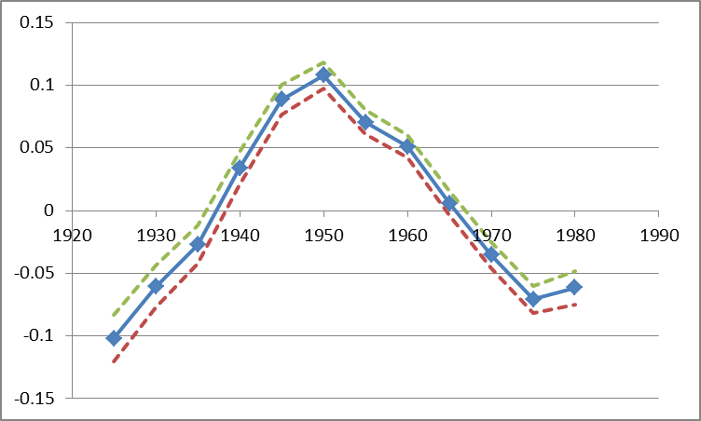
France : APCD (detrended) cohort coefficient of disposable per uc income
cohorts
controls for:
education (ISCED code), sex, partner in household, # of children, immigrant-status.
Luxembourg Income Study microdata – 1980s to 2010s
Notes:
Martin
These figures show: how much different cohorts (people with different dates of birth) are below or above the long-run trend of economic growth, before and after controls are introduced.
Germany: Fortunate cohorts can have a living standards around 8 percent above of what one would expect when every cohort‘s income would have been proportionate with general trends of economic growth. But much of this is due to their better education etc. After this is controlled, only the cohorts born around 1945/50 are about 5 percent above the trend.
France: Fortunate cohort‘s living standard about 10 percent above the trend, unfortunate ones almost 10 percent below it. Even worse after controls are introduced (right side).
US: cohort‘s living standard does not diverge very much from the trend.
But how does this compare when set in relation to overall increases in living standards? APCT

Slide 34
APCD (detrended) cohort coefficient of disposable per uc income, w controls
controls : education (ISCED code), sex, partner in household, # of children, immigrant-status.
ca de dk es
fi fr il it
nl no uk us
Luxembourg Income Study microdata – 1980s to 2010s
Notes:
Martin
These figures show: how much different cohorts (people with different dates of birth) are below or above the long-run trend of economic growth, before and after controls are introduced.
Germany: Fortunate cohorts can have a living standards around 8 percent above of what one would expect when every cohort‘s income would have been proportionate with general trends of economic growth. But much of this is due to their better education etc. After this is controlled, only the cohorts born around 1945/50 are about 5 percent above the trend.
France: Fortunate cohort‘s living standard about 10 percent above the trend, unfortunate ones almost 10 percent below it. Even worse after controls are introduced (right side).
US: cohort‘s living standard does not diverge very much from the trend.
But how does this compare when set in relation to overall increases in living standards? APCT

Slide 35
APCT (trended) cohort coefficient of Gini indexes
Notes:
Martin
These figures show: how much different cohorts (people with different dates of birth) are below or above the long-run trend of economic growth, before and after controls are introduced.
Germany: Fortunate cohorts can have a living standards around 8 percent above of what one would expect when every cohort‘s income would have been proportionate with general trends of economic growth. But much of this is due to their better education etc. After this is controlled, only the cohorts born around 1945/50 are about 5 percent above the trend.
France: Fortunate cohort‘s living standard about 10 percent above the trend, unfortunate ones almost 10 percent below it. Even worse after controls are introduced (right side).
US: cohort‘s living standard does not diverge very much from the trend.
But how does this compare when set in relation to overall increases in living standards? APCT

Slide 36
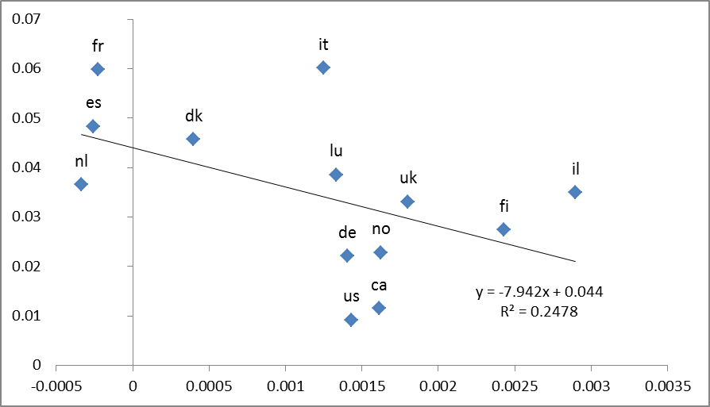
Intercohort inequality (after controls) and intracohort inequality dynamics
Intercohort inequality (non flat cohort profile)
intracohort inequality dynamics
(cohort growth of Gini index)
Notes:
Martin
These figures show: how much different cohorts (people with different dates of birth) are below or above the long-run trend of economic growth, before and after controls are introduced.
Germany: Fortunate cohorts can have a living standards around 8 percent above of what one would expect when every cohort‘s income would have been proportionate with general trends of economic growth. But much of this is due to their better education etc. After this is controlled, only the cohorts born around 1945/50 are about 5 percent above the trend.
France: Fortunate cohort‘s living standard about 10 percent above the trend, unfortunate ones almost 10 percent below it. Even worse after controls are introduced (right side).
US: cohort‘s living standard does not diverge very much from the trend.
But how does this compare when set in relation to overall increases in living standards? APCT

Slide 37
Conclusion
France is a very problematic case of young cohort economic slowdown
Italy, Spain, share very similar problems
=> there, the young get worse and the new seniors get relatively better
Reason: In conservative welfare state, the protection of insiders (the old) against outsiders (the young) produces strong difficulties in case of eco slow down, and then massive scarring effects
US not so bad? See closer in the details = suicide rates in the US!!!
See full paper here :
https://paa.confex.com/paa/2016/meetingapp.cgi/Paper/6950
Notes:
Louis
Controlling for education, household composition, immigration status etc, we find that French cohorts born very early or late or strongly disadvantaged.
Unsurprising for pre-1930 cohorts in France: E.g. entering the working market in 1940 is not a great moment to enter the working market. But more disquieting is our finding about cohorts that have been born recently.

Slide 38
inequality across birth cohorts
PART 3: The inequalities
to come IN THE U.S.
Louis Chauvel
Pr Dr at University of Luxembourg
louis.chauvel@uni.lu
http://www.louischauvel.org
3 aspects of inequality and cohorts in the U.S.
A- Cohort inequality and rising premium to education
C- booming interdecile gaps in wealth
IRSEI
Institute for Research
on Socio-Economic
Inequality

Slide 39
A- Cohort inequality and rising premium to education
U.S.
Data
Source CPS IPUMS 1975-2015 each 5th year – male population
Dependent variable
Log wage-income gap between BA holders and the others (many variants processed).
(log wages “medianized” by year)
Independent variables
Age, Period of measurement, Cohort-membership of respondent (date of birth).
Method
apctlag [included in the STATA ssc install apcgo ] of the gap
between diploma and non diploma holders
Bootstrapped 20 times
Main interest
How much does the mere date of birth (cohort membership) influence the diploma premium?
Notes:
Martin
These figures show: how much different cohorts (people with different dates of birth) are below or above the long-run trend of economic growth, before and after controls are introduced.
Germany: Fortunate cohorts can have a living standards around 8 percent above of what one would expect when every cohort‘s income would have been proportionate with general trends of economic growth. But much of this is due to their better education etc. After this is controlled, only the cohorts born around 1945/50 are about 5 percent above the trend.
France: Fortunate cohort‘s living standard about 10 percent above the trend, unfortunate ones almost 10 percent below it. Even worse after controls are introduced (right side).
US: cohort‘s living standard does not diverge very much from the trend.
But how does this compare when set in relation to overall increases in living standards? APCT

Slide 40
A- Cohort inequality and rising premium to education
Diploma premium : gap in log wage income of BA/noBA U.S.
75% premium
55% premium
45% premium
30% premium
Notes:
Martin
These figures show: how much different cohorts (people with different dates of birth) are below or above the long-run trend of economic growth, before and after controls are introduced.
Germany: Fortunate cohorts can have a living standards around 8 percent above of what one would expect when every cohort‘s income would have been proportionate with general trends of economic growth. But much of this is due to their better education etc. After this is controlled, only the cohorts born around 1945/50 are about 5 percent above the trend.
France: Fortunate cohort‘s living standard about 10 percent above the trend, unfortunate ones almost 10 percent below it. Even worse after controls are introduced (right side).
US: cohort‘s living standard does not diverge very much from the trend.
But how does this compare when set in relation to overall increases in living standards? APCT

Slide 41
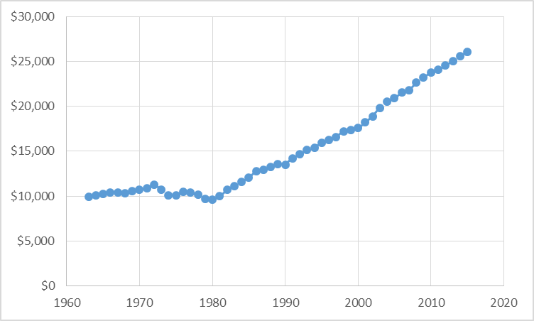
A- Cohort inequality and rising premium to education
Diploma premium : gap in log wage income of BA/noBA
Tuition and fees & other costs constant 2015$ 4-year
"Table 330.10. Average undergraduate tuition and fees and room and board rates charged for full-time students in degree-granting postsecondary institutions, by level and control of institution: 1963-64 through 2015-16"
Notes:
Martin
These figures show: how much different cohorts (people with different dates of birth) are below or above the long-run trend of economic growth, before and after controls are introduced.
Germany: Fortunate cohorts can have a living standards around 8 percent above of what one would expect when every cohort‘s income would have been proportionate with general trends of economic growth. But much of this is due to their better education etc. After this is controlled, only the cohorts born around 1945/50 are about 5 percent above the trend.
France: Fortunate cohort‘s living standard about 10 percent above the trend, unfortunate ones almost 10 percent below it. Even worse after controls are introduced (right side).
US: cohort‘s living standard does not diverge very much from the trend.
But how does this compare when set in relation to overall increases in living standards? APCT

Slide 42
C- booming interdecile gaps in wealth
Data
Source Survey of consumer finance 1989-2013
Dependent variable
Log wealth ( “medianized” by year)
Independent variables
Age, Period of measurement, Cohort-membership
Contrast beteween [ top decile versus median ] .
Method
apctlag [included in the STATA ssc install apcgo ] of the gap
between top decile and the median
Bootstrapped 20 times
Main interest
How much does the mere date of birth (cohort membership)
influence the wealth gap?
Notes:
Martin
These figures show: how much different cohorts (people with different dates of birth) are below or above the long-run trend of economic growth, before and after controls are introduced.
Germany: Fortunate cohorts can have a living standards around 8 percent above of what one would expect when every cohort‘s income would have been proportionate with general trends of economic growth. But much of this is due to their better education etc. After this is controlled, only the cohorts born around 1945/50 are about 5 percent above the trend.
France: Fortunate cohort‘s living standard about 10 percent above the trend, unfortunate ones almost 10 percent below it. Even worse after controls are introduced (right side).
US: cohort‘s living standard does not diverge very much from the trend.
But how does this compare when set in relation to overall increases in living standards? APCT

Slide 43
Difference of Log-wealth top decile D10 to the median M U.S. SCF
See in annex “My problem with Gini”
Notes:
Martin
These figures show: how much different cohorts (people with different dates of birth) are below or above the long-run trend of economic growth, before and after controls are introduced.
Germany: Fortunate cohorts can have a living standards around 8 percent above of what one would expect when every cohort‘s income would have been proportionate with general trends of economic growth. But much of this is due to their better education etc. After this is controlled, only the cohorts born around 1945/50 are about 5 percent above the trend.
France: Fortunate cohort‘s living standard about 10 percent above the trend, unfortunate ones almost 10 percent below it. Even worse after controls are introduced (right side).
US: cohort‘s living standard does not diverge very much from the trend.
But how does this compare when set in relation to overall increases in living standards? APCT

Slide 44
inequality across birth cohorts
PART 4: APCGO and
a gender gap APC
Louis Chauvel
Pr Dr at University of Luxembourg
louis.chauvel@uni.lu
http://www.louischauvel.org
The gender wag gap across cohorts: the role of education in 12 countries
IRSEI
Institute for Research
on Socio-Economic
Inequality

Slide 45



The gender wag gap across cohorts: the role of education in 12 countries
Louis Chauvel, Anne Hartung, Eyal Bar Haim
University of Luxembourg,
PEARL Institute for Research on Socio-Economic Inequality (IRSEI)

Slide 46
Gender trends
The rise of women (DiPrete and Buchman 2013): women caught up and even overtook men in terms of educational attainment (Becker, Hubbard, and Murphy 2010; Breen, Luijkx, Müller and Pollak 2010; Buchmann and DiPrete, 2006; Grant and Behrman 2010)
Narrowing but recently stagnating gender gap in many countries (England, Gornick & Shafer 2012; Blau and Kahn 2008, 2016; Cambell and Pearlman 2013; Bernhardt, Morris, and Handcock 1995; Fitzenberger and Wunderlich 2002; Fransen, Plantenga, and Vlasblom 2010)
Education is seen as the most important predictor of
wages (Mincer 1958) and the gender wage gap (Polachek 1993)
Since education is at first a cohort phenomenon, cohort analysis is required
Campbell, C. and J. Pearlman. 2013. Period effects, cohort effects, and the narrowing gender wage gap. Social Science Research, 42(6): 1693-1711.
46

Slide 47
Our specific contribution
Analysis of the gap by cohort to understand timing / socialization
Role of education versus labor participation of women
Wage distribution when a large, declining share of the pop has wage = 0
Compare intensity of the gender gap in each educational level

Slide 48
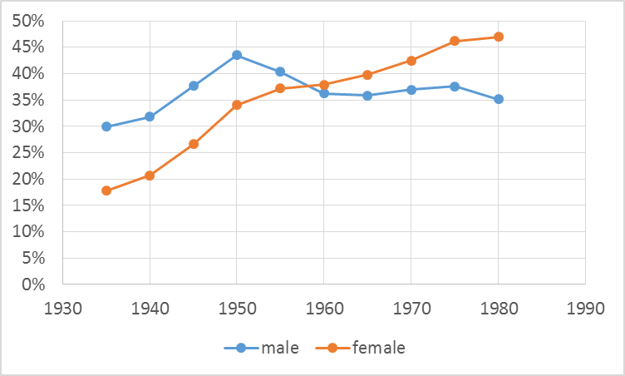
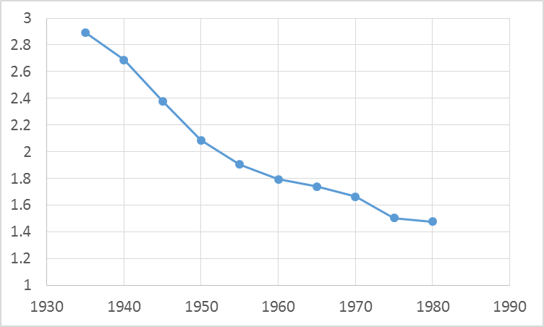
Reversed education gender gap and maintained wage gender gap in the U.S.
BA (or +) owners
Male to female wage income ratio
Birth cohort
Birth cohort
Source : IPUMS-CPS 1985-2010

Slide 49
Two relevant processes
See Paper Online
Educational expansion
  Educational expansion equipped women with better degrees and should eradicate the “legitimate” reason for the gender gap
  Occupation, work experience and industry are more relevant than education to explain the US gender wage gap (Blau and Kahn 2016)
  H1: The role of education in explaining the gender gap is and has been limited.
(2) Labour market transformation
  Disappearance of relatively well-paid, typically male occupied jobs in manufacturing → strongest equalization among lowest educated in the US
  US wage gap is wider at the top (Blau and Kahn 2016); female glass ceiling (Christofides et al 2013)
  H2: The trends in the gender wage gap differ between low and highly educated.
Notes:
Education seems necessary but not sufficient condition for narrowing gender gap
Given the gender segregation in occupations, also changes in the labour market structure impact on the gender gap

Slide 50
Gender gaps across space and time
See Paper Online
Countries differ considerably in the gender wage gap (Harkness 2010; England, Gornick & Shafer 2012; Mandel 2012; Christofides et al. 2013)
  Not consistent with existing welfare state typologies (Mandel 2012)
Prevalence of cohort effect while most studies do not distinguish period and cohort effects
  Cohort effects (changes among young cohorts leaving education or entering the labour force) in education and labour market rather than period effects (effecting all age groups similarly)
    Clear example: Educational attainment – changes across cohorts but is relatively stable across age
    Campbell and Pearlman (2013) showing that US exhibits strong cohort effects in the gender wage gap
  Cohort studies can help understanding why and when women, based on their educational attainment relative to men, caught up in terms of wages in some countries, but not in others
Notes:
When cohorts are excluded, period effects are not accurately measured
Existing cohort studies: Limited number of cohorts, countries; log hourly wages

Slide 51
Data and variables
Luxembourg Income Study (LIS)
  Germany (DE), Denmark (DK), Spain (ES), Finland (FI), France (FR), Israel (IL), Italy (IT), Luxembourg (LU), the Netherlands (NL), Norway (NO), the UK and the US
  Cross-sectional survey – approx. each 5th year between 1985 and 2010
  Sample: aged 25-59 years so that we can observe graduation from tertiary education and exclude elderly
Variables
  5-year birth cohorts between 1935 and 1980
  Highest level of education: non- tertiary vs tertiary education
  Wages: comprise paid employment income including basic wages, wage supplements, director wages and casually paid employment income but not self-employment income
    Standardised with logit-rank transformation as proposed by Chauvel (2016)

Slide 52
APC-GO (Gap/Oaxaca) model
Now on Stata: ssc install apcgo
  APC-GO is a APC model to provide a cohort analysis in gaps in outcomes between 2 groups after controlling for relevant explanatory variables
  e.g. (gender) gaps in income net of education effects
  or (racial) gaps in education net of State/county effects
Ingredients:
  Computation of Oaxaca decomposition in unexplained/explained gaps by A x P cell
  Estimate of APC-lag gaps with a focus on cohort
  Bootstrapping to obtain confidence intervals

Slide 53
Structure of data
See Paper Online
Lexis table / diagram:
  Age a indexed by a from 1 to A
  Period by p from 1 to P
  Cohort by c = p – a + A
  from 1 to C
Cross-sectional surveys
including one outcome y
and controls x
Condition: Large sample
with data for each cell (APC)
of the Lexis table
c = p – a + A

Slide 54
Part I: Blinder-Oaxaca decomposition in each cell apc of the Lexis Table
For each cell of the Lexis Table one Blinder Oaxaca decomposition is proceeded
So we transform the y_{apc} in each cell in an aggregate: the Oaxaca-blinder unexplained part u_{apc}
Blinder Oaxaca decomposition (Blinder 1973; Oaxaca 1973; Jann 2008):
  Y1 = X1b1 + e1 for male
  Y2 = X2b2 + e2 for female
mean outcome difference between the two groups can be decomposed as
R = x1'b1 - x2'b2
= (x1-x2)'b2 + x2'(b1-b2) + (x1-x2)'(b1-b2)
= E + [ C + CE ]
E: gap in ‘endowments’ (“explained”)
C: gap in ‘coefficients’ (“unexplained” 1 ) / CE: interaction of diff in endow & coef (“unexplained” 2)
In the twofold Oaxaca Decomposition, U = C+CE are the unexplained difference
From the initial y_{apc} we generate Oaxaca-Lexis-table of unexplained part u_{apc}
See Paper Online
e.g. Owen O’Donnell, Eddy van Doorslaer, Adam Wagstaff and Magnus Lindelow, “Analyzing Health Equity Using
Household Survey Data” The World Bank, Washington DC, 2008, www.worldbank.org/analyzinghealthequity and http://fmwww.bc.edu/RePEc/bocode/o/oaxaca8.html

Slide 55
Part II: APC-lag of the u_{apc}
See Paper Online
APC-Detrended as an identifiable solution of age, period and cohort non-linear effects (Chauvel, 2013, Chauvel and Schröder. 2014, Chauvel et al., 2016)
β₀ is the constant
is a two-dimensional linear (=hyperplane) trend
are 3 vectors of age, period and cohort fluctuations
To solve the “identification problem” (a=p-c ), a meaningful constraint is needed: trend in α_{a} = the average of the longitudinal shift observed in u_{apc}

Slide 56
Part II: APC-lag of the u_{apc}
See Paper Online
= [Σ (u(a+1, p+1, c) - uapc)] / [(A-1) (P-1)]
is the average longitudinal age effect along cohorts
(= the average difference between u_{(a+1, p+1, c)}
and its cohort lag u_{apc} across the table)
The APC-lag solution
Operator Trend for age coefficients:
α
APC-lag delivers a unique estimate of
vector γ_{c} a cohort indexed measure of gaps
Average γ_{c} is the general intensity of the gap
Trend of γ_{c} measures increases/decreases of the gap in the window of observation
Values of γ_{c} show possible non linearity
The γ_{c} can be compared between countries

Slide 57
Summary
APC-GO combines the different steps
Oaxaca of the cells of the initial Lexis table data generates an aggregated Oaxaca Lexis table of measures of gaps
unexplained by controls
APC-lag of the Oaxaca Lexis table deliver notably γ_{c} coefficients
Bootstrapping to obtain confidence intervals
→ See Stata ado file, ssc install apcgo

Slide 58
The Gender gap in Education & Wages in 12 countries

Slide 59
Educational expansion by gender
Figure 1: Attainment of tertiary education among men (blue) and women (red), over birth cohort
Source: LIS
Notes:
Men in the US and Italy: stagnation

Slide 60
Reversal of gender gap in education
Figure 2: Difference in attainment of tertiary education between men and women, over birth cohort
Male advantage
Female advantage
Notes:
TO DO:
Drop CA
Reverse *-1
DONE:
Reran with 100 reps

Slide 61
Narrowing of gender wage gap
Figure 3: Gender gap in logit-rank of wages, over birth cohort
Male advantage
Gender parity
Source: LIS

Slide 62
Gender wage gap by education
Figure 4: Gender wage gap for non-tertiary educated (red) and tertiary educated (blue), over birth cohort
Male advantage
Gender parity
Source: LIS
Notes:
= previous 2 slides in 1
TO DO
Reverse *-1
Label 2 lines
Chng CI (eg area vs black lines)

Slide 63
The unexplained gender wage gap
Figure 6: Blinder-Oaxaca decomposition including education, family and employment status :
Total wage difference (blue) and unexplained difference (green)
Source: LIS
Notes:
CONCLUSION: remaining unexplained gender wage gap is substantial
→ pointing towards other explanations

Slide 64
Convergence of the gender composition of the top Quartile
U.S.
Figure 7: percentage male population in the top quartile group Q4
Male advantage
50% ➔ Gender parity
Notes:
CONCLUSION: remaining unexplained gender wage gap is substantial
→ pointing towards other explanations

Slide 65
Convergence of the gender composition of the top Decile
U.S.
Figure 8: percentage male population in the top decile group D10
Male advantage
50% ➔ Gender parity
Notes:
CONCLUSION: remaining unexplained gender wage gap is substantial
→ pointing towards other explanations

Slide 66
Convergence of the gender composition of the top Decile
U.S.
Figure 8: percentage male population in the top ventile group V20 (top 5%)
Male advantage
50% ➔ Gender parity
Notes:
CONCLUSION: remaining unexplained gender wage gap is substantial
→ pointing towards other explanations

Slide 67
Conclusions
Gender wage gap decreased over cohorts in all the countries
  Small decreases in countries with already low gender gap: FI and US
  Large but sharply declining gender gap over cohorts in DE, ES, IT, NL and LU
  Largely due to declining in explained differences
The intrinsic role of education is limited in explaining the gender wage gap
  = large and continuing wage gaps among higher educated
A persistent unexplained part of the gap over cohorts except for UK
Slowing down in the most recent cohorts in NL, FI, FR, IL, NL, US
Future studies
  Compare the role of the different equalizing factors (educ. / labor participation / etc.)
  Gender composition of top incomes
  Compare the role of welfare regimes in the reducing gender gap
Notes:
But: no info on field of study of specific diploma (nurse vs. doctor)
And we look at overall wage levels – not at hourly wages: women remain contributing significantly less wage to the household income relative to men

Slide 68
Thanks!

Slide 69
Annex: My problem with Gini
2 completely different distributions can give the same Gini Index
2 distributions, same mean, with the same Gini of .30
D1: GB2(5.13;1;1;.5)
Poverty = .041 Richness = .097
D2: GB2(5.13;1;1;1.5)
Poverty = .115 Richness = .0986
We can show that
➔ A lower Gini
can go with higher
relative poverty rates
Notes:
CONCLUSION: remaining unexplained gender wage gap is substantial
→ pointing towards other explanations

Slide 70
Annex: My problem with Gini
2 completely different distributions can give the same Gini Index
Solution: the Isograph [ STATA ssc install isograph ]
D2 = GB2(2.81;1;1;1.5)
Poverty = .115 Richness = .0986
Y = ISO
(intensity of inequality)
D1 = GB2(5.13;1;1;.5)
Poverty = .041 Richness = .097
X = Logitrank
(fractile on the distribution)
Bottom 1%
Top 5%
Top 1%
Median
Notes:
CONCLUSION: remaining unexplained gender wage gap is substantial
→ pointing towards other explanations

Slide 71
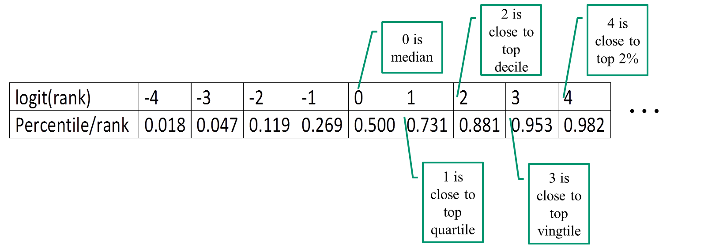
ISOGRAPH
Chauvel, L. (2016). The intensity and shape of inequality: the ABG method of distributional analysis. Review of Income and Wealth, 62(1), 52–68.
X is the logit of the rank of socioeconomic order (income quantiles, education, etc.)
Y is the log medianized income (divided by the median income)
ISO=Y/X is a measure of Level-specific inequalities
If ISO=α (constant) ➔ Champernowne-Fisk (double Pareto) distribution
with α = Gini (Dagum, 1977)
reading the ISOGRAPH (see examples in next slides)
  Each point represent ISO at the X (specific-level inequality)
  Differences in inequality between levels indicate variation in inequality levels

Slide 72
ISOGRAPH
We speak sometimes of “meta-Gini” for ISO since it is a “local” measure of the Gini index at a specific level of the distribution
The higher ISO, the higher the inequality at this specific level (=stronger stretch of the distribution)
X = Logit rank of disposable Income [aggregated in 9 categories c_{i}={-3 to 3}]
We compare 3 shapes of distributions:
  ISO₃ pertains to equivalized disposable income = “level of living”
  ➔ Y₃ = (Log medianized disposable income) ➔ ISO₃ = Y₃ / X
  ISO₁ pertains to income before taxes and transfers (“initial income” = labor + capital)
  ➔ ISO₁ = (Log medianized initial income by c_{i} group)) / X ;
  ISO₂ pertains to the difference (“effort”) ➔ ISO₂ = ISO₁ – ISO₃

Slide 73
ISO₃ pertains to equivalized disposable income = “level of living”

