Slide 1


inequality across birth cohorts
Linking social generations
and welfare regime dynamics
Louis Chauvel
Pr Dr at University of Luxembourg
louis.chauvel@uni.lu
http://www.louischauvel.org
CUNY-LIS June 2015
IRSEI
Institute for Research
on Socio-Economic
Inequality

Slide 2



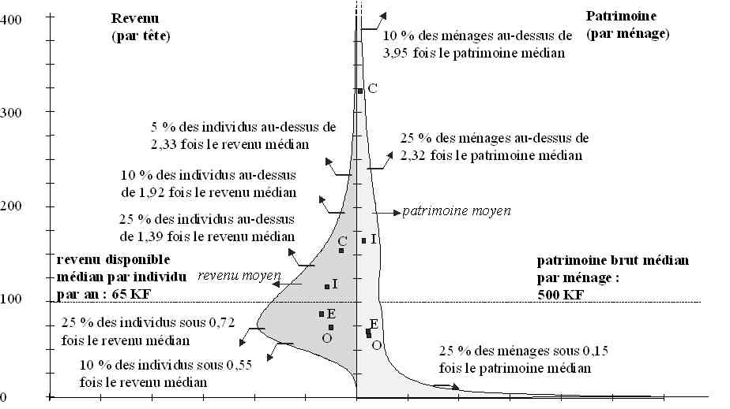



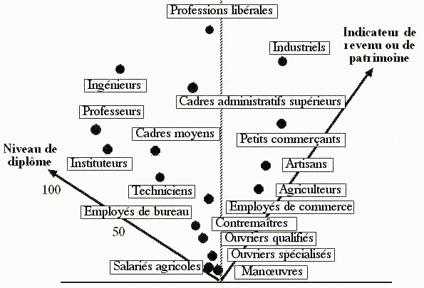
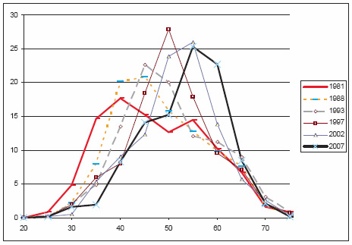


路易•肖韦尔
社会学教授
法国大学研究院成员
欧洲社会学协会秘书长

Slide 3


English Abstract in
Chauvel L. 2010,
The Long-Term Destabilization of Youth, Scarring Effects,
and the Future of the Welfare Regime in Post-Trente Glorieuses France
French Politics Culture & Society 11/2010; 28(3):74-96.
路易•肖韦尔
New edition
19 août 2014
社会学教授
法国大学研究院成员
欧洲社会学协会秘书长
http://www.louischauvel.org/frenchpolcultsoc.pdf

Slide 4
4 PARTS (very ambitious ….)
1- Cohort inequalities in France
2- Welfare regimes and international comparisons with the LIS
3- Intermezzo: a new method for inequality analysis
4- Application to the “overeducation” problem
Notes:
Louis

Slide 5
inequality across birth cohorts
PART 1:
As happy as a young person in France?
Louis Chauvel
Pr Dr at University of Luxembourg
louis.chauvel@uni.lu
http://www.louischauvel.org
CUNY-LIS June 2015
IRSEI
Institute for Research
on Socio-Economic
Inequality

Slide 6


Generation Limbo: Waiting It Out - New York Times
www.nytimes.com/.../recent-college-graduates-wait-for-their-real-car...
Aug 31, 2011 – The Limbo Generation, college graduates who entered the job market after the economic downturn, take dead-end jobs while waiting to start ...

Slide 7


A Japanese version of the debate :
Yamada Masahiro 山田昌弘
(東京学芸大学 教授)
parasite single
(パラサイトシングル parasaito shinguru)
Freeter (フリーター furita)
Hikikomori (引きこもり)
Genda Yuji 玄田有史
(東京大学教授)
NEET (Not in Employment, Education or Trainingニート）
« The Endless Ice Age » => www.louischauvel.org/gendayuji.pdf

Slide 8




  1. From theory to datacrunching:
  Social generations and cohort analysis
  Theory of social generations (Karl Mannheim)
  1968 gap of generations (Margaret Mead)
  Cohort and social change (Norman Ryder)
  The methodology of APC analysis (Yang Yang)
  Examples:
  * suicide in France
  * consumption in China
  * political participation
  * etc. , etc. , etc.
Karl Mannheim
1893-1947
Margaret Mead
1901-1978
Norman Ryder
1923-2010
Yang Yang
1970?-
www.louischauvel.org/ryder2090964.pdf

Slide 9

  Important references
  www.louischauvel.org/TheMannheim.pdf
  www.louischauvel.org/TheMead.pdf
  www.louischauvel.org/TheRyder.pdf
  http://davidcard.berkeley.edu/papers/vietnam-war-college.pdf
  www.louischauvel.org/TheYANGASR2008.pdf
http://www.louischauvel.org/frenchpolcultsoc.pdf
Margaret Mead
1901-1978

Slide 10
Socialization versus individual and collective history
    Life course and socialization
    Primary and secondary socialization
    The « transitionnal socialization »
    Long term impact of the « transitionnal socialization » :
    « scar effect »
    History and the constitution of a Generationengeist (spirit of generations) and of a Generationenlage (situation of generation)
Primary socialization Until end of compulsory secondary education (?) | Transitionnal socialization | Secondary socialization « adulthood »
16-18 y.o.
      25-30 y.o.

Slide 11
Material-objective or political-cultural generations?... Or all of that
    Karl Mannheim
    The impact of new social contexts on the young:
    «Mental data are of sociological importance not only because of their actual content, but also because they cause the individuals sharing them to form one group—they have a socializing effect». (…dass sie die Einzelnen zur Gruppe verbinden, „sozialisierend“ wirken )
    (K. Mannheim, Das Problem der Generationen, 1928)
    QUESTION 1
    From cohort to generations ? How generational cristallization ?
    QUESTION 2
    Does the national/Welfare regime context of entry into adulthood has a durable effect on future life chances of generations ?

Slide 12
General question of research on cohort inequalities:
Economic crises and the social integration of new cohorts.
Scarring effects of youth unemployment (Ellwood 1982 / Gangl 2004).
Permanence or resilience of initial trauma and Cumulative advantage/disadvantage (R. Merton 1968, Th. DiPrete 2006)
Or compensation, resilience (Luthar & al. 2000, Bonanno 2004)
Do states differ in how well they could integrate new cohorts or do we see more pronounced insider-outsider dynamics in some countries?
Are some generations sacrificed or do cohorts with a bad start catch up?
Goerres and Vanhuysse (2012: 1)
‘developing an integrated body of knowledge to answer the question of which generations get what, when and how.’
Notes:
Louis

Slide 13
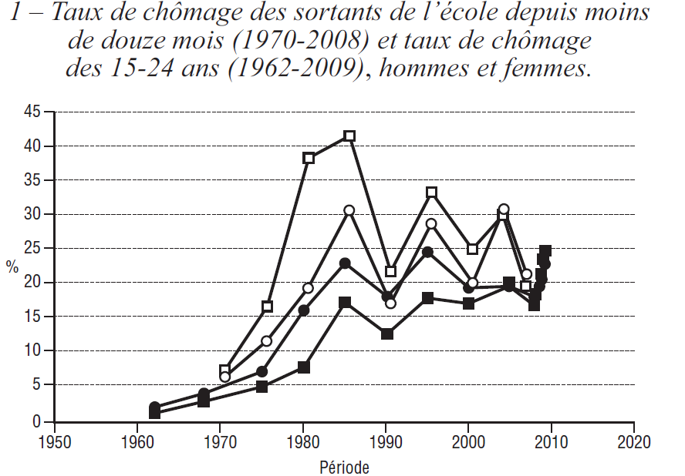

2a. FACTS : Example The French crash test
QUESTION :
are there long term consequences of collective difficulties when entering labor market ?
Unemployment rate for the male and female
Less than 25 year old,
and for those who left school less than 12 month ago
Risks of unemployment
12 months after living school (%)

Slide 14
Young generations as victims of social change
France as a crash test
Multidimensional generational fractures in France
Relative(?) socio-economic decline
Overeducation and educational déclassés
Risks of downward mobility
Dyssocialisation
Recomposition of risks of suicide
Out of the political arena

Slide 15
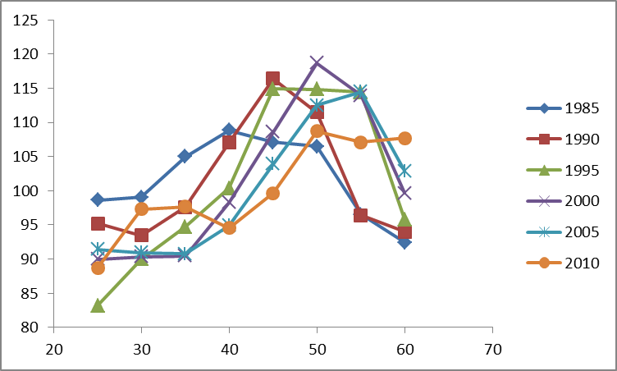
a. Relative(?) socio-economic decline
France
Lis 1985-2010
Level of living (=disposable income per CU)
by age group (100= year avarage)
year
age

Slide 16
a. Relative(?) socio-economic decline
France
Lis 1985-2005
Silc 2010
Log level of living (=disposable income per CU)
by age group (0= year avarage)
2010
1985
age

Slide 17
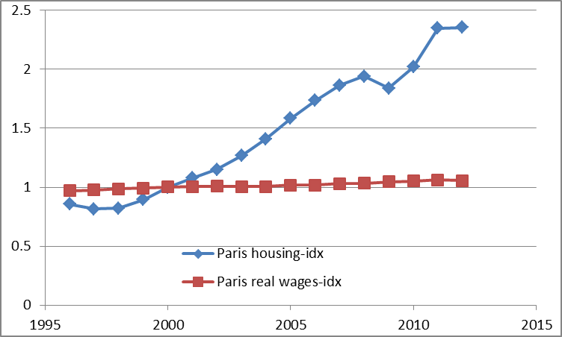
a. Relative(?) socio-economic decline
Wage growth and housing index in Paris
(real terms) (100 = 2000) 1996-2012
Housing index
Wages
Année
Source : Insee, Notaires d'Île de France - Base BIEN

Slide 18
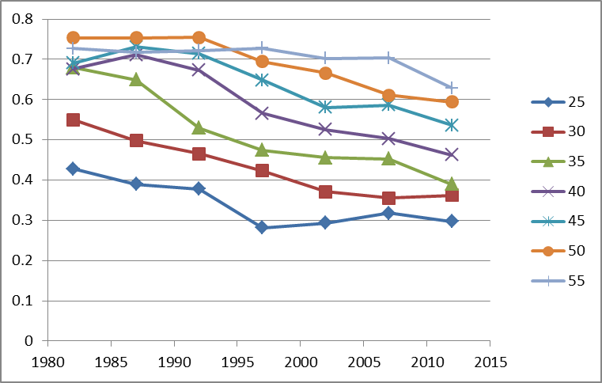
b. Overeducation and educational déclassés
Educational inflation
% of GED (‘bac’) (no more no less)
holders accessing middle class jobs (service cl h+l) 1970-2005
Age
Year
French labor force surveys 1970-2005
N= 608,837

Slide 19
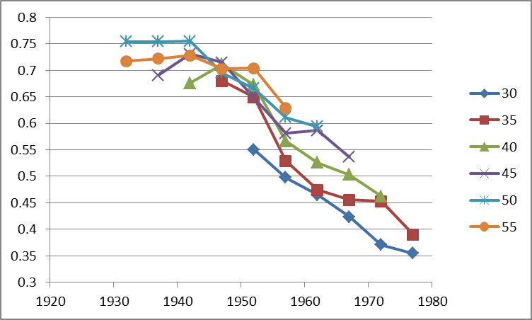
b. Overeducation and educational déclassés
Educational inflation
% of GED (‘bac’) (no more no less)
holders accessing middle class jobs (service cl h+l) 1970-2005
Age
Birth cohort
French labor force surveys 1970-2005
N= 608,837

Slide 20
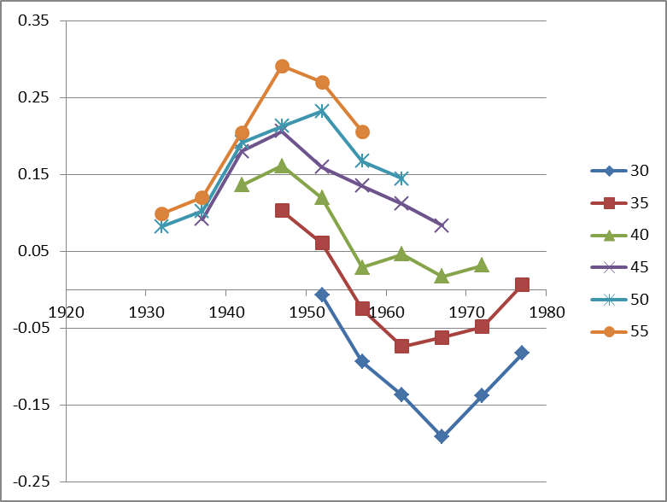
c. Increase in downward mobility (kid’s prestige minus father’s)
Lucky babyboomers
(born in 1948)
Age group
Birth cohort
Unlucky post-babyboomers
(born in 1968)
Recovery???
French labor force surveys 1982-2010, male pop
N= 302,786

Slide 21
d. Risk of dyssocialization
An Anomized generation (neo-Merton graph)
The aspirations / social opportunities of satisfaction contradictions
Aspirations
Anomie
Coh 1965
Coh 1955
Cohort
b 1975
Coh 1945
Regulation
?
Coh 1935
Coh 1925
Social opportunities
of satisfaction
Cohort b 1915

Slide 22
e. Recomposition of risks of suicide
Cohort born
in 1960
Source : WHO mortality data .
1985
Log[rsuicide(age)/rsuicide(total)]
2005
Cohort born
in 1945
Age

Slide 23
f. Out of politics
Desequilibrium in political representation
Age distribution of French Députés (National Parliament) 1981-to-2007
Source : Trombinoscopes de l’Assemblée Nationale.

Slide 24
First conclusions:
“As happy as God in France?”
(Hypothesis might be true(?) But avoid generalization to the young plz.)
Interpreting the French case:
    Esping-Andersen Typology of Welfare states:
    France = “corporatist-conservative” welfare regime, stabilization of social relations
    Protection of insiders (protected male workers) against outsiders
    In case of economic brake :
    « Insiderisation » of insiders, already in the stable labor force
    and « outsiderisation » of new entrants
    In France, young people can wait … decades
    Job seeking = Musical chairs game
    Increasing poverty rates for young people, stable intracohort inequalities
    (after taxes and welfare reallocations)
Strong problem of social welfare sustainability:
Those who pay might experience the collapse of this regime…
Notes:
Louis

Slide 25
inequality across birth cohorts
PART 2:
Comparing cohort inequalities
Louis Chauvel
Pr Dr at University of Luxembourg
louis.chauvel@uni.lu
http://www.louischauvel.org
CUNY-LIS June 2015
IRSEI
Institute for Research
on Socio-Economic
Inequality

Slide 26


  0- Backgrounds …
A 17 countries comparison of inter-cohort inequalities

Slide 27
  Cohort analysis and socioeconomic inequalities
Presentation
The context of cohort / generation issues
Question
Theory
Facts1 : The French Case
Data / Method : The APC model
Facts2 : Comparative results on intercohort inequalities
Facts3 : Developments: the dynamics of intracohort Ginis
Louis Chauvel and Martin Schröder
“Generational Inequalities and Welfare Regimes”
Social Forces (2014) 92 (4): 1259-1283
Inter cohort inequalities => APCD

Slide 28
Interpreting the French case:
    Esping-Andersen Typology of Welfare states:
    France = “corporatist-conservative” welfare regime, stabilization of social relations
    Protection of insiders (protected male workers) against outsiders
    In case of economic brake :
    « Insiderisation » of insiders, already in the stable labor force
    and « outsiderisation » of new entrants
    In France, young people can wait … decades
    Increasing poverty rates for young people, stable intracohort inequalities
    (after taxes and welfare reallocations)

Slide 29


  Theories of Welfare Regimes
  Decommodification models and welfare regimes
“De-commodification occurs when a service is rendered as a matter of right, and when a person can maintain a livelihood without reliance on the market” (Esping-Anderson, pp. 21-22)
Gosta Esping-Andersen (Danish, born 1947)
Professor @ Universitat Pompeu Fabra (Barcelona).

Slide 30


  Central references
  Pierson Ch. and Castles F.G. (eds) 2006,
  The Welfare State Reader, 2nd ed, Cambridge: Polity Press.
Pierson C., Obinger H., Lewis J., Leibfried S., Castles F.G. (Eds), 2010,
The Oxford Handbook of the Welfare State, Oxford ; Ox Univ Pr.

Slide 31
 | Liberal (=Residual) Theoretical equality of opportunity | Corporatist (=Conservative) Maintaining social order | Social-demo. (=Universalistic) decommodification defamilialistion destartification
Degree / Model of decommodification | Free Market as the central institution | Intermediate level of decommo-dification | Collective social consumption promoted
System of social stratification | Protection of the (good) poor, but stigmatization of “free riders”: Strong economic inequalities but more permeable boundaries between social classes | Solidarity between equals: Intermediate degree of inequality but social boundaries strongly impermeable | Economic, gender, inequality is minimal and strong “fluidity” (net mobility, equality of opportunities & outcomes) between classes
Typical countries | US UK | Germany (France) | Sweden

Slide 32
3b. Three (+1) modalities Esping-Andersen Typology of Welfare states :
    Conservative model (Continental Europe) : FRANCE
    Preservation of (old) social balance, with social insurance excluding unemployed => strong intercohort inequalities and less intracohort inequalities than in the Liberal model
    <Familialistic Model (Mediterranean Europe) : ITALY>
    <Conservative + family and local and clientelistic solidarities>
    Liberal model : (Anglo-saxon world) : US
    Market as a central institution, residual welfare state against market failures
    HL0 : more intracohort inequalities
    HL1 : less intercohort inequality (competition between generations)
    « Social-democrat » Model (Nordic Europe) : DENMARK
    Citizenship and broad participation to discussions and bargaining around social reforms between social groups (gender, generations, etc.) for a long-term development
    HD0 : less intracohort inequalities
    HD1 : residual intercohort inequalities (positive compromise between generations)

Slide 33
3. Methodology I : the base ➔ A = P – C
BUT ! How to distinguish durable scarring effects and fads ???
Hysteresis = stability versus Resilience = resorption of scars

Slide 34
Statistical background: Age Period Cohort models
Separate the effects of age, period of measurement and cohort.
Problematic colinearity:
cohort (date of birth) = period (date of measurement) - age
(Ryder 1965, Mason et al. 1973, Mason / Fienberg 1985, Mason / Smith 1985,
Yang Yang et al. 2006 2008, Smith 2008, Pampel 2012)
Notes:
Louis

Slide 35

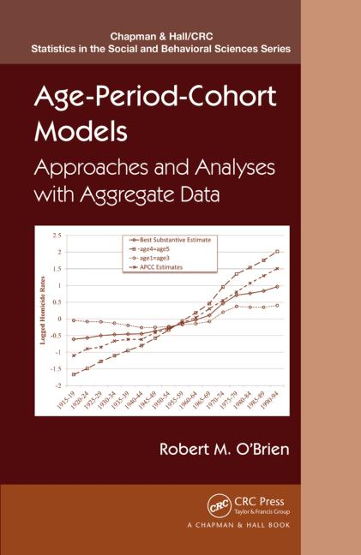
APC literature
Yang, Y. and Land, K.C. (2008). Age–period–cohort analysis of repeated cross-section surveys. Fixed or random effects? Sociological Methods & Research 36(3):297–326.
Smith, H.L. (2008). “Advances in Age-Period-Cohort Analysis.” Sociological Methods & Research 36-3:287-96.
Yang Y., Schulhofer-Wohl, S., Fu, W. and Land, K. (2008). “The Intrinsic Estimator for Age-Period-Cohort Analysis: What It is and How to Use it?” American Journal of Sociology, 113:1697-1736.
Wilson, J.A., Zozula, C. and Gove, W.R. (2011). Age, Period, Cohort and Educational Attainment: The Importance of Considering Gender. Social Science Research 40:136-49.
Pampel, F.C. and Hunter, L.M. (2012). Cohort Change, Diffusion, and Support for Environmental Spending in the United States. American journal of sociology 118(2):420-448.
Campbell Colin, Jessica Pearlman (2013), Period effects, cohort effects, and the narrowing gender wage gap, Social Science Research, Volume 42, Issue 6, p.1693–1711
Yang Y. and Land, K.C. (2013), Age-period-cohort analysis. New models, methods, and empirical applications. CRC Press, Taylor & Francis Group, Boka Raton, FL
Luo, L. (2013). Assessing Validity and Application Scope of the Intrinsic Estimator Approach to the
Age-Period-Cohort Problem. Demography 50(6):1945-67.
Chauvel, L. (2013). Spécificité et permanence des effets de cohorte: le modèle APC-D appliqué aux inégalités
de génération France U.S. Revue Francaise de Sociologie, 54(4):665-707.
Dassonneville, R. (2013). Questioning generational replacement. An age, period and cohort analysis of electoral volatility
in the Netherlands, 1971–2010. Electoral Studies 32(1):37-47
Grasso, M.T. (2014). Age, Period and Cohort Analysis in a Comparative Context: Political Generations and Political
Participation Repertoires in Western Europe. Electoral Studies, 33:63–76.
Chancel L. (2014). Are Younger Generations Higher Carbon Emitters than their Elders?: Inequalities, Generations and
CO2 Emissions in France and in the USA. Ecological Economics, 100:195–207.
Chauvel, L. and Schröder M., (2014). Generational inequalities and welfare regimes. Social forces 92 (4):1259-1283.
Chauvel, L. and Smits F.. (accepted sept 2014). The endless baby-boomer generation: Cohort differences in participation
in political discussions in nine European countries in the period 1976-2008. In: European Societies
Etc. etc.

Slide 36
Our method A: APCD
APCD (detrended): are some cohorts above or below a linear trend of long-run economic growth? Basically, the APCD is a ‘bump detector’.
ssc install apcd
=> available ado file
PLZ see more on www.louischauvel.org/apcdex.htm
Notes:
Louis

Slide 37
4. Data
Dependent variable
We want to explain the living standards of members of different cohorts:
Variable “dpi” (disposable income) from the Luxembourg Income Study.
Logged and divided by the square root of household members and adjusted for inflation: reflects household-equalized real disposable income after taxes and transfers.
Independent variables
Cohort-membership of respondent (date of birth).
Plus controls for: age, period of measurement,
education (ISCED code), sex, partner in household, # of children, immigrant-status.
Main interest
How much does the mere date of birth (cohort membership) influence living standards?
Notes:
Martin

Slide 38
clear all
ssc install apcd
set linesize 100
gen d3=.
foreach gogo in fr it no us {
qui {
if "`gogo'"== "fr" local fifi " fr84 fr89 fr94 fr00 fr05 fr10"
if "`gogo'"== "it" local fifi " it86 it91 it95 it00 it04 it10"
if "`gogo'"== "no" local fifi "no86 no91 no95 no00 no04 no10"
if "`gogo'"== "us" local fifi "us86 us91 us94 us00 us04 us10"
foreach toto in `fifi' {
local perso "$`toto'p"
local house "$`toto'h"
qui use hid ppopwgt age sex relation educ nchildren immigr educ_c pi deflat partner pmi ptime using `perso' , clear
qui joinby hid using `house'
keep hid ppopwgt age sex relation educ pi deflat year iso2 hpopwgt dpi ///
deflator nchildren immigr educ_c hmi hmx* npers partner pmi ptime
local save "t`toto'"
qui save `save' , replace
}
clear all
foreach toto in `fifi' {
local save "t`toto'"
qui append using `save'
}
qui recode year (1977/1982=1980) (1983/1987=1985) (1988/1992=1990) (1993/1997=1995) (1998/2002=2000) (2003/2008=2005)
qui gen age5=int((age-3)/5)*5+3
qui gen pweight = int(ppop)
qui keep if age >= 20 & age < 65
gen page=floor(age/5)*5
keep if (page >= 25 & page <= 64)
gen year5=year
replace year =int((year-1980)/5)
gen educ2=int(educ)
}
di "`gogo'"
gen ldpi=ln(dpi/sqrt(npers))
keep if age5>=25 & age5<60
xi: apcd ldpi [pw= pweight] if year5>=1985 & age5>=25 & age5<60 , age(page) period(year5)
}

Slide 39
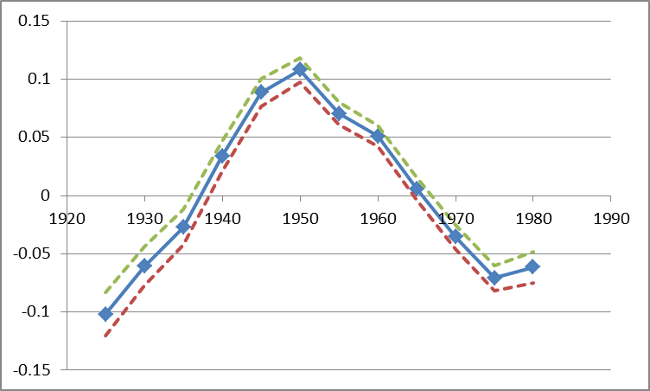
France : APCD (detrended) cohort coefficient of disposable per uc income
cohorts
Notes:
Martin
These figures show: how much different cohorts (people with different dates of birth) are below or above the long-run trend of economic growth, before and after controls are introduced.
Germany: Fortunate cohorts can have a living standards around 8 percent above of what one would expect when every cohort‘s income would have been proportionate with general trends of economic growth. But much of this is due to their better education etc. After this is controlled, only the cohorts born around 1945/50 are about 5 percent above the trend.
France: Fortunate cohort‘s living standard about 10 percent above the trend, unfortunate ones almost 10 percent below it. Even worse after controls are introduced (right side).
US: cohort‘s living standard does not diverge very much from the trend.
But how does this compare when set in relation to overall increases in living standards? APCT

Slide 40
APCD (detrended) cohort coefficient of disposable per uc income, w controls
ca de dk es
fi fr il it
nl no uk us
Notes:
Martin
These figures show: how much different cohorts (people with different dates of birth) are below or above the long-run trend of economic growth, before and after controls are introduced.
Germany: Fortunate cohorts can have a living standards around 8 percent above of what one would expect when every cohort‘s income would have been proportionate with general trends of economic growth. But much of this is due to their better education etc. After this is controlled, only the cohorts born around 1945/50 are about 5 percent above the trend.
France: Fortunate cohort‘s living standard about 10 percent above the trend, unfortunate ones almost 10 percent below it. Even worse after controls are introduced (right side).
US: cohort‘s living standard does not diverge very much from the trend.
But how does this compare when set in relation to overall increases in living standards? APCT

Slide 41
APCT (trended) cohort coefficient of Gini indexes
ca de dk es
fi fr il it
nl no uk us
Notes:
Martin
These figures show: how much different cohorts (people with different dates of birth) are below or above the long-run trend of economic growth, before and after controls are introduced.
Germany: Fortunate cohorts can have a living standards around 8 percent above of what one would expect when every cohort‘s income would have been proportionate with general trends of economic growth. But much of this is due to their better education etc. After this is controlled, only the cohorts born around 1945/50 are about 5 percent above the trend.
France: Fortunate cohort‘s living standard about 10 percent above the trend, unfortunate ones almost 10 percent below it. Even worse after controls are introduced (right side).
US: cohort‘s living standard does not diverge very much from the trend.
But how does this compare when set in relation to overall increases in living standards? APCT

Slide 42
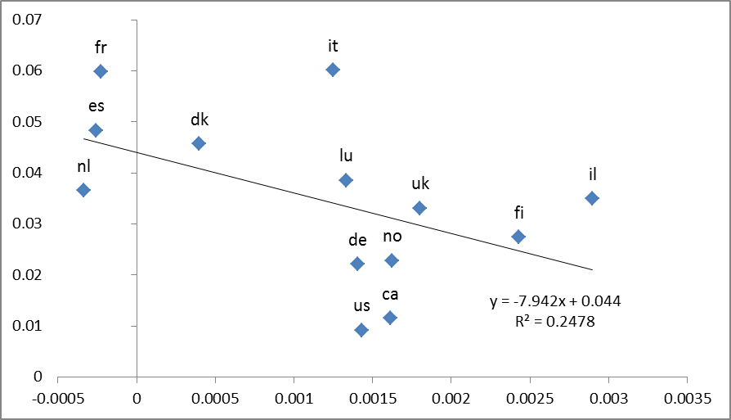
Intercohort inequality (after controls) and intracohort inequality dynamics
Intercohort inequality (non flat cohort profile)
intracohort inequality dynamics
(cohort growth of Gini index)
Notes:
Martin
These figures show: how much different cohorts (people with different dates of birth) are below or above the long-run trend of economic growth, before and after controls are introduced.
Germany: Fortunate cohorts can have a living standards around 8 percent above of what one would expect when every cohort‘s income would have been proportionate with general trends of economic growth. But much of this is due to their better education etc. After this is controlled, only the cohorts born around 1945/50 are about 5 percent above the trend.
France: Fortunate cohort‘s living standard about 10 percent above the trend, unfortunate ones almost 10 percent below it. Even worse after controls are introduced (right side).
US: cohort‘s living standard does not diverge very much from the trend.
But how does this compare when set in relation to overall increases in living standards? APCT

Slide 43
Conclusion
France is a very problematic case of young cohort economic slowdown
Italy, Spain, share very similar problems
=> there, the young get worse and the new seniors get relatively better
Reason: In conservative welfare state, the protection of insiders (the old) against outsiders (the young) produces strong difficulties in case of eco slow down, and then massive scarring effects
Notes:
Louis
Controlling for education, household composition, immigration status etc, we find that French cohorts born very early or late or strongly disadvantaged.
Unsurprising for pre-1930 cohorts in France: E.g. entering the working market in 1940 is not a great moment to enter the working market. But more disquieting is our finding about cohorts that have been born recently.

Slide 44
Notes:
Martin
These figures show: how much different cohorts (people with different dates of birth) are below or above the long-run trend of economic growth, before and after controls are introduced.
Germany: Fortunate cohorts can have a living standards around 8 percent above of what one would expect when every cohort‘s income would have been proportionate with general trends of economic growth. But much of this is due to their better education etc. After this is controlled, only the cohorts born around 1945/50 are about 5 percent above the trend.
France: Fortunate cohort‘s living standard about 10 percent above the trend, unfortunate ones almost 10 percent below it. Even worse after controls are introduced (right side).
US: cohort‘s living standard does not diverge very much from the trend.
But how does this compare when set in relation to overall increases in living standards? APCT

Slide 45
APCD (detrended) cohort coefficient
R = 0.4660
R = 0.8459 in it+es+de+fr
Investment variation (%) when the cohort is 20 yo
Notes:
Martin
These figures show: how much different cohorts (people with different dates of birth) are below or above the long-run trend of economic growth, before and after controls are introduced.
Germany: Fortunate cohorts can have a living standards around 8 percent above of what one would expect when every cohort‘s income would have been proportionate with general trends of economic growth. But much of this is due to their better education etc. After this is controlled, only the cohorts born around 1945/50 are about 5 percent above the trend.
France: Fortunate cohort‘s living standard about 10 percent above the trend, unfortunate ones almost 10 percent below it. Even worse after controls are introduced (right side).
US: cohort‘s living standard does not diverge very much from the trend.
But how does this compare when set in relation to overall increases in living standards? APCT

Slide 46
inequality across birth cohorts
PART 3: (INTERMEZZO)
Logitrank = a new method
to compare inequalities
Louis Chauvel
Pr Dr at University of Luxembourg
louis.chauvel@uni.lu
http://www.louischauvel.org
CUNY-LIS June 2015
IRSEI
Institute for Research
on Socio-Economic
Inequality

Slide 47
The Intensity and Shape of Inequality
The alpha-beta-gamma method
for the analysis of economic inequality
a 232 samples comparison
http://orbilu.uni.lu/handle/10993/18773

Slide 48
My aims
0. Vilfredo Pareto’s Legacy
New developments on old graphs (Champernowne/Fisk’s logit-log graph)
Methodology :
The isograph
Curvatures on the CF Graph
α β γ
Data : 232 LIS datasets
Analysis and comparisons with other indicators
Sub products
a. => the strobiloid
b. => volatility analysis
c. => etc.

Slide 49

0. Vilfredo Pareto’s Legacy
1896
Vilfredo Pareto
1848-1922
Pervasive and almost everywhere …
Aaron Clauset, Cosma Rohilla Shalizi, and M. E. J. Newman 2009
Power-Law Distributions in Empirical Data , SIAM Rev., 51(4), 661–703. (43 pages) Society for Industrial and Applied Mathematics

Slide 50
  1- From Pareto log-log to Pen’s Parade, and to logit-log
Luxembourg : Histogram of
Equivalised disposable
income 2011 euros EU-Silc
2011 current euros

Slide 51
  1- From Pareto log-log to Pen’s Parade, and to logit-log
Y % gain less or equal to …
X euros
Y
Luxembourg : Cumulative
distribution function CDF of
Equivalised disposable
income 2011 euros EU-Silc
X
2011 current euros

Slide 52

  1- From Pareto log-log to Pen’s Parade, and to logit-log
Y % gain less or equal to …
X euros
Y
Pen’s Parade
Luxembourg : Cumulative
distribution function CDF of
Equivalised disposable
income 2011 euros EU-Silc
X
2011 current euros

Slide 53
  1- From Pareto log-log to Pen’s Parade, and to logit-log
Ln(1-Y)
= ln(proportion richer)
Luxembourg :
Pareto log-log graph
N = A / x^{α}
x=Ln(2011 current euros)

Slide 54
  1- From Pareto log-log to Pen’s Parade, and to logit-log
Ln(1-Y)
= ln(proportion richer)
Pareto α
= - slope
≈ 3.7
Luxembourg :
Pareto log-log graph
N = A / x^{α}
x=Ln(2011 current euros)

Slide 55
  Consider
  log(M) where M is the “medianized” eq income
  log (p / (1- p) ) where p is the “fractional rank” ( 0 < p < 1)
  We graph ln(M) by logit(p) => almost a straight line
  1- From Pareto log-log to Pen’s Parade, and to logit-log
Luxembourg :
Logit-log graph
euros EU-Silc
Ln(M medianized income)
Logit (p)

Slide 56
  Consider
  log(M) where M is the “medianized” eq income
  log (fr / (1- fr) ) where fr is the “fractional rank” ( 0 < fr < 1)
  We graph ln(M) by logit(fr) => almost a straight line
  1- From Pareto log-log to Pen’s Parade, and to logit-log
Luxembourg :
Logit-log graph
euros EU-Silc
Ln(medianized income)
If this is a perfect
straight line
α = Gini index
(Dagum 1975)
Slope
α ≈ 0.28
Logit (fractional rank)

Slide 57
  We express the rank of an individual as a proportion p € [0,1] of the cumulative population below her/him on the scale of resource (earning, income, wealth <randomization of ex-eaquo>
  Logitrank = ln( p / (1-p) )
  It is not totally new ex : John Copas, The Effectiveness of Risk Scores: The Logit Rank Plot Journal of the Royal Statistical Society. Series C (Applied Statistics), Vol. 48, No. 2 (1999), pp. 165-183
  Generalization of log Tam’s “Positional Status Index (PSI)” (Rotman, Shavit, Shalev 2014; rank measure of social origins)
inflation neutral, inequality shape neutral,
A convenient way to consider quantiles
Allows bottom and top quantile details
Can be applied to any ordinal variable
A way to standardize variables in comparative inequality contexts
When computed by (country/year), it provides a baseline for national comparisons (any country has its own bottom 5% or top 1%)
implemented in Stata: abg.ado (Chauvel 2014)

Slide 58
(Logit rank) What’s that?
It is not totally new ex : John Copas, The Effectiveness of Risk Scores: The Logit Rank Plot Journal of the Royal Statistical Society. Series C (Applied Statistics), Vol. 48, No. 2 (1999), pp. 165-183
(it looks like the Positional status index, PSI, of Tony Tam)
We express the rank of an individual as a proportion p € [0,1] of the cumulative population below her/him on the scale of resource (earning, income, wealth)
<randomization of ex-eaquo>
Logitrank = ln( p / (1-p) )
We know that (for median adjusted income)
ln(medincome) ≈ α Logitrank where α is the Gini coeff of income
(Champernowne 1937 Fisk 1961 Kleiber & Kotz 2003)
Properties: inflation neutral, inequality shape neutral,
  3- Methodology-b Logit rank (=logistic quantile)

Slide 59
  Logit-rank transformation is a convenient tool to transform ordinal variables in
  ]–infinite ; + infinite[ standardized distribution
  In the context of distributional analysis, it provides a “net of distributional change” relative reference position of individuals and of groups
  It is more convenient than percentiles levels [between 0 and 1] that present border issues
  Useful in income volatility analysis and in contexts where “positional” aspects are central
  Logit-Rank & Applications
2 is close to top decile
4 is close to top 2%
0 is median
…
1 is close to top quartile
3 is close to top vingtile

Slide 60
  2- Curvatures on the CF Graph
slopes, curvatures and alpha-beta-gamma
β>0
Y=Ln (medinc)
(1)
The stronger the slope,
The higher local inequality
(2)
Slope=
ISO = Y/X
X=Logit(fr)
α
(4)
Higher inequality at the top β>0
(2) Lower inequality at the top β<0
(3) Higher inequality at the bottom γ>0
(4) Lower inequality at the top γ<0
γ>0
(3)

Slide 61
3- Data and measurements :
    Data :
    Lis source of medianized equivalized disposable income after tax and transfers (01/10/2014)
    232 country/year samples

Slide 62
Figure 1: The Isograph in 10 contrasting cases
  4- The isograph = graphing local level inequality
ISO(X)
X=logit(quantile)

Slide 63
Figure 1: The Isograph in 10 contrasting cases
  4- The isograph = graphing local level inequality

Slide 64
  4- Analysis
a set of 12 indicators of inequality
to be compared with alpha beta gamma
a2, a1, ahalf = Atkinson class of indexes, coefficient 2, 1, ½ (Atkinson 1970)
ge2, ge1, ge0, gem1 = Generalized entropy class of indexes, coefficient 2, 1, 0, -1 (Berry et al. 1983)
gini = Gini coefficient (Gini, 1914)
r90v50 = ratio of the last decile by the median
r50v10 = ratio of the median by the first decile
r90v75 = ratio of (the last decile by the last quartile) by (the last quartile by the median)
r25v10 = ratio of (the first quartile by the first decile) by (the median by the first quartile)

Slide 65
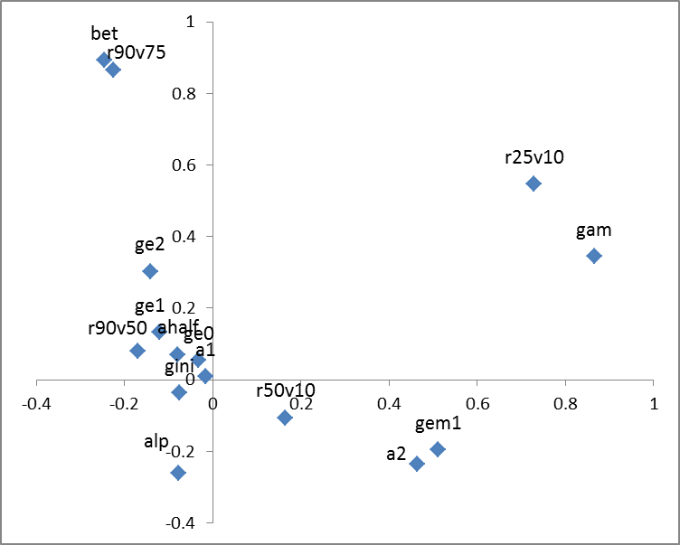
  4- Analysis
Figure 7: PCA factors of the 200x15 indicators of inequality
X = axe3 Y = axe2

Slide 66
  4- Analysis

Slide 67
  5- Subprod : The strobiloid = graphing changing shapes

Slide 68
  5- Further analyses: income volatility (PAA with AH)
Figure 9: Distribution of MEDI medianized equivalized disposable income in the U.S. x-axis logit quantile y-axis log MEDI of the year

Slide 69
inequality across birth cohorts
PART 4:
Return to education as
gradient analysis
Louis Chauvel
Pr Dr at University of Luxembourg
louis.chauvel@uni.lu
http://www.louischauvel.org
CUNY-LIS June 2015
IRSEI
Institute for Research
on Socio-Economic
Inequality

Slide 70
Our aims
Overeducation? What?
Theories and Definitions
Methodology & Datasets: LIS data 1985-2010
Results: Overeducation or youth social decline?
Discussion: infantile disorder or forever cohort scar?

Slide 71

  1- Overeducation? What?
  http://economy.money.cnn.com/2013/01/28/overeducated-and-underemployed/
  Overeducated and underemployed By Annalyn Kurtz January 28, 2013: 10:50 AM ET
“Take taxi drivers for example. About 15%, or more than 1 in 7, had at least a bachelor's degree in 2010, according to Bureau of Labor Statistics data. Compare that to 1970 when less than 1% of taxi drivers had college degrees. And the job description hasn't changed much, if at all, since then”.

Slide 72
  1- Overeducation? What? … more seriously …
3 main approaches
A. Compared to what they received yesterday,
the todays young graduates receive less (in cash or occupational social class)
Richard Freeman (1976) and college grad. taxi drivers
(see critiques of Smits and Welch (1978) = Easterlin Effect)
B. Compared to their relative social rank yesterday,
the todays young graduates occupy lower relative socioeconomic ranks
This is mechanics (sptd!): more diploma for all = less relative rewards for each
and then actors act so that inflation credentials increases (Herman Van de Werfhorst)
C. The premium (in %) to the young graduates compared to less educated juniors today is lower than yesterday BUT IT DEPENDS …
Each country has its profile, and this depends on which diploma

Slide 73
  2- Theories and Definitions
So? Three implicit definitions of overeducation
 | Relative to previous cohorts (at the same age) | Relative to the less educated
Economic outcomes Log(real-$) | If Edu. Growth > Eco. Growth Overeducation = lower wages after control by education (but “undereducation” could happen as well!...) | The gap in resources of educated juniors relative to less educated changes over time Techno. biased growth in the U.S.=> increasing inequalities and increasing returns to education (relative to those less educated). In Europe?...
Positional Ranking Logit(quantile) | Educational massification always generates overeducation Overeducation = declining relative rank after control by education Its mechanics … Exception: transitorily when the juniors take the place of the seniors.
A
C
B

Slide 74
  2- Theories and Definitions
Research quests:
1- are the young graduates poorer than yesterday ?
2- did they lose their socioeconomic rank?
3- is the distance between educated and less-educated smaller?
4- did the different nations experience parallel stories?
Additional parameters:
1- Junior / senior imbalances:
some more educated cohorts can seize the jobs of seniors (or not…)
2- Welfare state age-biased intervention:
seniority rights can be protected, affirmative action, etc.
3- Gender-specific dynamics:
Declining educational gender gaps may hide increasing economic gender gaps
4- etc.

Slide 75
  3- Methodology- logitrank based gradients
Dependent variable = lrldpi logit rank of (logged) level of living
= Relative position in the equivalised income hierarchy
The average lrldpi of a cohort (net of age effect) varies
(= Lucky and unlucky cohorts)
The slope of lrldpi by (logitranked) education depicts
the education premium
(steep slopes mean strong return to higher educational positons)
=> We can model these measures with multilevel random slopes
Intercept is cohort position and slope its return to education

Slide 76
  3- Methodology Data sources
A- LIS 1985-2010 each 5 years, 3 countries
We have detailed isced code of education(thanks Lindsay Flynn!),
hh income before/after transfers, etc.
DE FR US

Slide 77
  3- Methodology c-
LIS 1985-2010 N per country and year
Country/ye | 1985 1990 1995 2000 2005 2010 | Total
-----------+------------------------------------------------------------------+----------
de | 8,125 7,110 10,379 16,675 15,570 15,004 | 72,863
fr | 17,082 13,025 15,572 14,689 14,324 21,824 | 96,516
us | 16,629 17,219 16,426 23,669 22,735 22,830 | 119,508
-----------+------------------------------------------------------------------+----------
Total | 41,836 37,354 42,377 55,033 52,629 59,658 | 288,887

Slide 78
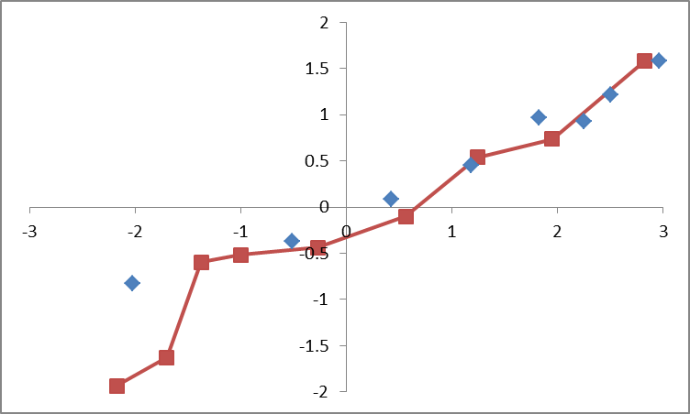
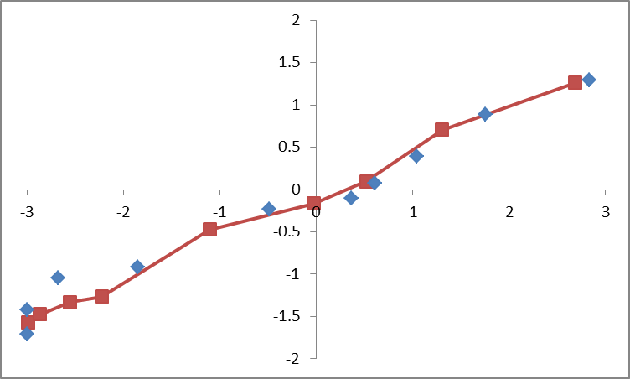
  4- Results Descriptives of the educ=>income link
FR X=lr(education) Y =lr(level of living) US
lr(level of living)
lr(level of living)
lr(education)
lr(education)

Slide 79
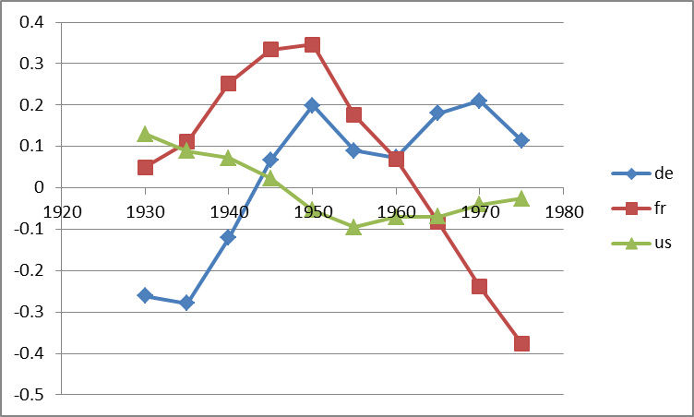
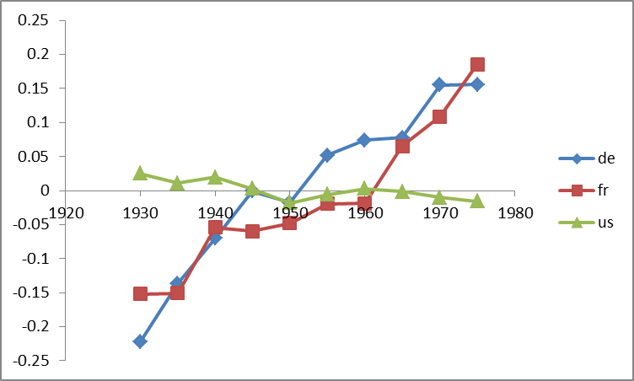
  5- Cohort change in the educ=>income link
Intercept of cohort on logitrank level of living Slope of cohort
effect on Lr(ll)
slope effect on Lr(ll)
= variation of educ premium
cohort
cohort

Slide 80
A – “Overeducation” does not express a complicated recomposition
B – The higher my diploma the higher my position
C – The higher the proportion of diploma owners,
the lower their (relative) position
D – The cohorts relative socioeconomic circumstances
can change completely the intercepts / gradients
E – France is an extreme case of social downgrading
of the young birth cohorts
F – France is not alone = Italy, Span, Greece, … who’s next?
G – LIS data provide fantastic tools for international comparison
  6- Conclusion

