Slide 1
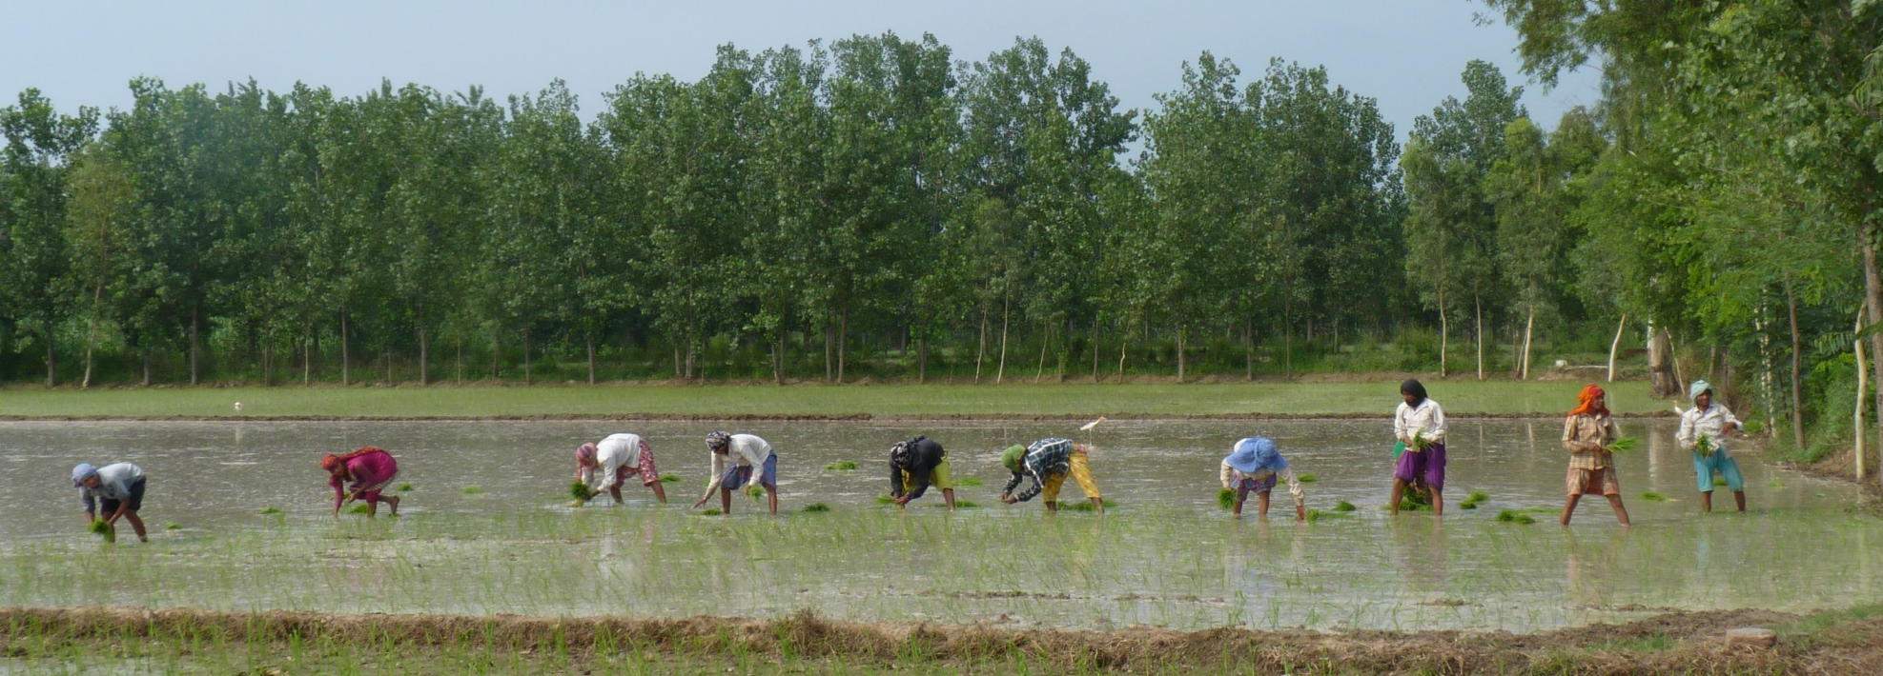
Contours of Occupational Inequality in India
Sonalde Desai, University of Maryland and National Council of Applied Economic Research

Slide 2
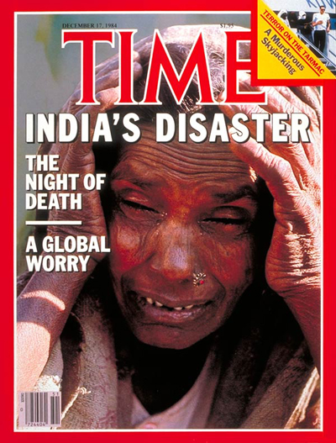

The Idea of India….
1984
2006

Slide 3
Growing middle class…
Numbers remain fuzzy … many estimates put it at 300 million but this may be too large a number (e.g. Credit Suisse puts it at about 30 million)
Regardless of the exact estimates (and frankly, this is not a game worth playing!) growing wealth of India’s upper and middle income groups has attracted tremendous attention around the globe, particularly among people who want to sell to this group
But we know little about who forms a part of this middle class and whether it is really “new”
Tremendous political economy implications whether the economic power is in the hands of farmers or educated salaried employees
  1970s – Charan Singh’s Janata Party swept in to power via support from middle peasants in a protest wave against urban bias in public policy
  2010s – Kejriwal’s Aam Aadmi Party gaining support of educated salaried workers on an anti-corruption wave

Slide 4
Changes in the composition of groups holding economic power

Slide 5
Changing occupational power structure in an era of rising inequality
Inequality in India has been rising, regardless of the data we use
Typical Indian discourse centered around government’s CPS like surveys National Sample Surveys that only collect consumption expenditure
Consumption data understate inequality
  Consumption smoothing via borrowing for the poor
  The rich do not consume all they earn
Inequality based on income data is far larger

Slide 6
Overall inequality in India has been rising
Consumption Gini from National Sample Survey
Income Gini from India Human Development Survey
Year | Gini Coeff
1983 | 0.323
1987 | 0.324
1994 | 0.316
2000(*) | 0.304
2005 | 0.344
2010 | 0.345
2012 | 0.351
Year | Gini Coeff
2005 | 0.518
2012 | 0.531
* Different methodology

Slide 7
Little attention to occupational reward structure as a driver of inequality

Slide 8
Goal of this presentation
Describe the process through which some occupations gained and some lost
Provide empirical contours for these trends
Discuss the way in which Indian experience differs from that of the US and the West

Slide 9
Roots of occupational inequality have a long history
Focus of this presentation is on empirical data between 1983 and 2012. 1983 and 1987 represent pre liberalization period, subsequent years show progressive liberatlization
Part of the story will rely on historical data but most of the story is based on National Sample Surveys (NSS) between 1983 and 2012. These are CPS like surveys for over 100,000 households and contain data on employment, occupation and household consumption expenditure
More recent and nuanced data come from India Human Development Survey (IHDS) of 2004-2005 and 2011-2012 and contain employment, income and expenditure data
But we need to look a little farther back to understand the pre-liberalization period
For just a few minutes, let us play post-colonial theorists’ favorite game of blaming everything on the empire

Slide 10
Mammoth conceptual challenges in a vast informal economy
Biggest problem for the study of income inequality in India lies in the fact that a vast proportion of population is in informal economy – family farms and small businesses – where many different members of the household work
So difficult to attribute income to individuals
Hence, much of my story is based on households and not individuals
NSS asked households to identify primary occupation and industry from which their income was drawn
Once we get to IHDS, we can look at a more nuanced story of multiple occupations within a household and for the same individual

Slide 11
Political Economy of Occupational Reward Structure
Pre Independence Era
Before 1947
Post Independence State Capitalism
1947-1985 – reaction to the Colonial power structure
Increasing Liberalization
Began in 1985, intensified after 1991 – reaction to dismantling of socialist regimes

Slide 12
In service of the Empire..
Bureaucracy
Landed Gentry - Zamindars
Pre Independence Power Structure
Merchant Houses and nascent industrialists

Slide 13
Machinery of the Empire
Colonial administration in India consisted of two major services:
  Indian Civil Service – Initially consisted of British public school educated sons of aristocracy and middle classes recruited through direct examination
  Later inclusion of Indians in early 20th Century
  Provincial Civil Services – Recruitment in India of Anglo Indians, Indians etc.
  ICS officers dubbed the “Heaven Born” carried tremendous power and perks.
    Circa 1919, in the whole of the Federal Government of the United States there were only three officers whose salary was more than $8,000. In contrast, few ICS officers earned less than $7,000, for example Commissioner of Salt Revenue received $10,000 while Director of Post and Telegraph received $10,000.
  Provincial civil servants paid less than ICS but still VERY well paid compared to other Indians

Slide 14
Landlords or Zamindars who acted as revenue farmers for the British government
Several systems of revenue collection in India but the one on Eastern and Central India relied on landlords as middlemen who collected rents from the subtenants and paid fixed revenue to the government, keeping the profits
Revenue collection system in West and South were different but all led to substantial land concentration in the hands of wealthy landlords
Tentant farmers and few rights and bore the weather related risks

Slide 15
Commercial and Industrial Middle Classes
From 1757-1858 much of India was governed by the East India Company which conducted its business through middlemen based out of English Agency Houses.
Indigenous traders began as clerks in the Agency Houses and slowly replaced them as middlemen following the bankruptcy of East India Company and takeover of Indian administration by the British Crown.
They began operating around Presidency towns like Calcutta and Madras and then moved to smaller towns
Away from the British stranglehold in Calcutta, they also began setting up coal, steel and textile manufacturing concerns in central and western India.

Slide 16
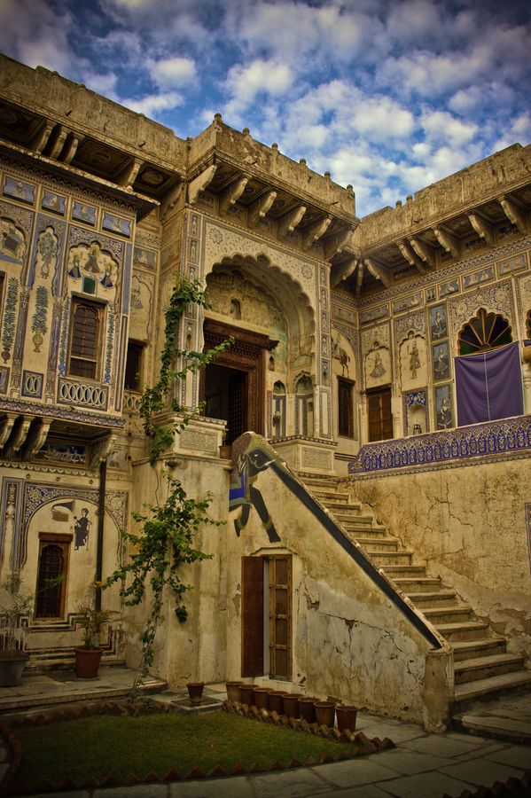
Marwari merchant and industrial houses
A walk through one of the most remote parts of India, Shekhawati in Rajasthan, will show the wealth that poured into these region from her sons making commercial and industrial fortunes
  There are many havelis in a 50 km radius bearing illustrious names like Goenka, Bajaj, Piramal etc.

Slide 17
Expectations on the eve of Indian Independence in 1947
When India gained her Independence, it land reforms diminishing the powers of large landholders were fully expected
But both indigenous industrial houses and bureaucrats expected to prosper once freed of the Colonial constraints.
Bureaucrats expected the perks of top positions now to fully devolve to Indians and to replace the Raj functionaries.
Industrial houses expected the Indian state to protect them from foreign competition and prosper. Gist of the “Bombay Plan” proposed on the eve of the Independence by large industrialists.

Slide 18
Central Planning and Intermediate Regime
The Congress government quickly delivered on its promise to abolish Zamindari. Although land reform – particularly land distribution to the landless laborers – was never fully carried out, this broke the power of large land owners.
But the other two groups did not anticipate Nehru’s fascination for Central Planning and turn towards state capitalism
Following Independence, Indian government adopted a central planning process and import substitution development in which imports were restricted and goods were divided into categories reserved for production by public sector units, production by large firms and production by small enterprises.

Slide 19
India’s Intermediate Regime
The term ”Intermediate Regime” was first articulated by Polish economist Michel Kalecki (who also served as an advisor to Govt. of India)
Expanded by KN Raj (with admiration) and Prem Shankar Jha (with disdain)
It has been argued that India’s Intermediate Regime (1947-1985) benefitted middle farmers and small producers
Later on Pronab Bardhan added bureaucracy to the group that also benefitted from this regime

Slide 20
The Intermediate Reigme...
Winners
Middle Farmers
Small enterprise owners
Lower level govt. servants
Losers
Large farmers
Large industrialists
Upper level govt. servants

Slide 21
Decline in Large absentee landlords and growth of middle farmers
FARMERS:

Slide 22
Decline in area owned by large farmers, increase in area owned by med. & small farmers

Slide 23
Increasing farm incomes due to green revolution and govt subsidies
Farm productivity grew in 1970s and 1980s
Government instituted minimum support prices for a variety of crops whereby farmers were free to sell in open market at whatever price they could get but government would be a buyer of last resort at preestablished prices.
These prices were and continue to be reasonably high, increasing farmers’ incomes.

Slide 24
Protection from being squeezed out BY LARGE COMPANIES
SMALL AND MEDIUM ENTREPRENEURS:

Slide 25
Control over large industries, preference for small manufacturers
Import restrictions helped Indian industry
Within it, growth of large companies restricted via production quota and reserving certain items for public sector companies as well as small scale industries
Labor laws encouraged large companies to outsource
Small manufacturers benefitted from this.
  Some items only small scale industries could produce
  Large companies outsourced certain manufacturing to small producers who could more easily ignore labor laws.
    Textile mills purchased from small powerloom operators who used family labor among others

Slide 26
Micro and Small Enterprises in India
Over 90 percent of these enterprises are sole proprietorships
Most have 2-4 employees
Manufacturing 59%, 35% services, 6% repairing an maintenance
Examples:
  Shoemaker
  Tailor
  Insurance agent
  Cyber café operator
  Powerloom owner
  Plastic bag manufacturer
  Restaurant owner

Slide 27
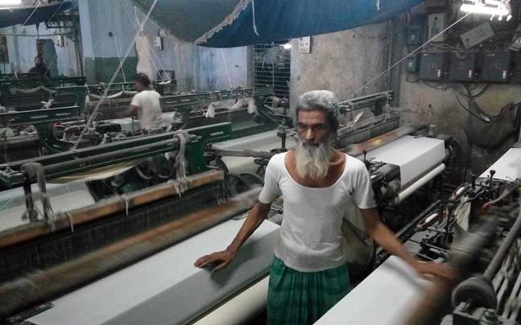
Textile industry offers an interesting case study
Only 10% of the production in large mills
60% in small powerlooms
Many are family owned but some have a few employees

Slide 28
Differential impact of high tax rates

Slide 29
India’s ”Black” or shadow economy
It is impossible to estimate the size of India’s parallel or shadow economy but estimated between 23 to 52 percent of the GDP, depending upon the method uses
Black money available to:
  Self employed individuals who can hide this income on their income tax
  Government servants who collect bribes and obviously do not report them
Since black money is hard to invest, it tends to boost consumption
But decline in tax rates increases the disposable incomes of salaried workers who find it difficult to hide their incomes

Slide 30
High tax rates led to cheating on income tax, but only possible for certain occupations

Slide 31
LOSS OF PRIVILEGE FOR UPPER LEVEL BUREAUCRATS, LIVING WAGE TO LOWER LEVEL
PUBLIC SERVANTS:

Slide 32
Salary compression in public sector
Public sector jobs about 2/3 of formal sector jobs
Post Independence ideology
  Govt as a model employer and living wage to low level positions
  Resentment of colonial administration and efforts to suppress wages of top bureaucrats

Slide 33
DISMANTLING OF STATE CONTROLS
LIBERALIZATION 1985 ONWARDS:

Slide 34
Liberalization began in 1985, accelarated in 1991
Liberalization related changes
Secular changes
Easier entry for multinational firms
Dismantling (although incomplete) of license raj including production quotas and reservation for small scale industries
Decline in taxes
Increasing salaries of public sector workers and some efforts at redressing salary compression
Stagnation of public sector jobs
Agricultural productivity slowdown
Declining farm sizes
Rising education with slow change in occupational structure
Greater competition for formal sector jobs

Slide 35
Liberalization sweepstakes
Winners
All govt. workers
Professionals and managers
Technicians
Personal service workers
Losers
Small entrepreneurs
Farmers
Laborers

Slide 36
Churning occupational fortunes
Decline-Farmers
Fewer farmers
Self Employed-transformation
Transformation of economic power structure
Rise-Formal sector
Low productivity
Salary increase
Tax decrease
More self employed
Stagnant incomes

Slide 37
Farming is an increasingly unsustainable way of life
Small farm sizes due to household division
Stagnant farm productivity – Indian farm productivity far lower than the US
As a result Indian farmers are forced find any work they can to make the ends meet. This includes:
  Work on other people’s farms as day laborers
  Non agricultural day labor in construction or in government sponsored public works programs
  Short term migration in search of work as laborers in nearby cities
Far cry from the days of prosperous middle farmers – at least in most areas of the country

Slide 38
Agriculture plays increasingly smaller role in household incomes, yet over 80% of the rural households engage in it
Distribution of rural households by income source
Income Sources for Rural Households by Income Quintile, 2011-12
 | 2004-05 | 2011-12
Only farming | 18.58 | 16.64
Farming+Farm Labor | 25.32 | 23.99
Farm labor | 13.34 | 10.95
Farming+Non Farm | 25.46 | 30.23
Non farm only | 15.52 | 15.28
Other | 1.77 | 2.91
Total | 100 | 100

Slide 39
Monthly salaried work is a step up from daily labor
Workers paid on monthly basis have year-round work, not available to daily laborers
But this work could be in the formal sector and governed by labor legislation or in the informal sector
Informal sector salaried workers
  Drivers, cooks, child care workers
  Workers in formal sector with informal jobs such as temporary or contract workers

Slide 40
Formal sector employment is a a tiny fraction of Indian workforce

Slide 41
Rising education, slow expansion of jobs, results in higher competition

Slide 42
All formal sector jobs not created equal
Tremendous demand for public sector jobs for all education levels
Government employs many drivers, clerks, technicians

Slide 43
Sharp increase in public sector salaries while employment share of public sector was declining

Slide 44
Amazing demand for government jobs
In 2015, 2.3 million applicants for 656 jobs in state of Uttar Pradesh requiring class 5 education
255 applicants with Ph.D.; 200,000 applicants with BA/BS

Slide 45
Salaried workers in public sector paid far more than in the private sector
 | 2004-05 |  |  | 2011-12
Education | Private | Govt | Ratio Govt/Priv | Private | Govt | Ratio Govt/Priv
Upto Class 5 | 40889 | 96333 | 2.36 | 43200 | 120000 | 2.78
Class 6-8 | 48818 | 111023 | 2.27 | 48000 | 133080 | 2.77
Class 9-10 | 62464 | 139258 | 2.23 | 60000 | 174000 | 2.90
Class 11-12 | 63385 | 146591 | 2.31 | 72000 | 180000 | 2.50
At least some college | 91409 | 184354 | 2.02 | 120000 | 220400 | 1.84
Total | 55364 | 140265 | 2.53 | 60000 | 180000 | 3.00

Slide 46
Pushed into self employment….
What do people who can’t get government jobs or formal sector jobs do?
The lowest preference job is daily wage labor
But many engage in small businesses or trades
Crowding into self employment with poor returns
Micro informal enterprises are 98% of all enterprises
Extremely vulnerable, credit constraints

Slide 47
VERY slow transformation of occupational structure
 | 1983 | 1987 | 1994 | 2000 | 2005 | 2010 | 2012
Upper Prof. & Manager | 1.6 | 1.8 | 2.2 | 2.1 | 2.0 | 2.6 | 3.1
Lower Prof. & Teacher | 3.3 | 3.3 | 3.5 | 3.6 | 3.6 | 3.1 | 3.4
Clerical | 2.6 | 2.7 | 2.8 | 2.8 | 2.4 | 2.7 | 2.5
Working Proprietor | 1.0 | 1.4 | 1.6 | 2.6 | 3.2 | 6.4 | 6.8
Merchant | 4.6 | 5.1 | 5.4 | 5.3 | 5.6 | 3.9 | 4.1
Salesman | 1.7 | 1.6 | 2.0 | 2.0 | 2.6 | 2.3 | 2.4
Personal Service | 3.5 | 3.6 | 3.6 | 3.6 | 3.9 | 4.0 | 4.1
Agr w land +0.25 hect | 33.0 | 29.0 | 27.6 | 24.6 | 24.9 | 21.4 | 21.4
Agric & Allied Worker | 25.2 | 26.3 | 26.4 | 26.9 | 22.4 | 22.5 | 19.2
Prod. Worker/Artisan | 14.1 | 14.4 | 14.9 | 14.5 | 17.5 | 15.6 | 17.2
Laborer | 4.7 | 5.6 | 5.2 | 5.6 | 5.5 | 8.3 | 8.2
No Occupation/Retiree | 4.8 | 5.1 | 4.8 | 6.4 | 6.4 | 7.3 | 7.6
Total | 100 | 100 | 100 | 100 | 100 | 100 | 100

Slide 48
Growing Between Occupation Inequality

Slide 49
Rapid increase in median incomes of some occupational groups (in constant Rupees, $1=Rs. 53 in 2011-12)
 | 1983 | 1987 | 1994 | 2000 | 2005 | 2010 | 2012 | Change
Upper Prof. & Manager | 8818 | 9771 | 9531 | 11201 | 11748 | 11780 | 12922 | 4104
Lower Prof. & Teacher | 6000 | 6731 | 6758 | 7546 | 7651 | 7302 | 8113 | 2113
Clerical | 7033 | 7328 | 7420 | 8613 | 8561 | 8539 | 9215 | 2182
Working Proprietor | 7417 | 6896 | 7510 | 7931 | 7952 | 7730 | 7955 | 538
Merchant | 4856 | 5243 | 5288 | 6109 | 6147 | 5826 | 6578 | 1722
Salesman | 3963 | 4267 | 4626 | 5179 | 4750 | 5203 | 5830 | 1867
Personal Service | 3993 | 4441 | 4381 | 5325 | 4732 | 5104 | 5827 | 1834
Agr w land +0.25 hectare | 4217 | 4533 | 4356 | 5029 | 4812 | 5047 | 5527 | 1310
Agric & Allied Worker | 2476 | 2754 | 2760 | 3310 | 3101 | 3372 | 3884 | 1408
Prod. Worker/Artisan | 4238 | 4456 | 4555 | 5145 | 4670 | 4975 | 5686 | 1448
Laborer | 3620 | 3661 | 3710 | 4307 | 3878 | 4031 | 4554 | 934
No Occupation/Retiree | 1879 | 2387 | 2342 | 3091 | 2828 | 3664 | 3706 | 1827
Total | 3694 | 3940 | 3965 | 4592 | 4403 | 4667 | 5377 | 1683

Slide 50
Growing within occupation inequality

Slide 51
Even greater increase in incomes for the top decile
 | 1983 | 1987 | 1994 | 2000 | 2005 | 2010 | 2012 | Change
Upper Prof. & Manager | 19498 | 20950 | 19801 | 23916 | 26123 | 26280 | 33650 | 14152
Lower Prof. & Teacher | 13239 | 14461 | 13779 | 15120 | 15442 | 15515 | 18077 | 4838
Clerical | 14988 | 14237 | 14320 | 15526 | 16524 | 16685 | 18566 | 3578
Working Proprietor | 17706 | 18265 | 18489 | 19167 | 18913 | 17831 | 18554 | 848
Merchant | 11987 | 12191 | 12220 | 13772 | 14349 | 12317 | 14568 | 2581
Salesman | 8948 | 9251 | 9693 | 10624 | 9793 | 11253 | 12336 | 3388
Personal Service | 8945 | 9507 | 9087 | 10725 | 9902 | 10624 | 12430 | 3485
Agr w land +0.25 hectare | 10020 | 10218 | 9219 | 10548 | 10002 | 10076 | 11460 | 1440
Agric & Allied Worker | 5316 | 5505 | 5258 | 6061 | 5759 | 6217 | 7224 | 1908
Prod. Worker/Artisan | 9360 | 9711 | 9444 | 10460 | 9753 | 10384 | 11395 | 2035
Laborer | 7941 | 7639 | 7183 | 8496 | 7525 | 7358 | 8631 | 690
No Occupation/Retiree | 6567 | 7086 | 7473 | 9408 | 9931 | 9166 | 11136 | 4569
Total | 9446 | 9720 | 9427 | 10729 | 10642 | 10966 | 12449 | 3003

Slide 52
Greater dispersion within the professional category
Professionals & Managers
Entrepreneurs

Slide 53
Transformation of Indian upper income group
From intermediate regime – middle farmers and small scale entrepreneurs – to professionals and managers
Also growth in incomes at the top decile for some of the personal service workers and salesmen who serve this upper income strata

Slide 54
Difference between India and the West in economic expansion
US Occupational Structure
The Indian Paradox
 | 1949 | 1979 | 1996
Professional and Managerial | 16.67 | 22.9 | 28.6
Other white-collar | 15.2 | 18.7 | 20.5
Blue-collar | 47.6 | 44.4 | 38.5
Service workers | 5 | 7.7 | 8.1
Farm | 12.7 | 4.1 | 2.9
Armed Forces | 2.4 | 2.3 | 1.2
Circa 1950, about 50% of the US GDP was in services sector similar to where India is today
But India’s employment in white collar jobs is minuscule
Wages to white collar work have grown, job opportunities have not

Slide 55
Stuck in agriculture….
India
Political Unrest among Agriculturists
Massive demands from agricultural groups for preferential treatment in
  College education
  Government jobs

Slide 56
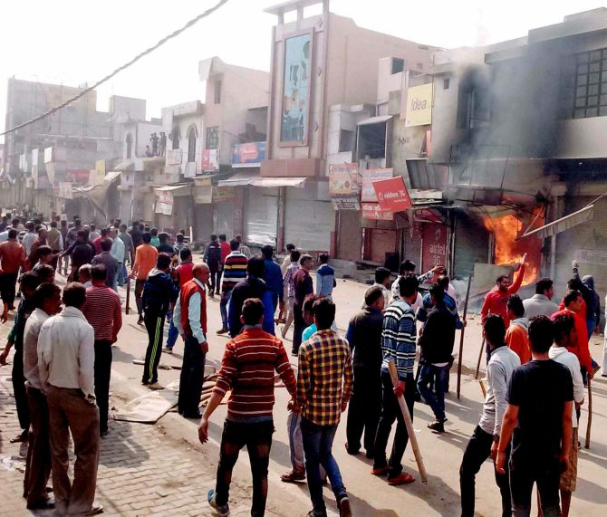
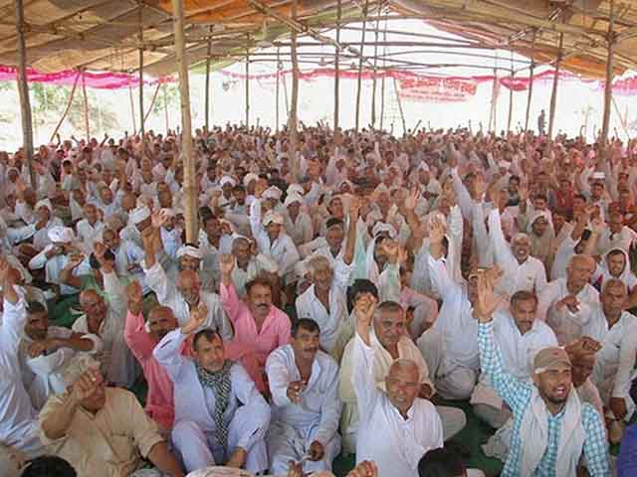
Unending demands for affirmative action from better off farmers

