Slide 1
Inequality by the Numbers:
LIS Data: A Resource for Inequality Research
June 10, 2016
Janet Gornick

Slide 2
@ LIS …
We gather income datasets, based on household surveys, from a large number of countries; we harmonize them, and we make them available to researchers around the world.
We provide harmonized microdata; that enables researchers to ask a vast range of questions – e.g., on income inequality, poverty, labor market disparities – and to tailor their analyses to their precise needs.
We are widely recognized as world leaders in data harmonization; we regularly advise projects (e.g., at OECD, World Bank, ECB) on how “ex post” harmonization can and should be done.
We are in a growth spurt, recently adding several more countries (especially middle-income countries) and new blocks of data (most recently, data on assets and debt).

Slide 3
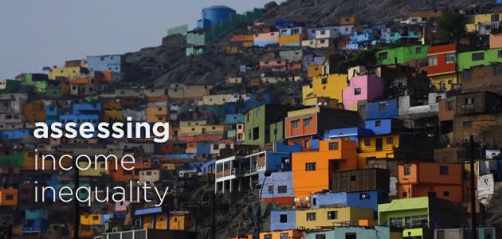
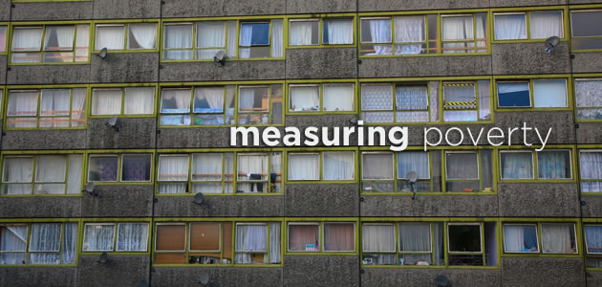

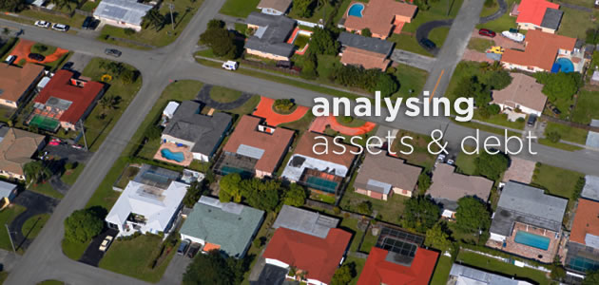
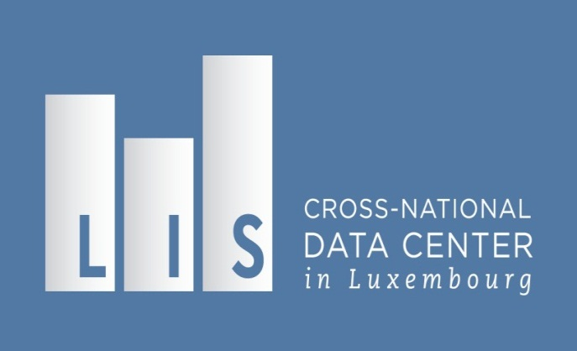
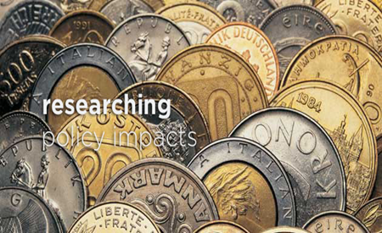
Our mission
To enable, facilitate, promote, and conduct cross-national comparative research on socio-economic outcomes and on the institutional factors that shape those outcomes.

Slide 4
LIS: an overview
LIS: Cross-National Data Center
• parent organization (founded 1983)
• located in Luxembourg
• independent, chartered non-profit organization
• cross-national, participatory governance
• acquires, harmonizes, and disseminates data for research
• venue for research, conferences, and user training
LIS Center @ Graduate Center - CUNY
• satellite office (founded 2006)
• located at the Graduate Center of the City University of New York
• administrative, managerial, development support to parent office
• venue for research, teaching, PhD supervision, and public programs

Slide 5
What we do
Step 1. We identify appropriate datasets.
Data must be high-quality.
Step 2. We negotiate with each data provider.
Step 3. We collect, harmonize and document the data.
  LIS’ data experts harmonize the data into a common, cross-national template, and create comprehensive documentation.

Slide 6
Data harmonisation at LIS: an overview
Harmonisation

Slide 7
Data harmonisation at LIS: an overview
The origins of the LIS data
Harmonisation
Notes:
LIS does not organise surveys but collects data from existing data sources:
Survey data: income, household budget, living conditions, multipurpose, human development
Administrative records: tax records, employers records, social security records
Any mix of the above
Common denominator:
microdata (household and individual level)
representative of the whole population
good quality income/wealth data
main demographic and (possibly) labour market information

Slide 8
Data harmonisation at LIS: an overview
The origins of the LIS data
The harmonisation process
Harmonisation

Slide 9
Data harmonization at LIS: an overview
The ingredients of LIS: the original datasets
The harmonization process
Harmonisation
The final output: LIS Database,
LWS Database

Slide 10
What we do (cont).
Step 4. We double-check the harmonized data and create some national-level indicators.
Step 5. We make the harmonized microdata available to researchers via “remote execution”, and other user-friendly pathways.

Slide 11
LIS:
data, products,
and services

Slide 12
LIS and LWS Databases
Luxembourg Income Study Database (LIS)
First and largest available database of harmonized income data, available at the household and person levels
In existence since 1983
Data mostly start in 1980, some go back to the 1960s (recollected every 3-5 years)
Approx 50 countries
300 datasets
Used to study: poverty; income inequality; labor market outcomes; policy effects
Luxembourg Wealth Study Database (LWS)
First available database of harmonized wealth data, available at the household level
In existence since 2007
13 countries, 11 datasets, more coming up in near future
Newly released 2016
Used to study: household assets, debt, and expenditures; wealth portfolios; policy effects

Slide 13
Current Coverage of High- and Middle-Income
Countries in LIS and LWS Databases approximately 65% of world population and 84% of world GDP
High-income countries: (33) |  |  | Upper-middle-income countries: (12) |  | Lower-middle-income countries: (4)
Australia | Greece | Slovenia | Brazil | Panama | Egypt
Austria | Iceland | South Korea | China | Paraguay | Georgia
Belgium | Ireland | Spain | Colombia | Peru | Guatemala
Canada | Israel | Sweden | Dominican Republic | Romania | India
Chile * | Italy | Switzerland | Hungary | Serbia
Cyprus (LWS only) | Japan | Taiwan | Mexico | South Africa
Czech Republic | Luxembourg | United Kingdom
Denmark | Netherlands | United States
Estonia | Norway | Uruguay
Finland | Poland
France | Russia
Germany | Slovak Republic
* Dataset in-house, but not yet available for use.

Slide 14
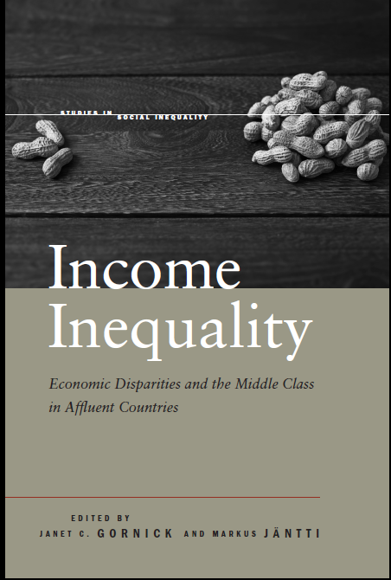
Users, products, services
Thousands of data users - and growing
“remote execution” enables data use around the world
tools for non-technical users
Pedagogical activities
training workshops
self-teaching materials
Research activities and support
visiting scholar programs
working paper series (700+)
research conferences
authored and edited books, e.g.:

Slide 15
Research
based on the LIS/LWS data:
some illustrations

Slide 16
LIS provides evidence for comparative research on socio-economic outcomes
  • assessing income inequality
  • measuring poverty
  • comparing employment outcomes
  • analyzing assets and debt

Slide 17
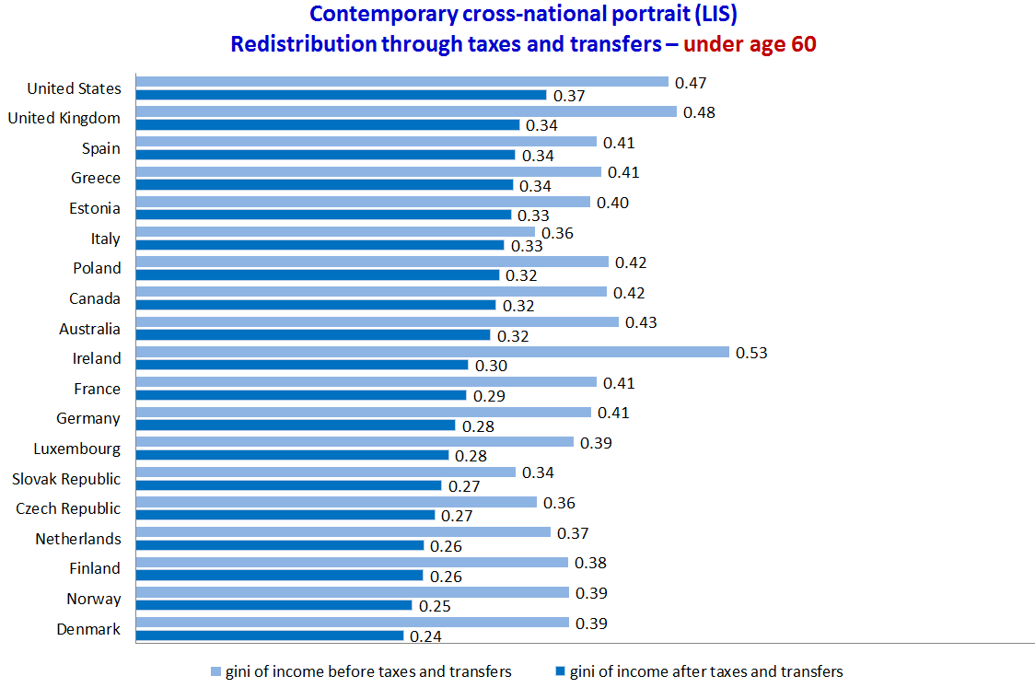
Assessing Income Inequality
Inequality and Redistribution
Source: Janet Gornick and Branko Milanovic. 2015. Income Inequality in the United States in Cross-National Perspective: Redistribution Revisited. LIS Center Research Brief.

Slide 18
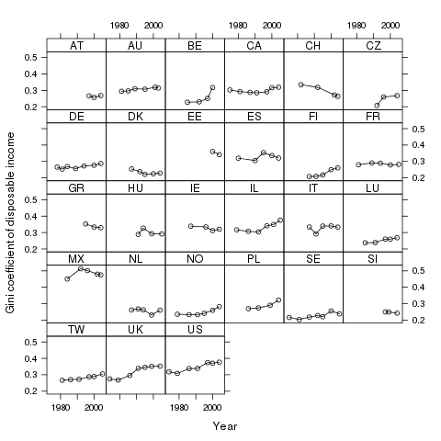
Recent trends -1
Is inequality rising in middle- and high-income countries?
Inequality Trends in Comparative Perspective – Gini Coefficients of Disposable Income
1980 to 2004
Gornick and Jäntti
(from Introduction,
in Gornick and Jäntti, eds., 2013)

Slide 19
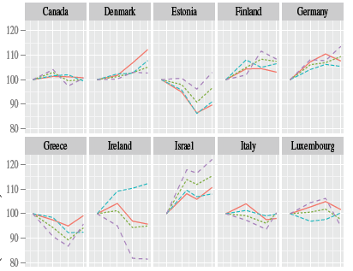


Recent trends -2a
Is inequality rising in middle- and high-income countries?
Updated to include changes
just before and during the Great Recession
Four inequality measures
2001, 2004, 2007, 2010
Milanovic, Gornick, Jäntti forthcoming

Slide 20
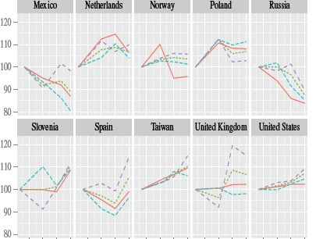
Recent trends -2b
Is inequality rising in middle- and high-income countries?
Updated to include changes
just before and during the Great Recession
Four inequality measures
2001, 2004, 2007, 2010
Milanovic, Gornick, Jäntti

Slide 21
Recent trends -3
Has the middle been “hollowing out”?
Change in the Income Share of the Bottom, Middle and Top Income Groups between around 1985 and around 2004
(percentage points)
Atkinson and Brandolini
(from Chapter 2,
in Gornick and Jäntti, eds., 2013)

Slide 22
Measuring Poverty
“Real Income Levels” of Children
Source: Timothy Smeeding and Lee Rainwater. 2002. Comparing Living Standards Across Nations: Real Incomes at the Top, the Bottom and the Middle. LIS Working Paper 266.

Slide 23
Real income levels in the middle (Kenworthy 2013)
Trends in Real Incomes
of Middle-Income
(P25, P50, and P75) Households,
late-1970s to mid-2000s
(from Chapter 3,
in Gornick and Jäntti, eds., 2013)

Slide 24
Contribution of women’s employment/earnings (Harkness 2013)
Income Inequality under Three Counterfactuals, around 2004
(from Chapter 7, in Gornick and Jäntti, eds., 2013)

Slide 25
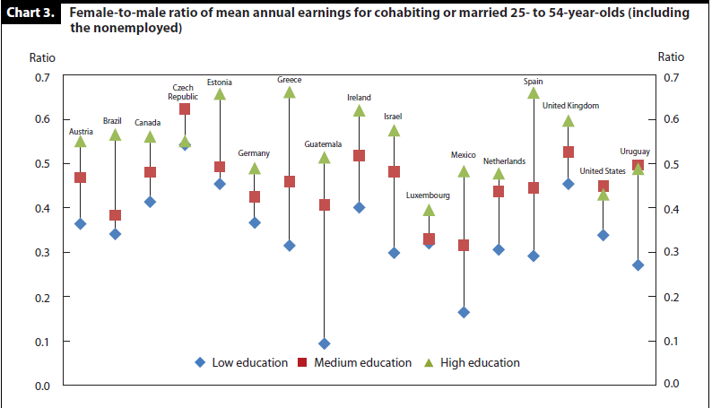
Comparing Employment Outcomes
Gender Gaps in Earnings by Education Level
Source: Paula England, Janet Gornick, and Emily Shafer. 2012. “Women’s Employment, Education, and the Gender Gap in 17 Countries.” Monthly Labor Review (April): 20-29.

Slide 26
Analyzing Assets and Debt
Older Women’s Income and Asset Poverty
Source: Janet Gornick, Eva Sierminska, Timothy Smeeding. 2009. “The Income and Wealth Packages of Older Women in Cross-National Perspective.”
Journal of Gerontology: Social Sciences 64B(3): 402-414.

Slide 27
Combining LIS data with other data sources
  • micro-micro
  (merging, statistical matching)
  • macro-micro
  (nesting micro in macro)
  • macro-macro
  (unit of analysis: country-year)

Slide 28
Thank You
Janet Gornick

