Slide 1



Inequality by the Numbers:
Introduction and Overview
June 5, 2016 / 9am to 10:30am
Janet C. Gornick
Director, Stone Center on Socio-Economic Inequality
Director, US Office of LIS
Professor of Political Science and Sociology,
Graduate Center, City University of New York

Slide 2
9:00 - 9:30am Overview of the workshop
● Institutional hosts:
- CUNY Graduate Center
- Advanced Research Collaborative (ARC)
- Stone Center for Socio-Economic Inequality
● Workshop general information and logistics
- “people”
- one-on-one research consultations
- dinner on Thursday
9:30 - 10:00am Preview of the sessions
10:00 - 10:20am Introduction to LIS: Cross-National
Data Center in Luxembourg
10:20 - 10:30am Q&A

Slide 3
9:00 - 9:30am
Overview of the workshop
● Institutional hosts:
- CUNY Graduate Center
- Advanced Research Collaborative (ARC)
- Stone Center for Socio-Economic Inequality
● Workshop, general information and logistics
- “people”
- one-on-one research consultations
- dinner on Thursday

Slide 4
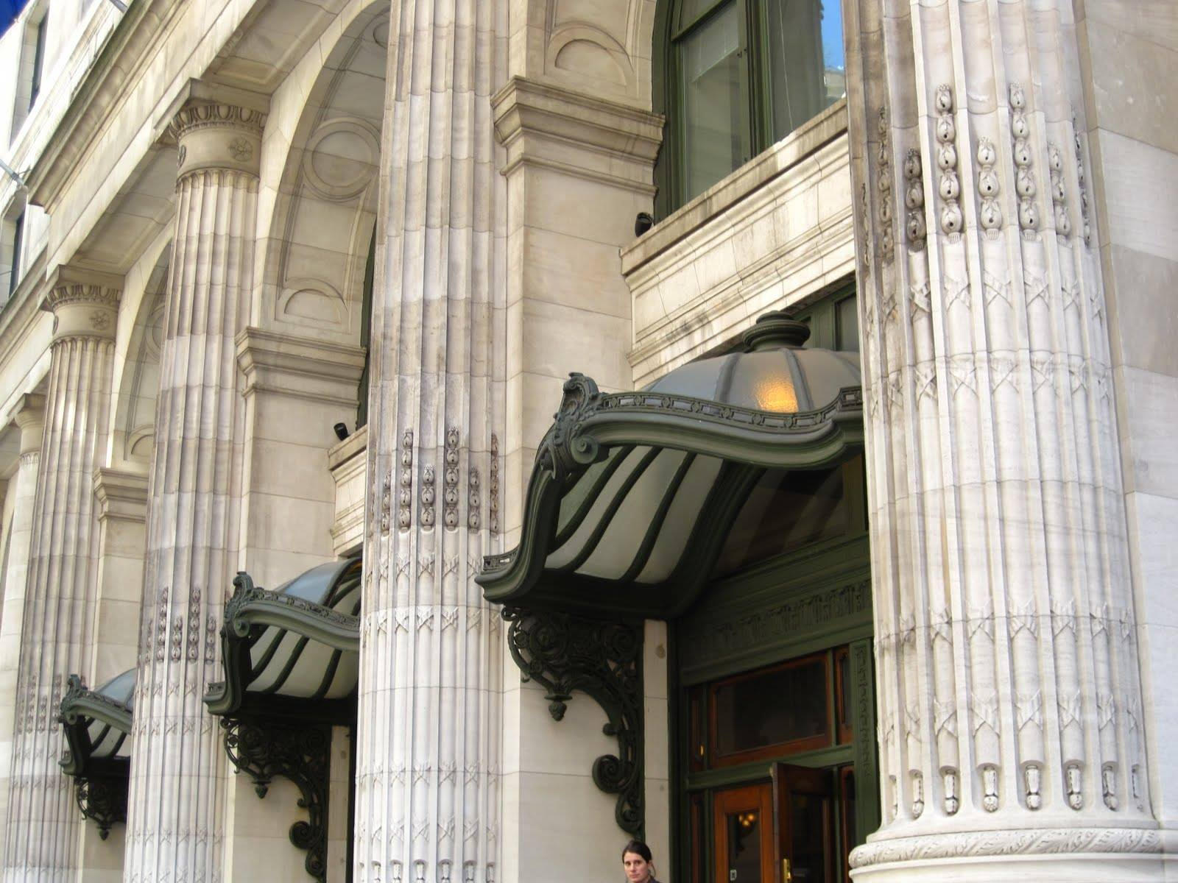

Slide 5

The Advanced Research Collaborative … partners with the Graduate Center's forty research centers, institutes, interdisciplinary committees, and other academic initiatives to promote interdisciplinary research.
ARC also works closely with Graduate Center offices to promote public programming on critical issues of the day.
Through its fellowships, which attract international researchers and scholars as well as doctoral students, participants are offered even more possibilities for collaboration. ARC supports several areas of study:
Inequality
Immigration
Multilingualism
Digital Initiatives
Urban Studies

Slide 7
● Workshop, general information and logistics
- “people”
Stone Center staff onsite
Janet Gornick, Workshop Director
Berglind Hólm Ragnarsdóttir, Workshop Associate Director
Alex Breindel, Workshop Intern
Laurie Maldonado, Stone Center
Nathaniel Johnson, Stone Center
Caroline Batzdorf, Stone Center
Plus
53 workshop students (see bios in packet)
23 instructors (see bios online)
- one-on-one research consultations
see sign-up sheets
- dinner on Thursday (in Brooklyn)
Berglind has sign-up sheet;
directions in your packet

Slide 8
9:30 - 10:00am
Preview of the sessions

Slide 10

Previews!

Slide 11
Michael Förster
OECD
Inequality:
Trends, Causes, Consequences

Slide 12
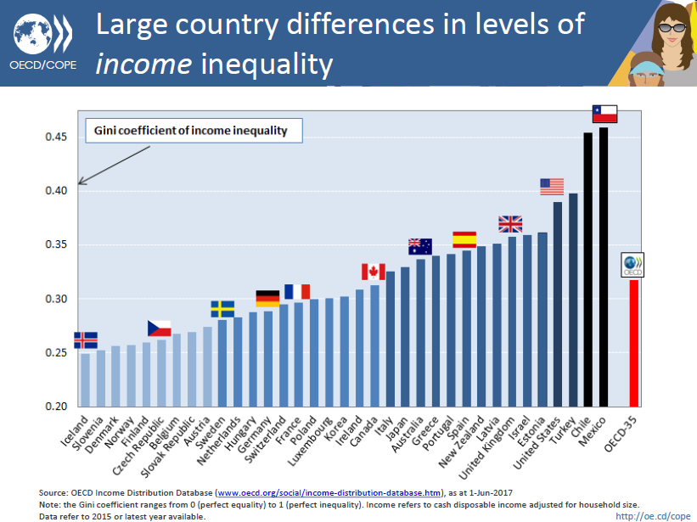

Slide 13
Paul Krugman
GC-CUNY
Inequality
and the Macro-Economy

Slide 14
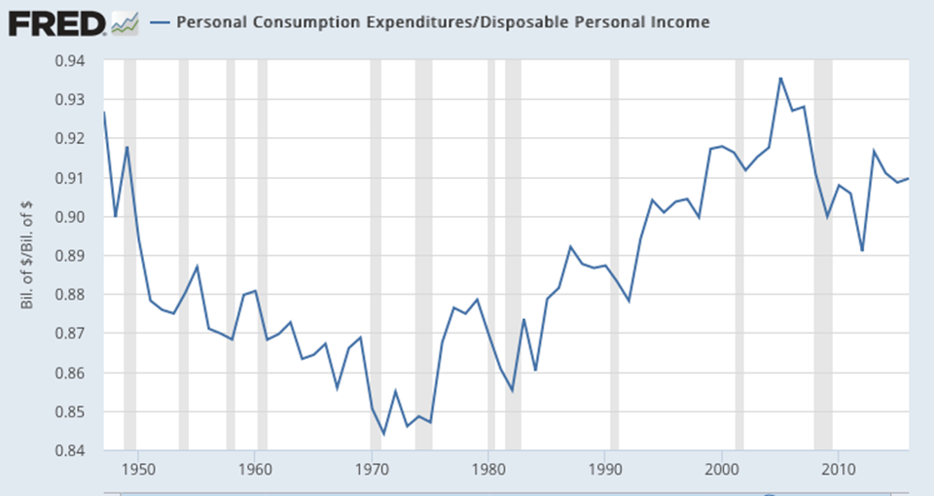

Slide 15
Andrew Clark
Paris School of Economics
Inequality and Happiness

Slide 16
Some key conclusions:
We think that higher income reduces the dispersion of well-being through the provision of public goods (paid for by the rich, enjoyed by all)
Happiness inequality is determined by income inequality as well.
Modern growth has come with greater income inequality.
In most countries the level of income effect has trumped the income inequality effect.

Slide 17
Branko Milanovic
GC-CUNY
Global Inequality

Slide 18
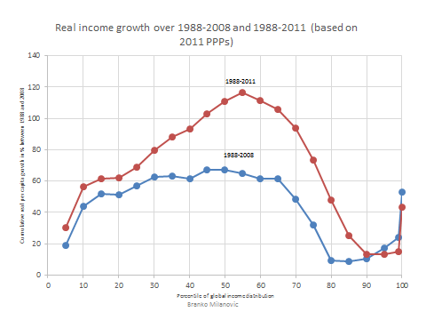

Slide 19
Janet Gornick
GC-CUNY / Stone Center with
Berglind Hólm Ragnarsdóttir
Laurie Maldonado
Nathaniel Johnson
LIS Data: A Resource for
Inequality Research

Slide 20
Topics illustrated
Household-level market income inequality
Women’s economic dependency
Poverty among single parents
Wealth and wealth inequality

Slide 21
Sonalde Desai
University of Maryland
Inequality in India

Slide 22
Overall inequality in India has been rising
Consumption Gini from National Sample Survey
Income Gini from India Human Development Survey
Year | Gini Coeff
1983 | 0.323
1987 | 0.324
1994 | 0.316
2000(*) | 0.304
2005 | 0.344
2010 | 0.345
2012 | 0.351
Year | Gini Coeff
2005 | 0.518
2012 | 0.531
* Different methodology

Slide 23
Juan Battle
GC-CUNY
Inequality, Race, Sexuality

Slide 24

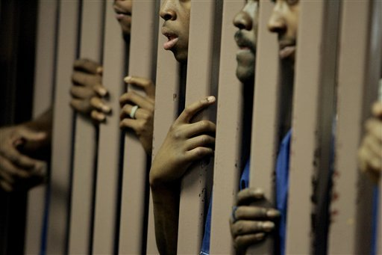





Inequality, Race, & Sexuality
Prof. Juan Battle
JuanBattle.com
June 6, 2017
Notes:
Special thanks to …

Slide 25
Conchita D’Ambrosio
University of Luxembourg
Inequality Analysis Tools

Slide 26
Some key conclusions:
Deprivation has attracted increasing attention in the past decades when the measurement of individual well-being gained importance not only in the academic context but also in the public discourse and in policy-making circles.
The main reason for this is … the observation that, since individuals do not live in isolation, they determine their well-being also from comparisons with others. Comparisons to richer individuals matter.
Although this consideration appears to be absent from much of standard economic modeling, it has been shown to be one of the main determinants of self-reported satisfaction with income and life.
Measuring relative deprivation is important not only per se but also because of its links to major social phenomena such as: crime, political violence, health status, mortality, and migration decisions.

Slide 27
Larry Mishel
Economic Policy Institute
Inequality and Wages

Slide 28
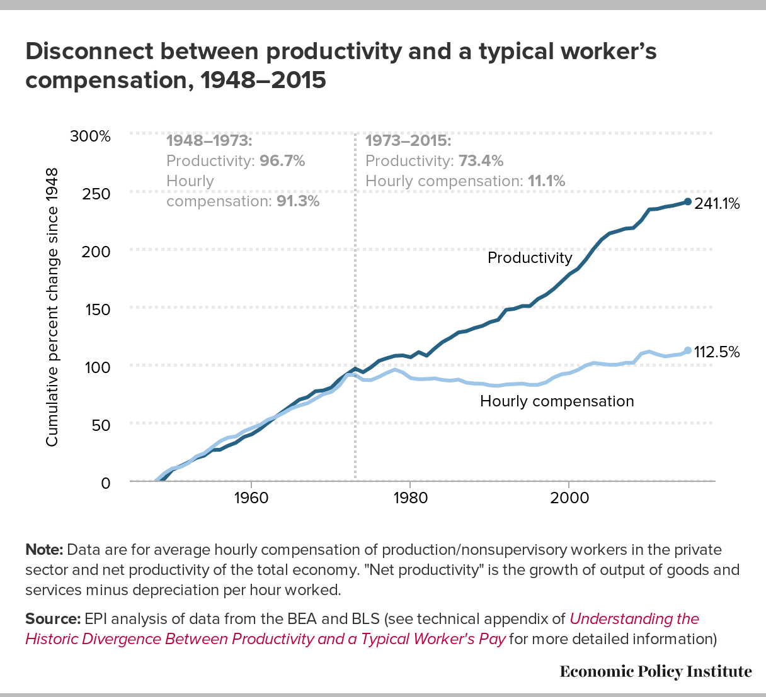
Productivity-pay gap

Slide 29
Walter Scheidel
Stanford University
History of Inequality,
Stone-Age to Today

Slide 30

Argument
Violence has been the single most important means of leveling wealth and income inequality in human history
4 principal mechanisms:
Mass mobilization war
Transformative revolution
State collapse
Pandemics

Slide 31
Richard Alba
GC-CUNY
Inequality and Immigration

Slide 32
An historic transition underway
Because of immigration, all western societies are facing a demographic transition to a much more diverse working-age population.
During the next quarter century, this transition will result from a conjunction of two forces:
  The exit from the work force of the large, heavily native, baby-boom cohorts born after World War II.
  The maturation of very diverse youth cohorts, containing many who have grown up in immigrant homes.
Historically, the U.S. mostly has recruited its most highly skilled workers and its leadership from white men. What will these changes mean?

Slide 33
Louis Chauvel
University of Luxembourg
Inequality Across Cohorts

Slide 34

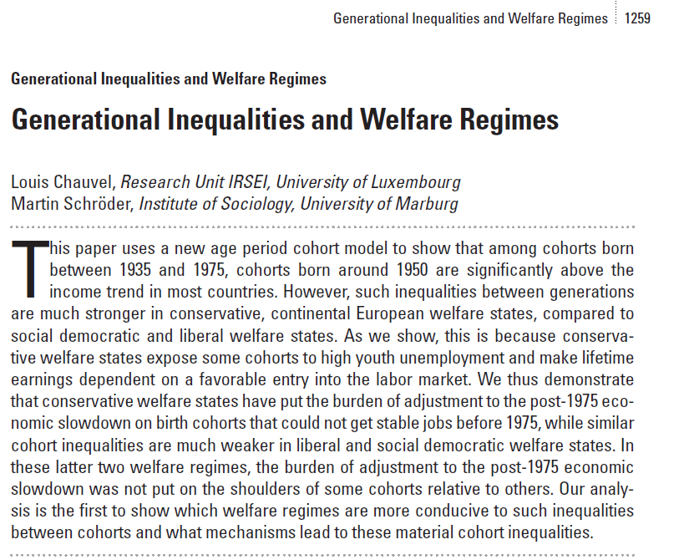

Slide 35
James Parrott,
Center for New York City Affairs
Inequality and NYC
Economic Structure

Slide 36
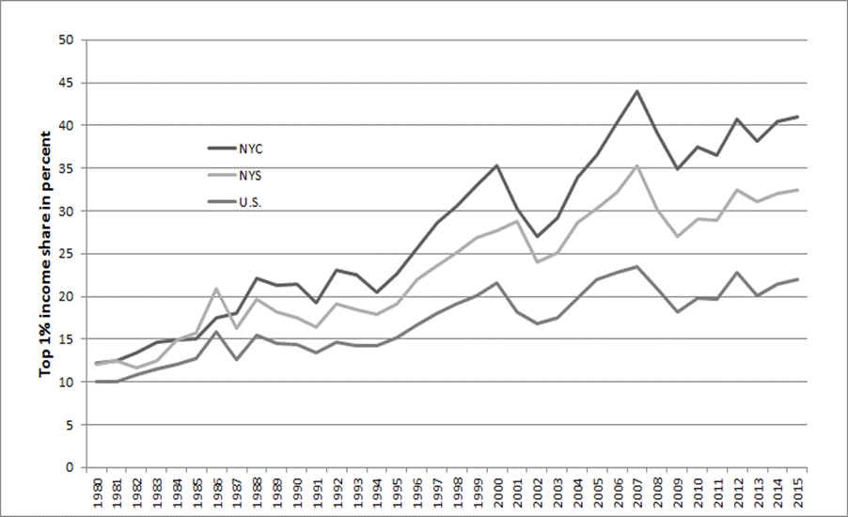
How does the 1%’s income share in NYC compare?

Slide 37
Darrick Hamilton
The New School
Inequality, Racial Disparity,
and Stratification Economics

Slide 38
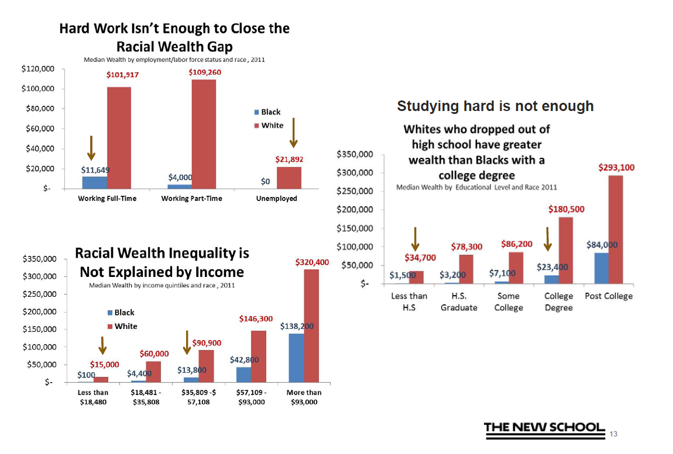

Slide 39
Nancy Folbre
UMass-Amherst, Emerita
Inequality, Gender,
Work, and Care

Slide 40
Occupation/ Industry Interactions
(controlling for other individual and job characteristics)
Penalties for Working in a Care Industry
Managers: -14%
Professionals in non-care occupations: -20%
Professionals in care industries: -22%
Premia for Managers
In care industries: 26%
In other industries: 37%
Premia for Professionals
In care industries: 16%
In other industries: 31%
Penalty to a Manager for Working in a Care industry: -14%
Penalty to a Professional Working in a Non-Care Occupation in a Care Industry:
Penalty to a Professional Working in a Care Industry:
Bonus for Being a Manager in a Care Industry
Bonus for Being a Manager in Other Industries
Bonus for Being a
Bonus for a Professional in Non-Care Occupation in a Care Industry
Bonus

Slide 41
Leslie McCall
GC-CUNY
The Politics of Inequality

Slide 42
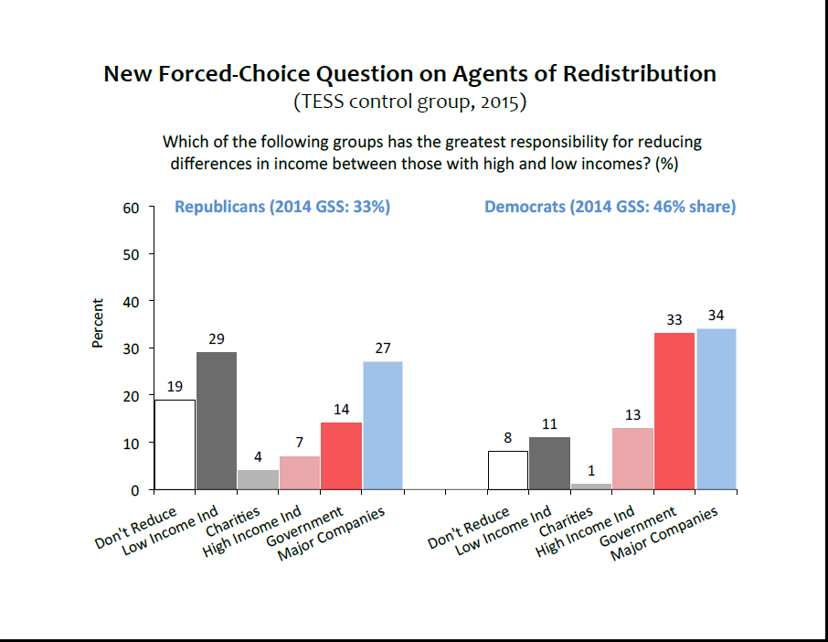

Slide 43
John Mollenkopf
GC-CUNY
Inequality in NYC:
Social Impact
and Political Consequences

Slide 44
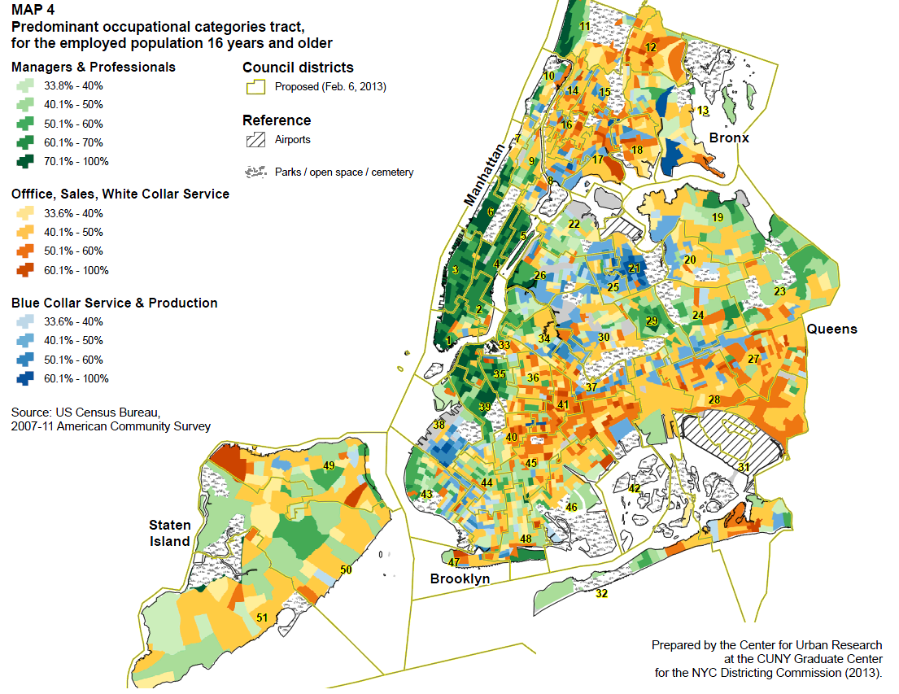

Slide 45
Sarah Bruch
University of Iowa
Inequality Across
the U.S. States

Slide 47
Arthur Kennickell
Federal Reserve Board, Ret.
Measuring Wealth
and Wealth Inequality

Slide 48
Net worth share of wealthiest 1%

Slide 49
10:00 - 10:20am
Introduction to LIS:
Cross-National
Data Center in Luxembourg

Slide 50
@ LIS …
We gather income datasets, based on household surveys, from a large number of countries; we harmonize them, and we make them available to researchers around the world.
We provide harmonized microdata; that enables researchers to ask a vast range of questions – e.g., on income inequality, poverty, labor market disparities – and to tailor their analyses to their precise needs.
We are widely recognized as world leaders in data harmonization; we regularly advise projects (e.g., at OECD, World Bank, ECB) on how “ex post” harmonization can and should be done.
We are in a growth spurt, recently adding several more countries (especially middle-income countries) and new blocks of data (most recently, data on assets and debt).

Slide 51
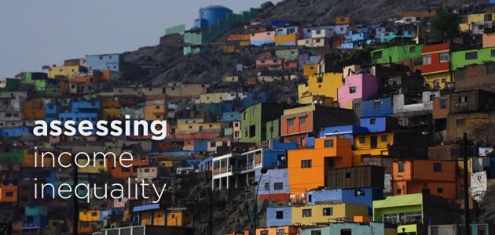
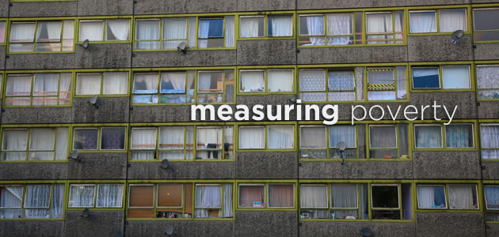

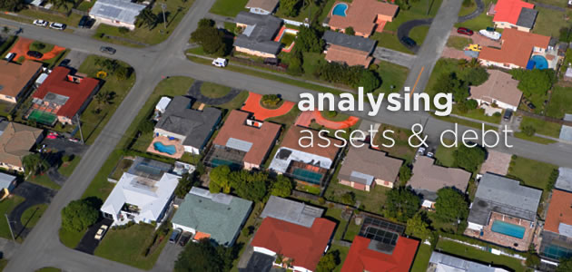


Our mission
To enable, facilitate, promote, and conduct cross-national comparative research on socio-economic outcomes and on the institutional factors that shape those outcomes.

Slide 52
LIS: an overview
LIS: Cross-National Data Center
• parent organization (founded 1983)
• located in Luxembourg
• independent, chartered non-profit organization
• cross-national, participatory governance
• acquires, harmonizes, and disseminates data for research
• venue for research, conferences, and user training
US Office of LIS @ Stone Center / GC - CUNY
• satellite office (founded 2006, folded into Stone Center 2016)
• located at the Graduate Center of the City University of New York
• administrative, managerial, development support to parent office
• venue for research, teaching, PhD supervision, and public programs

Slide 53
What we do
Step 1. We identify appropriate datasets.
Data must be high-quality.
Step 2. We negotiate with each data provider.
Step 3. We collect, harmonize and document the data.
  LIS’ data experts harmonize the data into a common, cross-national template, and create comprehensive documentation.

Slide 54
Data harmonisation at LIS: an overview
Harmonisation

Slide 55
Data harmonisation at LIS: an overview
The origins of the LIS data
Harmonisation
Notes:
LIS does not organise surveys but collects data from existing data sources:
Survey data: income, household budget, living conditions, multipurpose, human development
Administrative records: tax records, employers records, social security records
Any mix of the above
Common denominator:
microdata (household and individual level)
representative of the whole population
good quality income/wealth data
main demographic and (possibly) labour market information

Slide 56
Data harmonisation at LIS: an overview
The origins of the LIS data
The harmonization process
Harmonisation

Slide 57
What we do (cont).
Step 4. We double-check the harmonized data and create some national-level indicators.
Step 5. We make the harmonized microdata available to researchers via “remote execution”, and other user-friendly pathways.

Slide 58
LIS:
data, products,
and services

Slide 59
LIS and LWS Databases
Luxembourg Income Study Database (LIS)
First and largest available database of harmonized income data, available at the household and person levels
In existence since 1983
Data mostly start in 1980, some go back to the 1960s (recollected every 3-5 years)
Approx 50 countries
300 datasets
Used to study: poverty; income inequality; labor market outcomes; policy effects
Luxembourg Wealth Study Database (LWS)
First available database of harmonized wealth data, available at the household level
In existence since 2007
About 40 datasets from 15 countries – up or in process
Newly released 2016
Used to study: household assets, debt, and expenditures; wealth portfolios; policy effects

Slide 60
Current Coverage of High- and Middle-Income
Countries in LIS and LWS Databases approximately 65% of world population and 84% of world GDP
High-income countries: (33) |  |  | Upper-middle-income countries: (12) |  | Lower-middle-income countries: (4)
Australia | Greece | Slovenia | Brazil | Panama | Egypt
Austria | Iceland | South Korea | China | Paraguay | Georgia
Belgium | Ireland | Spain | Colombia | Peru | Guatemala
Canada | Israel | Sweden | Dominican Republic | Romania | India
Chile * | Italy | Switzerland | Hungary | Serbia
Cyprus (LWS only) | Japan | Taiwan | Mexico | South Africa
Czech Republic | Luxembourg | United Kingdom
Denmark | Netherlands | United States
Estonia | Norway | Uruguay
Finland | Poland
France | Russia
Germany | Slovak Republic
* Dataset in-house, but not yet available for use.

Slide 61

Users, products, services
Thousands of data users - and growing
“remote execution” enables data use around the world
tools for non-technical users
Pedagogical activities
training workshops
self-teaching materials
Research activities and support
visiting scholar programs
working paper series (700+)
research conferences
authored and edited books, e.g.

Slide 62
10:20 - 10:30am
Q&A

