Slide 1
Inequality by the Numbers: Introduction and Overview June 1, 2015 / 9am to 12pm Janet C. Gornick Director, LIS (Luxembourg) Director, LIS Center (New York) Professor of Political Science and Sociology, Graduate Center, City University of New York

Slide 2
9:00am to 10:15 ● Introduction: Inequality Workshop 2015
- sponsors, hosts, and senior colleagues
- context / Graduate Center inequality initiatives
- workshop participants
- workshop instructors / scope
- logistics for the week
● LIS: Cross National Data Center in Luxembourg
● LIS Center at Graduate Center, CUNY
● Q&A
10:15 to 10:45 Coffee break
10:45 to 12:00pm ● Overview: Income inequality
“High and Rising Inequality: Causes and Consequences”
● Q&A

Slide 3
9:00 to 10:15am
● Introduction: Inequality Workshop 2015
● LIS: Cross National Data Center in Luxembourg
● LIS Center and Graduate Center, CUNY
● Q&A

Slide 4
Introduction:
Inequality Workshop 2015
● sponsors, hosts, and senior colleagues
● context / Graduate Center inequality initiatives
● workshop participants
● workshop instructors / scope
● logistics for the week

Slide 5
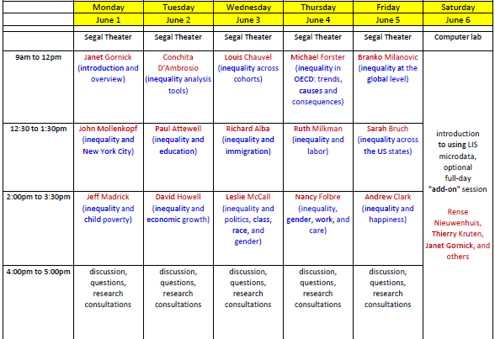

Slide 6
LIS in Luxembourg
is a cross-national data archive and research center
enables, facilitates, promotes, and conducts cross-national comparative research on socio-economic outcomes and on the institutional factors that shape those outcomes;
acquires and harmonizes datasets and makes them available to scholars and analysts around the world;
houses datasets from nearly 50 countries; about half include repeated cross-sections going back 2-3 decades;
allows analysts to work with harmonized micro-data.
http://www.lisdatacenter.org

Slide 7
LIS Center at Graduate Center, CUNY
The Luxembourg Income Study Center, also known as the LIS Center, brings the resources of LIS to the Graduate Center.
Senior scholars
Janet Gornick, Professor and LIS Director [here]
Branko Milanovic, Visiting Presidential Professor and LIS Senior Scholar [here]
Paul Krugman, Professor and LIS Distinguished Scholar
Affiliated staff, students, and researchers
Caroline Batzdorf, Assistant Office Director
Natascia Boeri, Sociology, Doctoral Candidate
Nathaniel Johnson, Economics, Doctoral Student
Sarah Kostecki, Political Science, Doctoral Student [here]
Laurie Maldonado, Social Welfare – UCLA, Doctoral Student [here]
Emily Nell, Sociology, Doctoral Student
Berglind Hólm Ragnarsdóttir, Sociology, Doctoral Candidate [here]
Wenjie Zhang, Visiting Junior Scholar
… also PhD Candidates Andrew Schroeder, Young-Hwan Byun, Alice Zulkarnain [here]
http://www.gc.cuny.edu/liscenter
http://www.gc.cuny.edu/liscenter

Slide 8
10:15am to 10:45am

Slide 9
10:45am to 12:00pm
● Overview: Income inequality
“High and Rising Inequality: Causes and Consequences”
● Q&A

Slide 10
“High and Rising Inequality: Causes and Consequences”

Slide 11
Content
1. Contemporary portrait: levels and trends in inequality
focus on income inequality across households
2. High and rising inequality: causes
3. High and rising inequality: consequences
4. Strengthening data capacity
“high quality information drives sustainable development”

Slide 12
Contemporary portrait: levels and trends in inequality

Slide 13
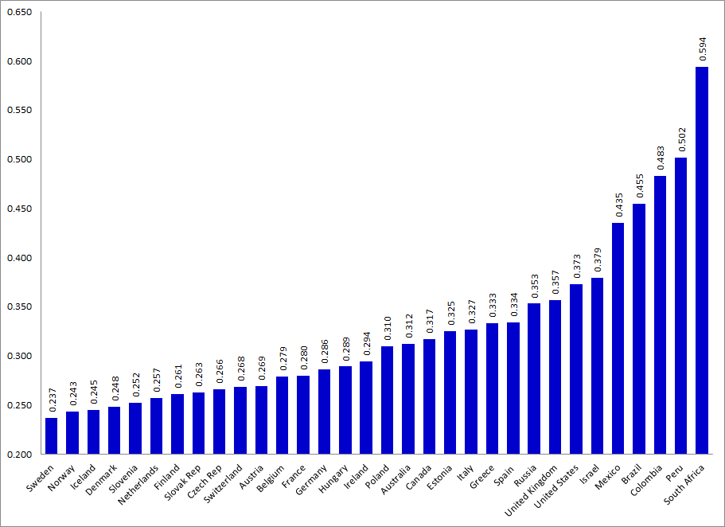
Figure 1 Income inequality varies across high- and upper-middle-income countries. Gini coefficient, most recent time point, post-tax-post-transfer income (data source: LIS Key Figures, 32 countries – 26 high-income, 6 upper-middle-income)

Slide 14
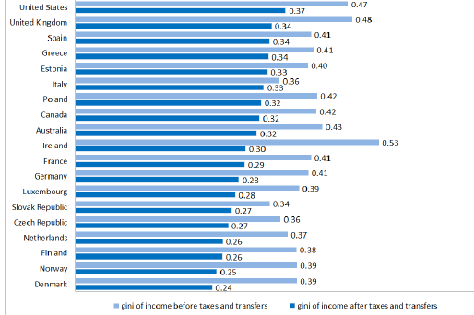
Figure 2 (newly added) Income redistribution through taxes and transfers - < age 60 Gini coefficient, 2010, pre and post-tax-post-transfer income (data source: LIS microdata, 19 high-income countries)

Slide 15
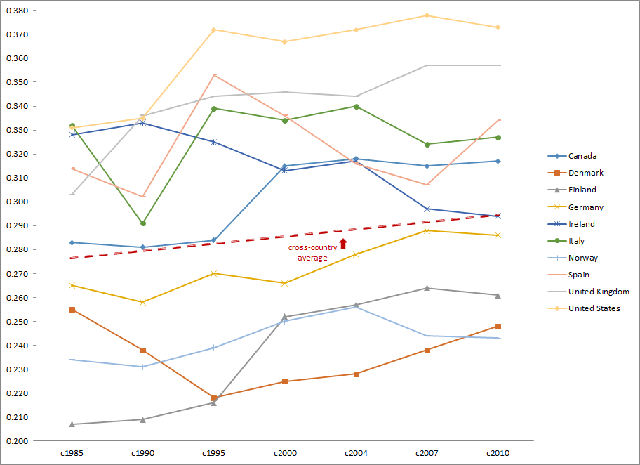
Figure 3 Income inequality has risen in many high-income countries. Gini coefficient, approx. 1985-2010, post-tax-post-transfer income (data source: LIS Key Figures, 10 countries)

Slide 16
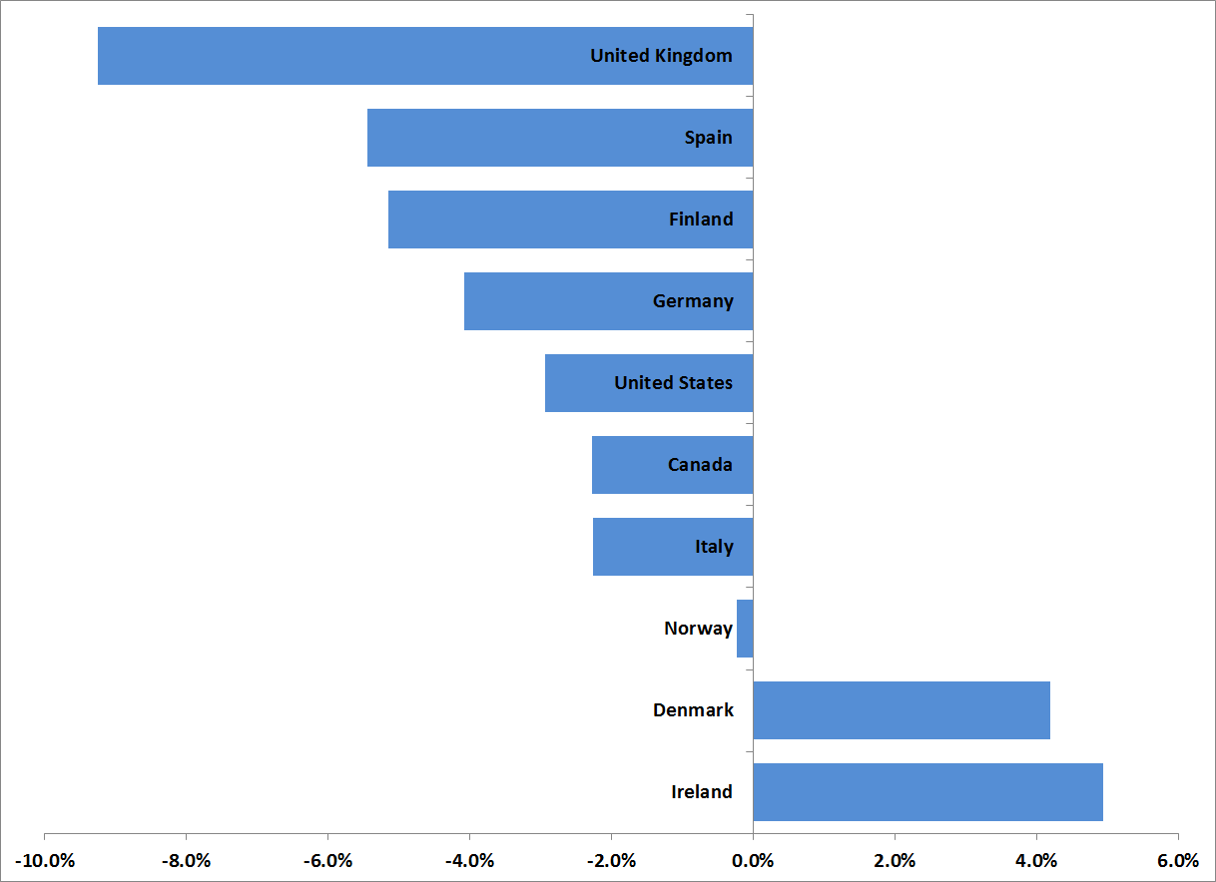
Figure 4 The middle class has diminished in size in many high-income countries. change in share between ½ and 2x median, approx. 1985-2010, post-tax-post-transfer income (data source: LIS microdata, from N. Johnson and D. Johnson, same 10 countries)

Slide 17
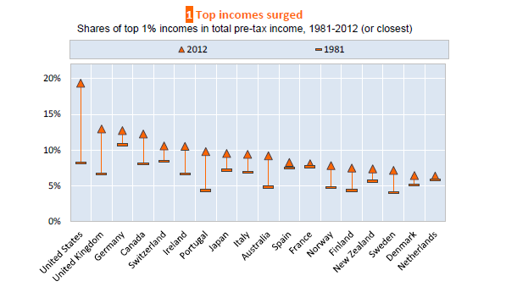
Figure 5 Top income shares have risen in many high-income countries. top 1 percent, approx. 1981 to 2012, pre-tax income (data source: World Top Incomes Database, from OECD)

Slide 18
High and rising inequality: causes

Slide 19
causes
High and rising income inequality may be shaped by:
globalization (e.g., openness of trade, movement of capital, outsourcing);
growing importance of technical skills;
“financialization”;
changes in the way that high earners are compensated; changing pay norms;
weakening protections for low-earning workers;
changes in household structure, especially the rise of one-adult households;
reductions in redistributive policies that lessen market-generated inequality.

Slide 20
one countervailing factor
In nearly every high-income country, women’s engagement in paid work has risen in the last three decades – especially in the form of increased labor force participation.
A growing literature finds that women’s contributions to household income mitigate income inequality across households. That is because women’s increased contributions to household income have pulled up the bottom more than they have pushed up the top.

Slide 21
High and rising inequality: consequences

Slide 22
consequences
High and rising income inequality may harm or thwart:
living standards at the bottom (poverty);
intergenerational mobility;
economic growth;
social cohesion and a range of outcomes;
the democratic process.

Slide 23
Strengthening data capacity

Slide 24
Strengthening data capacity
Proposed Sustainable Development Goal (SDG):
Goal 10. Reduce inequality within and among countries
10.1 By 2030, progressively achieve and sustain income growth of the bottom 40% of the population at a rate higher than the national average
***
Ban Ki-Moon: “… there is nothing inevitable about inequality. Our shared goal should aim at taking practical steps to remove this formidable barrier to development and human dignity.“
Kofi Annan: “Knowledge is power. Information is liberating.”
Bono: "I thought, forget the rock opera, forget the bombast, the only thing I would be singing today is the facts…Enter the evidence activist. The 'factivist.' "

Slide 25
Strengthening data capacity
First, we need:
theoretical and technical advances to enable us to more meaningfully define and compare inequality across countries at all levels of economic development and from diverse regions
Second, we need more data, higher quality data, and more fine-grained data on socio-economic wellbeing and standards of living:
more disaggregated data, by ethnicity, race, geography, family structure, disability, gender, caste, and class
more standardization of data across countries and over time
more timely processing and releasing of data, so that we can learn and monitor “in real time”
fewer legal and administrative restrictions on sharing data beyond national borders
Third, we need more resources and new strategies for enhancing existing resources:
more resources for national statistical offices and other producers of national and subnational data
more resources for projects that acquire and harmonize data across countries
more resources for making data and analyses available to political actors, policy-makers, and activists
more opportunities for volunteers to join the “data revolution”

Slide 26
Thank You
Janet C. Gornick, Director

