Slide 1


Inequality by the Numbers:
Introduction and Overview
June 6, 2016 / 9am to 11:30am
Janet C. Gornick
Director, LIS (Luxembourg)
Director, LIS Center (New York)
Professor of Political Science and Sociology,
Graduate Center, City University of New York

Slide 2
9:00am to 10:00am Part I
● Structure of the workshop and logistics
● The Graduate Center and ARC
● LIS and the LIS Center
● LIS/GC Public Programming related to inequality
● ECINEQ Conference – July 17-18-19, 2017
10am to 10:15am ● Coffee break
10:15 to 11:30am Part 2
● Overview of the week
- 9 sessions on Monday and Tuesday
- 9 sessions on Wednesday, Thursday, Friday
● Q&A

Slide 3
Part 1
9:00am to 10:00am

Slide 4
Structure of the workshop
and logistics

Slide 5
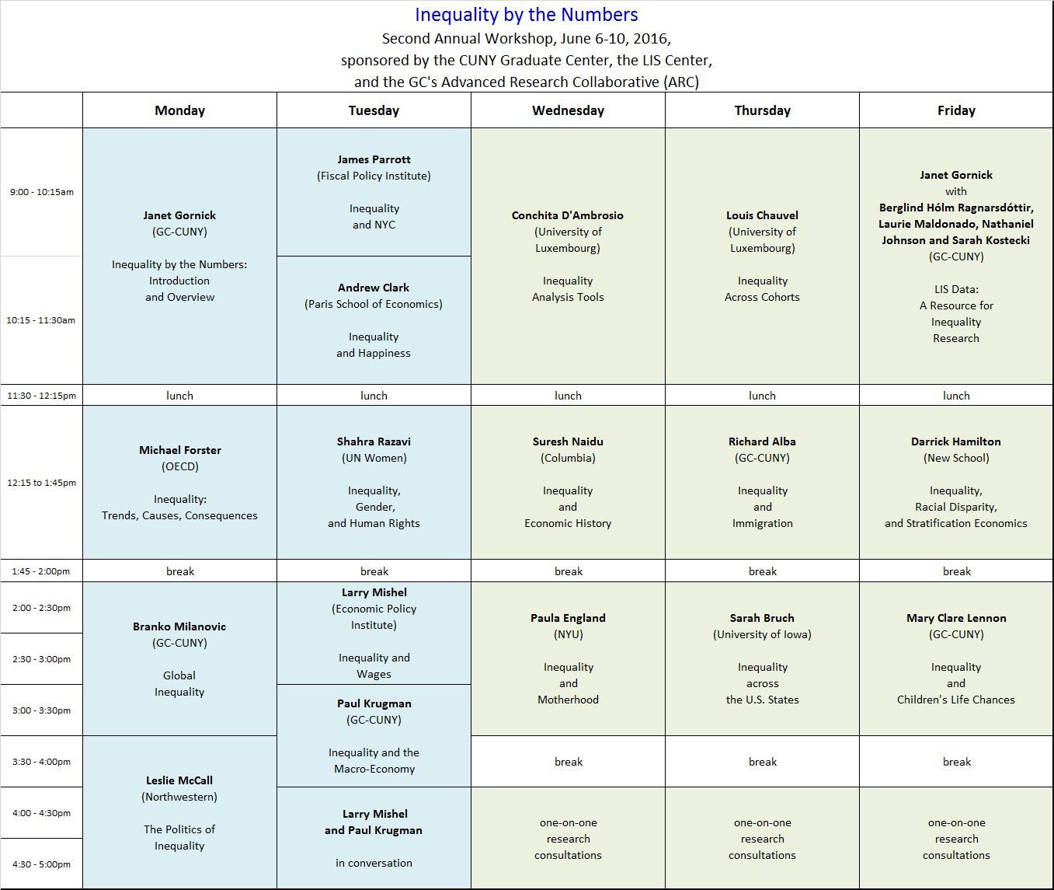

Slide 6
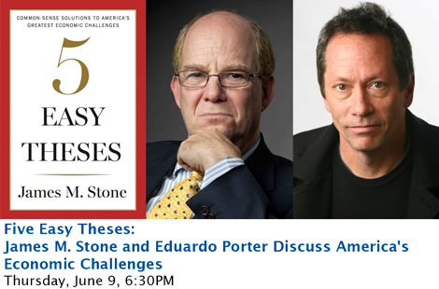
Thursday evening lecture and conversation
If you wish to attend and have not yet registered, do so today.
There are some seats remaining. https://community.gc.cuny.edu/five_easy_theses

Slide 7
The Graduate Center and the Advanced Research Collaborative

Slide 8

The Advanced Research Collaborative … partners with the Graduate Center's forty research centers, institutes, interdisciplinary committees, and other academic initiatives to promote interdisciplinary research.
ARC also works closely with Graduate Center offices to promote public programming on critical issues of the day.
Through its fellowships, which attract international researchers and scholars as well as doctoral students, participants are offered even more possibilities for collaboration. ARC supports several areas of study:
Inequality
Immigration
Multilingualism
Digital Initiatives
Urban Studies

Slide 9
LIS and the LIS Center

Slide 10
LIS: Cross-National Data Center in Luxembourg
LIS, a cross-national data archive and research center
enables, facilitates, promotes, and conducts cross-national comparative research on socio-economic outcomes and on the institutional factors that shape those outcomes;
acquires and harmonizes datasets and makes them available to scholars and analysts around the world;
houses datasets from 50 countries; about half include repeated cross-sections going back 2-3 decades;
allows analysts to work with harmonized micro-data.
www.lisdatacenter.org

Slide 11
LIS Center at Graduate Center, CUNY
The Luxembourg Income Study Center, also known as the LIS Center, brings the resources of LIS to the Graduate Center.
Senior scholars
Janet Gornick, Professor and LIS Director [here]
Branko Milanovic, Visiting Presidential Professor and LIS Senior Scholar [here]
Paul Krugman, Professor and LIS Distinguished Scholar [here]
Leslie McCall, Professor and LIS Senior Scholar, as of January 2017 [here]
Affiliated staff, students, and researchers
Caroline Batzdorf, Assistant Office Director
Mei-Ling Israel, Financial Officer
Nathaniel Johnson, Economics, Doctoral Student [here]
Sarah Kostecki, Political Science, Doctoral Student [here]
Laurie Maldonado, Social Welfare – UCLA, Doctoral Student [here]
Berglind Hólm Ragnarsdóttir, Sociology, Doctoral Candidate [here]
http://www.gc.cuny.edu/liscenter
www.gc.cuny.edu/liscenter

Slide 12
LIS/GC Public Programming related to inequality

Slide 13
GC Public Programs – Inequality Series
Programs since 2013 are on LIS’ playlist on the GC YouTube channel
  Search: < CUNY GC YOUTUBE LIS PLAYLIST >
  Past events concerning inequality have featured:
    Tony Atkinson
    Thomas Piketty
    Joseph Stiglitz
    Angus Deaton
    Paul Krugman
    Branko Milanovic
    Shahra Razavi
    Gita Sen
    Nancy Folbre
    Heather Boushey
    Janet Gornick
    Elizabeth Warren, and
    Bill de Blasio
Academic year 2016-2017 in the planning stage:
- event on gender inequality at work (tentatively 12/5/2016)
- event on low wage work and inequality (spring 2017)
- sign up for mailing list
- stay tuned!
http://www.gc.cuny.edu/liscenter

Slide 14
ECINEQ Conference –
July 17-18-19, 2017
at the Graduate Center

Slide 15

The LIS Center, partnered with the Institute for New Economic Thinking (INET), will jointly host the 2017 Meeting of the Society for the Study of Economic Inequality (ECINEQ).
The meeting will be held at the Graduate Center on 17-19 July, 2017. This meeting – ECINEQ’s seventh – will be the first one held in the United States.
The call-for-papers will be issued by the ECINEQ Secretariat later in 2016. The LIS Center will issue periodic updates.
www.ineteconomics.org
http://www.gc.cuny.edu/liscen
, https://ineteconomics.org/er
www.ecineq.org

Slide 16

10:00am to 10:15am

Slide 17
Part 2
10:15am to 11:30am
● Overview of the week
- 9 sessions on Monday and Tuesday
- 9 sessions on Wednesday, Thursday, Friday
● Q&A

Slide 18

Previews!

Slide 19
Michael Förster
OECD
Inequality:
Trends, Causes, Consequences

Slide 21
Branko Milanovic
GC-CUNY
Global Inequality

Slide 22
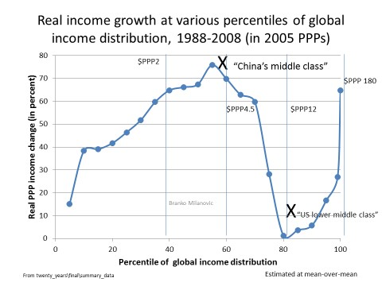

Slide 23
Leslie McCall,
Northwestern University
The Politics of Inequality

Slide 24
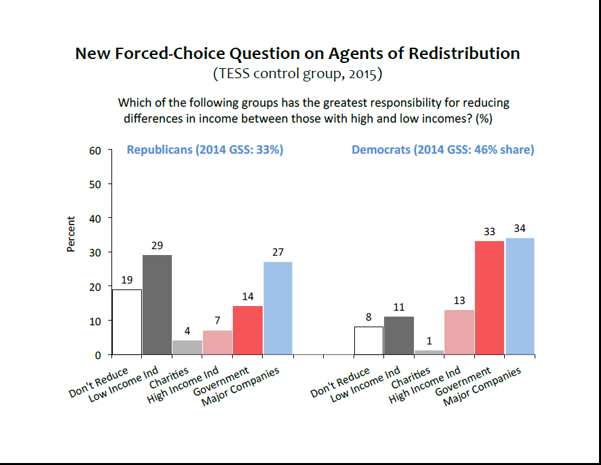

Slide 25
James Parrott,
Fiscal Policy Institute
Inequality and NYC

Slide 26
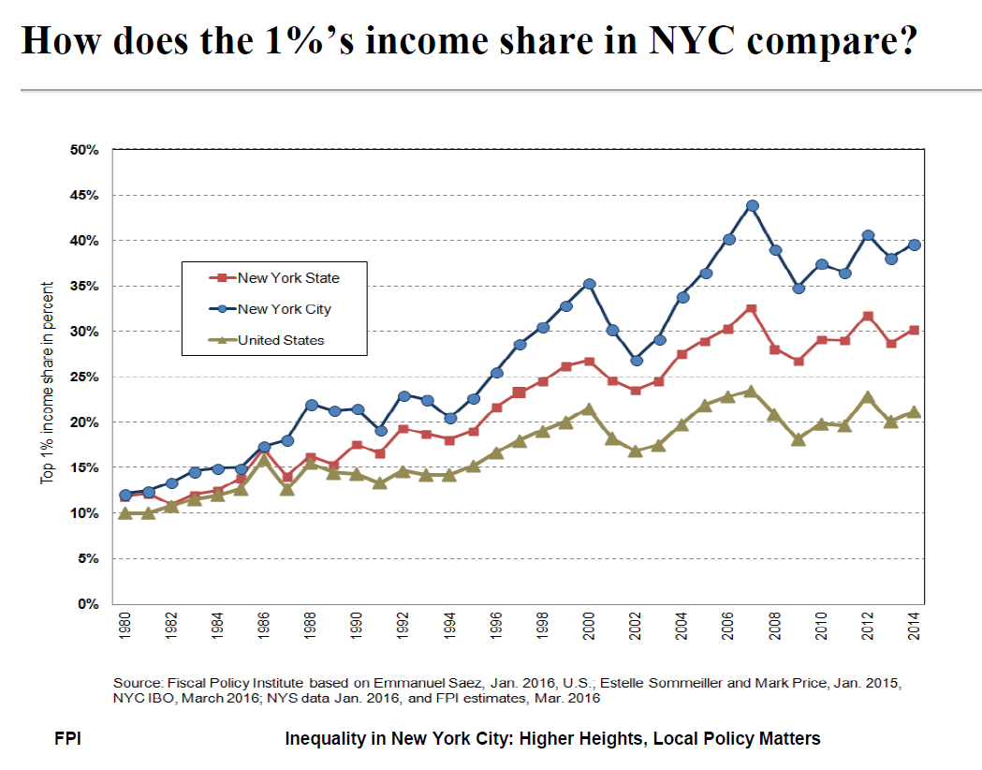

Slide 27
Andrew Clark
Paris School of Economics
Inequality and Happiness

Slide 28
Some key conclusions:
We think that higher income reduces the dispersion of well-being through the provision of public goods (paid for by the rich, enjoyed by all)
Happiness inequality is determined by income inequality as well.
Modern growth has come with greater income inequality.
In most countries the level of income effect has trumped the income inequality effect.

Slide 29
Shahra Razavi
UN Women
Inequality, Gender,
and Human Rights

Slide 30
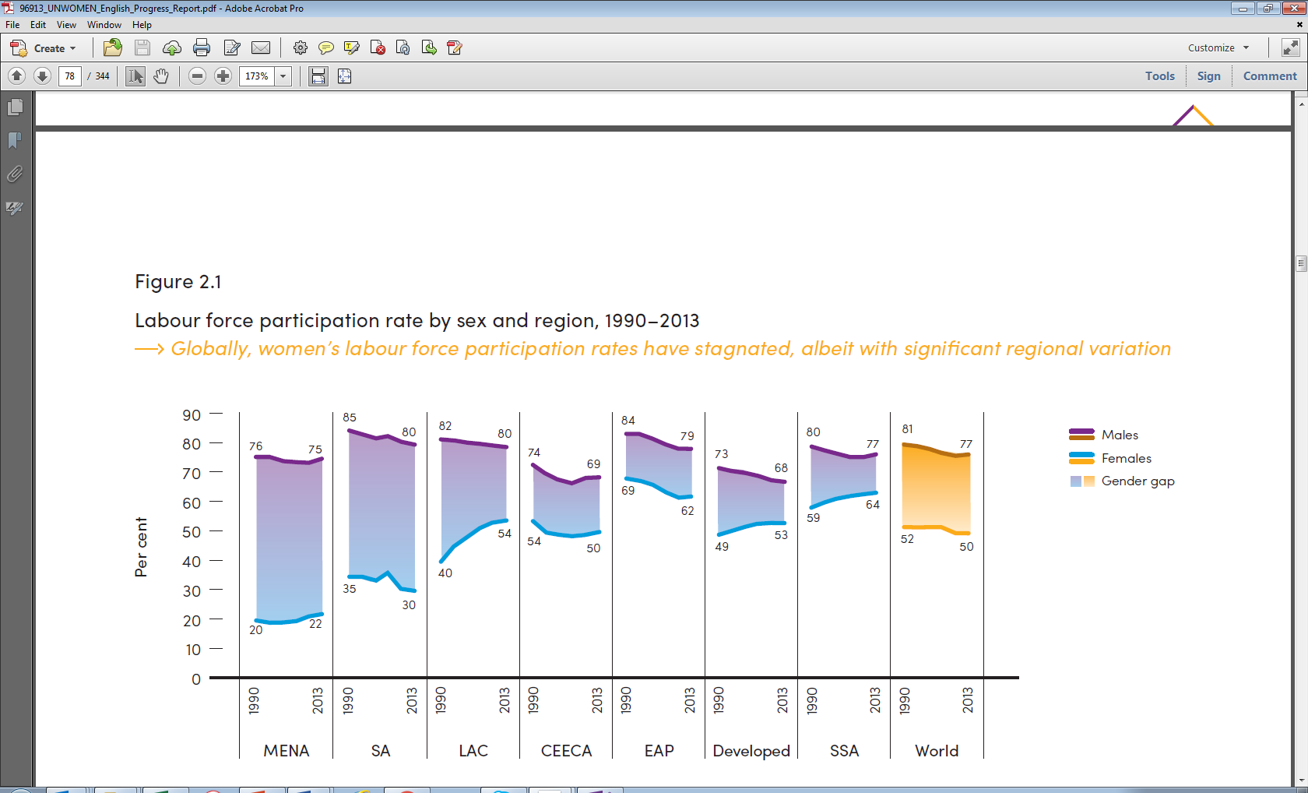
Gender inequalities in the economic domain labour force participation rates, 1990-2013
Middle East and North Africa (MENA), South Asia (SA), Latin America and the Caribbean (LAC), Central, Eastern Europe, Central Asia (CEECA), East Asia and the Pacific (EAP), Sub-Saharan Africa (SSA).
Labour force participation rate by sex and region, 1990-2013

Slide 31
Larry Mishel
Economic Policy Institute
Inequality and Wages

Slide 32
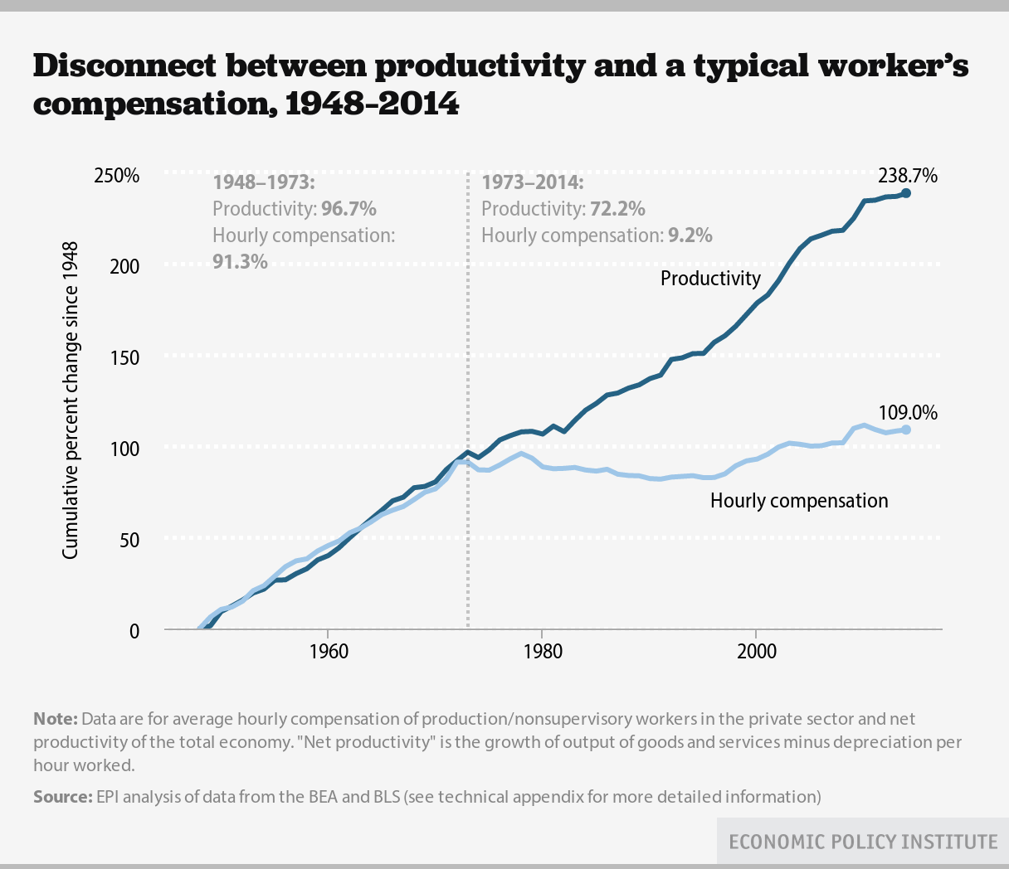

Slide 33
Paul Krugman
GC-CUNY
Inequality
and the Macro-Economy

Slide 34
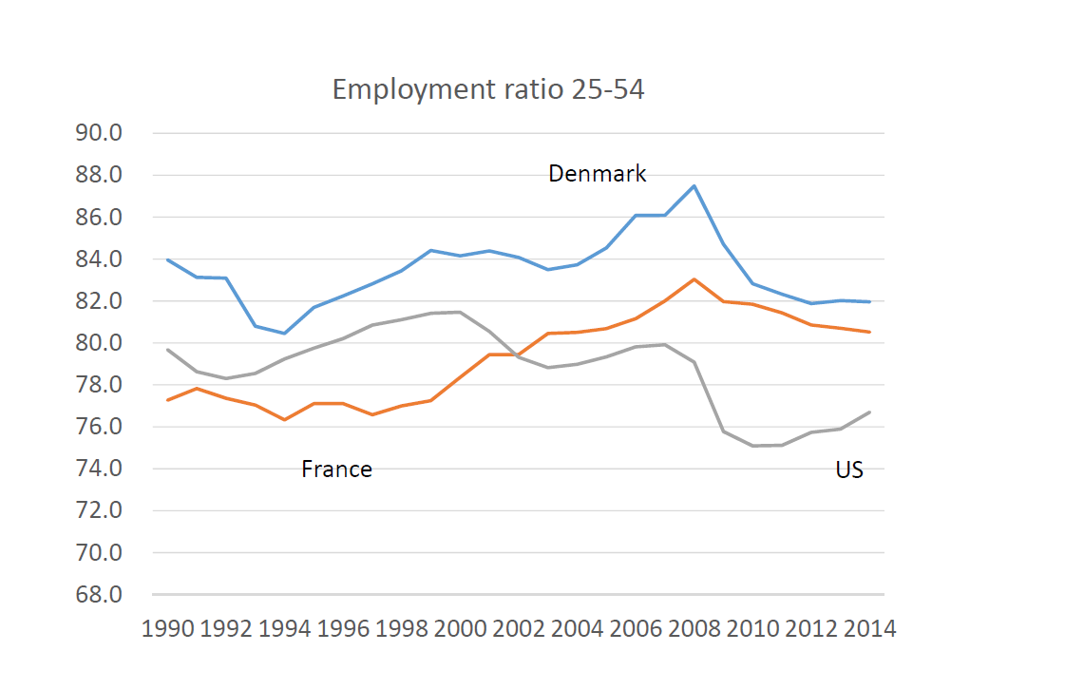

Slide 35
Conchita D’Ambrosio
University of Luxembourg
Inequality Analysis Tools

Slide 36
Some key conclusions:
Deprivation has attracted increasing attention in the past decades when the measurement of individual well-being gained importance not only in the academic context but also in the public discourse and in policy-making circles.
The main reason for this is … the observation that, since individuals do not live in isolation, they determine their well-being also from comparisons with others. Comparisons to richer individuals matter.
Although this consideration appears to be absent from much of standard economic modeling, it has been shown to be one of the main determinants of self-reported satisfaction with income and life.
Measuring relative deprivation is important not only per se but also because of its links to major social phenomena such as: crime, political violence, health status, mortality, and migration decisions.

Slide 37
Suresh Naidu,
Columbia University
Inequality and Economic History

Slide 38
Shares of global income received by bottom 60% and top 10% of world population (1820-2008).
Industrial
Revolution
Start of WWI: 1914
Start of WWII: 1939
Take-off of China and India:

Slide 39
Paula England
New York University
Inequality and Motherhood

Slide 40
Some key conclusions:
After adjustments for selectivity, motherhood depresses the wages of U.S. women.
Suggested explanations are that mothers
- spend years out of employment, losing experience
- work part-time, which pays less well per hour
- shift to more “mother-friendly” jobs that pay less
- have lowered productivity, even net of experience
- are victims of employers’ discrimination against mothers
Persistence of effects in analyses with “fixed effects” (women compared to themselves) suggests causal effects

Slide 41
Louis Chauvel
University of Luxembourg
Inequality Across Cohorts

Slide 42
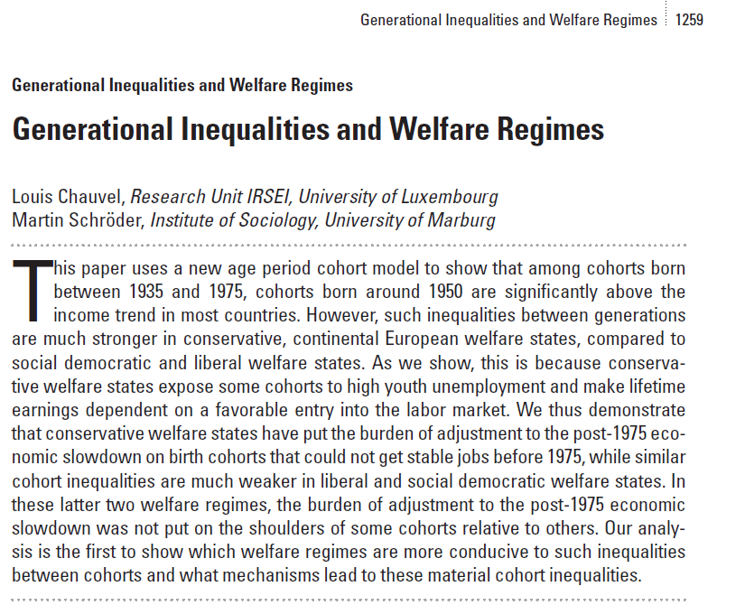

Slide 43
Richard Alba
GC-CUNY
Inequality and Immigration

Slide 44
An historic transition underway
Because of immigration, all western societies are facing a demographic transition to a much more diverse working-age population.
During the next quarter century, this transition will result from a conjunction of two forces:
  The exit from the work force of the large, heavily native, baby-boom cohorts born after World War II.
  The maturation of very diverse youth cohorts, containing many who have grown up in immigrant homes.
Historically, the U.S. mostly has recruited its most highly skilled workers and its leadership from white men. What will these changes mean?

Slide 45
Sarah Bruch
University of Iowa
Inequality Across the U.S. States

Slide 47
Janet Gornick
GC-CUNY with
Berglind Hólm Ragnarsdóttir,
Laurie Maldonado, Sarah Kostecki, and Nathaniel Johnson
LIS Data: A Resource for
Inequality Research

Slide 48
Topics illustrated
Poverty among single parents
Role of non-cash transfers
Women’s economic dependency
Wealth levels and composition

Slide 49
Darrick Hamilton
New School
Inequality, Racial Disparity,
and Stratification Economics

Slide 50
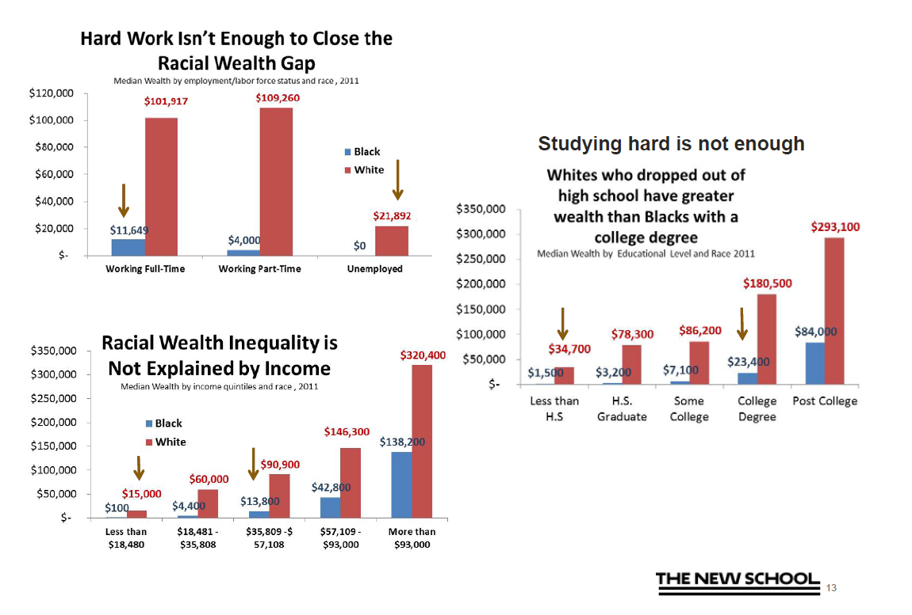

Slide 51
Mary Clare Lennon
GC-CUNY
Inequality and
Children's Life Chances

Slide 52
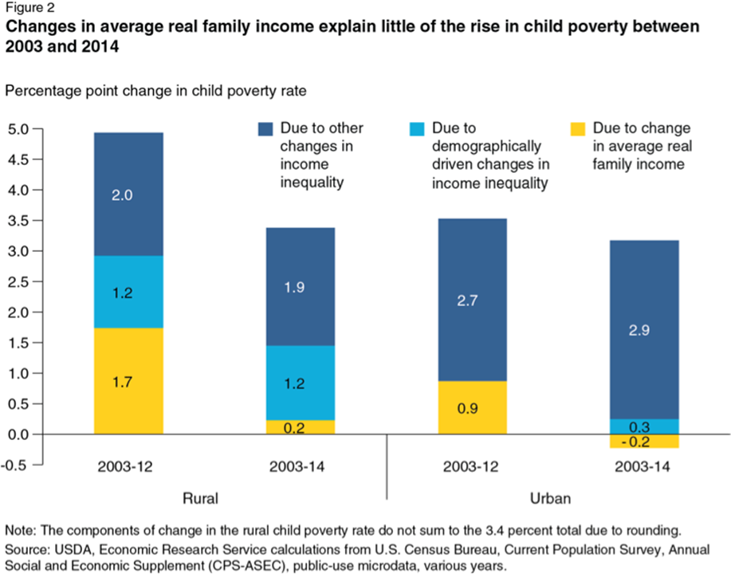

Slide 53
Thank You
Janet C. Gornick, Director

