Slide 1
Inequality, Economic Growth and Decent Jobs in the Rich World: What Happened to Labor Market Institutions?
David R. Howell
The New School
“Inequality by the Numbers”
Workshop on Socio-Economic Inequalities
GC-CUNY and LIS
New York City
June 2, 2015

Slide 2
Outline
The Problem: Documentation of a distributional regime change that starts around 1980 (the neo-liberal era; the great laissez-faire experiment)
Explanations: S&D versus Political Economy Stories
From Inequality to Growth: Is this really the question? (CAP report)
Positive: Orthodox equality-efficiency tradeoff view
Negative: PE equality-efficiency complementarity view
From Growth to Decent Jobs: Or is the sharing of growth really the question, if you’re in the bottom 90%? (WCEG project)

Slide 3
1. The Problem in 8 Dimensions (Slides)
A spectacular distributional regime change, from shared to unshared growth
Date of the revolution: about 1980
Top Incomes: take-off in both income shares and real incomes
The rest: stability or decline in shares and $$
Income and compensation decouples from productivity growth
US exceptionalism (excepting the UK…)

Slide 4
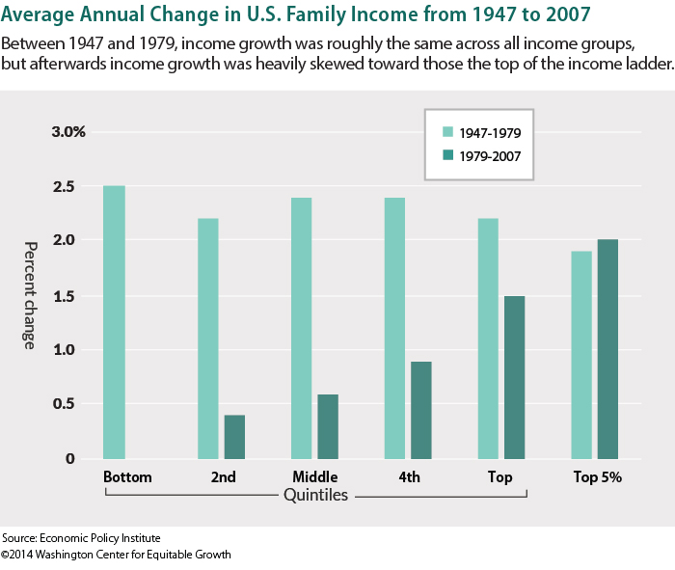
The Great American U-Turn in Shared Wealth

Slide 5
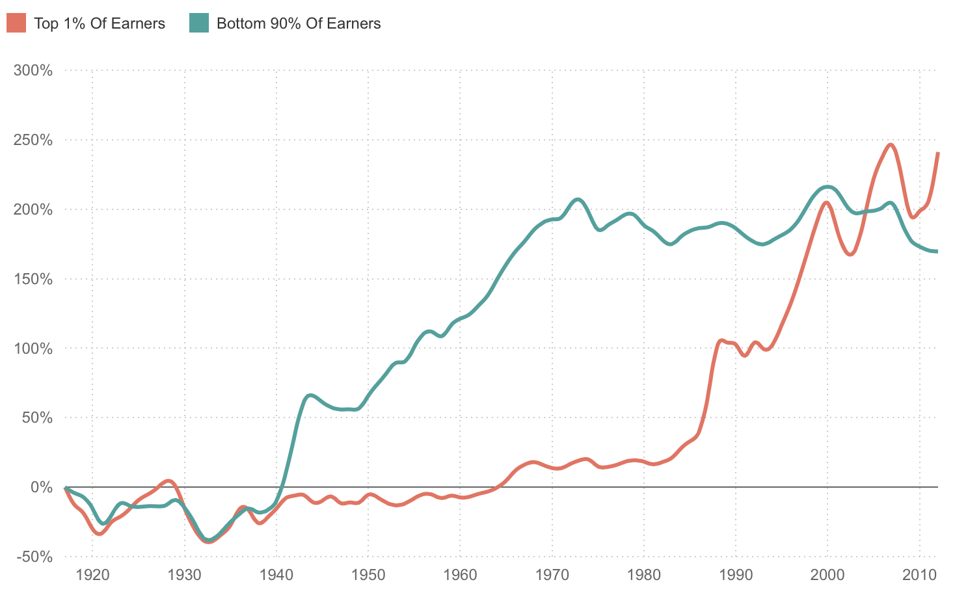
Income Growth for the Top 1% and the Bottom 90%, 1917-2012
Source: NPR, 2015: http://www.npr.org/sections/money/2015/02/11/384988128/the-fall-and-rise-of-u-s-inequality-in-2-graphs

Slide 6
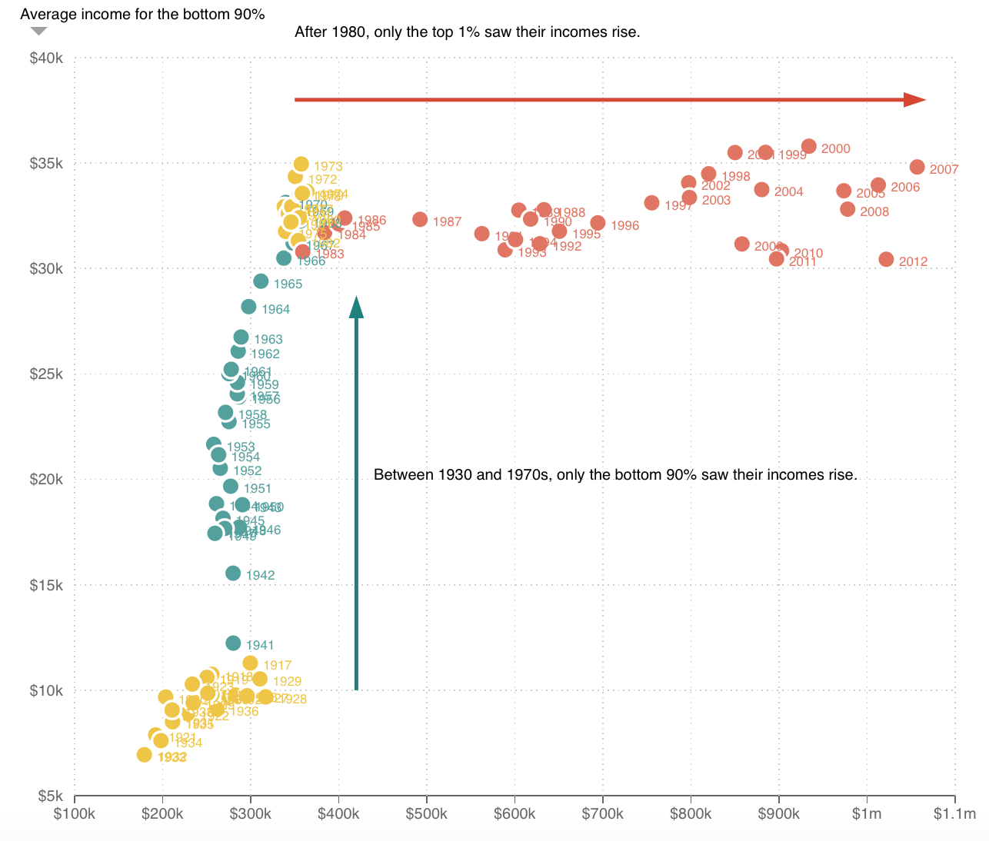
Income Levels for the top 1% and bottom 90% in Real $$, 1917-2012
Source: npr 2015: http://www.npr.org/sections/money/2015/02/11/384988128/the-fall-and-rise-of-u-s-inequality-in-2-graphs

Slide 7
The 1980 Revolution in Unshared Growth Top 1%, Top 5% and the Middle 60% Share of Total Income for the US
Sources: US Census Table H-2 for the series Top 5 Percent and the Middle Class. The Top 1 Percent series is taken from the World Top Incomes Database (WTID). All three series are indexed to 100 in 1980.
Notes:
2007: from 1980, top 1% - up 125%; top 5% up 30%; middle 60% down 10%
Sources: US Census Table H-2 for the series Top 5 Percent and the Middle Class. The Top 1 Percent series is taken from the World Top Incomes Database (WTID). All three series are indexed to 100 in 1980.

Slide 8
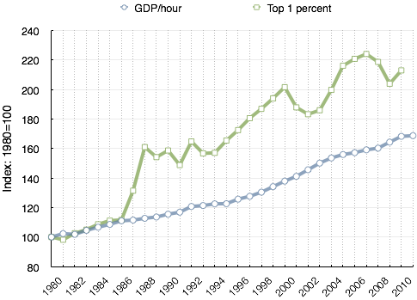
US Growth in Real Productivity (GDP/Hour)
and Top Incomes (1% Share), 1980-2011

Slide 10
Cumulative Manufacturing Productivity Growth and Real Manufacturing Production Worker Compensation Growth in 6 Rich Countries, 1980-2009
(Index: 1980 = 100)
Author’s calculations based on data from the US Bureau of Labor Statistics. Compensation of production workers is from “International Comparisons of Hourly Compensation Costs in Manufacturing, 1975-2009”, Table 1.5. Real compensation is calculated with CPI-U. Productivity is taken from “International Comparisons of Manufacturing Productivity and Unit Labor Cost Trends, 2011: table7, which is calculated based on the GDP deflator.
Notes:
The US had by far the strongest mfg productivity growth over these 3 decades, but also had by far the slowest mfg worker compensation growth (cumulative 4%, compared to France’s 43%) – producing a huge prod-comp gap.

Slide 11
The Middle-Class (20-79th percentiles) Income Shares for 15 High-Income Countries, 1980-85 and 2004-07
Source: Author’s calculations based on data from the Luxembourg Income Study (LIS) Database. Middle Income Shares are defined as the share of total disposable monetary household income going to 20th-79th percentiles. Income is bottom-coded and excludes income of less than1 unit of national currency.

Slide 12
2. What Explains the Distributional Regime Shift (Revolution)?
Orthodox Economics and the Political Right:
S&D: Globalization, SBTC and the race between technology and education
The Political Economy Account:
The orthodox story only outlines the context, one that applies to the entire rich world
The story behind the US (UK) post-1980 regime change and exceptionalism in the rich world:
political choices → policy shifts/institutional restructuring →
1) increasing rents at the top (10%)
2) collapsing bargaining power at the bottom (90%)

Slide 13
Mainstream economics and the political right
A Demand/Supply story: computerization → massive SBTC in the workplace while workers have failed to upgrade their skills (the educational system…)
The Vision: LMs are increasingly competitive in the textbook sense -- workers generally get their “marginal product”

Slide 14
Examples
Rising wage inequality? Acemoglu/Autor (2010 HLE: wage inequality) is explained by a model that “crucially depends on competitive labor markets, where each worker is paid the value of his or her marginal product” (p. 82).
Extremely high top incomes?: companies are larger and costs of poor performance higher (Kaplan, JEP)
Low and falling middle/low incomes: a problem of a slowdown of college grads as computers have driven up demand

Slide 15
Where are the LM institutions?
Goldin and Katz (The Race Between Technology and Education): “Stripped to essentials, the ebb and flow of wage inequality is all about education and technology.”
Acemoglu and Autor (2012 JEL review of G-K on how to explain rising wage inequality): “institution” appears exactly once, as “education institutions”
not a single mention labor market institutions

Slide 16
But then… Acemoglu critiques Piketty for failing to take institutions into account!
“(Piketty’s) approach and general laws ignore both institutions and the flexible and multifaceted nature of technology shaped by institutions…. any plausible theory of inequality has to include political and economic institutions at the center stage.” YES!!!
[Acemoglu and Autor
vs
Acemoglu and Robinson?]

Slide 17
A Reality Check: Piketty’s critique of the Neoclassical story
Chapter 9: “… (T)he main problem with the theory of marginal productivity is quite simply that it fails to explain the diversity of the wage distributions we observe in different countries at different times. In order to understand the dynamics of wage inequality, we must introduce other factors, such as the institutions and rules that govern the operation of the labor market in each society.

Slide 18
Piketty’s Critique Con’t
To an even greater extent than other markets, the labor market is not a mathematical abstraction whose workings are entirely determined by natural and immutable mechanisms and implacable forces: it is a social construct based on specific rules and compromises.
In the previous chapter I noted several important episodes of compression and expansion of wage hierarchies that are very difficult to explain solely in terms of the supply of and demand for various skills” (p. 308).

Slide 20
The Political Economy Story: What Was the Laissez-Faire Experiment?
State Policy:
*deregulation (finance, transp. & comm.),
* tax ‘reform’ (high incomes), and
* public policies (explicitly designed to undermine LM protections like min wage and labor unions)
Financialization: explosion in pay for financiers and CEOs, collapse in worker bargaining power
greatly facilitated by tech changes in communications and transportation and by shifts to pro-market social norms/ideology )

Slide 21
Financialization?
Nonfinancial firms - corp gov: max share value, incentivizing arms race in exec compensation via debt, squeezed worker pay and outsourcing/offshoring: explosion of w/in firm inequality
Financial sector: debt & speculative trading → doubling of finance sector income share: financier incomes skyrocket

Slide 23
Household Disposable Income Inequality (2000) and ‘Freedom’ from Government (the inverse of government size, 2000-08 average) for 20 High-Income Countries
Source: Gini coefficient is from the OECD database on income inequality and poverty (disposable household equivalized income). The size of government metric is taken from the economic freedom index, published by the Fraser Institute.

Slide 24
The 90/10 ratio of Household Disposable Monetary Income (per HH member) for 14 High-Income Countries, 1980-85 and 2005-08
Source: Author’s calculations based on data from the Luxembourg Income Study (LIS) Database.

Slide 25
3. Income Inequality and Growth
Howell, CAP report (2013):
the literature is inconclusive
Data quality, levels of development, time periods, parts of the income distribution…
OECD (2014) and the IMF (2014) !!!!
Unequivocal: Inequality → slower growth!
Federico Cingano, “Trends in Income Inequality and its Impact on Economic Growth” (OECD, WP no. 163)
Ostry, Berg and Tsangarides, “Redistribution, Inequality, and Growth (IMF Staff Discussion Note, February 2014)
Milanovic/van der Weide, “Inequality is Bad for Growth of the Poor (But Not for thaty of of the Rich), no date…
: “We find that high overall inequality only appears to hurt income growth of the poor.”

Slide 26
Household Disposable Income Inequality (gini 2000) and Average Annual Real Productivity Growth (GDP per hour, 1994-2007) for 20 Rich Countries
Author’s calculations based on data from the OECD Database on Income Distribution and Poverty and the EU-KLEMS Database

Slide 27
4. From Growth to Decent Jobs
In the Post-1980 world, it’s not about inequality to growth, but about growth to decent jobs and household incomes
The Equitable Growth Decent Jobs Project – motivating questions
Since the early 1990s, how successful have other rich countries been at sharing economic growth with workers and households across the income distribution? What role for institutions?
Which economic sectors (e.g., manufacturing, finance, wholesale and retail trade, and health/education) were the best at translating economic growth into good jobs with rising real (inflation-adjusted) pay after 1980 for prime-age workers (by gender and education) – in the US and other affluent countries: the UK, Canada, France and Germany?

Slide 28
Two-part Research Design: data analysis & institutional case studies for 5 rich countries
Empirical:
This project makes use of national household survey data to explore the relationship between economic growth and both the generation of decent jobs (those not characterized by very low pay or inadequate hours) and the growth in real (inflation-adjusted) pay
by gender and education and economic sector, focused on prime-age workers – for the US and four other large, diverse and affluent nations: the UK, Canada, Germany and France.
Same for low-paid jobs: changes in share, average wage, and dispersion below the low-wage threshold

Slide 29
Institutional Case Studies:
What are the institutional determinants of good job performance/ worker bargaining power?
Case Studies: effects on worker bargaining power of
wage setting institutions (unions/min wage)
PLMIs (UI, EPL…)
the social wage
product market regulations and firm-driven employment restructuring
trade and outsourcing
Financialization: of corporate decision making; worker/consumer/student debt

Slide 30
The Measurement of ‘Decent jobs’
The “decent jobs” indicator is a measure of employment quality, and to facilitate cross-country analysis with national household survey data, it is limited to the adequacy of wages and hours worked.
It defines a “decent job” as one in which the worker is paid above the conventional low wage threshold and has adequate hours of work.

Slide 31
The Baseline Low-Wage Threshold
The baseline low-wage threshold is the same as used by the OECD: 2/3 of the full-time median wage.
It is therefore a relative measure, one that is sensitive to the wage distribution of each country
But assumes that the “socially inclusive” relative wage is the same
Problem of the social wage: the US should have a HIGHER market wage, especially lower in the distribution where employment-related benefits are fewer/absent).

Slide 32
Our preferred wage threshold is one that reflects growing inequality
But under conditions of growing wage inequality and stagnant or declining median hourly pay, the average full-time wage would likely be a better reference point for what is a socially acceptable wage.
But due to top-coding issues, we will also use 1/3 of the 90th percentile wage (thanks to John Schmitt for this suggestion).

Slide 33
Anecdotal Evidence: What’s a decent wage threshold for the US (and other rich countries?)
Fast food wage movement: $15
National Low Income Housing Coalition study
Wage required for a modest 2 bedroom apartment for a full time (40 hours, 52 weeks) worker with total housing costs at no more than 30% of total income : $19.35
For a modest 1 bedroom: $15.50

Slide 34
Hourly Wage Needed to Afford a Two-Bedroom Apartment
Source: NLIHC, “Out of Reach”, 2015

Slide 35
Adequate Hours
Decent employment also requires adequate hours of work, and an appropriate indicator is available from the household surveys of many countries.
Some workers prefer part-time jobs, so our second criterion for a decent job is that working less than a full-time weekly work schedule is voluntary.
So in addition to not paying low wages, a worker has a decent job if he/she is not working involuntarily part-time (or as the household surveys put it, “part-time for economic reasons”).

Slide 36
Preliminary Results
1. Low wage thresholds (what’s a “low wage”?)
2/3 median F-T wage for prime age workers?
Mean for all workers?
1/3 of the 90th percentile wage?
2. Decent Job rates using the median for P-A workers (per EMPL, LF, POP)
3. Growth and Employment
→ Growth and Decent Jobs

Slide 37
Author’s calculations from CPS ORG data, available from the Center for Economic and Policy Research

Slide 38
Alternative Low Wage Thresholds Using the Median Wage
(in 2014 dollars)
Author’s calculations from CPS ORG data, available from the Center for Economic and Policy Research

Slide 39
Alternative Low Wage Thresholds Using the Mean Wage
(in 2014 dollars)
Author’s calculations from CPS ORG data, available from the Center for Economic and Policy Research

Slide 40
Decent job/empl rates for total and prime age workers
Decent jobs are defined as those not paid a low wage (<2/3 of the median wage for full time workers and not working involuntarily part-time, using CPS-ORG data from CEPR (Washington DC).

Slide 41
Decent Job/employment rates for 20-34 year olds: total, male and female, 1980-2014
Decent jobs are defined as those not paid a low wage (<2/3 of the median wage for full time workers and not working involuntarily part-time, using CPS-ORG data from CEPR (Washington DC).

Slide 42
How Does Economic Growth Translate into Employment? Into Decent Jobs? [The results shown in slides 44-51 are our calculations using data from the National Income and Product Accounts (for output and the index of Industrial Production) and from the Bureau of Labor Statistics for the employment indicators]

Slide 43
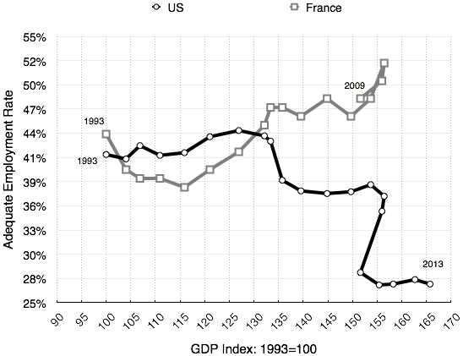
Real GDP/hour and Decent Job Rates for 20-34 year old high school graduates in the US and France since 1993
The adequate employment (or ‘decent job’) rate is measured as the share of employed wage and salary workers not paid a low wage and not working involuntarily part-time. “Low-wage” is defined as less than 2/3 of the median wage for full time workers. The data are the CPS-ORG, available from the Center for Economic and Policy Research. For details on the French adequate employment rate, see Howell and Okatenko, “By What Measure: A Comparison of French and US labor market performance with new indicators of employment adequacy, International Review of Applied Economics, May 2010)

Slide 44
Alternative Employment Metrics

Slide 45
Alternative Growth Metrics: GDP and the Industrial Production Index

Slide 46
FTE Employment and GDP: What Happened ?

Slide 47
Industrial Production and Employment: better than GDP?

Slide 48
Growth and Decent Employment

Slide 49
Industrial Production and Decent Employment: Definitely Superior!

Slide 50
The Post-late 90s Employment to Output deficit (predicted vs actual) – IPI vs GDP

Slide 51
The Decent Employment-Output Gap: IPI does a much better job of predicting decent job than GDP since the 2001 recession

Slide 52
Conclusion
An expanded version of these analyses will be done for Canada, the UK, France and Germany
Output-decent job relationships will be done for each major sector and demographic group
A story needs to be told: application of the institutional case studies… (I’ll be busy in the Fall at the GC… ☺

