Slide 1
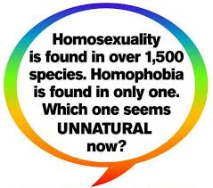
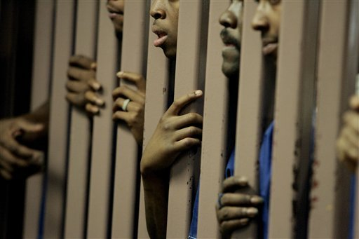
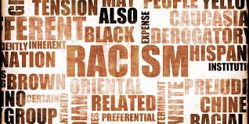
Inequality, Race, & Sexuality
Prof. Juan Battle
JuanBattle.com
June 6, 2017
Notes:
Special thanks to …

Slide 2
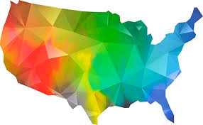
Outline
I. Intersectionality
Size Matters: LGBT America, By The Numbers
No Lube or Mood Music: Researchers (inadvertently) Screwing (over) Vulnerable Populations
Social Justice Sexuality Survey: Researching the Whole Body and Not Just the Holes in the Body
V. Wrapping It Up: Q&A

Slide 3
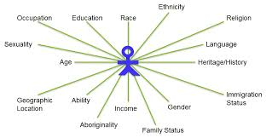
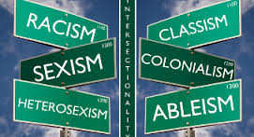
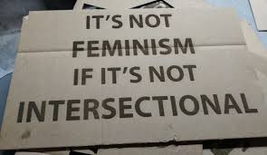
Intersectionality

Slide 4
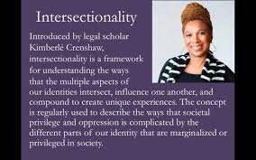
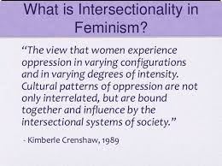
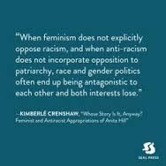
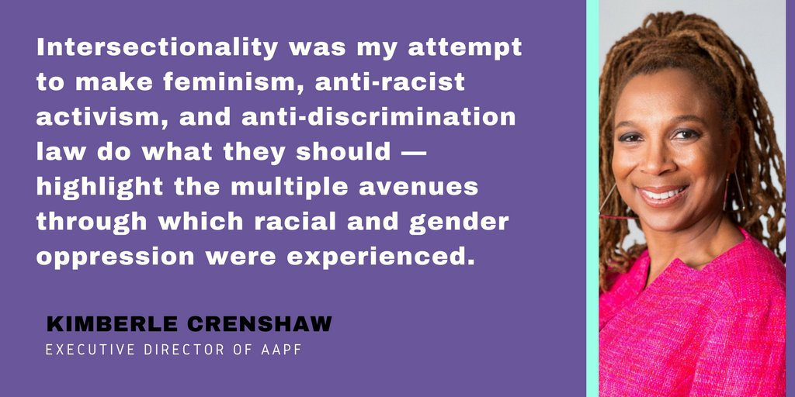
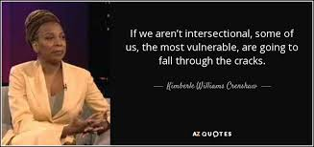

Slide 5
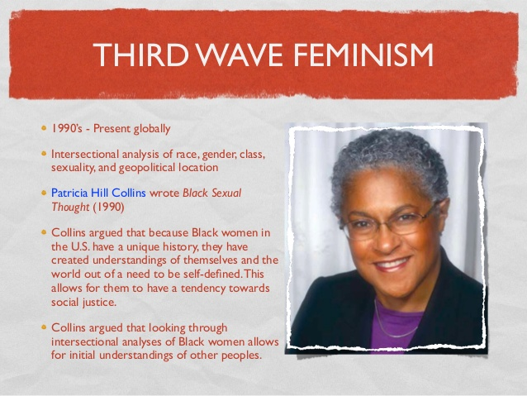
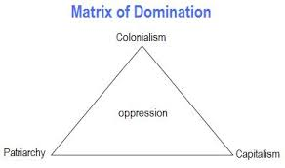
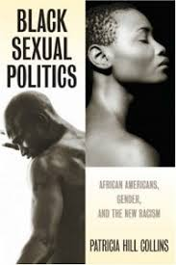
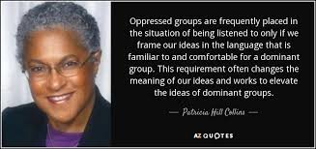

Slide 6
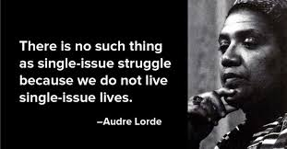
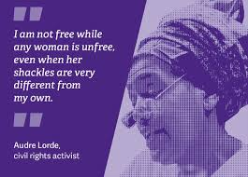
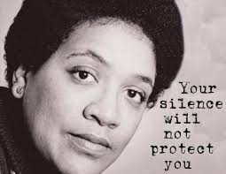
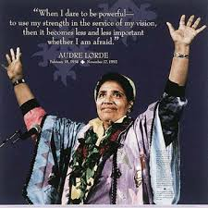
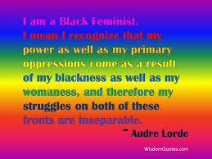

Slide 8
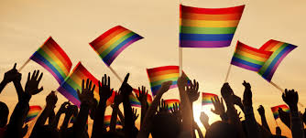
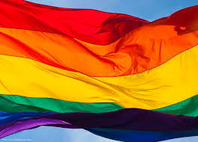
Size Matters: LGBT America, By The Numbers

Slide 9
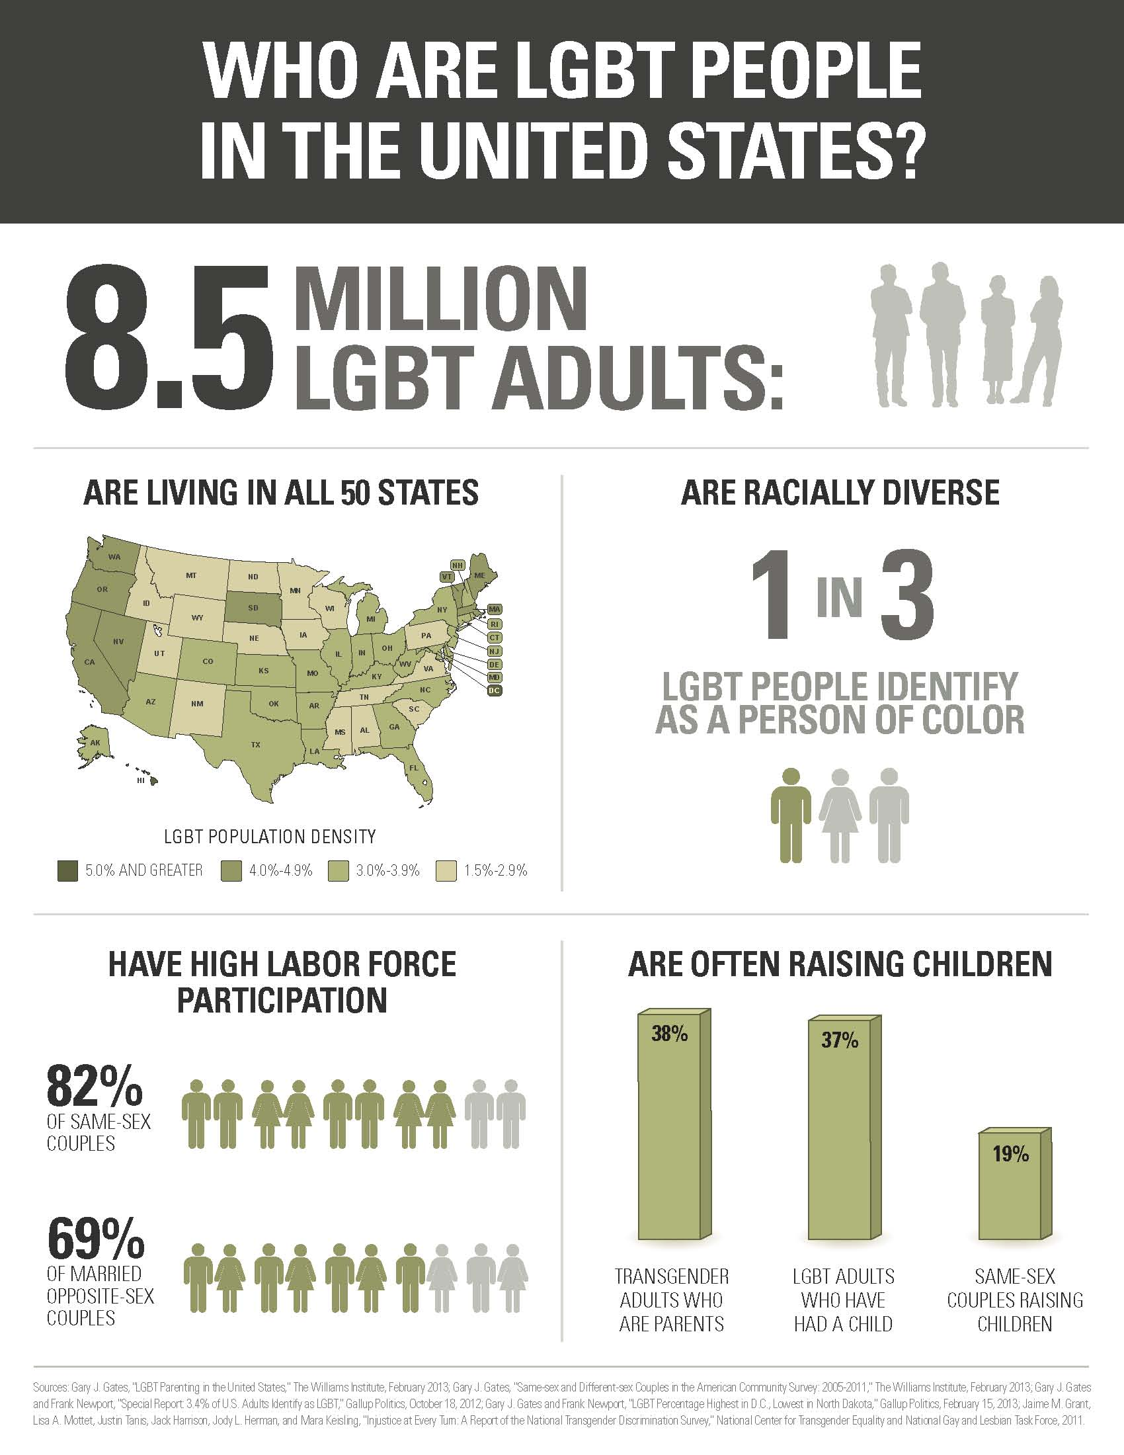

Slide 11
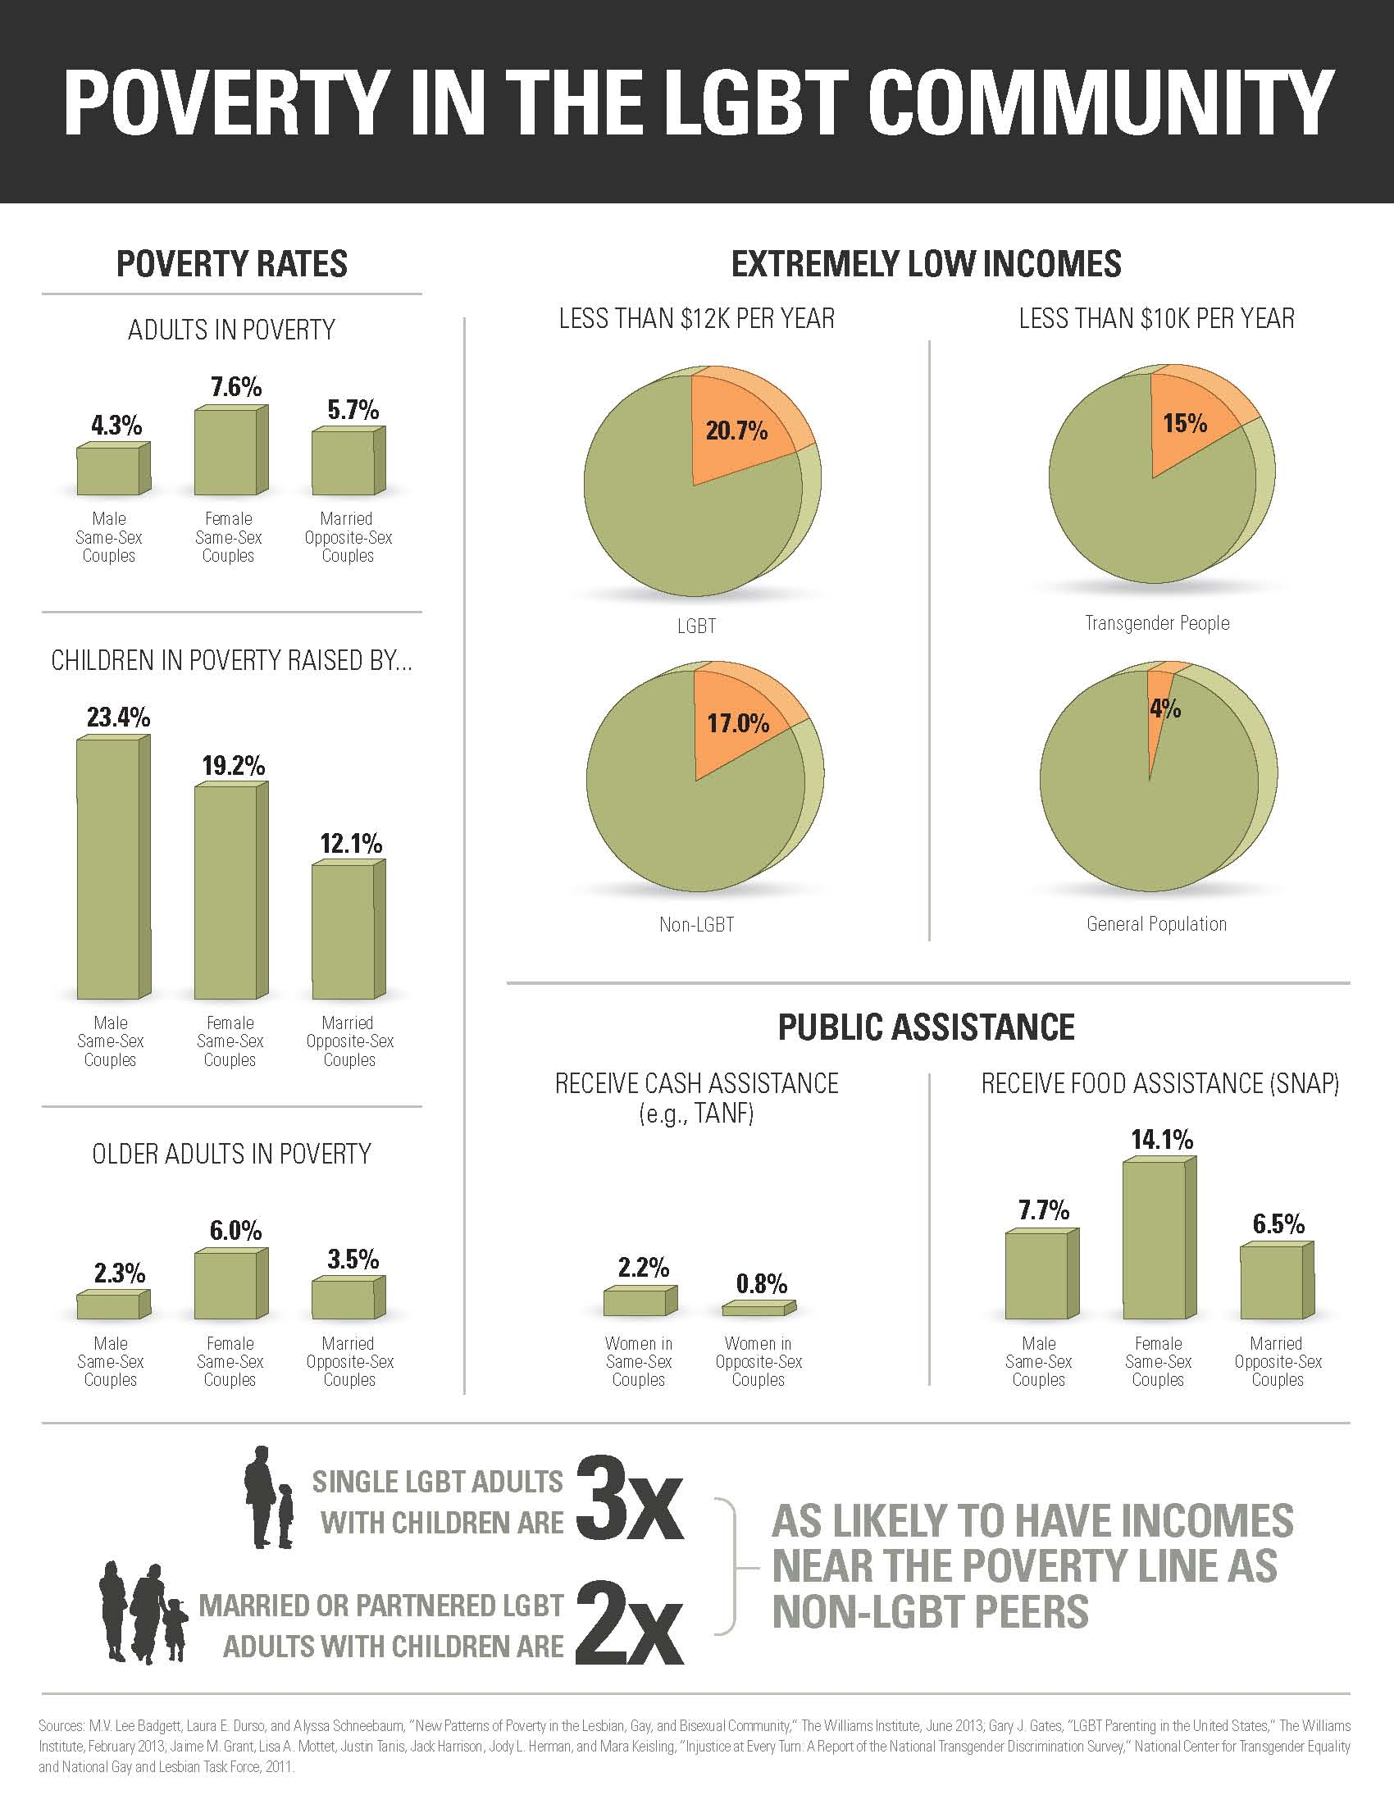

Slide 12
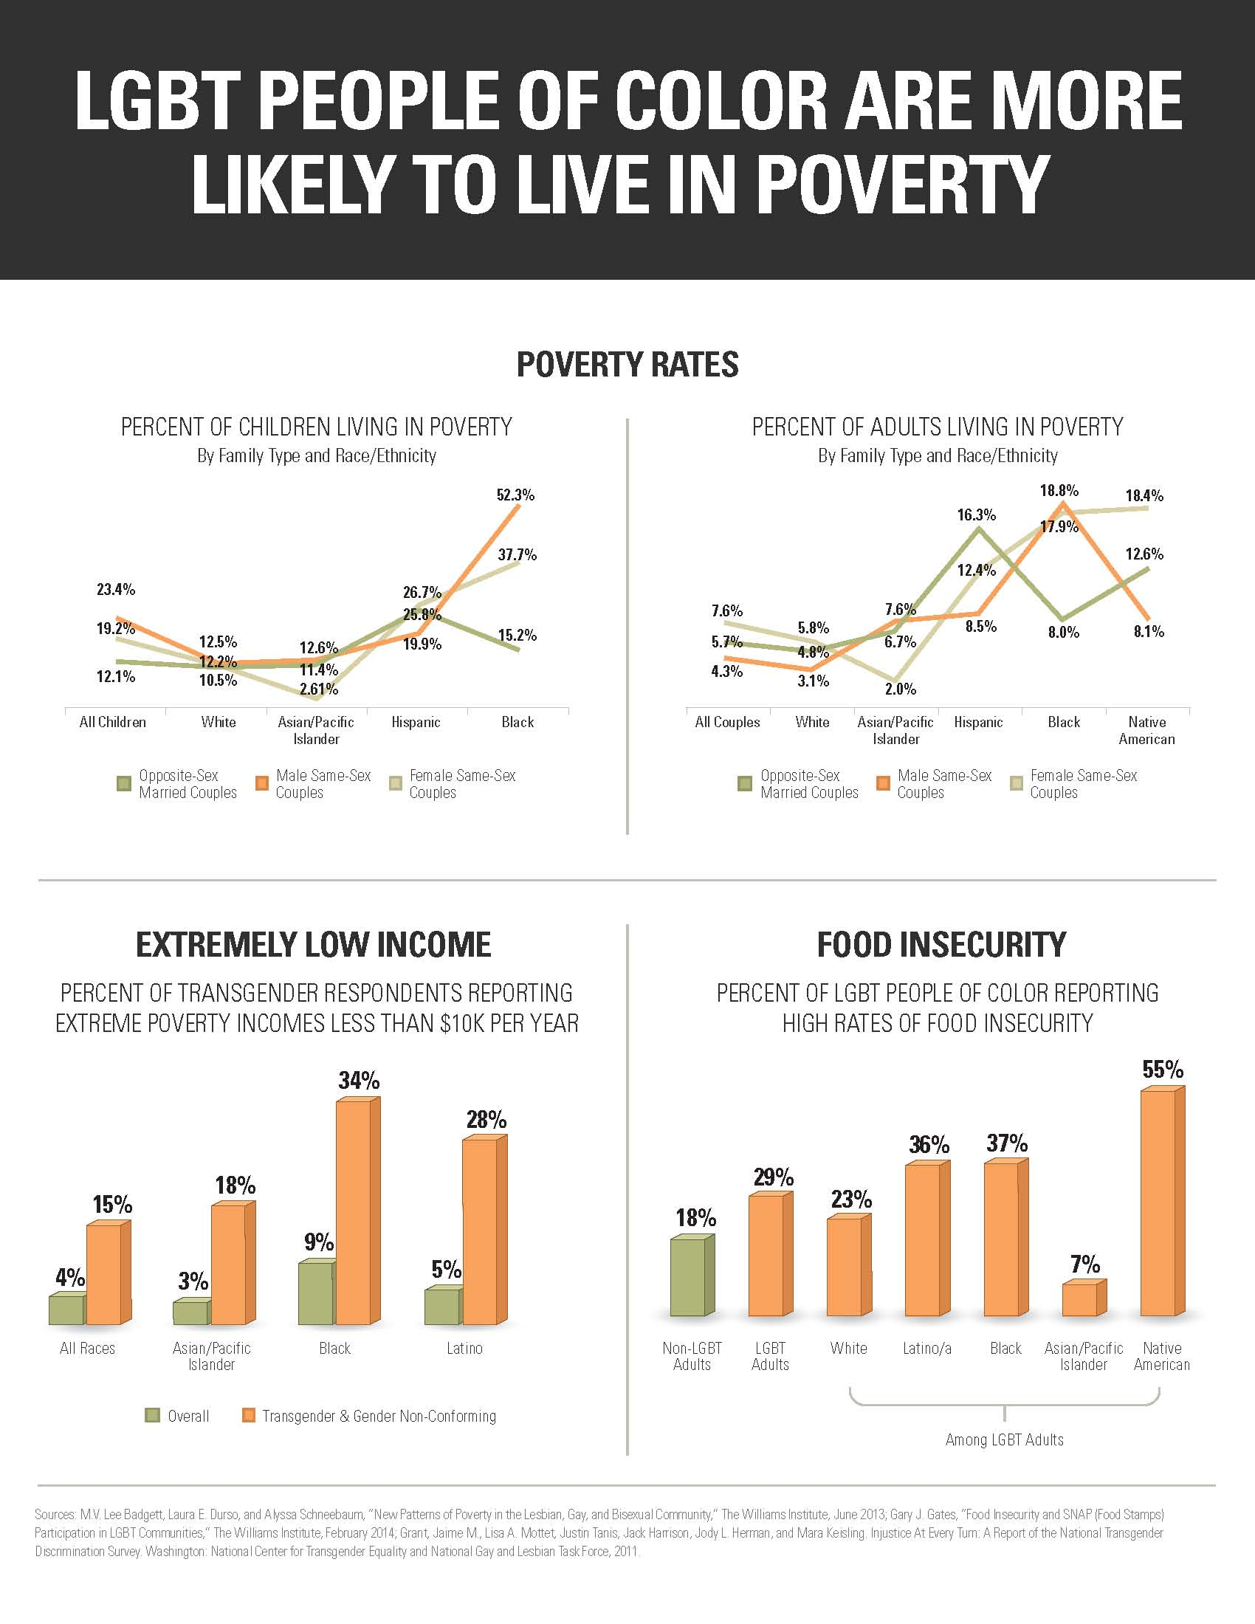

Slide 13
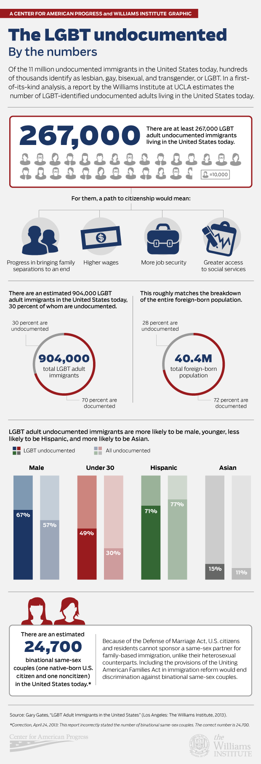

Slide 14
No Lube or Mood Music: Researchers (inadvertently) Screwing (over) Vulnerable Populations
- researchers can perpetuate inequality/discrimination based on
the assumptions they (don’t) make and
the questions they (don’t) ask

Slide 15
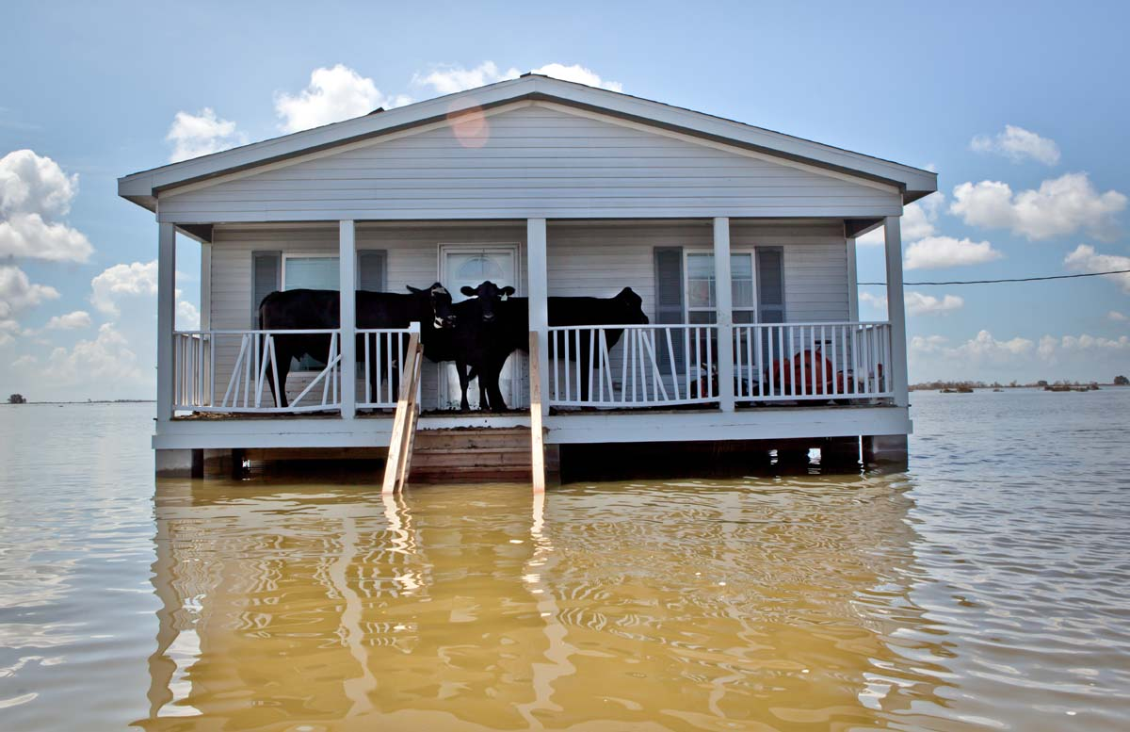

Slide 16
Individual Choices/Behavior

Slide 18
Institutional/Structural
Constraints

Slide 19
< a jailhouse promise>
Notes:
19
Before we began…

Slide 20
< a jailhouse promise>
Notes:
20
Before we began…

Slide 21
Researching the Whole Body and Not Just the Holes in the Body

Slide 22
< proper lens>
Notes:
22
Our purpose: to document & celebrate, not pathologize. We are not just one LGBT community, we are a mosaic of communities.

Slide 23
< our purpose >
Notes:
23
Our purpose: to document & celebrate, not pathologize. We are not just one LGBT community, we are a mosaic of communities.

Slide 24
< knowledge-based survey>
Notes:
24
Our purpose: to document & celebrate, not pathologize. We are not just one LGBT community, we are a mosaic of communities.

Slide 25
< sociopolitical mosaic >
Notes:
25
Our purpose: to document & celebrate, not pathologize. We are not just one LGBT community, we are a mosaic of communities.

Slide 26
< document & celebrate >
Notes:
26
Our purpose: to document & celebrate, not pathologize. We are not just one LGBT community, we are a mosaic of communities.

Slide 27
< not pathologize >
Notes:
27
Our purpose: to document & celebrate, not pathologize. We are not just one LGBT community, we are a mosaic of communities.

Slide 28
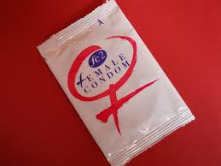
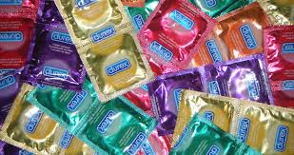
A sexuality study that examined what condoms could not hold!

Slide 29
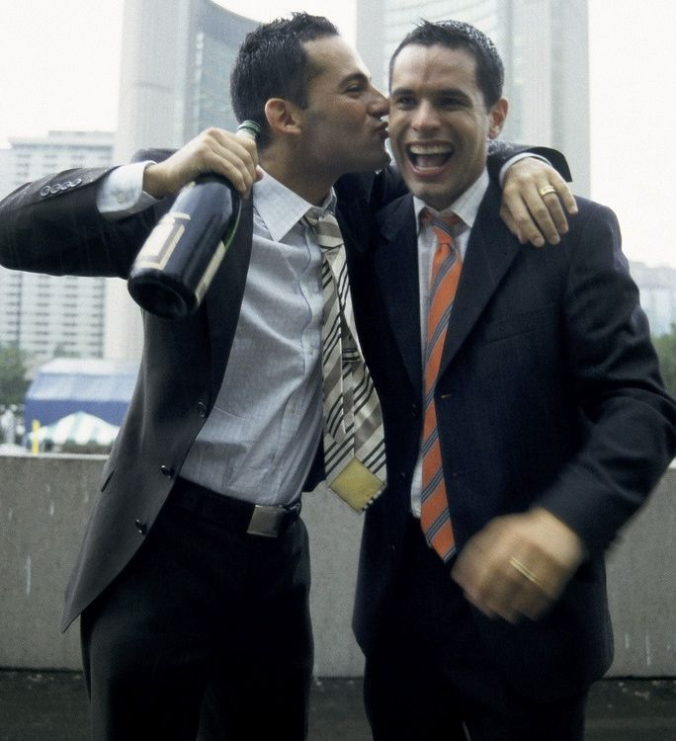
<Other Studies>
Notes:
Focused primarily on one racial/ethnic group (Diaz) or couples (Census), and all have been smaller.

Slide 30
<Diaz, et al; & Battle, et al>
Notes:
Other studies on LGBT people have focused on single racial/ethnic groups, one gender, or gender ID, or on those in couples, or on smaller populations, and were generally done with “easier to capture” or easier to study subpopulations.

Slide 31
<One Group>
Notes:
31
Other studies on LGBT people have focused on single racial/ethnic groups, one gender, or gender ID, or on those in couples, or on smaller populations, and were generally done with “easier to capture” or easier to study subpopulations.

Slide 32
<One Gender>
Notes:
32
Other studies on LGBT people have focused on single racial/ethnic groups, one gender, or gender ID, or on those in couples, or on smaller populations, and were generally done with “easier to capture” or easier to study subpopulations.

Slide 33
<Couples>
Notes:
33
Other studies on LGBT people have focused on single racial/ethnic groups, one gender, or gender ID, or on those in couples, or on smaller populations, and were generally done with “easier to capture” or easier to study subpopulations.

Slide 34
<Ethnographic>
Notes:
34
Other studies on LGBT people have focused on single racial/ethnic groups, one gender, or gender ID, or on those in couples, or on smaller populations, and were generally done with “easier to capture” or easier to study subpopulations.

Slide 35
<Easier to Measure>
Notes:
35
Other studies on LGBT people have focused on single racial/ethnic groups, one gender, or gender ID, or on those in couples, or on smaller populations, and were generally done with “easier to capture” or easier to study subpopulations.

Slide 36
<Sample(s) Looked the Same>
Notes:
36
Other studies on LGBT people have focused on single racial/ethnic groups, one gender, or gender ID, or on those in couples, or on smaller populations, and were generally done with “easier to capture” or easier to study subpopulations.

Slide 37
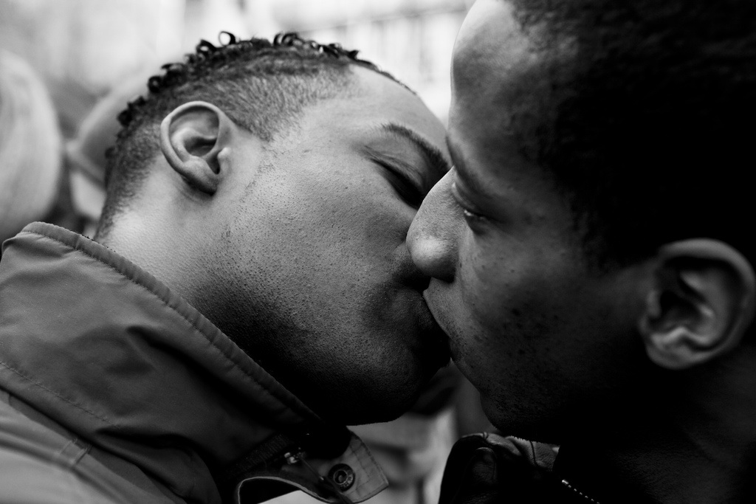
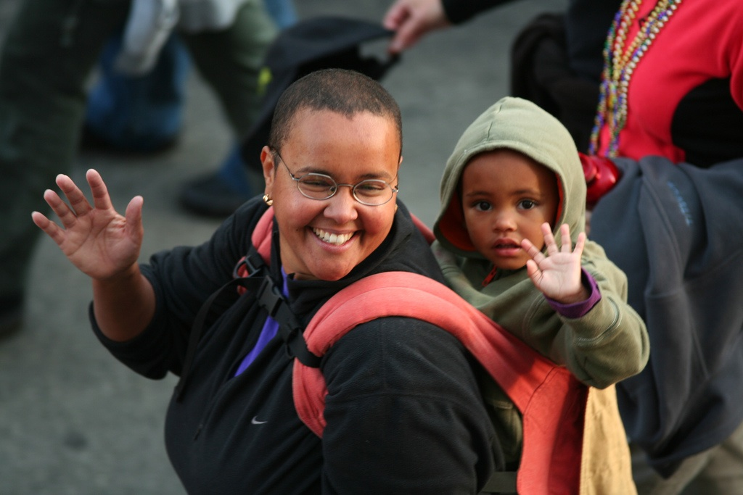
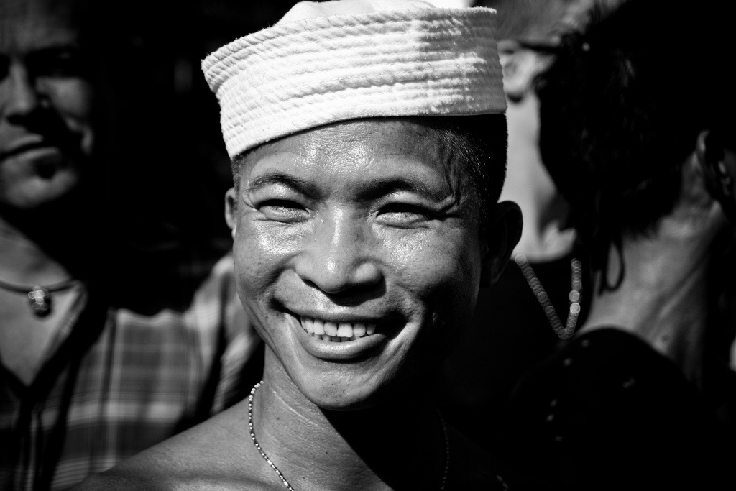
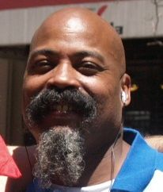
How is the SJS Study Unique/Different?
Notes:
In contrast, the SJS study has a total sample size of 5,500 (down to 4,963). It covers a range of 5 groups - diverse in terms of racial/ethnic group, age, gender, relationship status, sexual orientation & gender ID, and 5 broad topic areas. We used a purposive sample, ideal for a study of this kind where random sampling would systematically exclude people of color and disproportionately include white people.

Slide 38
< Diversity in Groups Sampled>
Notes:
In contrast, the SJS study has a total sample size of 5,500 (down to 4,963). It covers a range of 5 groups - diverse in terms of racial/ethnic group, age, gender, relationship status, sexual orientation & gender ID, and 5 broad topic areas. We used a purposive sample, ideal for a study of this kind where random sampling would systematically exclude people of color and disproportionately include white people.

Slide 39
< 5 Groups >
Notes:
In contrast, the SJS study has a total sample size of 5,500 (down to 4,963). It covers a range of 5 groups - diverse in terms of racial/ethnic group, age, gender, relationship status, sexual orientation & gender ID, and 5 broad topic areas. We used a purposive sample, ideal for a study of this kind where random sampling would systematically exclude people of color and disproportionately include white people.

Slide 40
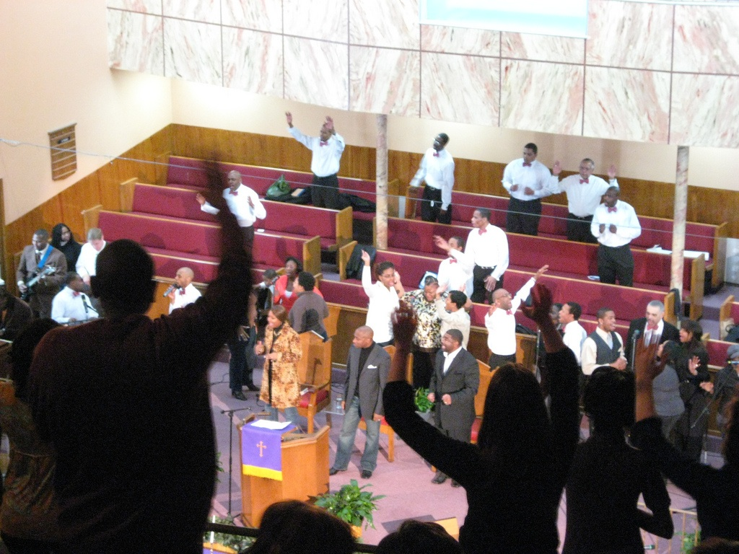
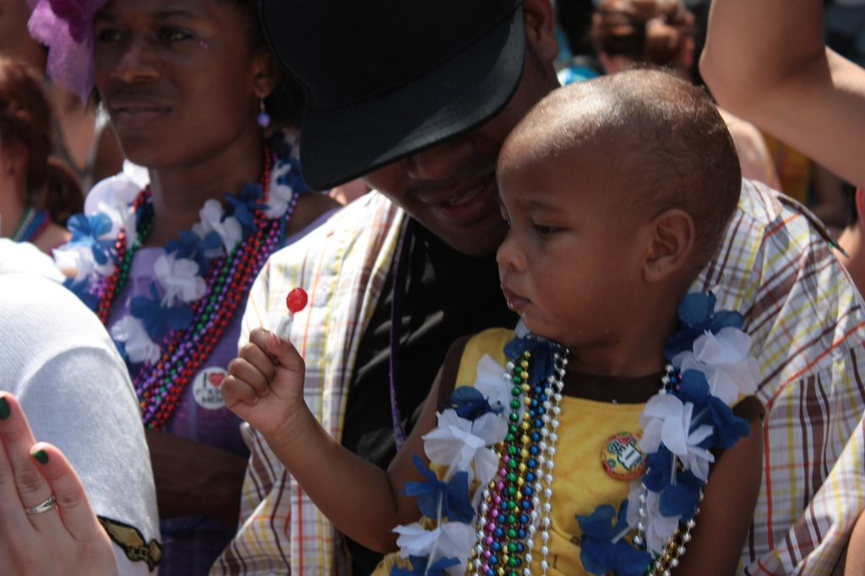
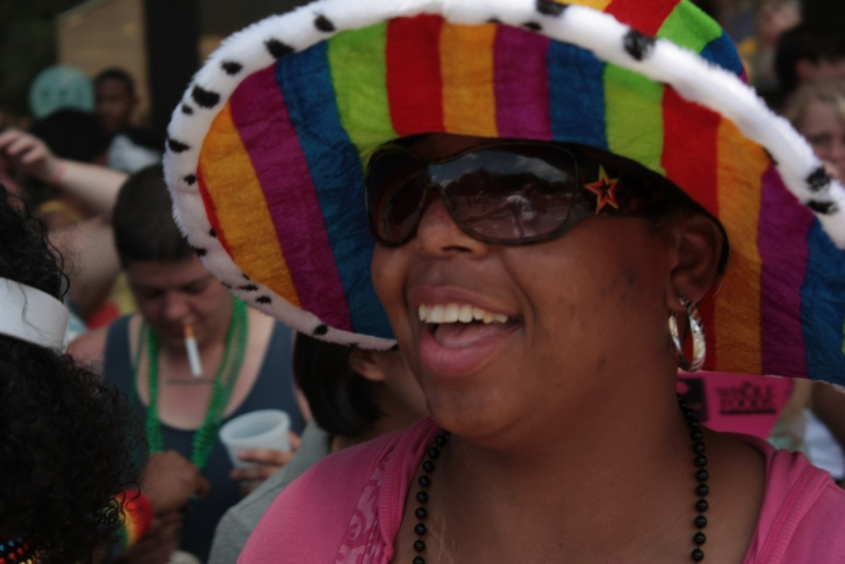
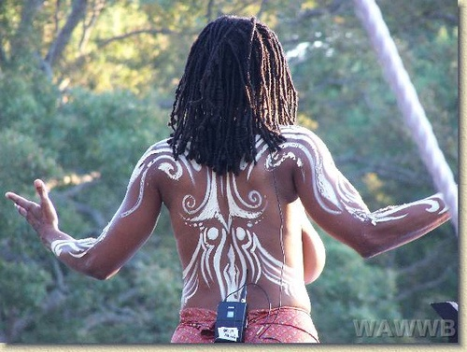
< Black People>

Slide 41
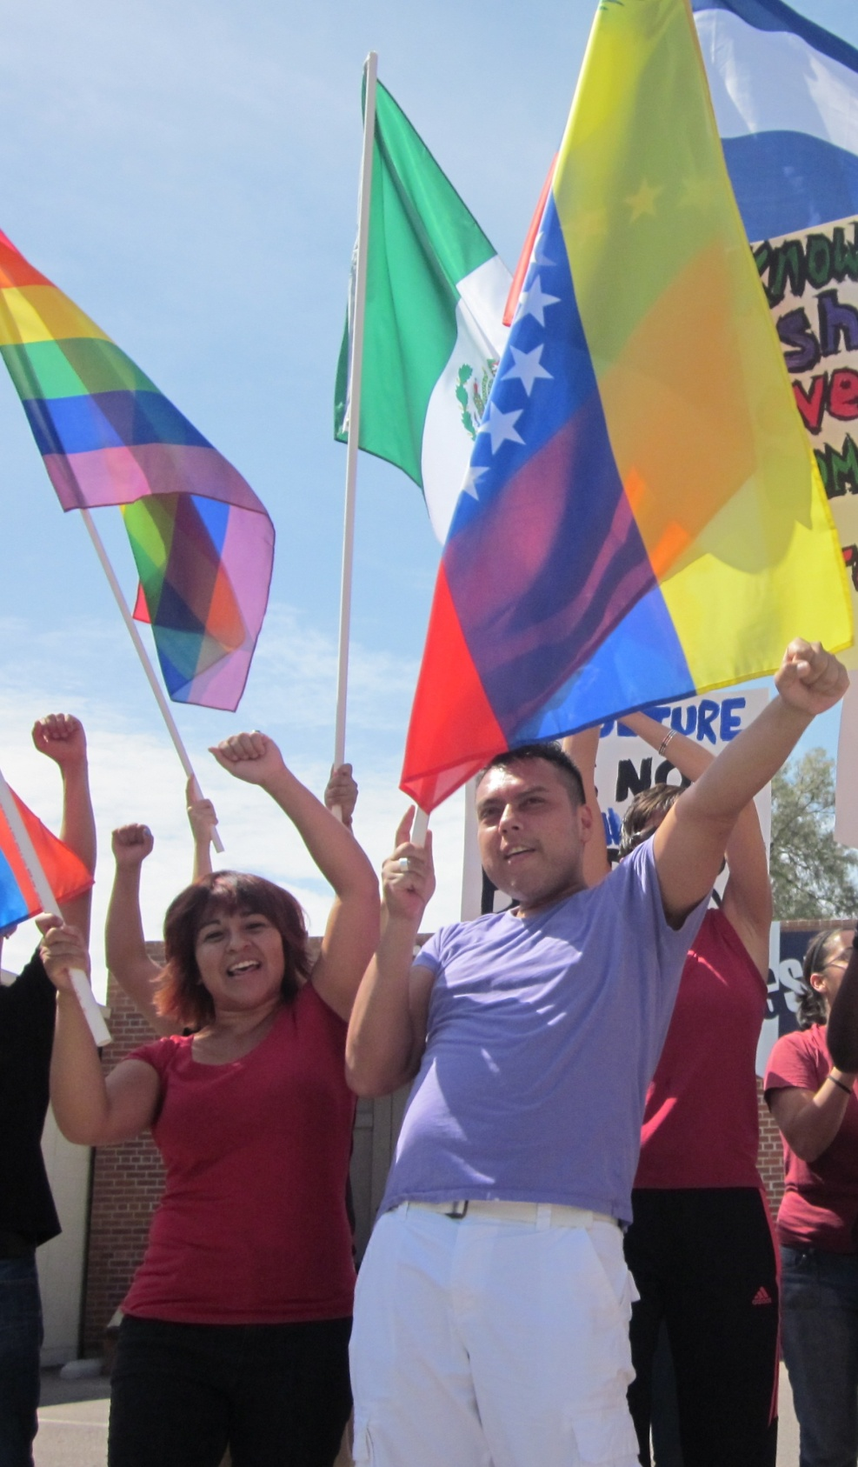
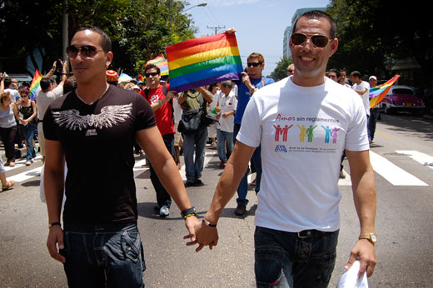
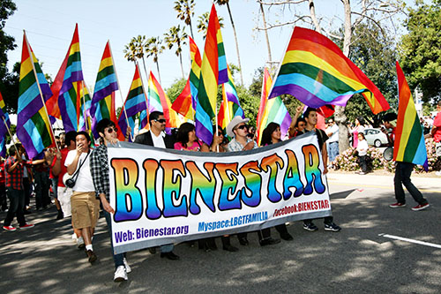
< Latinas/os>
Notes:
http://wingspan.org/cms/img/latin-pride-2011-4.jpg
http://www.cubaabsolutely.com/articles/feature/imagenes/GayPride2_01.jpg
http://www.sanfernandosun.com/sanfernsun/images/stories/1013/Cesar%20Chavez%20March%20016.jpg

Slide 42
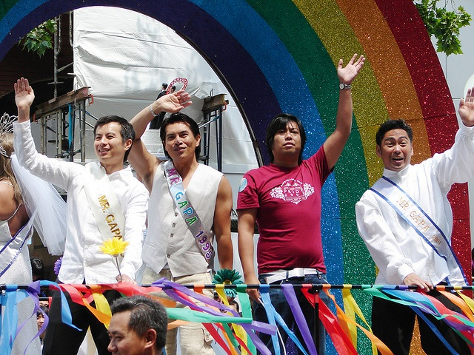
< Asians & Pacific Islanders >
Notes:
Asian Pride
http://www.flickr.com/photos/38443582@N00/2650198952/Asian
SuperGirl
http://www.flickr.com/photos/luizmachadophotos/2099846614/
Asian Sailor
http://www.flickr.com/photos/philippeleroyer/2623249833/

Slide 43
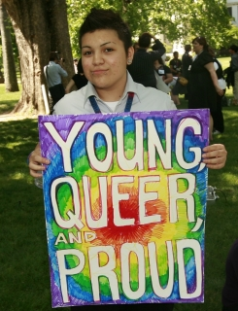
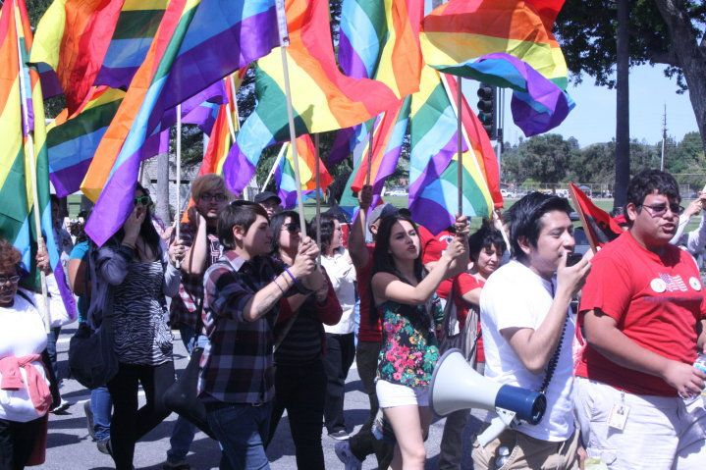
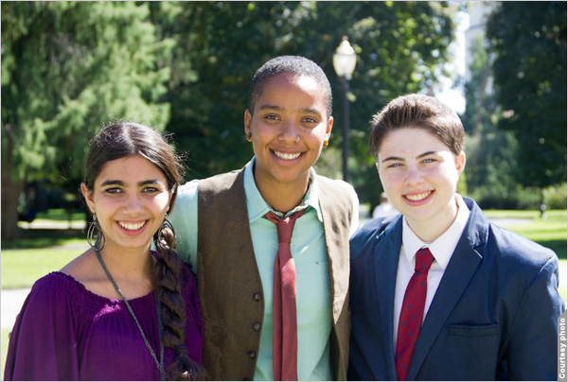
< Youth >
Notes:
http://www.gsanetwork.org/files/insideimages/2%20Queer%20Youth%20Advocacy%20Day.jpg?1256759242
http://photos.state.gov/libraries/amgov/3234/Week_4_Oct_2011/10272011_Gay-Strait-Alliance-Network-2-IMG_0668_600.jpg
http://lgbtpov.frontiersla.com/wp-content/uploads/2010/03/SABORES-Youth-of-BIENESTAR-at-march.jpg

Slide 44
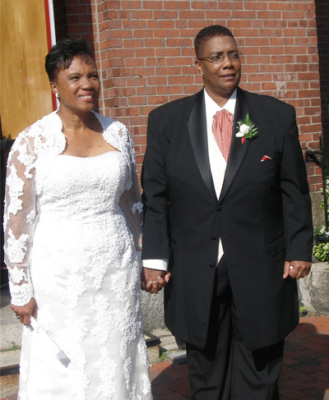
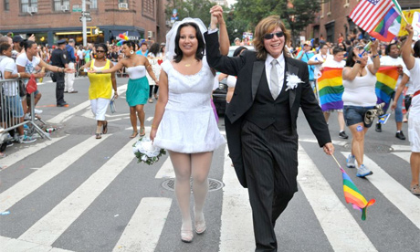
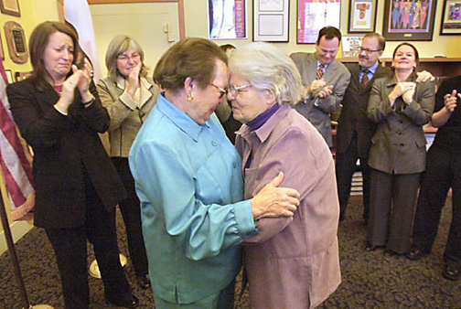
< Older Adults >
Notes:
44
In contrast, the SJS study has a total sample size of 5,500 (down to 4,963). It covers a range of 5 groups - diverse in terms of racial/ethnic group, age, gender, relationship status, sexual orientation & gender ID, and 5 broad topic areas. We used a purposive sample, ideal for a study of this kind where random sampling would systematically exclude people of color and disproportionately include white people.

Slide 45
< Diversity in Topics Investigated>
Notes:
In contrast, the SJS study has a total sample size of 5,500 (down to 4,963). It covers a range of 5 groups - diverse in terms of racial/ethnic group, age, gender, relationship status, sexual orientation & gender ID, and 5 broad topic areas. We used a purposive sample, ideal for a study of this kind where random sampling would systematically exclude people of color and disproportionately include white people.

Slide 46
< 5 Topic Areas>
Notes:
In contrast, the SJS study has a total sample size of 5,500 (down to 4,963). It covers a range of 5 groups - diverse in terms of racial/ethnic group, age, gender, relationship status, sexual orientation & gender ID, and 5 broad topic areas. We used a purposive sample, ideal for a study of this kind where random sampling would systematically exclude people of color and disproportionately include white people.

Slide 47
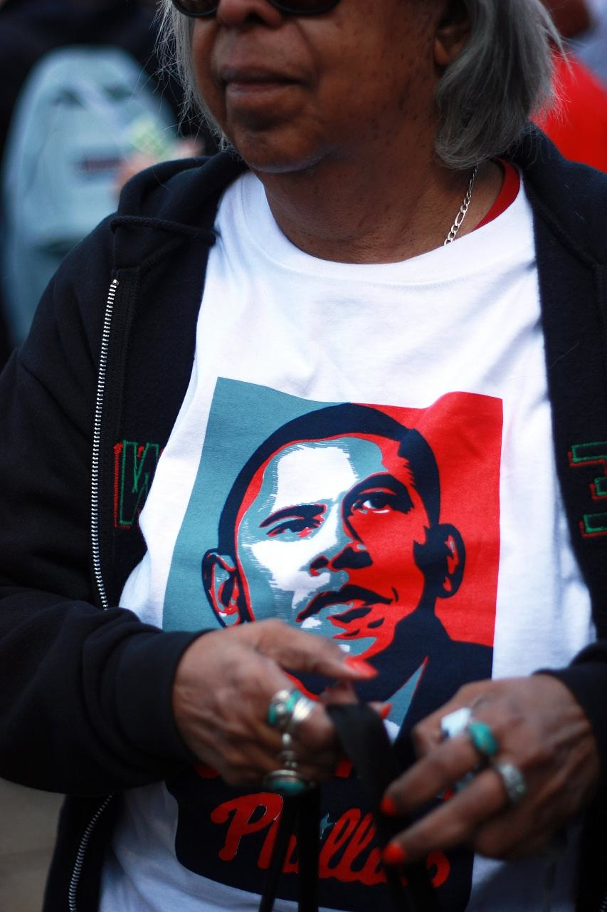
<Sociopolitical Involvement>

Slide 48
< Family Formations & Dynamics>
Notes:
In contrast, the SJS study has a total sample size of 5,500 (down to 4,963). It covers a range of 5 groups - diverse in terms of racial/ethnic group, age, gender, relationship status, sexual orientation & gender ID, and 5 broad topic areas. We used a purposive sample, ideal for a study of this kind where random sampling would systematically exclude people of color and disproportionately include white people.

Slide 49
<Spiritual & Religious Experiences>
Notes:
11a - pray daily
Af Ams all 76%
Af Ams SJS - 69.4%
11b - I look to my faith as providing meaning and purpose in my life.
Af Ams - All 79% say yes (very important in lives - PEW.)
Af Am - SJS 78% say yes (11b)
Latinos -
Pie chart.
We’d come if you didn’t be mean to us. Religion / faith is important to us but not attending b/c of homophobia.

Slide 50
< Racial & Sexual Identity>
Notes:
In contrast, the SJS study has a total sample size of 5,500 (down to 4,963). It covers a range of 5 groups - diverse in terms of racial/ethnic group, age, gender, relationship status, sexual orientation & gender ID, and 5 broad topic areas. We used a purposive sample, ideal for a study of this kind where random sampling would systematically exclude people of color and disproportionately include white people.

Slide 51
<Mental & Physical Health>

Slide 52
SSRC
Notes:
52
Latina/o Gathering + SSRC
The gathering - 2009 - 1) researching, raising money,

Slide 53
Gathering of Leaders
Notes:
53
Latina/o Gathering + SSRC
The gathering - 2009 - 1) researching, raising money,

Slide 54
Research Methods
Notes:
Survey (105 questions)Piloted Survey Multiple Times Translated & Back Translated
This is how we did it - online, venue based events, partners.
Goal was to get people who would not necessarily go to gay pride, but may be a gay rodeo or senior event or religious event.

Slide 55
Raise $$$ throughout the entire process!!!
Notes:
Survey (105 questions)Piloted Survey Multiple Times Translated & Back Translated
This is how we did it - online, venue based events, partners.
Goal was to get people who would not necessarily go to gay pride, but may be a gay rodeo or senior event or religious event.

Slide 56
Purposive & Quota Sampling Strategy – Fill Certain Cells
Notes:
56
Piloted multiple times - standard for this methodology - and multiple translations + back translations.

Slide 57
Piloted Multiple Times
Notes:
57
Piloted multiple times - standard for this methodology - and multiple translations + back translations.

Slide 58
Compromise on Questions
Notes:
Survey (105 questions)Piloted Survey Multiple Times Translated & Back Translated
This is how we did it - online, venue based events, partners.
Goal was to get people who would not necessarily go to gay pride, but may be a gay rodeo or senior event or religious event.

Slide 59
Translate & Back Translate
Notes:
Survey (105 questions)Piloted Survey Multiple Times Translated & Back Translated
This is how we did it - online, venue based events, partners.
Goal was to get people who would not necessarily go to gay pride, but may be a gay rodeo or senior event or religious event.

Slide 60
Ultimately, 105 Questions
Notes:
60
Piloted multiple times - standard for this methodology - and multiple translations + back translations.

Slide 61
Phoenix Pride
Long Beach Pride
DC Black Pride
Portland Latino Pride
Orlando Black Pride/Gay Days
Austin Pride
New York Queens Pride
Boston SPYCE & Boston Pride
Central Alabama Pride (Birmingham)
Milwaukee Wisconsin Pride
Honolulu Pride
Denver Pride
New York Pride
Venue-based Sampling
Notes:
We gathered data through a variety of purposive sampling methods: venue based events� Goal was to get people who would not necessarily go to gay pride, but may be a gay rodeo or senior event or religious event.

Slide 62
Phoenix Pride
Long Beach Pride
DC Black Pride
Portland Latino Pride
Orlando Black Pride/Gay Days
Austin Pride
New York Queens Pride
Boston SPYCE & Boston Pride
Central Alabama Pride (Birmingham)
Milwaukee Wisconsin Pride
Honolulu Pride
Denver Pride
New York Pride
Respondent-Driven
Notes:
62

Slide 63
Columbia South Carolina Black Pride
New York Harlem Pride
Miami Beach Bruthaz Bash
Charlotte North Carolina Black Pride
Michigan's Womyn's Festival
Market Days
GMHC House of Latex Ball
Pueblo, CO Gay Pride
Twin Cities Black Pride & South Central MN Pride
World Gay Rodeo Finals, Laughlin, NV
Snowball Sampling

Slide 64
Columbia South Carolina Black Pride
New York Harlem Pride
Miami Beach Bruthaz Bash
Charlotte North Carolina Black Pride
Michigan's Womyn's Festival
Market Days
GMHC House of Latex Ball
Pueblo, CO Gay Pride
Twin Cities Black Pride & South Central MN Pride
World Gay Rodeo Finals, Laughlin, NV
Compromise on Locations
Notes:
64

Slide 65
Internet
Notes:
65
Internet sample, with partner orgs. Online = 18% Paper = 82%. Great for reaching “hard to reach” LGBT populations, such as those in rural areas.

Slide 66
all 50 states
and Puerto Rico
Survey Reach
Notes:
66
The survey reach:
All 50 states
Image from here: http://geology.com/state-map/maps/usa-map.jpg

Slide 67
Our Partner Organizations

Slide 68
Did I mention: Raise $$$ throughout the entire process!!!
Notes:
Survey (105 questions)Piloted Survey Multiple Times Translated & Back Translated
This is how we did it - online, venue based events, partners.
Goal was to get people who would not necessarily go to gay pride, but may be a gay rodeo or senior event or religious event.

Slide 69
< 175+ people >
Notes:
69
More than 175+ people were involved in administering this survey, huge effort by lots of people.

Slide 70
< Total Sample Size = 5,500 >
Notes:
70
In contrast, the SJS study has a total sample size of 5,500 (down to 4,963). It covers a range of 5 groups - diverse in terms of racial/ethnic group, age, gender, relationship status, sexual orientation & gender ID, and 5 broad topic areas. We used a purposive sample, ideal for a study of this kind where random sampling would systematically exclude people of color and disproportionately include white people.

Slide 71
Delete cases because of …
Notes:
71
In contrast, the SJS study has a total sample size of 5,500 (down to 4,963). It covers a range of 5 groups - diverse in terms of racial/ethnic group, age, gender, relationship status, sexual orientation & gender ID, and 5 broad topic areas. We used a purposive sample, ideal for a study of this kind where random sampling would systematically exclude people of color and disproportionately include white people.

Slide 72
< respondent fatigue>
Notes:
72
In contrast, the SJS study has a total sample size of 5,500 (down to 4,963). It covers a range of 5 groups - diverse in terms of racial/ethnic group, age, gender, relationship status, sexual orientation & gender ID, and 5 broad topic areas. We used a purposive sample, ideal for a study of this kind where random sampling would systematically exclude people of color and disproportionately include white people.

Slide 73
< data integrity>
Notes:
73
In contrast, the SJS study has a total sample size of 5,500 (down to 4,963). It covers a range of 5 groups - diverse in terms of racial/ethnic group, age, gender, relationship status, sexual orientation & gender ID, and 5 broad topic areas. We used a purposive sample, ideal for a study of this kind where random sampling would systematically exclude people of color and disproportionately include white people.

Slide 74
< N = 4,953 >
Notes:
74
In contrast, the SJS study has a total sample size of 5,500 (down to 4,963). It covers a range of 5 groups - diverse in terms of racial/ethnic group, age, gender, relationship status, sexual orientation & gender ID, and 5 broad topic areas. We used a purposive sample, ideal for a study of this kind where random sampling would systematically exclude people of color and disproportionately include white people.

Slide 78
< Qualitative Interviews>
Notes:
78
In contrast, the SJS study has a total sample size of 5,500 (down to 4,963). It covers a range of 5 groups - diverse in terms of racial/ethnic group, age, gender, relationship status, sexual orientation & gender ID, and 5 broad topic areas. We used a purposive sample, ideal for a study of this kind where random sampling would systematically exclude people of color and disproportionately include white people.

Slide 79
Notes:
79
In contrast, the SJS study has a total sample size of 5,500 (down to 4,963). It covers a range of 5 groups - diverse in terms of racial/ethnic group, age, gender, relationship status, sexual orientation & gender ID, and 5 broad topic areas. We used a purposive sample, ideal for a study of this kind where random sampling would systematically exclude people of color and disproportionately include white people.

Slide 80
Notes:
80
In contrast, the SJS study has a total sample size of 5,500 (down to 4,963). It covers a range of 5 groups - diverse in terms of racial/ethnic group, age, gender, relationship status, sexual orientation & gender ID, and 5 broad topic areas. We used a purposive sample, ideal for a study of this kind where random sampling would systematically exclude people of color and disproportionately include white people.

Slide 81
race based
not geography based
Notes:
81
In contrast, the SJS study has a total sample size of 5,500 (down to 4,963). It covers a range of 5 groups - diverse in terms of racial/ethnic group, age, gender, relationship status, sexual orientation & gender ID, and 5 broad topic areas. We used a purposive sample, ideal for a study of this kind where random sampling would systematically exclude people of color and disproportionately include white people.

Slide 82
50+
~ 1/3rd Black, Latina/o, Asian
Notes:
82
In contrast, the SJS study has a total sample size of 5,500 (down to 4,963). It covers a range of 5 groups - diverse in terms of racial/ethnic group, age, gender, relationship status, sexual orientation & gender ID, and 5 broad topic areas. We used a purposive sample, ideal for a study of this kind where random sampling would systematically exclude people of color and disproportionately include white people.

Slide 83
Next Step? Bring It All Together …
Notes:
83
In contrast, the SJS study has a total sample size of 5,500 (down to 4,963). It covers a range of 5 groups - diverse in terms of racial/ethnic group, age, gender, relationship status, sexual orientation & gender ID, and 5 broad topic areas. We used a purposive sample, ideal for a study of this kind where random sampling would systematically exclude people of color and disproportionately include white people.

Slide 84
V. Wrapping It Up: Q&A

Slide 85
Thank You
For Listening!
Prof. Juan Battle
JuanBattle.com jbattle@gc.cuny.edu
Notes:
Special thanks to …

Slide 86
Thank You
For Listening!
Prof. Juan Battle
JuanBattle.com jbattle@gc.cuny.edu
Notes:
Special thanks to …

Slide 87
Thank you for listening!
JuanBattle.com

