Slide 1
Inequality and the macroeconomy
Paul Krugman

Slide 2
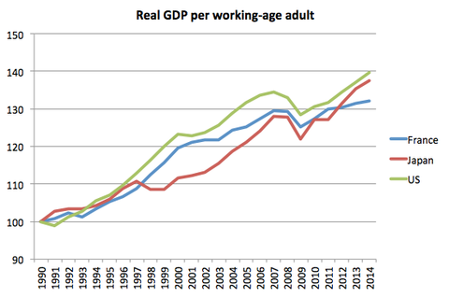
OECD

Slide 3
Source: OECD

Slide 4
Denmark
France
US
Source: OECD

Slide 5
OECD

Slide 6
France
Denmark
OECD

Slide 7
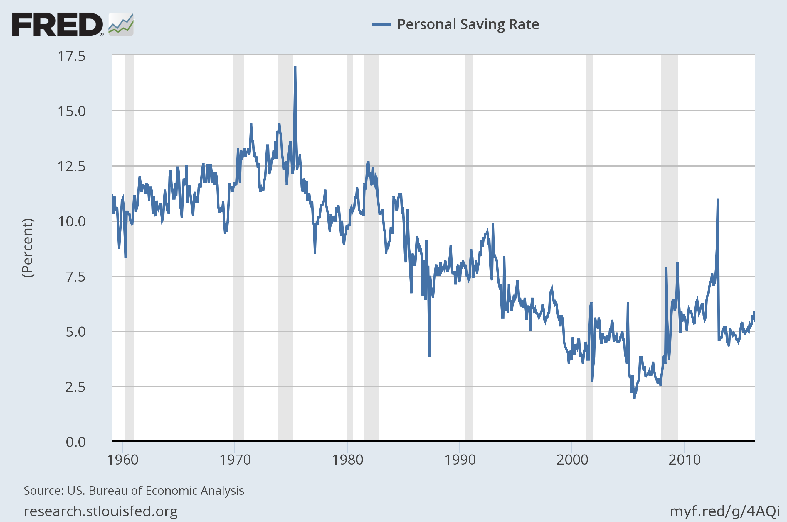

Slide 8
OECD

Slide 9
US 2007 (Gini .371)
Sweden 1989 (Gini .212)
OECD

Slide 10
“mirror test” economy
EPI

