Slide 1
Measuring Wealth and Wealth Inequality
Arthur Kennickell
Inequality by the Numbers, III
June 5-9, 2017
Stone Center, CUNY

Slide 2
Gratitude to others
Many FRB and Eurosystem colleagues
Colleagues at SOI, especially Barry Johnson
Colleagues at NORC, especially Cathy Haggerty
Many statistics/economics colleagues—especially Fritz Scheuren
NORC field staff, who opened their minds to me
Survey respondents
Conference organizers, especially Janet Gornick
You, for listening

Slide 3
Outline
What is “wealth”?
How might we measure household wealth effectively?
Where are the growth points for wealth measurement?
What do we mean by “wealth inequality”?
(Largely SCF-centric: household surveys)

Slide 4
What is “wealth”?
Wealth is often confused with “income”
  “Income” has its own definitional issues!
Obviously, interdependent concepts
Income can be seen as a return on some element of capital
  Straightforward for interest on a bank account: Y_{t}=r_{t}*A_{t}
  ”Imputed rent” on owner-occupied real estate
  “Deferred income” more complicated
    Pensions etc.
    Capital gains that may not be realized in the current period
  Return on “Human capital” (whatever that is!) is most important for most people over their lifetime
“Wealthy” people seem often to act to minimize their reportable income
Will return to relationship of income and wealth in the “way forward”

Slide 5
Joint distribution of household wealth and gross income, 2007 (“Dragon Plot”)

Slide 6
No universally agreed definition of wealth
There is no substitute for thinking about what you are doing
  (But don’t be paralyzed by the fact: Learning by doing is inevitable)
Many conventional definitions of wealth
  Should be driven as much as possible by analytical concerns
  But also practical concerns/limitations
  Most often, no “perfect” solution
    “Jagger’s Theorem and Corollary”

Slide 7
Categories of Income, debt and assets in SCF
Income Measured Debt Measured Assets Measured
Wages and salaries M Credit card debt M Transaction accounts M
Self-employment/farm M Lines of credit M Savings/money market accounts M
Tax-exempt interest M Mortgages M Stocks M
Taxable interest M Installment loans M Bonds M
Dividends M Past-due bills M Mutual and hedge funds M
Real estate/business/trust M Loans against pensions M Tax-deferred retirement accts. M
Realized capital gains M Loans against insurance M Other exchange-traded assets M
Unemployment insurance M Misc. personal loans M Annuities and life insurance M
Welfare M Trusts M
Pension and annuities M Bills not yet due U Misc financial assets M
Alimony and child support M Contractual obligations P Homes M
Misc. income M Future obligations P Other real estate M
“Psychic debt” U Businesses M
Unrealized capital gains P Vehicles M
Noncash employee ben. P Intellectual property M
Service flow P Misc. valuables M
Inheritances and gifts P
In-kind income U Defined-benefit pension rights P
Unpaid work for self U Other contingent assets P
“Psychic income” U Expected future transfers M
Human Capital P
(M=measured in SCF, P=measured in part, U=unmeasured) “Psychic assets” U

Slide 8
Two examples
Analysis of the Survey of Consumer Finances (SCF) at FRB typically considers wealth as assets and liabilities that are, in principle, liquidatable or otherwise controllable by the owner
  For considering the potential to move/influence markets
  Fits reasonably with a macro perspective
One noted researcher does not treat vehicles as assets, but includes vehicle debt as a liability
  Describes vehicles as nondurable consumption or a “necessity”
  Implies far more negative net worth at the low end of the distribution that case treating vehicles as an asset
  How different is a principal residence?

Slide 9
Hard-to-measure items may be important
Role of family or social networks in “insurance”
Vested rights to income, without direct asset ownership
  Annuities, defined-benefit pensions, Social Security, income-only trust funds, etc.
  Accrued value or account for future participation?
  Valuation usually requires detailed knowledge of benefits and complicated assumptions about the future
    For future DB pension (or SS) income for a current worker, typically need to know benefit structure, engagement to present (time and wage path), future engagement with plan, longevity, future inflation, appropriate discount rate, future solvency of the plan, …
      Gross or net of future contributions?
Co-signed loans
Tax loss carryovers, share of national debt, etc.
Many “social goods” that may have different values for different people

Slide 10
Valuation in time
Some assets have a clear valuation at every time in highly liquid markets
  E.g., bank accounts, publicly traded stocks
Some asset types trade rarely—or (almost) never
Some assets have no directly observable market value, outside of the sale of a specific asset
  Must assume some search interval
  E.g., closely held businesses, some types of bonds, artwork, unusual homes, etc.
  Short of actual sale, a distribution of values may be most meaningful
    Appraisals may generate different distributions, depending on the purpose
      E.g., willing buyer/willing seller vs. fire sale
Should the “value” of a fixed-rate mortgage be considered to change when interest rates change, as would be the case for a bond?
  Depends on perspective

Slide 11
Other valuation issues
Some assets may have higher value in terms of use or productivity than would be reflected in a used asset market
  A car, or a small business highly geared to specific human capital of the owner
  Owner’s reservation price for a house may differ from market “comparable” due to idiosyncratic factors that have positive (or negative) value to the owner
  Valuation sometimes more like “opinion”
Trade-off of risk and return over time
  Affects future distribution of wealth
  Limited access to some assets with high average returns: hedge funds, IPOs, private equity, etc.

Slide 12
Classes of wealth
Sometimes may care about wealth according to “purpose” (from perspective of the holder)
  Consumption smoothing, durables/home, ”precaution,” college education, retirement, “control,” “investment” (in sense of future asset transformation or current strategy), bequests,…
In principle, wealth is fungible, so could argue accounting does not matter: but…
  Monetary and psychic transactions costs of asset transformation can be substantial
  Mental accounting
  Different items of wealth may relate differently to behavior and expectations

Slide 13
Role of taxes
Many assets accumulate capital gains (or losses) that are not always required to be realized when they occur
  E.g., stocks, businesses, houses
Thus, net liquidation value of two assets with the same market value may differ to the extent they embed different levels of taxable capital gains
  But relevant taxes are often difficult to determine
  Some assets may never be liquidated, even after the lifetime of the owner
  Typically, such differences are ignored

Slide 14
Whose wealth?
General tendency among income researchers to define “equivalized household income”
  Divide income by a function of the number of household members and sometimes their characteristics
  If nearly all income goes to current needs, perhaps easier to argue than for wealth
But wealth may serve variety of purposes spread over time
  E.g., retirement savings has relatively limited direct connection to children in a household
“Owner”/“controller”/”decision maker” for wealth may not be straightforward
  Depends, in part, on intra-household arrangements
  May be more than one such actor, based on ownership, specialization, etc.
  Community property rules may override formal ownership
Broader “family wealth”

Slide 15
How might we measure household wealth effectively?
Various possible approaches: will focus on interviewer-mediated household surveys and return to broader possibilities later
Decompose desired measure of wealth into components we can expect people to understand and have relevant conceptual meaning
  Order and describe to support analytic goals and data quality
  Include tools and other support for meaningful reporting
Consider sample design deeply: Is oversampling the wealthy important?
Address privacy concerns
Acknowledge and support role of interviewers
“Prepare for the worst”

Slide 16
What needs to be measured
Enumerate elements on which we want information to construct wealth
  Typology depends on an analytic framework: most fundamental determinant of what can be done with the resulting data
    Risk/liquidity
    Transaction-related [credit cards, current accounts (checking or money market), stored-value cards]
    Work related (pensions, businesses)
    Mutual funds in multiple categories (directly held, money market accounts, managed accounts, 401(k) etc. plans, trusts)
    In multinational context, conventional categories may differ in important ways
  Associated characteristics
    Insured vs. uninsured deposits, domestic vs. non-domestic stocks, investment characteristics for mutual funds, etc.
  Ownership within household may be important for job-related items

Slide 17
Arrangement and detail
Terms and outward face of framework must be understandable to broad range of people
  “Distribution of understanding” of language
  Financial literacy issues
  Wealthy people with complex portfolios have more possibilities for confusion
Sequencing/modulation matter:
  Items that may appear relevant in multiple places: ask most obviously distinguishable one first
  Psychological factors in sequencing
    Affects on respondent’s “mood”/Establish different cognitive frameworks
    Modulation of topics can defuse some problems
Level of detail: trade-offs
  Comprehensiveness and clarity argue for very detailed decomposition and characterization of wealth: queue recognition for completeness and support clear definitions and distinctions
  Risks of boring or alienating respondents (insincere/lazy answers and possible break-offs): argue for streamlining to some degree—how much?
SCF is designed as a broad wealth survey and collects very granular data along with variety of wealth characteristics (and other supporting variables)
  75 minutes median length, maximum several hours

Slide 18
Support for accurate reporting
Interviewers: #1 (will return to this)
Exhaustive testing and evaluation of all protocols
  Design errors generally unrecoverable
Consider physical layout and capacity for maneuvering from interviewer’s perspective!
Guidance: put it where it is useful (Don Dillman)
  Glossary
  Instructions
  Gentle pressure to use records
Provision for range responses
  Inherent uncertainty of values
  Sensitivity of exact responses
  Uncertainty or unwillingness in mind of respondent
Live consistency checks/constraints
  Great benefit of computer assisted personal interviewing (CAPI)

Slide 19
Sample design
Sample gives mathematical basis for scientific assessment of results
Need to decide how important is upper tail of the wealth distribution
  US: Wealthiest 1% owns about 1/3 of total wealth (depends on wealth definition!)
  Is analytical objective to understand:
    Extreme wealth inequalities?
    Behavior/condition/welfare of the “bottom 99”?
    “Macroeconomic” possibilities?
    Specific economic characteristics/behaviors?
    Etc.?
Without over-sampling strategy and means of coping with differential nonresponse with wealth, unreasonable to expect to have analytical objectives requiring accurate coverage of upper tail
  But very expensive and very difficult to reach that population
  Data often very difficult to collect/edit

Slide 20
SCF sample design
SCF must support both “macro” analysis and behavior of the general population
Dual-frame sample design
  “Area-probability sample”: geographically based sample with selection probabilities proportional to population, using Census data and USPS postal address sequences
    Robust method of covering the general population
    Without some way of oversampling the very wealthy, would need an enormous sample to support (in principle) stable estimates of tail-dependent quantities, such as means
    (Also, no effective way of addressing differential nonresponse
  “List sample”: list of names/addresses selected from statistical records derived from individual tax returns
    With cooperation of the Statistics of Income Division of the IRS
    Inefficient coverage of households other than high-income ones
    But allows high degree of over-sampling at the top of the distribution
    (Excludes “Forbes 400”)
    (Also supports effective adjustments for differential nonresponse)

Slide 21
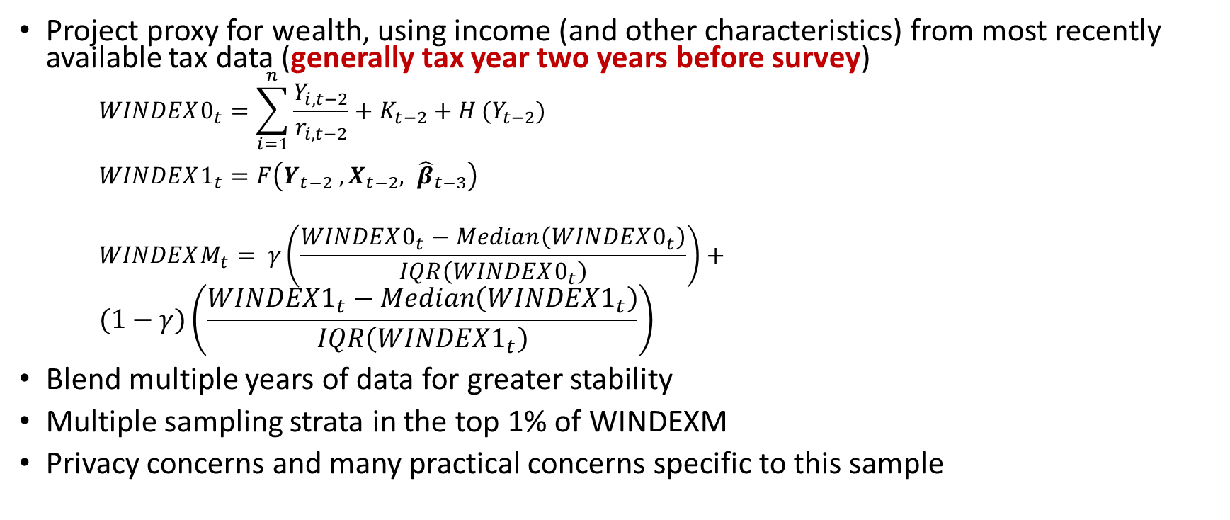
List sample stratification
Project proxy for wealth, using income (and other characteristics) from most recently available tax data (generally tax year two years before survey)
$$WINDEX0_{t}=\sum_{i=1}^{n}{\frac{Y_{i, t−2}}{r_{i,t−2}}+K_{t−2}+H}(Y_{t−2})$$
$WINDEX1_{t}=F\left(Y_{t−2} ,X_{t−2}, {\hat{β}}_{t−3}\right)$
$$WINDEXM_{t}= γ\left(\frac{WINDEX0_{t}−Median\left(WINDEX0_{t}\right)}{IQR\left(WINDEX0_{t}\right)}\right)+$$
$$(1−γ)\left(\frac{WINDEX1_{t}−Median\left(WINDEX1_{t}\right)}{IQR\left(WINDEX1_{t}\right)}\right)$$
Blend multiple years of data for greater stability
Multiple sampling strata in the top 1% of WINDEXM
Privacy concerns and many practical concerns specific to this sample

Slide 23
Not allowed to show you confidence intervals for AP sample only, except for 2004!

Slide 24
95% confidence intervals for top 1% share, 2004
(adjusted for difference in sample sizes)

Slide 25
Household Finance and Consumption Survey
Wealth survey of the European Central Bank
  Executed at the country level in the Euro Zone
Like SCF, specifically designed as a wealth survey
  Ex ante harmonized to a high degree across countries
  Some important institutional differences across countries
Not possible to standardize approach to sampling
  Some countries (e.g., Spain and France) have access to tax-based data for oversampling
  Most other countries have weaker (or no) instruments for oversampling
  Key concern is developing a way to make robust comparisons of tail-dependent estimates

Slide 26
Privacy concerns
Why would anyone share such personal information with a stranger?
  Voluntary participation
  Fear of strangers
  No computer system is 100% safe
  Fears of identity theft or exploitation for commercial purposes
  Suspected political motivation, etc.
“How do I know this is legitimate?”
  Directly address hesitations
  “Authority letters”/Federal Register/Community engagement/etc.
Role of CIPSEA in U.S.: applies to “data creators”
  But no legal constraints on users!
Disclosure reduction techniques for published data
  Including data simulation

Slide 27
Role of interviewers
Interviewers are the (largely) unsung heroes of social science research
  Require technical ability to navigate survey, personal skills to engage respondents, flexibility, persistence and resilience
    Professional work for a nonprofessional wage!
    Legacy of false “golden age” of women “who didn’t need to work”
  Most productive 20% complete half the interviews
  Differences in interview quality
Focus on training critical, but not sufficient
Agent-principal problem
  Interviewers’ work observed only indirectly
  Role of supportive feedback

Slide 28
Quality vs. Completion Rates,
Across Interviewers, 2004

Slide 29
“Prepare for the worst”
Plan for success, but prepare for possible failure:
Misreporting
  Misunderstanding, deliberately incorrect answer, question error, etc.
Missing data
  Unconditional missing and conditional missing
Unit nonresponse
  Variety of reasons
Data fabrication
(Other types of error)

Slide 30
Editing the raw data
Driven by comments, debriefing notes and computer-driven review
  Correct errors/misclassifications/omissions
Most often, editing review reveals
  Respondent did not understand/accept
    The question
    Confidentiality protections
    Purpose of the interview
  The interviewer did not understand or lacked motivation
  The interviewer did not follow instructions
  Question wording was ambiguous
  Underlying concept shifted
  Situation was too confusing to cope with effectively

Slide 31
Editing is a recognition of failure
Communication failure!
  Generate feedback to educate/motivate interviewers
  New strategies to engage respondents
  Devise improved strategies for next time
Editing does not create truth
  Some “in-liers” difficult to observe
  Always some chance edits are wrong
Expensive/labor intensive: possible to achieve most benefits at much lower cost, via model-based selection
Editing may have uncomfortably large effects on outcomes

Slide 32
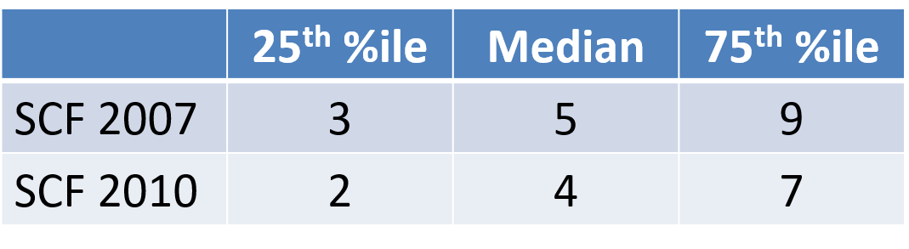
Number of edits, SCF AP sample
Quality improvement program in place in 2010

Slide 33
Percent quantile difference plot: 2010 NW: (Edited value-unedited value)/ABS(edited data)

Slide 34
Quantile difference plot: 2010 NW:
Edited value-unedited value
Wealth negative in this range

Slide 35
Role of imputation for missing data
Why not use only cases with complete data?
  Possibilities for selection bias, as well as reduced estimation efficiency
    Most SCF cases have at least some missing variable
    Greater wealth usually implies greater asset diversity, and thus more opportunities for missing (or garbled) data
  Data creator often has more information than a general user
Imputation does not create truth
  Imputation, at its best, creates a transparent representation of the estimated distribution of the missing data, conditional on observed data
Single imputation
  Represents that distribution by one value
Multiple imputation
  Uses multiple draws from the conditional distribution, both to better reflect the uncertainty and to increase efficiency

Slide 36
Selected reports of dollar amounts, 1995

Slide 37
Data fabrication
Always a risk that a field interviewer, who works alone, may make up the all data or part of the data
  Profoundly undermines usefulness/credibility of data
  May also affect respondents adversely
  Sometimes collusion with respondents
Costly methods of detection
  Validating interviews
  Review of case records for suspicious patterns
Where prevalent enough to serve as basis for study, the survey is highly likely to be worthless for its intended purpose
Healthy culture is best defense
  Monitoring is secondary defense that serves mainly to support credibility

Slide 38
Case management
Beyond initial “eager respondents” contact/persuasion strategy becomes critical
  Ultimately, strategies are formulated at the level of individual cases
  For wealthy respondents, locating them and navigating their “gatekeepers” is a major issue
  Conflicting ethics: every voice should be heard, but no one should be harassed
“Incentives” can be helpful in motivating some people or giving a sense of “value” to the work
  But may be seen by human subjects committee as manipulative bribery when applied to poor people
  May create suspicion among other people: “Why are you paying me?”
  Definitely not a panacea
“Nonresponse” is, in part, a judgement about when/whether to stop

Slide 39
Cumulative distribution completed interviews; by number of weeks in the field; 2007

Slide 40
Cumulative distribution of attempts:
2007 AP sample

Slide 41
Cumulative distribution of attempts:
2007 High-stratum list sample

Slide 42
Hazard Rates* of case completion:
AP and high-stratum LS
* % of “unresolved” cases completed
Notes:
Hazard rate is the percent of cases “in play” that convert to a given status at a particular time period.
Patterns of resolved nonresponse for AP and LS are very similar.
AP response hazard falls to about 2% and the LS hazard holds a plateau of about 1%.
Late field period spikes driven by mass reclassifications and relatively small remaining sample in play.
Time to completion useful, but what was the actual work being done during that time?

Slide 43
Response Rates, by Sample Type, 2007
Far higher response than would be the case without targeted effort

Slide 44
Weighing adjustments
Sampling weights = 1/Probability(Selection)
  Applies to entire sample: respondent and nonrespondents
Weighting calibration/adjustment is chance to “compensate” for differences in nonresponse for various subpopulations
  Although conventionally done, weighting does not create truth
    E.g., “aligning” with demographic categories effective in reducing bias only if nonresponse (or under-coverage) correlated with demographics
    Nonresponse bias is relative to an analytic objective
Research shows that nonresponse is strongly correlated with wealth proxies, and independently with financial income
  SCF sample design supports wealth-related adjustment
  AP and list samples combined respecting the strengths of each approach

Slide 45
Accounting for uncertainty
Uncertainty is a statistical property—most often speak of “variance”
Variance estimation too often treated as “nicety”
  Most often, pro forma “± x%”
No science without meaningful ability to characterize the strength of estimates
  Very common and shockingly frequent disregard of this point
In principle, should include ALL sources of uncertainty
  Sampling, nonresponse, data handling/processing error, other nonsampling error—conceptual/specification error
In practice, usually limited to sampling and nonresponse error
  SCF combines replicate weight approach to sampling error and unit nonresponse with multiple imputation to unit nonresponse error

Slide 46
Where are the growth points for wealth measurement?
Continuous improvement—structuring work for learning—should be a baseline
  Unfortunately, research on survey adjustments for problems attracts more intellectual attention than research to avoid problems
  “Autopilot” all too common: entropy
Also need to look beyond current practice
  Serious SCF-type wealth panel data of relatively short duration
  Exploit administrative data
  (Not necessarily independent)
  Others…

Slide 47
Joint distribution of NW, 2007 and 2009

Slide 48
Real change in ∆NW, 2007-2009

Slide 49
Exploiting administrative data
Mainly, estate tax and personal income tax data
Estate data: Mallet [1908], Lampman [1962], Scheuren [1962] …
  Death as a mechanism for sampling from the living population
  Issues of valuation, appropriate death probabilities, person vs. household
Saez and Zucman [2016]
  Estimate wealth from personal income tax data
    Tax unit vs. individuals/households
    Fixed rates of return
    Single time period
  Some important similarities with SCF sampling
Statisticians have long argued for pooling multiple data sources
  Information and technology now more within grasp

Slide 50
Hybrid of survey and modeling
Surveys face escalating costs and pressures from nonresponse
  May not be sustainable in current form
Match survey data with concurrent, past and future tax-based (and other) data—largely, income data
  Evaluate survey responses
  Model measured wealth conditional on administrative data
  Project both survey data and independent estimates
  More efficient use of available information
  BUT privacy and legal issues need to be addressed

Slide 51
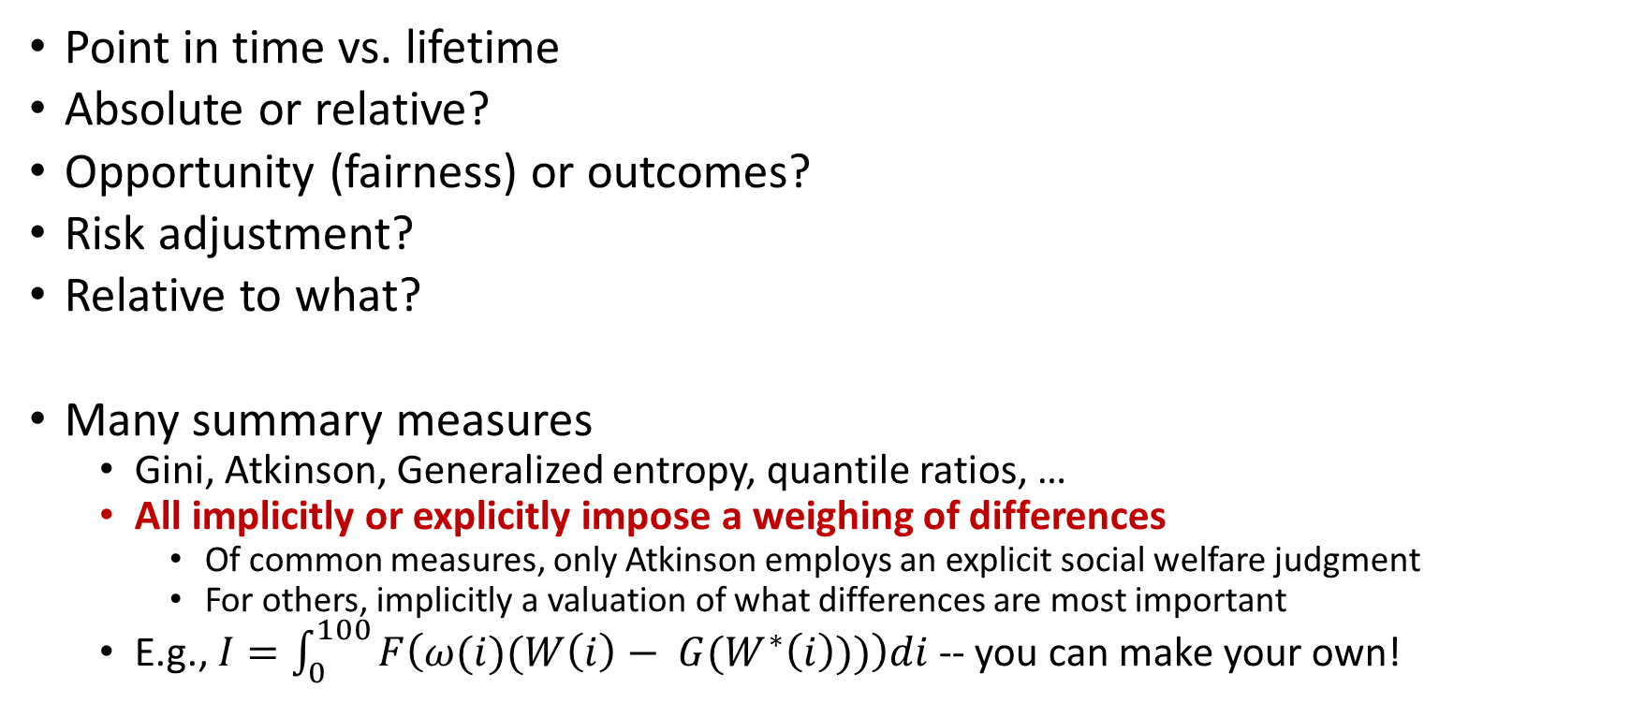
What do we mean by “wealth inequality”?
Point in time vs. lifetime
Absolute or relative?
Opportunity (fairness) or outcomes?
Risk adjustment?
Relative to what?
Many summary measures
  Gini, Atkinson, Generalized entropy, quantile ratios, …
  All implicitly or explicitly impose a weighing of differences
    Of common measures, only Atkinson employs an explicit social welfare judgment
    For others, implicitly a valuation of what differences are most important
  E.g., $I=\int_{0}^{100}{F\left(ω(i)(W\left(i\right)− {G(W}^{∗}\left(i\right)))\right)di}$ -- you can make your own!

Slide 52
Cumulative distributions:
1988 and 2006 income/1989 and 2007 net worth

Slide 53
Lorenz curves: 1988, 2003 and 2006 total gross family income and 1989 2004 and 2007 net worth

Slide 54
Gini coefficient for net worth with confidence interval

Slide 55
Wealth shares (repeat)

Slide 56
Households with zero or negative NW

Slide 57
Wealth of Forbes 400 as % SCF wealth
(could also show as share of median from a “normal” survey)

Slide 58
Relative quantile difference plot: %Δ real wealth

Slide 59
Relative quantile difference plot: %Δ gross income

Slide 60


Slide 61
Thanks for your attention!
Questions/comments?
Arthur.Kennickell@gmail.com

