Slide 1
Do not fear the robots: The challenge is good jobs at good wages
Larry Mishel, President
Economic Policy Institute
@Larrymishel

Slide 2
Let’s be clear about ‘technology’
Consumer products: your phones, TVs, stoves, etc. improve;
Communications: Wi-Fi, internet
Automation: in workplace the substitution of capital (equipment/software) for labor
What’s Amazon? What’s Uber? Robots?

Slide 3
What are the issues?
Technology is a large topic. Robots are a smaller topic: capital replacing human labor and possibly eroding the total number of jobs and the skill composition of jobs.
1. Number of Jobs: Will technology (i.e., Robots!) slow aggregate job growth, raise unemployment?
2. Wage Inequality: Will technology (i.e., Robots!) create only high-skilled, high-wage jobs, leaving non-college-educated workforce behind?

Slide 4
Impact of automation/robots?
Joblessness
Inequality
Past
Recent, 1999-2016
Post WWII
Future
Immediate
Decades away
Past
Recent, 1999-2016
Post WWII
Future
Immediate
Decades away

Slide 5
Where can we look for evidence?
Recent past, 1999-2007 and 2007-14: 2MA claims trends are already evident. If not, then why do we think the future will reflect their story?
Projections: ‘Oh wow’ stories? Examine various projections.

Slide 6
A jobless future? Given not in the past!
Automation eliminates jobs in specific occupations and industries but does it lead to overall joblessness?
Why have we not seen ever-rising unemployment over last century or more?;
Or, how did unemployment drop from 10% to under 5% since 2010 if we’re in a job-killing automation surge?

Slide 7
Ok, automation happens but then what?
Only done to cut costs, right?
When costs drop then what? Lower prices Higher incomes, some combo of higher profits and higher wages
Those who bought automated good or service in future will buy more of that item, or of other items. Higher incomes spent.
Unless we have run out of ‘needs’ and capitalists fail to satisfy them, even invent some;
Poof: more jobs created.
Will next time be different?

Slide 8
Where’s the Footprint of accelerated automation?

Slide 9
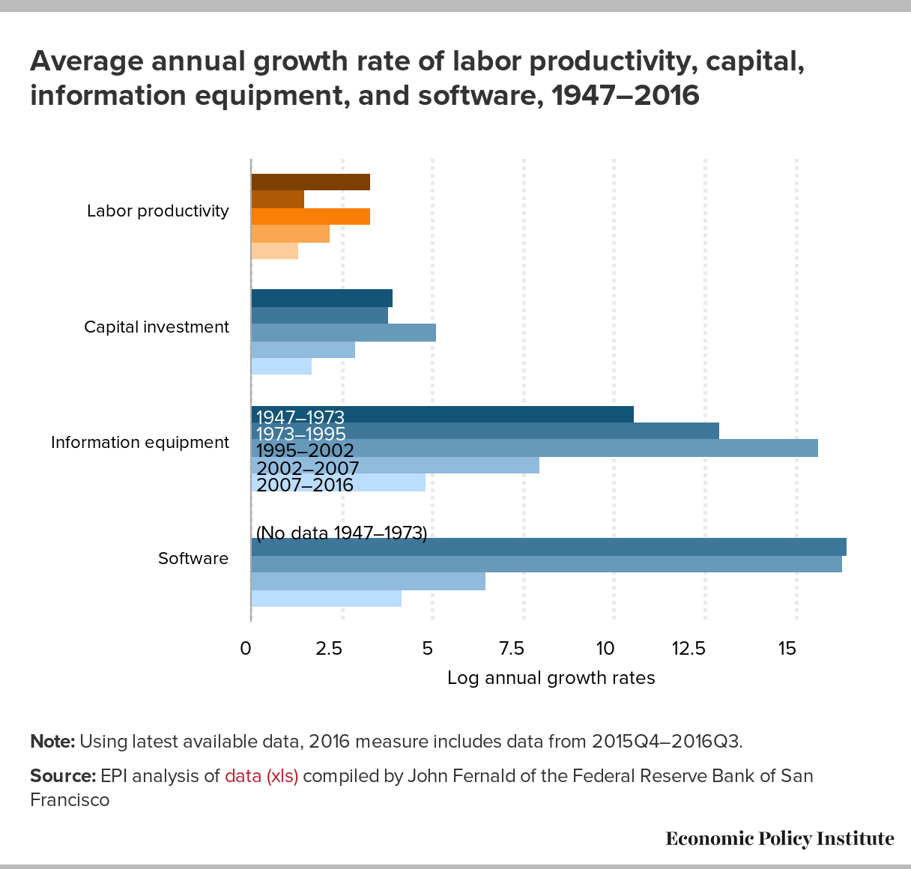

Slide 10
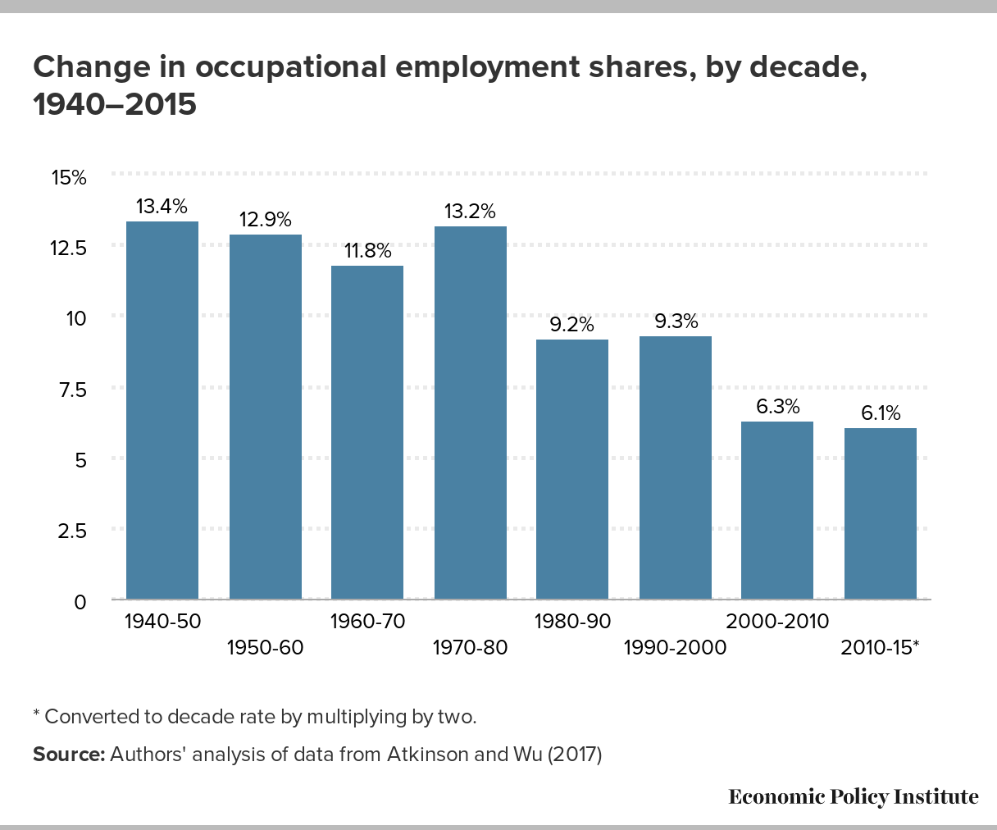

Slide 11
Other indicators
Displacement
Job loss

Slide 12
The Second Machine Age (2MA) story of increasing joblessness?

Slide 13
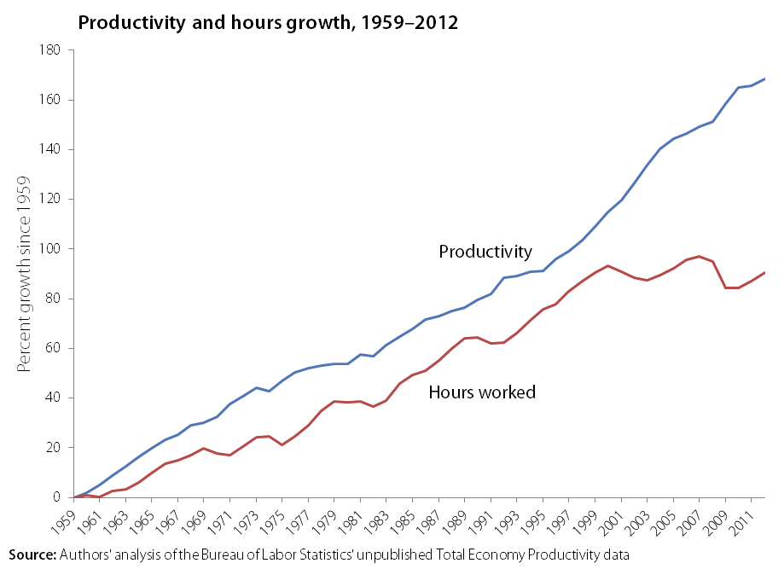

Slide 14
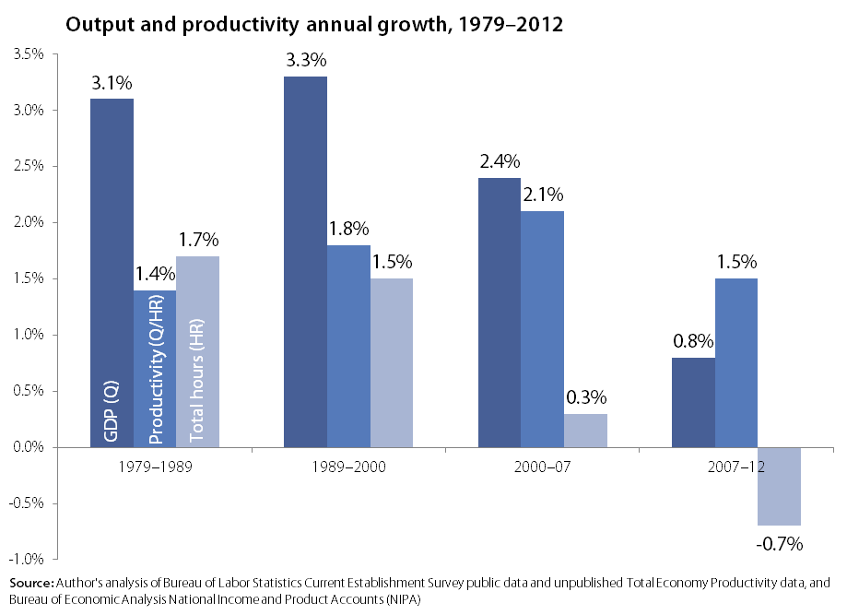

Slide 15
If not now, in future?
Scale of impact
Time frame
First order impact only?
Measured against past trends

Slide 16
Does automation, SBTC, create wage inequality?

Slide 17
Two stories about wage inequality
Education—need for college graduates—driven by technology/computers
Occupations—job polarization computers erode middle, expand relative demand for non-routine, cognitive skills expands at top and do not affect routine, manual work at bottom

Slide 18
Polarization?
Occupational employment polarization can’t possibly explain wage trends since 1999
Silent on top 1.0%;
Polarization not present since 1999;
Occupational employment patterns unrelated to relative wage trends.

Slide 19
19
Technology
Changes in occupation
employment
shares
Changes in occupation wages
Changes in overall wage distribution

Slide 20
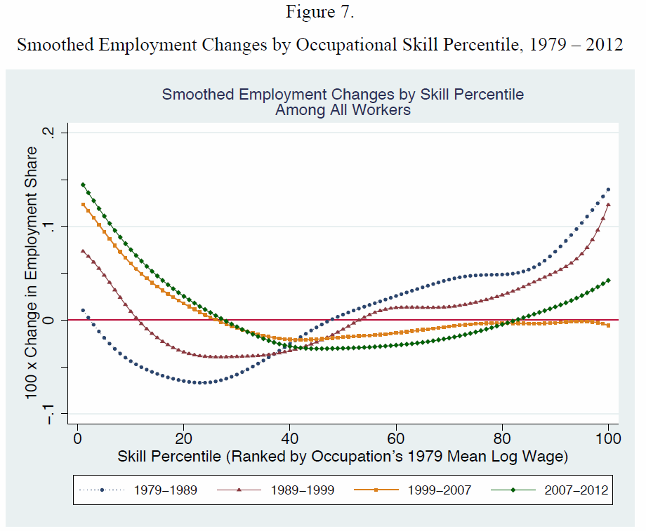
Notes:
Source: Autor (2014)
20

Slide 21
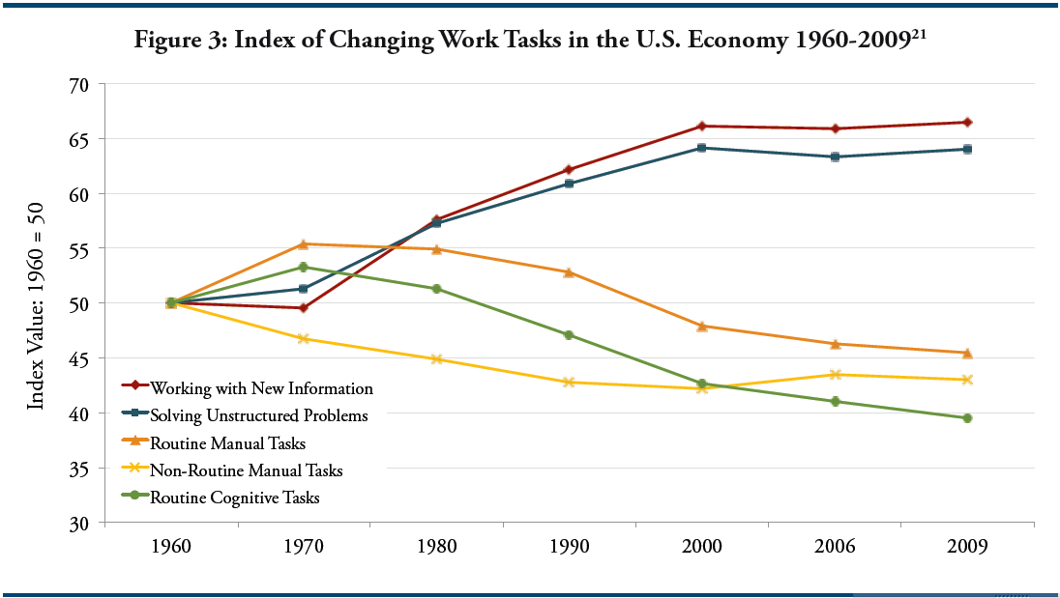
Source: Reproduced from Levy and Murnane (2013)

Slide 22
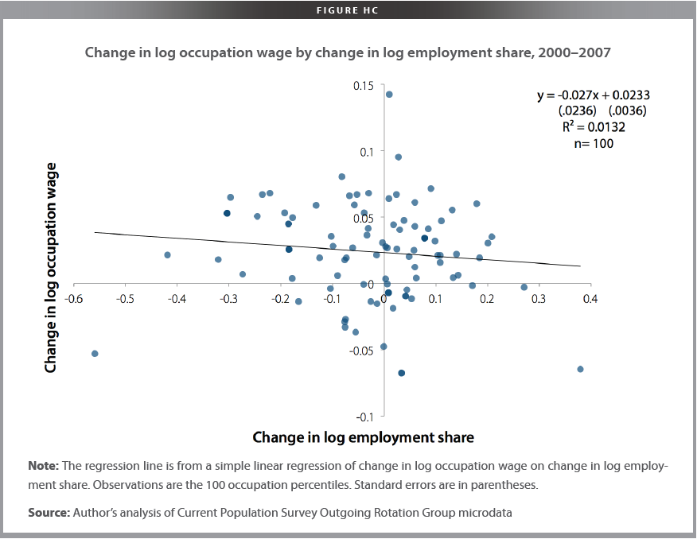

Slide 23
1. College (4 yr) wage premium flattened after mid-90s, but wage gap still grew strongly;
2. College wages flat, at best, for many years
The top 1%
Why the ‘Skills Deficit’/Education Explanation Fails

Slide 24
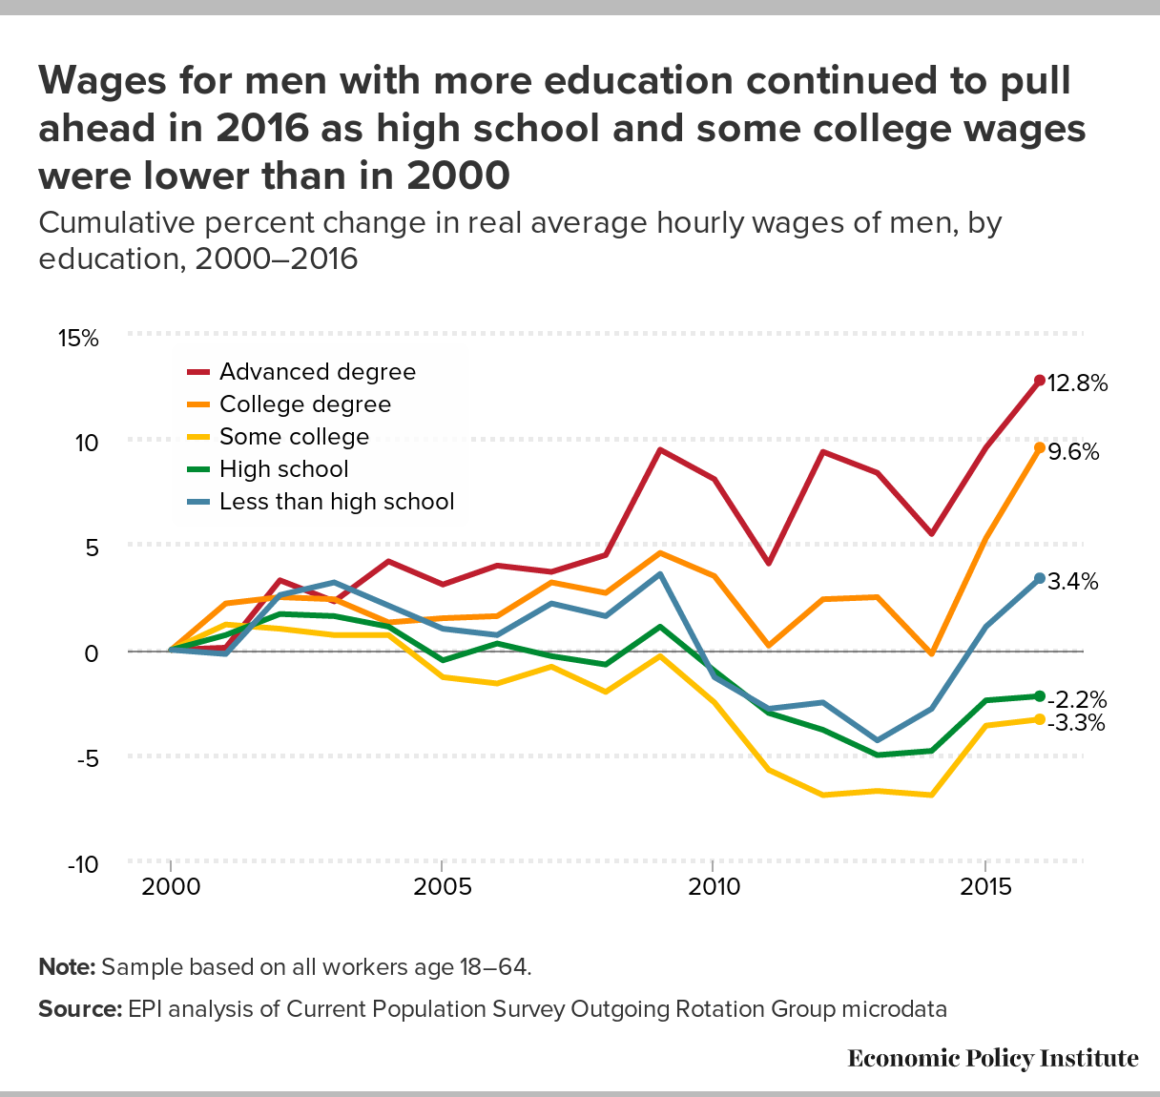

Slide 25
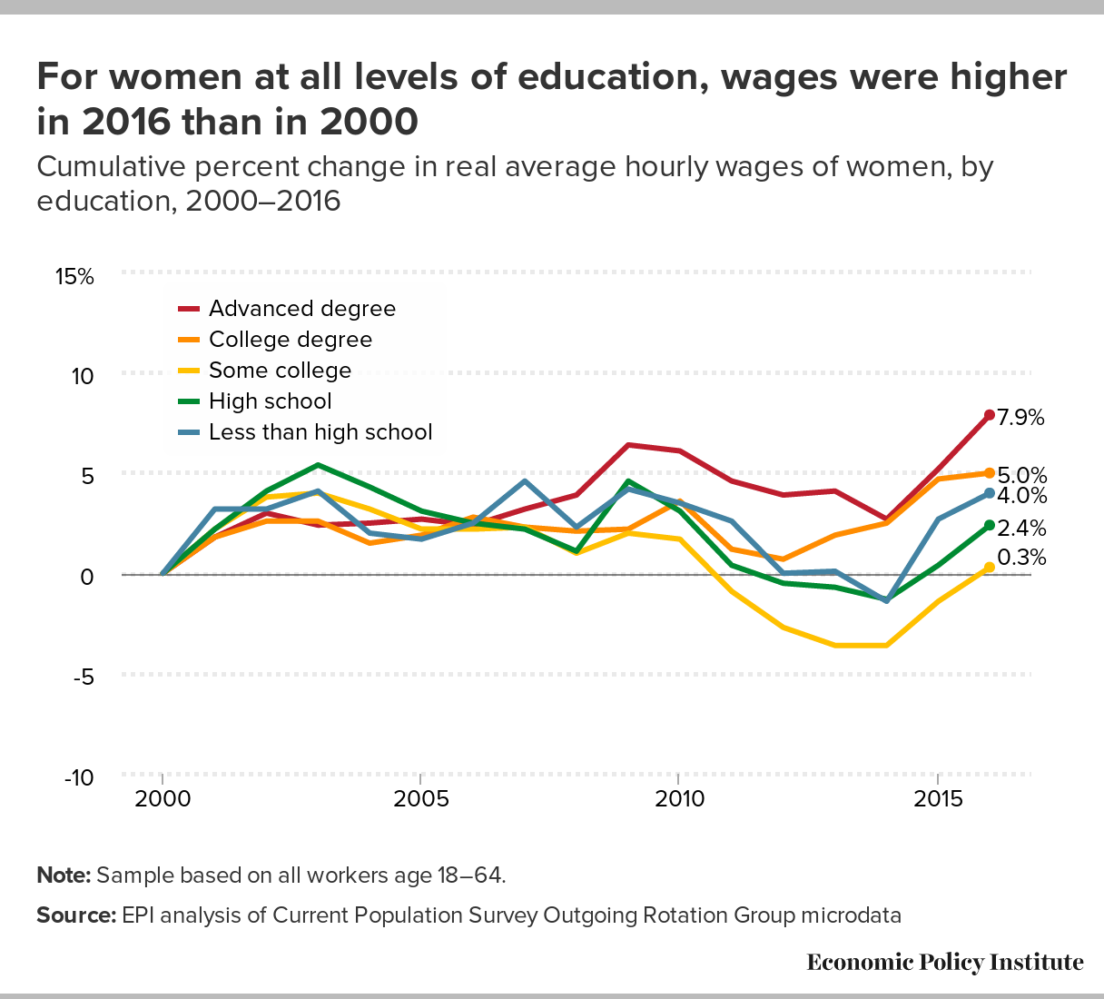

Slide 26
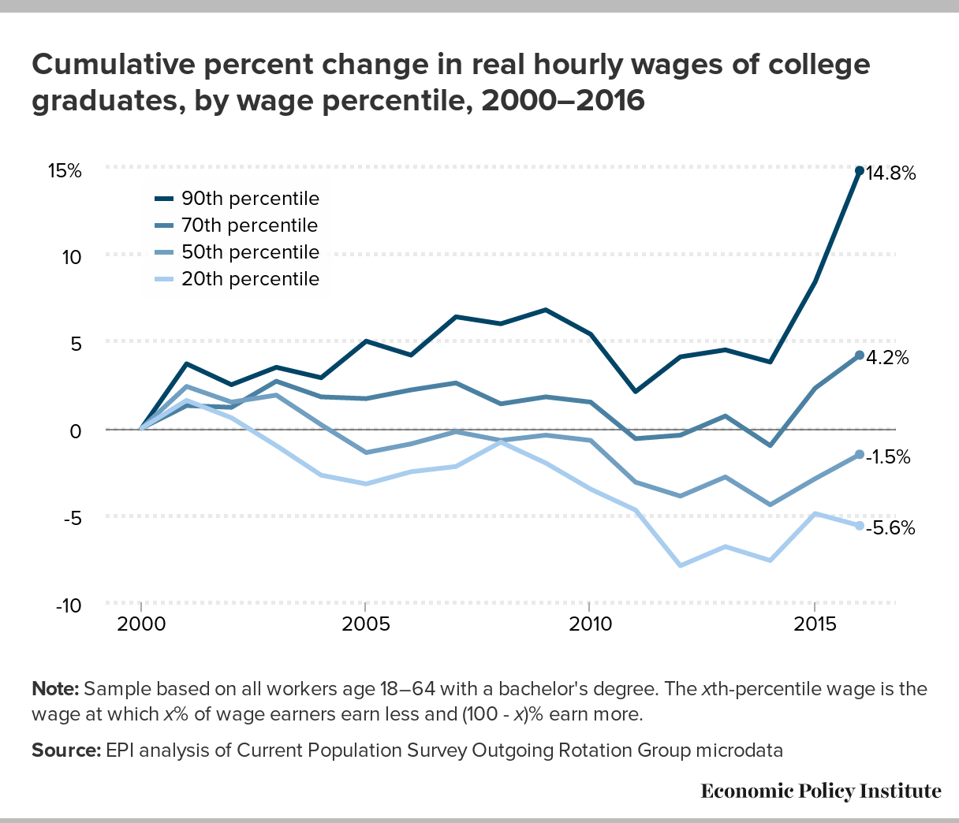

Slide 27
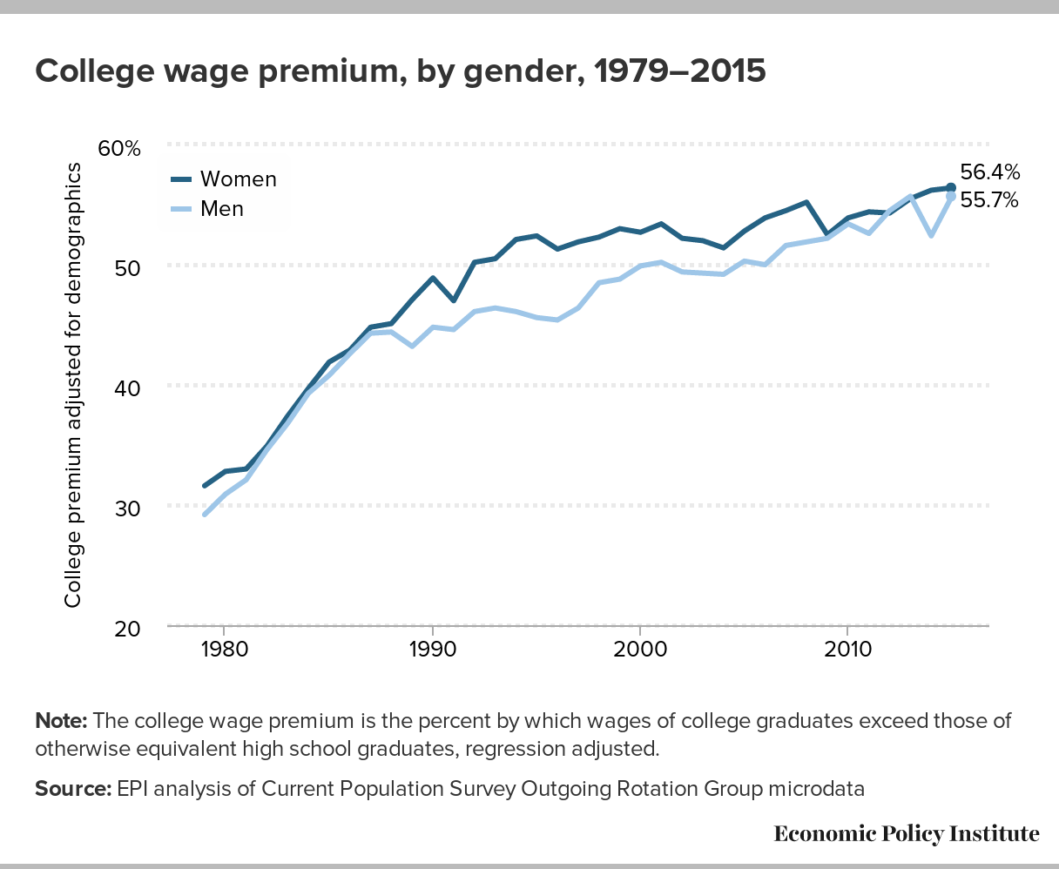
College wage premium

Slide 28
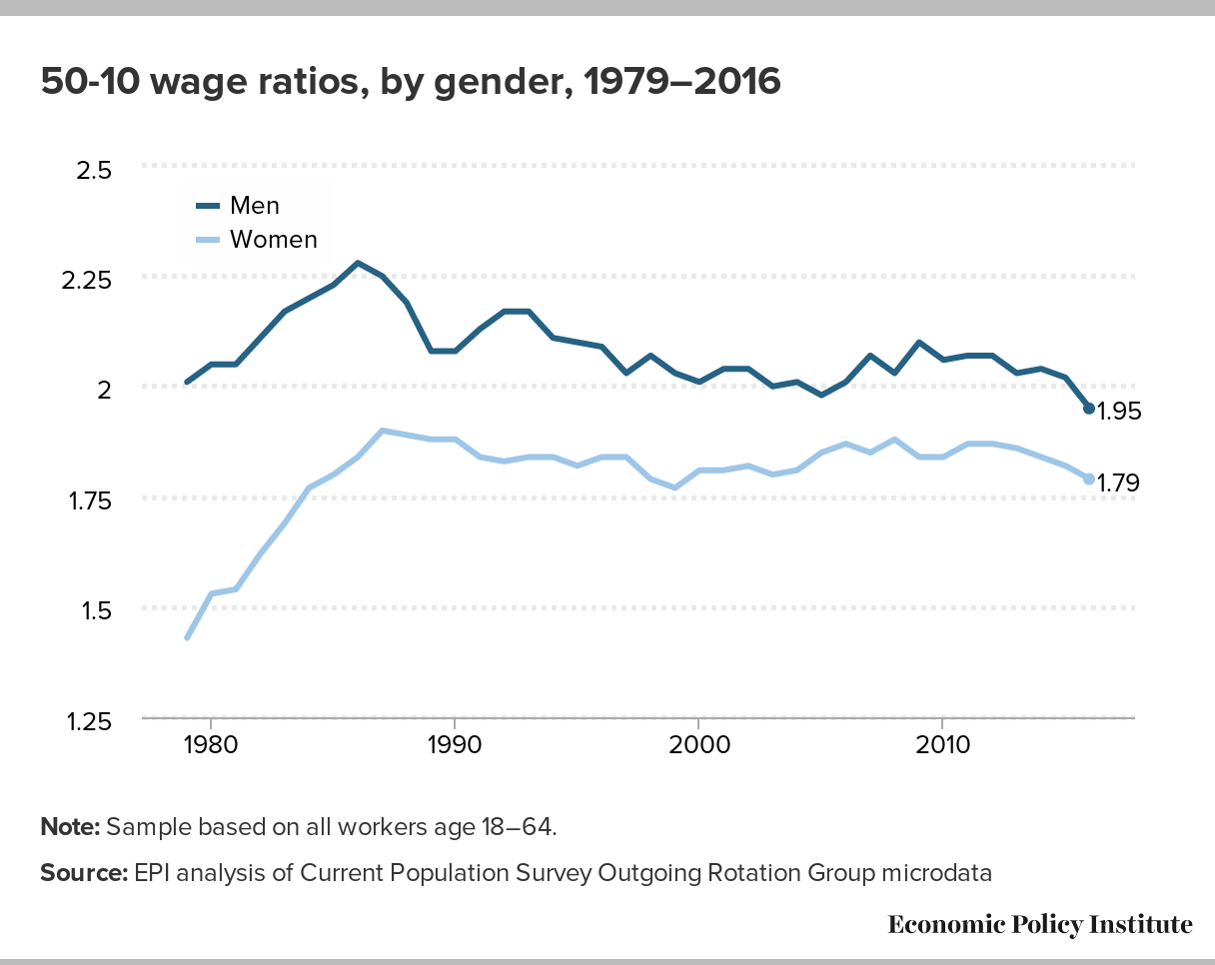

Slide 29
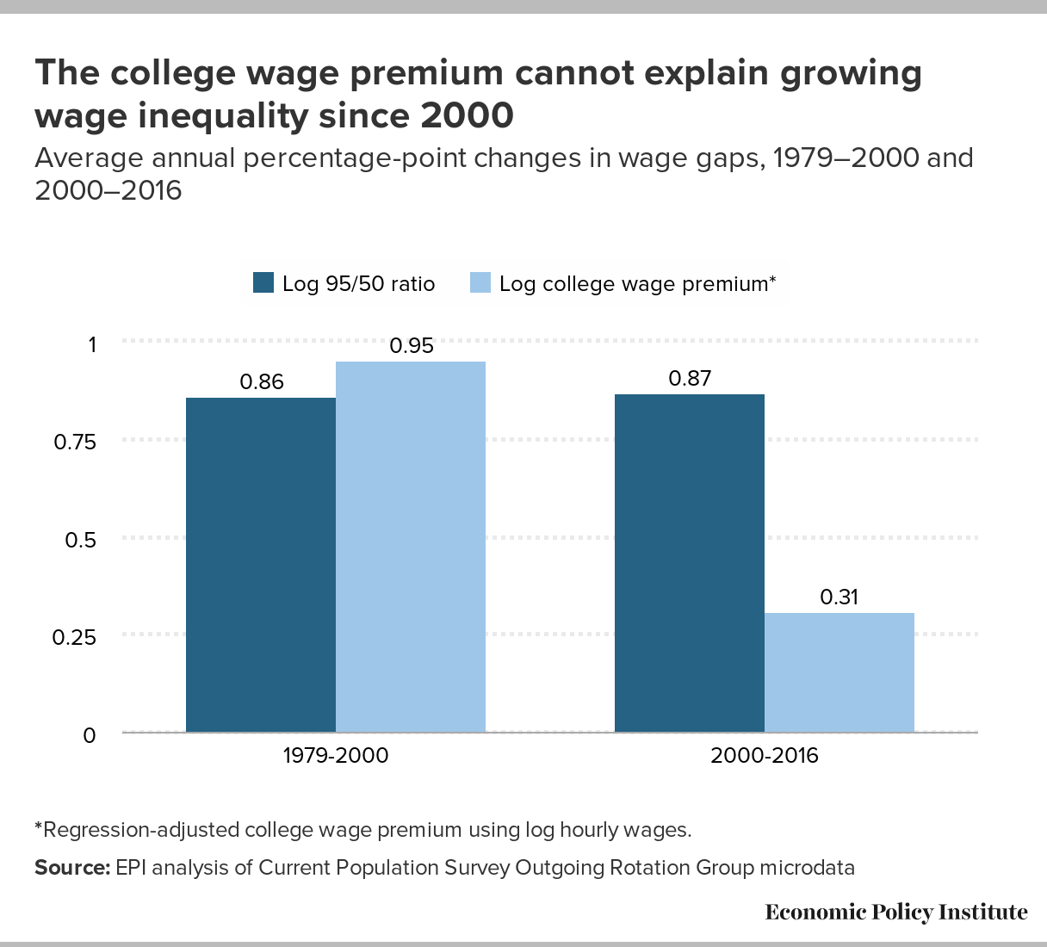

Slide 30
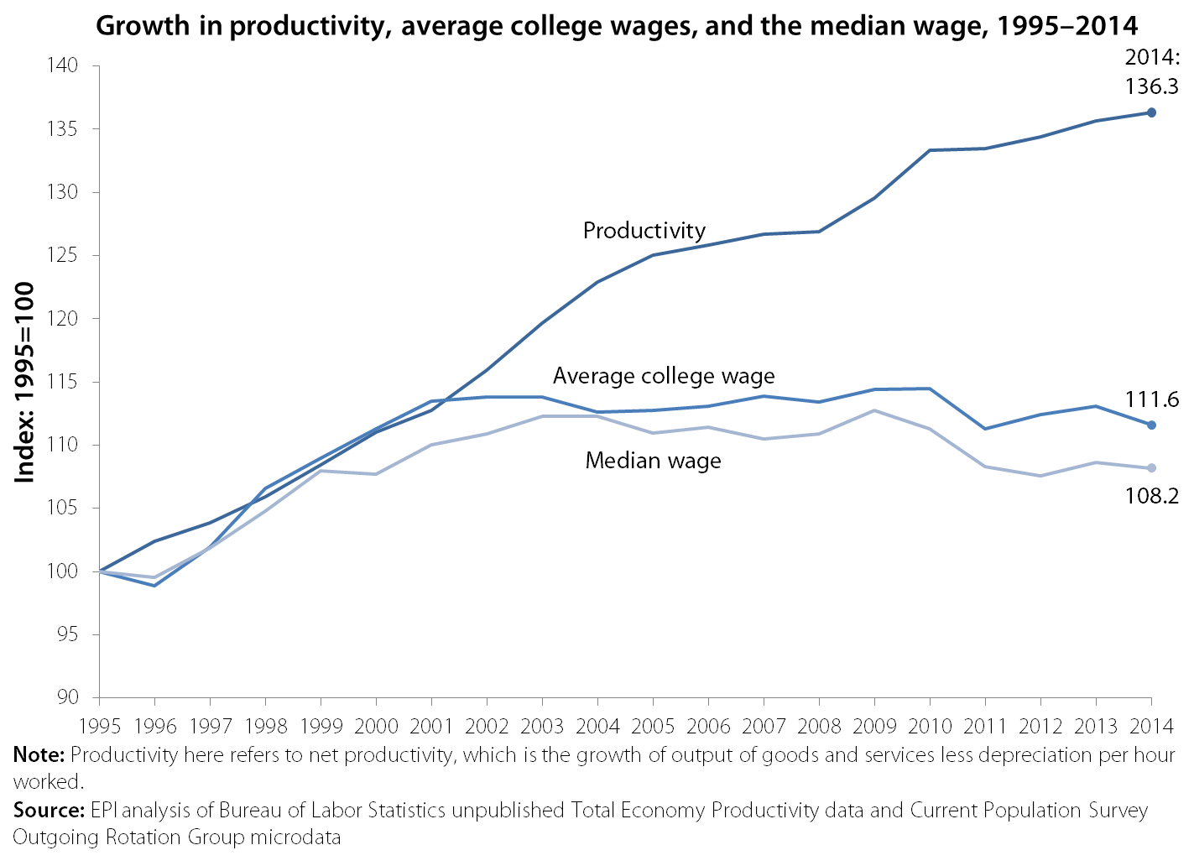

Slide 31
Marxist Explanation
‘Are you going to believe me, or what you see with your own eyes?’
Groucho Marx
Example: unpaid internships
Example: lower wages, less benefits for young college grads, underemployment

Slide 32
BLS Occupational Projections
By wage level
By education requirements

Slide 34
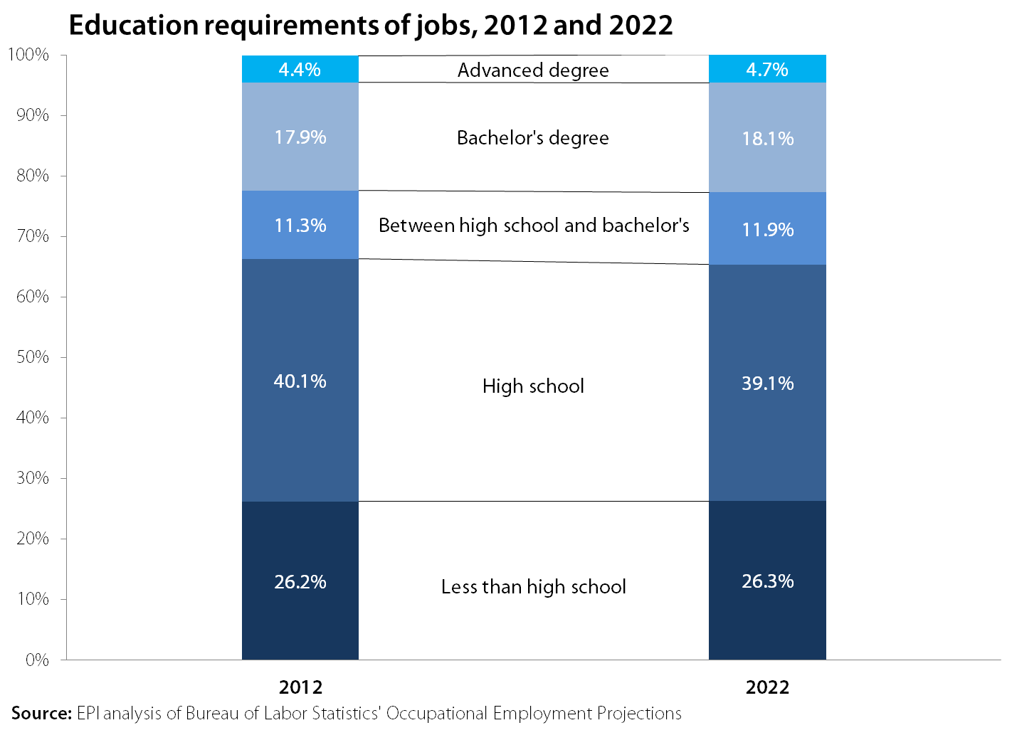

Slide 35
Gig Economy, Self-Employment are not Future of Work!
“At a ‘Future of Work’ conference the gig economy or freelancing deserves workshops, not a plenary”

Slide 36
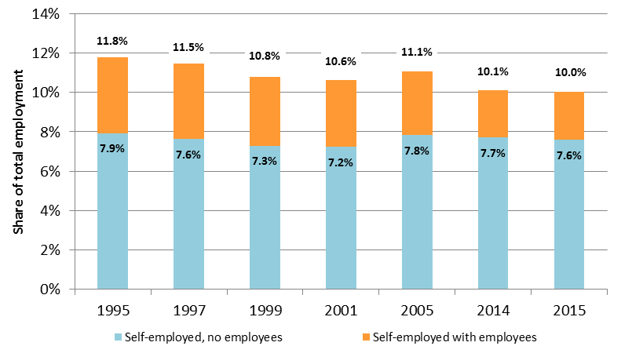
Self-employed share of employment, 1995-2015

Slide 38
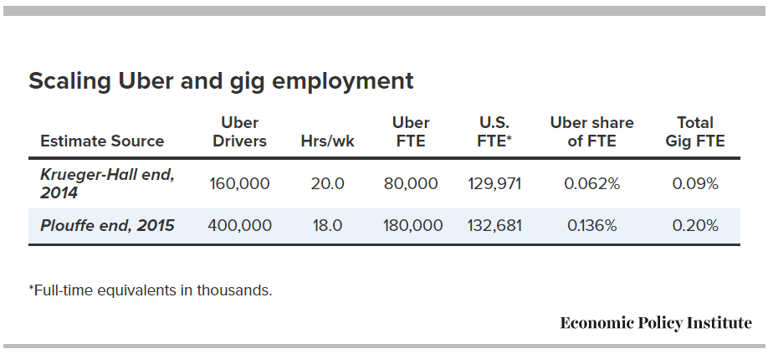

Slide 39
Scaling Uber and Gig wages paid
Uber driver pay, 2015
Annual pay: $4.70 Billion
Pay net of expenses: $3.76 Billion
Uber pay relative to economy:
% private wages 0.06%, (i.e. .0006 of total)
% private compensation 0.05%
Uber is two-thirds of gig economy, so Gig Economy was about 0.1% of private wages in 2015

Slide 40
What really happened: Policy choices, on behalf of those with most wealth and power, that have undercut wage growth of a typical worker:
Excessive unemployment;
Fissured economy;
Weakened labor standards;
Globalization;
Eroded institutions: collective bargaining
Top 1.0% wage/income growth

Slide 41
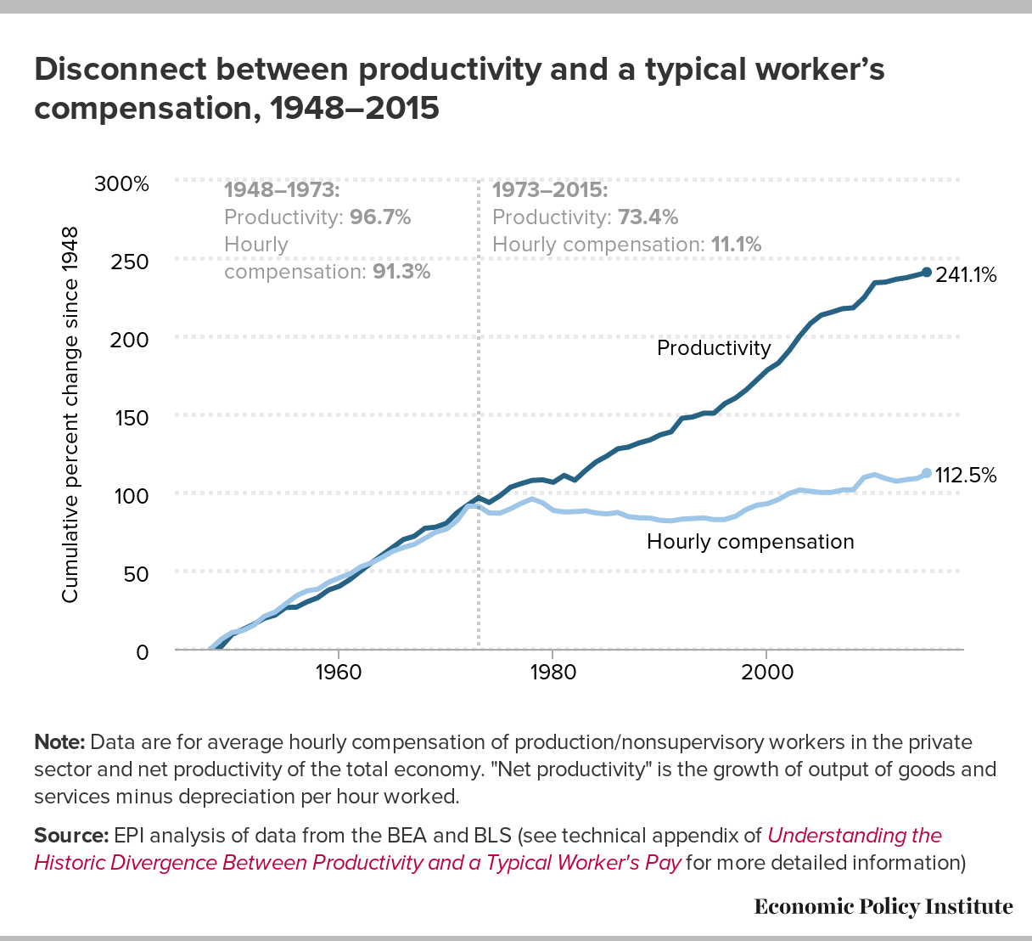
Productivity-pay gap

Slide 42
Raising America’s Pay
Full Employment
Restrain top 1% incomes (Finance, Executive pay)
Restore labor standards (min wage, OT, wage theft, misclassification, forced arbitration, undocumented workers)
Modernize labor standards (earned sick leave, family leave, fair work week/scheduling)
Rebuild collective bargaining
See: http://www.epi.org/pay/

