Slide 1
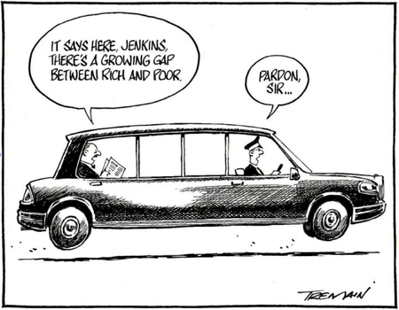
HISTORY OF INEQUALITY, STONE AGE TO TODAY
Walter Scheidel
(Stanford University)

Slide 2
Argument
Violence has been the single most important means of leveling wealth and income inequality in human history
4 principal mechanisms:
Mass mobilization war
Transformative revolution
State collapse
Pandemics

Slide 4
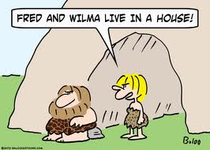
Transition from hunter-gatherers to farmers and herders >> increasing importance of material wealth (and political power)

Slide 5
Argument
Violence has been the single most important means of leveling wealth and income inequality in human history
4 principal mechanisms:
Mass mobilization war
Transformative revolution
State collapse
Pandemics

Slide 6
STATE COLLAPSE
The larger a tributary empire became and the longer it lasted, the richer its ruling class became

Slide 7
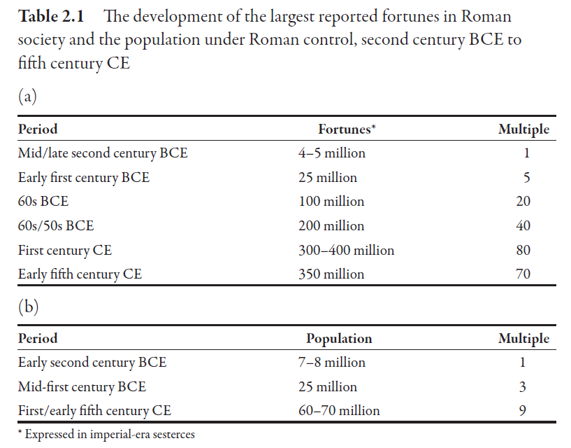
(TGL 72)

Slide 8
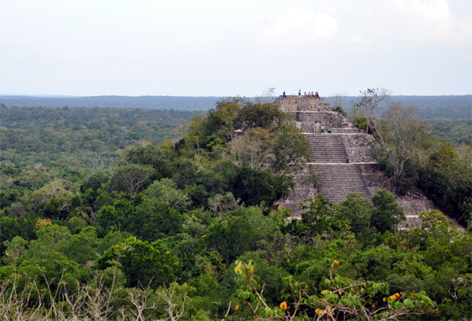
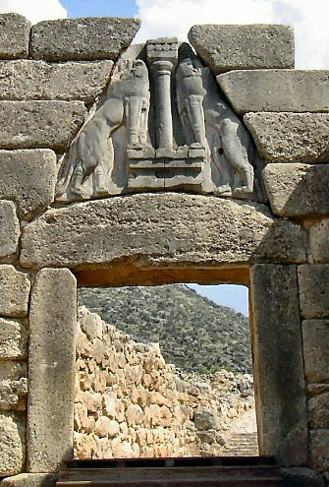
State collapse reverses this process – the more dramatic the collapse, the more substantial the leveling
Examples:
Mycenaean Greece
Western Roman Empire
Classic Maya
Tang China

Slide 9
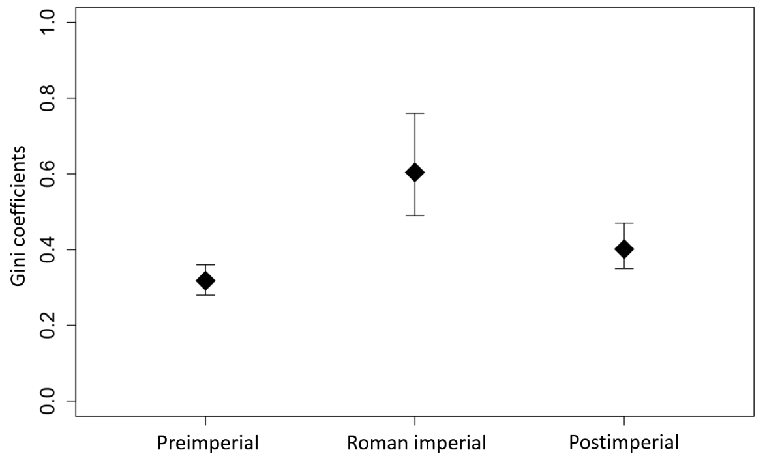
Gini coefficients of house sizes in Britain from the Iron Age to the Early Middle Ages
(TGL 269, from Stephan 2013: 90)

Slide 10
PANDEMICS
Black Death (14th/15th c.)
New World pandemics (16th/17th c.)
Justinianic Plague (6th/8th c.)

Slide 11
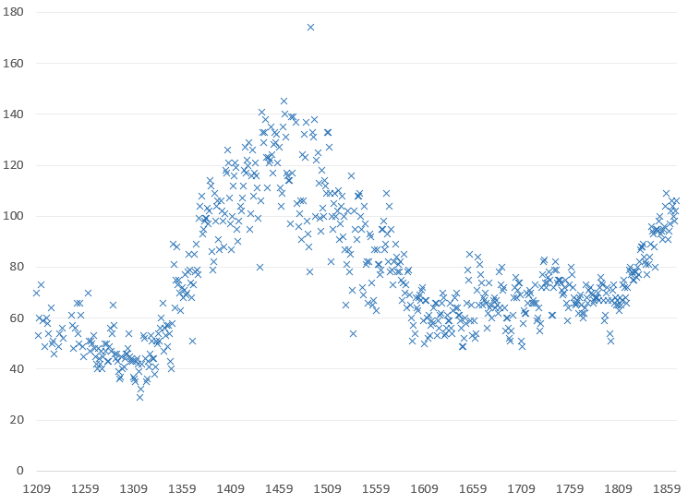
Rural real wages in England, 1200-1869
(TGL 303, from Clark 2007: 130-4)

Slide 12
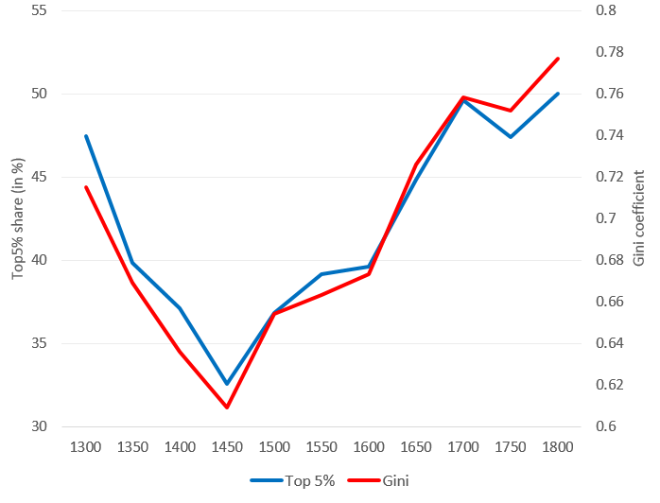
Wealth inequality in the cities of Piedmont, NW Italy, 1300-1800
(TGL 307, from Alfani 2015: 1084)

Slide 13
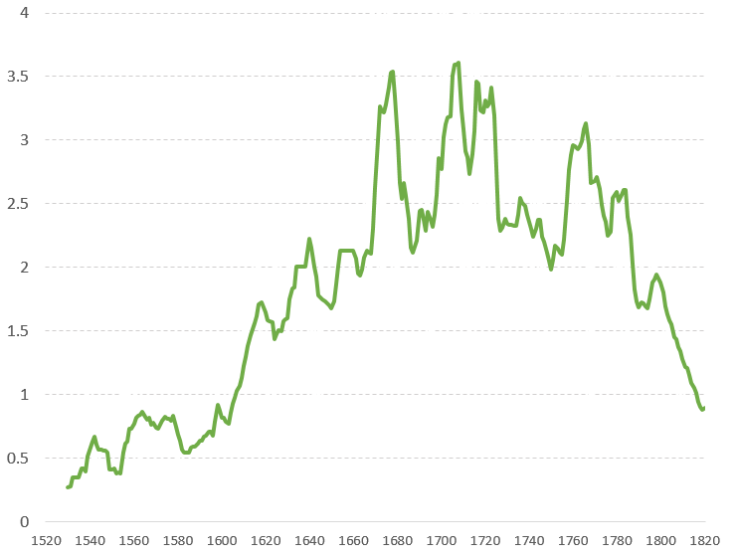
Real wages in central Mexico, 1520-1820
(TGL 317, from Arroyo Abad et al. 2012: 156)

Slide 14
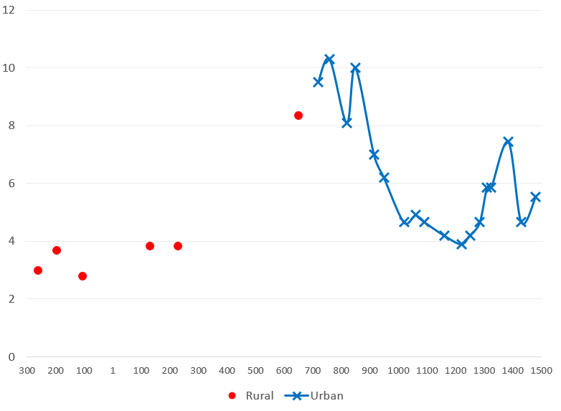
Daily wheat wages of unskilled workers in Egypt, 3rd cent. BCE to 15th cent. CE
(TGL 323, from Scheidel 2010: 448 and Pamuk & Shatzmiller 2014: 202)

Slide 15
Argument
Violence has been the single most important means of leveling wealth and income inequality in human history
4 principal mechanisms:
Mass mobilization war
Transformative revolution
State collapse
Pandemics

Slide 16
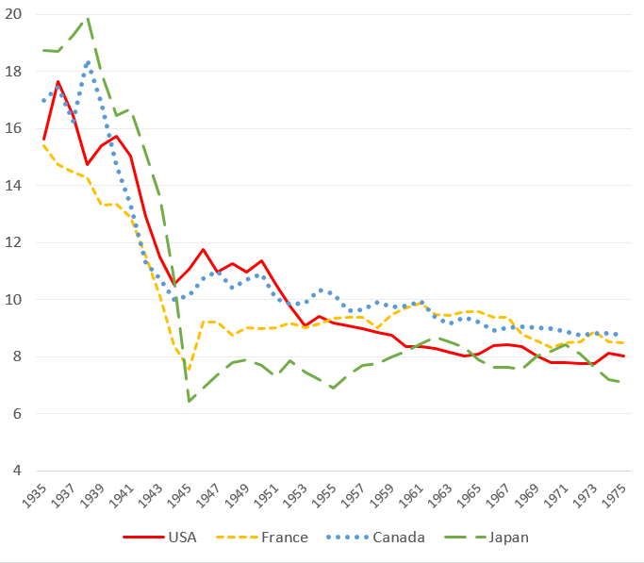
Top 1% income shares in four countries, 1935-1975 (in %)
(TGL 131, from WWID)

Slide 17
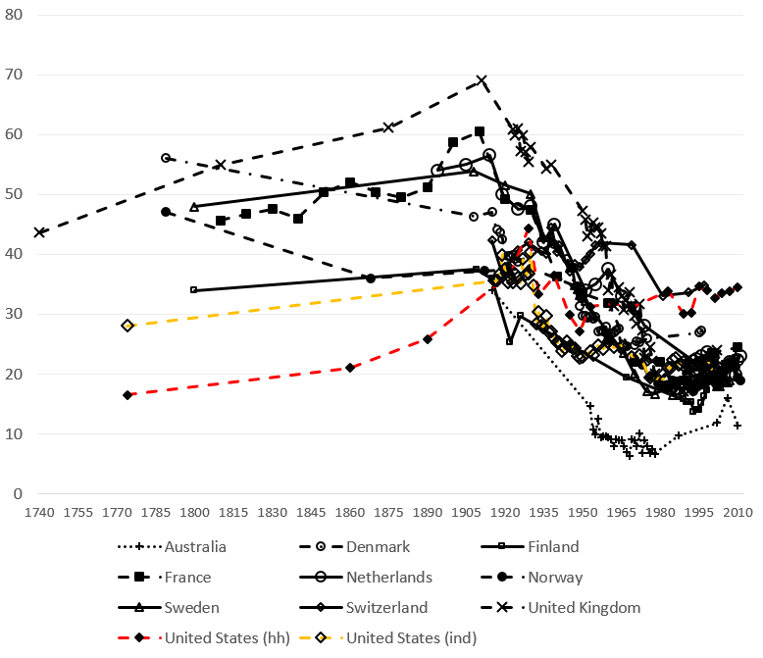
Top 1% wealth shares in 10 countries, 1740-2011
(TGL 139, from Roine & Waldenstrom 2015: 539)

Slide 18
Principal wartime factors:
Decline of capital value and returns on capital due to government intervention and other war-related effects
Very high top tax rates for income and estates
Redistribution of resources to workers
Falling skill premiums
Inflation
Physical destruction

Slide 19
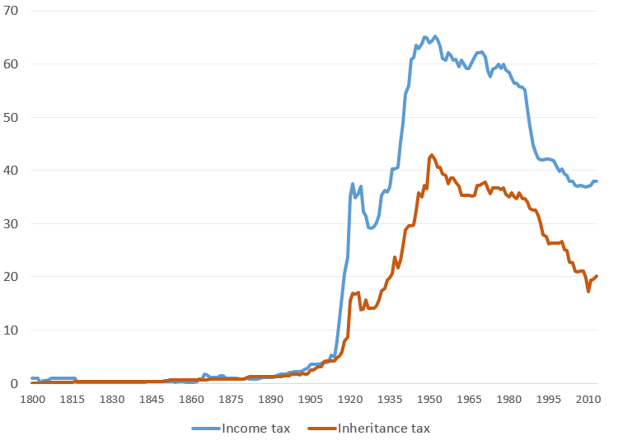
Average top tax rates in 20 countries, 1800-2013 (in %)
(TGL 145, from Scheve & Stasavage 2016: 81)

Slide 20
Principal wartime factors:
Decline of capital value and returns on capital due to government intervention and other war-related effects
Very high top tax rates for income and estates
Redistribution of resources to workers
Falling skill premiums
Inflation
Physical destruction
Knock-on effects:
Democratization (franchise extension)
Unionization
Welfare state (built on wartime fiscal expansion)
Social solidarity

Slide 21
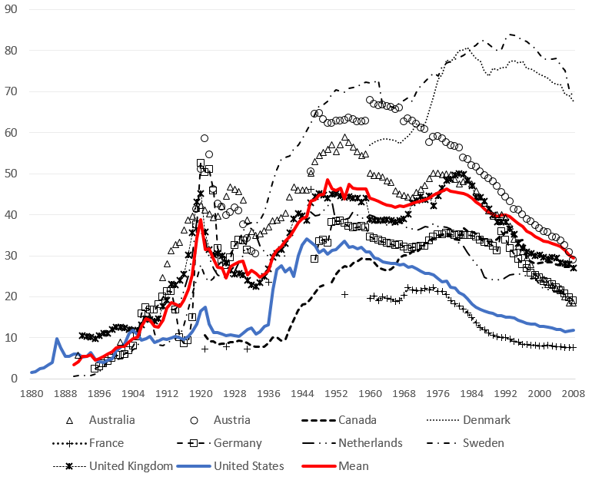
Trade union density in 10 OECD countries, 1880-2008 (TGL 167, from www.waelde.com)

Slide 22
Q: Earlier instances of leveling associated with mass mobilization warfare?
A: Hardly ever.

Slide 23
Q: Earlier instances of leveling associated with mass mobilization warfare?
A: Hardly ever.
Effects of civil war
Very rare in modern societies – leveling in and after Spanish Civil War
In developing countries – on average increase in inequality
allows uncontrolled profiteering by small minority
interferes with access to market for the poor
interferes with state taxation and redistribution including social spending
(Bircan, Bruck & Vothknecht 2010)

Slide 24
REVOLUTION
Communist revolutions – 100 million deaths + massive leveling of inequality
Soviet Union (expropriation, capital destruction, wage compression: very low income Gini below 0.3)
Maoist China (the same)
Vietnam, Cambodia, Cuba etc (all similar)

Slide 25
Earlier cases? Transformative revolutions rare before 20th century
French Revolution (expropriation, redistribution, real wage growth)
(TGL 237, from Morrisson & Snyder 2000: 71)

Slide 26
Peaceful alternatives?

Slide 27
Peaceful alternatives?
Peaceful land reform – only minor or no leveling in the longer term (violent reforms work better)

Slide 28
Peaceful alternatives?
Peaceful land reform – only minor or no leveling in the longer term (violent reforms work better)
Financial crises – not really (e.g., Great Recession of 2008; impact of Great Depression in US as main exception)

Slide 29
Peaceful alternatives?
Peaceful land reform – only minor or no leveling in the longer term (violent reforms work better)
Financial crises – not really (e.g., Great Recession of 2008; impact of Great Depression in US as main exception)
Democracy – no consistent effect (esp. Acemoglu et al. 2015; Scheve & Stasavage 2017)

Slide 30
Peaceful alternatives?
Peaceful land reform – only minor or no leveling in the longer term (violent reforms work better)
Financial crises – not really (e.g., Great Recession of 2008; impact of Great Depression in US as main exception)
Democracy – no consistent effect (esp. Acemoglu et al. 2015; Scheve & Stasavage 2017)
Unionization – largely a function of mass warfare (+ manufacturing)

Slide 31
Peaceful alternatives?
Peaceful land reform – only minor or no leveling in the longer term (violent reforms work better)
Financial crises – not really (e.g., Great Recession of 2008; impact of Great Depression in US as main exception)
Democracy – no consistent effect (esp. Acemoglu et al. 2015; Scheve & Stasavage 2017)
Unionization – largely a function of mass warfare (+ manufacturing)
Economists’ favorites: economic development (Kuznets curve); race between education and technology (skill-biased income inequality)

Slide 32
Interplay between processes of
wealth/income concentration (driven by state formation and economic development)
and
violent shocks
has been crucial in determining evolution of inequality in the very long run
>> “super-curves”

Slide 33
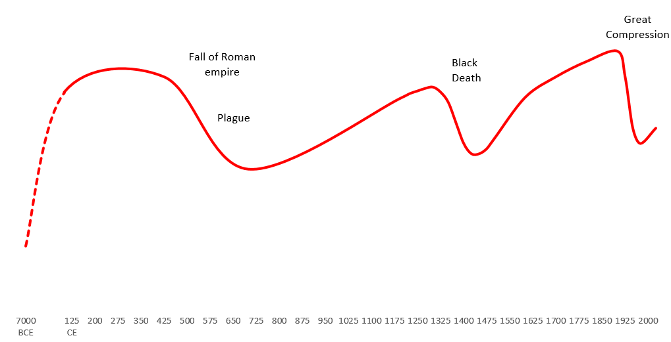
Inequality trends in Europe in the long run
(TGL 87)

Slide 34
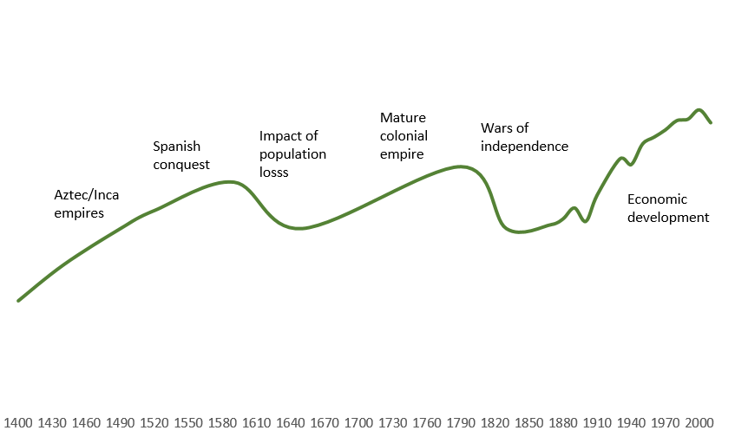
Inequality trends in Latin America in the long run
(TGL 104)

Slide 35
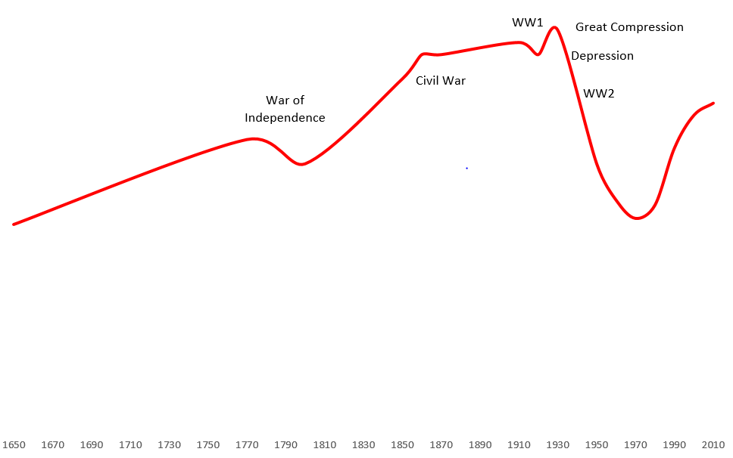
Inequality trends in the United States in the long run
(TGL 110)

Slide 37
Questions
What about Sweden?

Slide 38
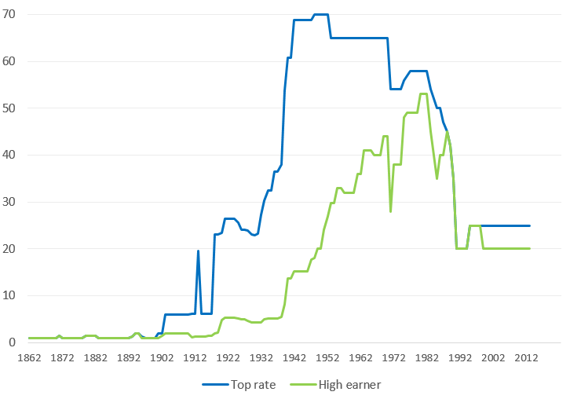
State marginal income tax rates in Sweden, 1862-2013
(TGL 161, from Stenkula et al. 2014: 174)

Slide 39
Questions
What about Sweden?
What about Latin America?

Slide 40
Inequality trends in Latin America in the long run
(TGL 104)

Slide 41
Questions
What about Sweden?
What about Latin America?
What would have happened in the absence of violent shocks?

Slide 42
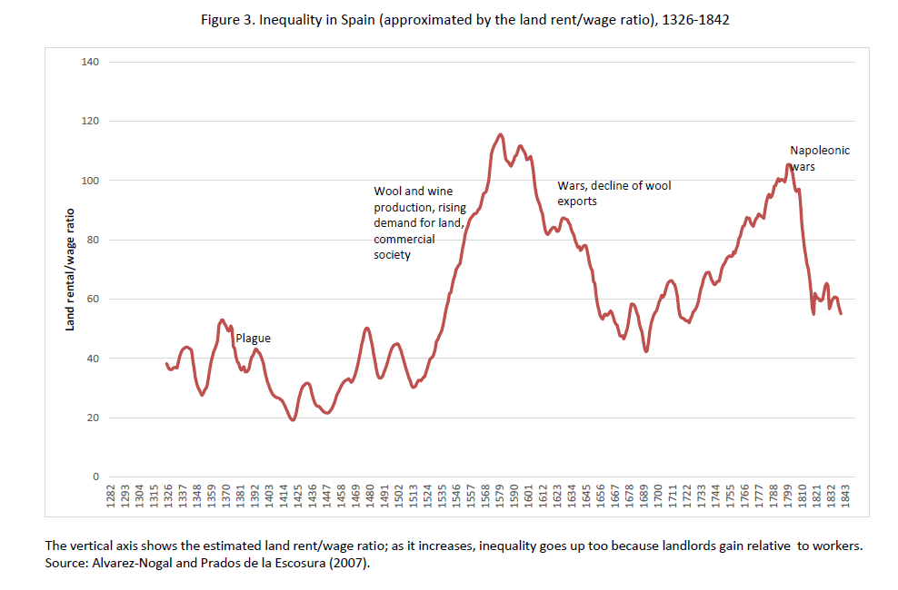
Earlier version of Milanovic 2016: 60

Slide 43
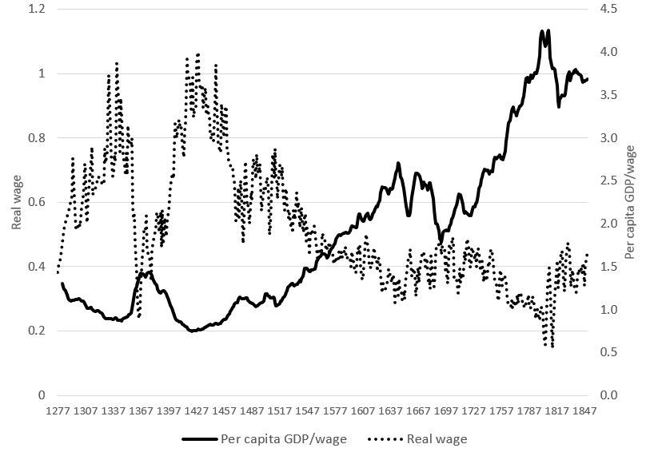
Spain, 1277-1850
(TGL 99, from Alvarez-Nogal & Prados de la Escosura 2013)

Slide 44
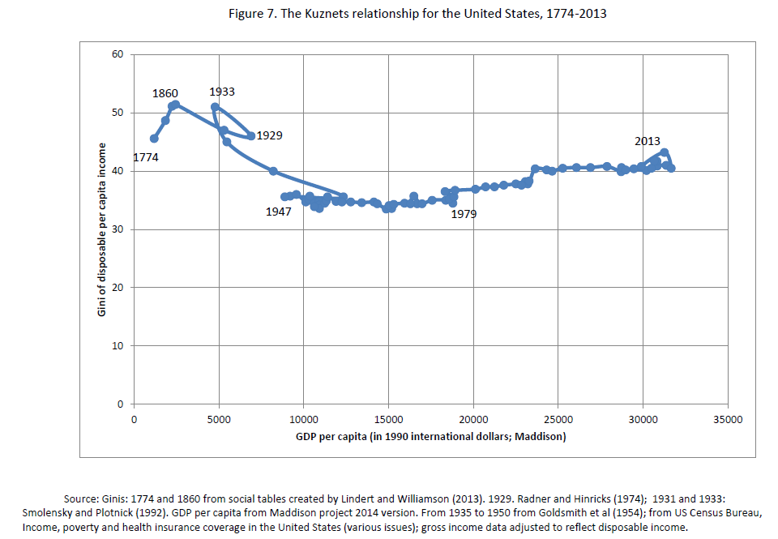
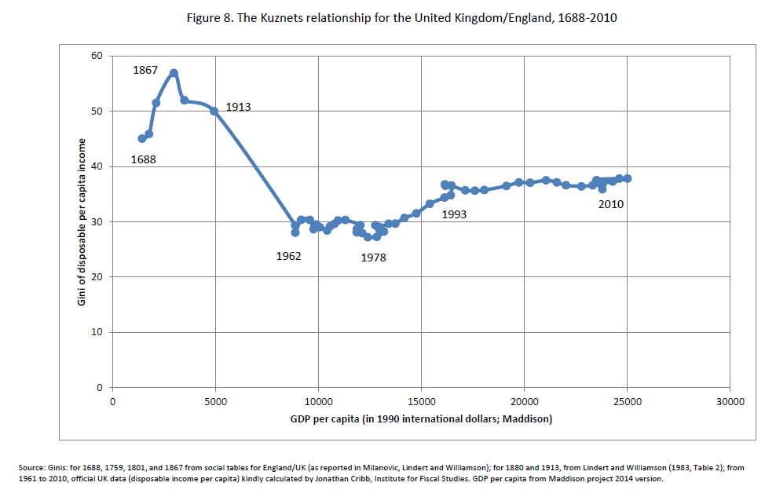
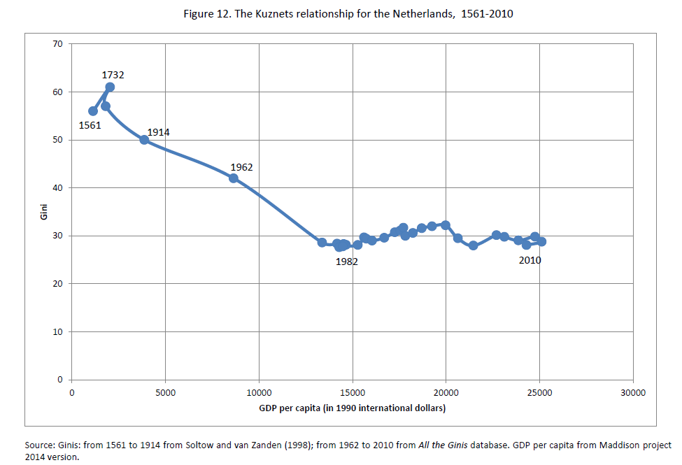
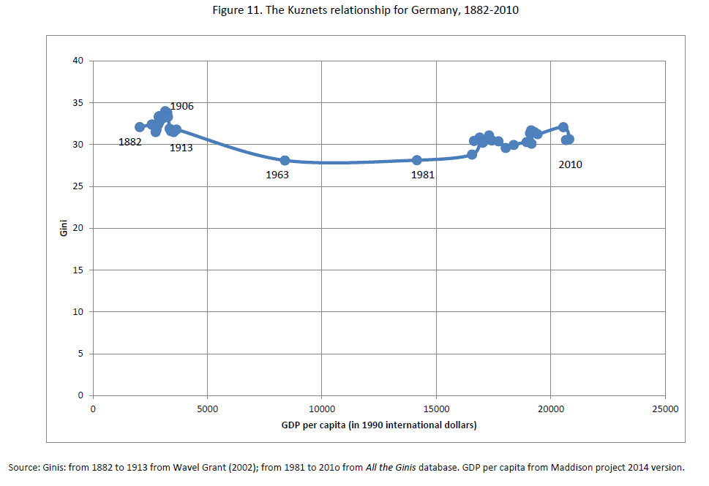

Slide 45
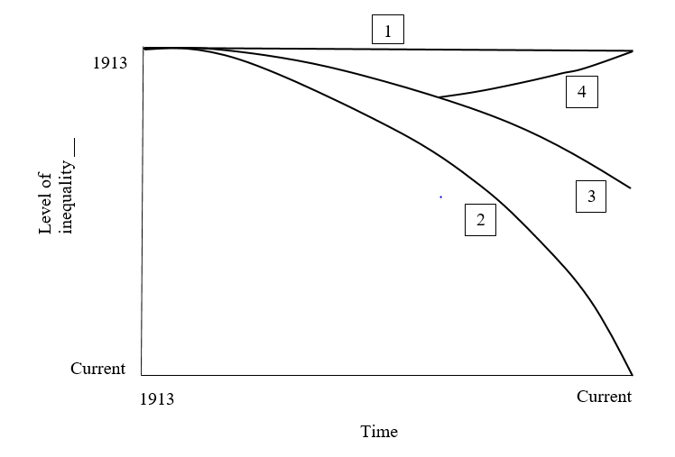
Counterfactual inequality trends for the twentieth century
(TGL 400)

Slide 47
Questions
What about Sweden?
What about Latin America?
What would have happened in the absence of violent shocks?
Is history relevant?

Slide 48
Where do we go from here?
The traditionally effective mechanisms
mass-mobilization wars
transformative revolutions
state collapse
pandemics
are no longer available to us today ( – nor would we want them to be…)

Slide 49
Where do we go from here?
The traditionally effective mechanisms
mass-mobilization wars
transformative revolutions
state collapse
pandemics
are no longer available to us today ( – nor would we want them to be…)
How realistic are calls for sweeping policy changes in the absence of such preconditions?

Slide 50
Where do we go from here? (cont.)
Plausible policy measures (targeted fiscal intervention, investment in education, tracking offshore wealth, basic income, campaign finance reform, etc)
must be contextualized in altered global environment (fading of previous shock-induced equalization)
and absorb disequalizing trends related to
globalization
automation
secular aging
migration
(and, one day) somatic enhancement

