Slide 1
Inequality and Economic History

Slide 2
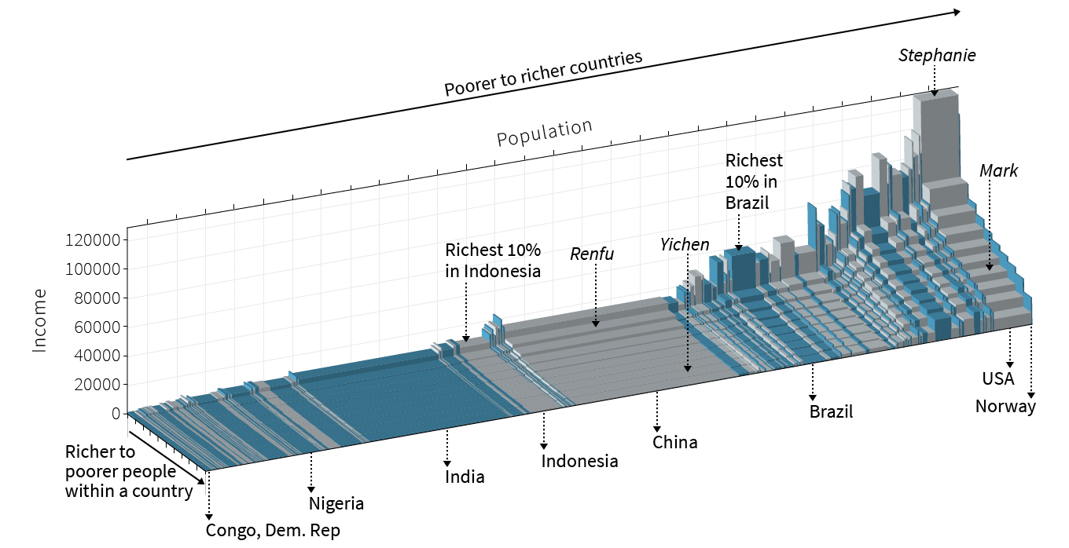
The World Distribution of Income (From CORE)
Stephanie:rich in US
Mark: middle in US
Renfu:rich in China
Yichen poor in China

Slide 3
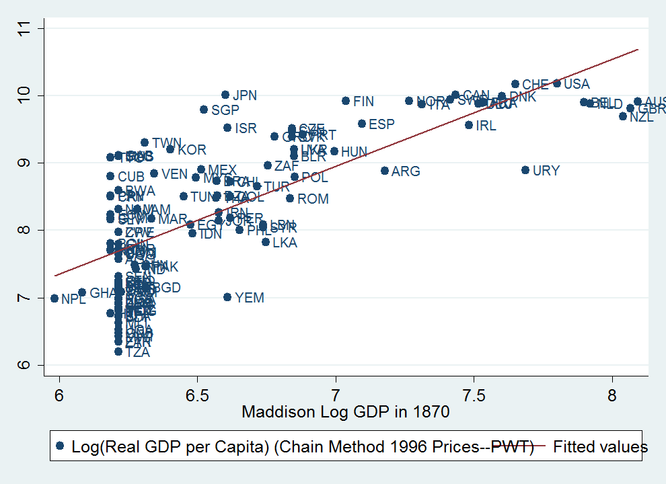
Persistence of GDP
Maddison + PWT

Slide 4
Some relationships of inequality and history.
Global inequality before and since the industrial revolution.
Intergenerational mobility and persistence.
Historical and institutional correlates of within-country inequality.
Normative implications of historical determinants of inequality.

Slide 5
Figure 8. Share of total wealth held by the richest 1%: 1740-2011.
Bolshevik revolution, World War I and voting rights for all males (except US) 1914-1919
French Revolution 1789-1799
Voting rights for all males, France 1884
World War II
1939-1945
Golden age of capitalism 1945-1973
From www.core-econ.org U 19 (using data from Waldenstrom and Roine)
US independence: 1776
Denmark
Sweden
United Kingdom
Norway
France
Finland
United States

Slide 6
Digression about tax havens
From Zucman JEP 2015

Slide 7
From Zucman JEP 2015

Slide 8
Over time: “The Past is Another Country”
Same issues of measurement of GDP plague measuring real income over time.
We have so many products that we consume now that we didn’t consume in the past.
Need to come up with consumption bundles that are common.
Wind up missing a lot of things, like health and lifespan.

Slide 9
How to measure GDP in the past?
Classic reference is Maddison
  Using many many different sources.
    A whole lot of guesses!
  Morten Jervens “Poor Numbers” on national income statistics in poor countries (largely Africa).
  Even PWT 8.0 is contested GDP numbers (PPP prices?)
Maddison being updated by Bolt and Van Zanden (2013).
Robert Allen real wages around the world.
Broadberry et al. (2014) new estimates of British GDP from 1270 on.
Good online links: http://www.iisg.nl/hpw/link.php

Slide 10
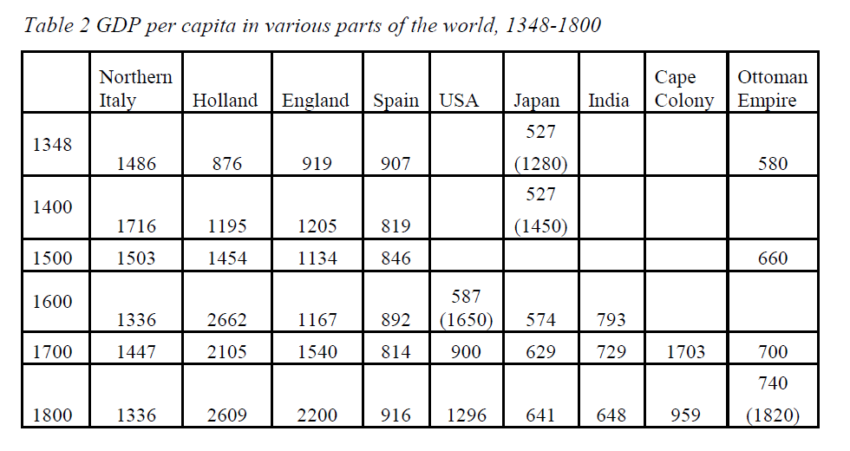
From Robert Allen “Comparative Divergence”

Slide 11
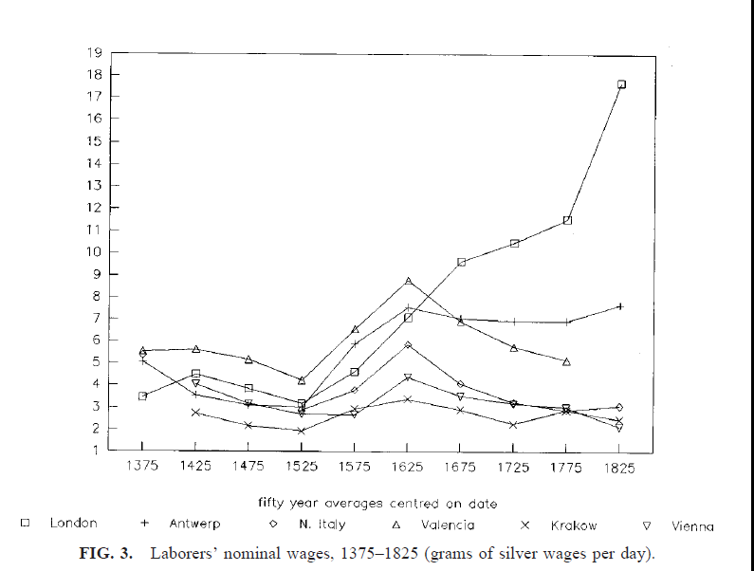
From Robert Allen “Comparative Divergence”

Slide 12
Figure 9. The share of total income received by the top 1%: 1913 -2012.
Start of global financial crisis: 2008
Start of Great
Depression:
1929
End of ‘golden age’ of capitalism:
1973
End of WWI: 1918
End of WWII: 1945
South
Africa
United
States
Argentina
India
United Kingdom
China
www.core-econ.org

Slide 13
Figure 17. Declining share of the top 1% in some European economies and Japan.
Start of global financial crisis: 2008
Start of Great
Depression:
1929
End of ‘golden age’ of capitalism:
1973
End of WWI: 1918
End of WWII: 1945
Japan
Denmark
Germany
Italy
France
Sweden
Netherlands
www.core-econ.org

Slide 14
Figure. Shares of global income received by bottom 60% and top 10% of world population (1820-2008).
Industrial
Revolution
Start of WWI: 1914
Start of WWII: 1939
Take-off of China and India:
www.core-econ.org

Slide 15
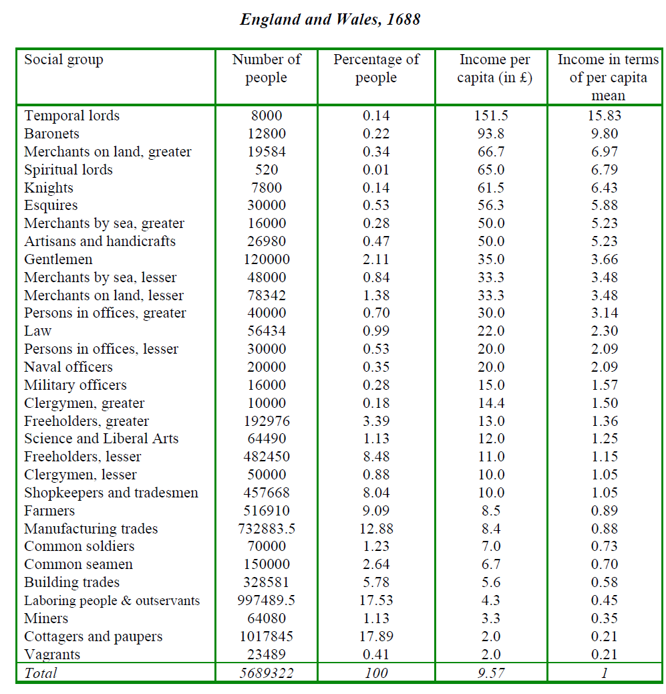
Social Tables first measurement of inequality
First measured by William Petty and Gregory King
(Lindert, Milanovic, and Williamson 2007).

Slide 16
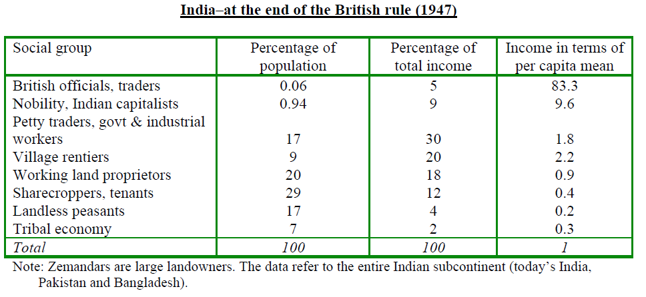
(Lindert, Milanovic, and Williamson 2007).

Slide 17
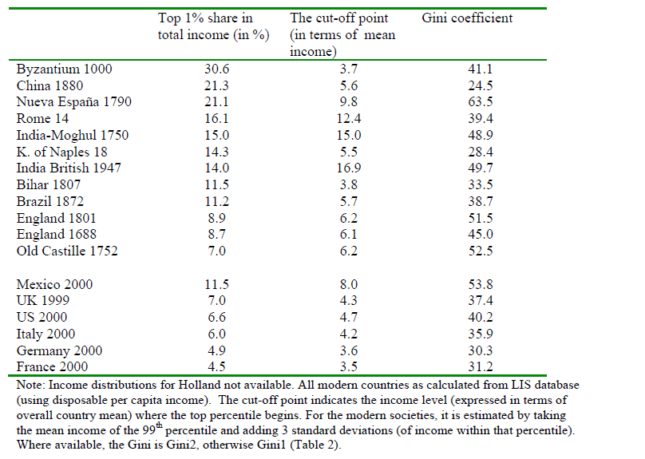
(Lindert, Milanovic, and Williamson 2007).

Slide 18
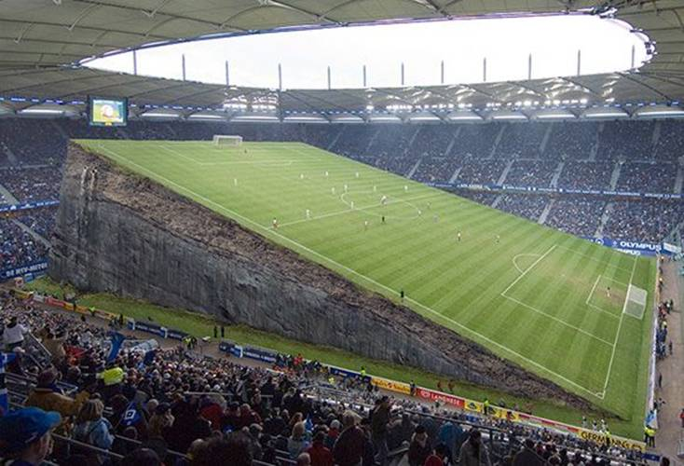
Equality of Opportunity.

Slide 19
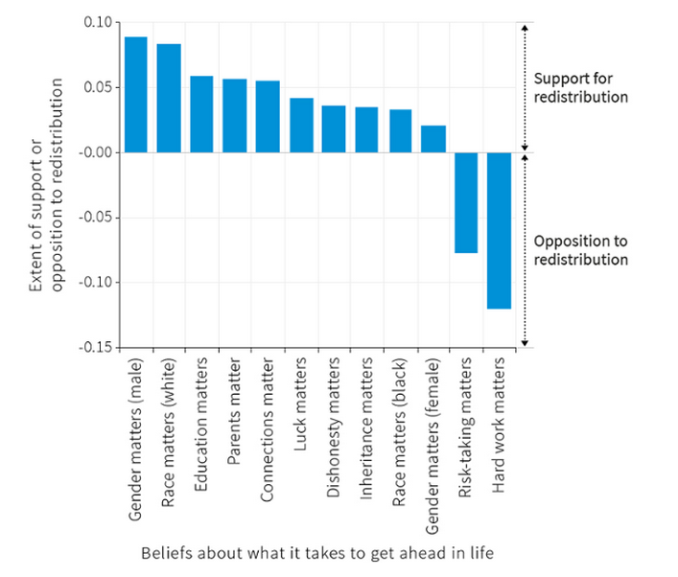
Accidents of Birth. What’s fair? What’s a level playing field?
Survey question: “What does it take to get ahead in America? “
How this is answered is correlated with how people feel about government programs to help the poor
www.core-econ.org U21

Slide 20
Intergenerational Transmission of Income
How much does parental income influence child outcomes.
Basically look at correlations between parent and child incomes.
Why do we care?
One idea is that liberal societies care about equality of opportunity more than equality of outcome.
i.e. we particularly object to wealth inequality because it is bequestable.
Large literature estimating relationship of children’s outcomes to parent’s outcomes.

Slide 21
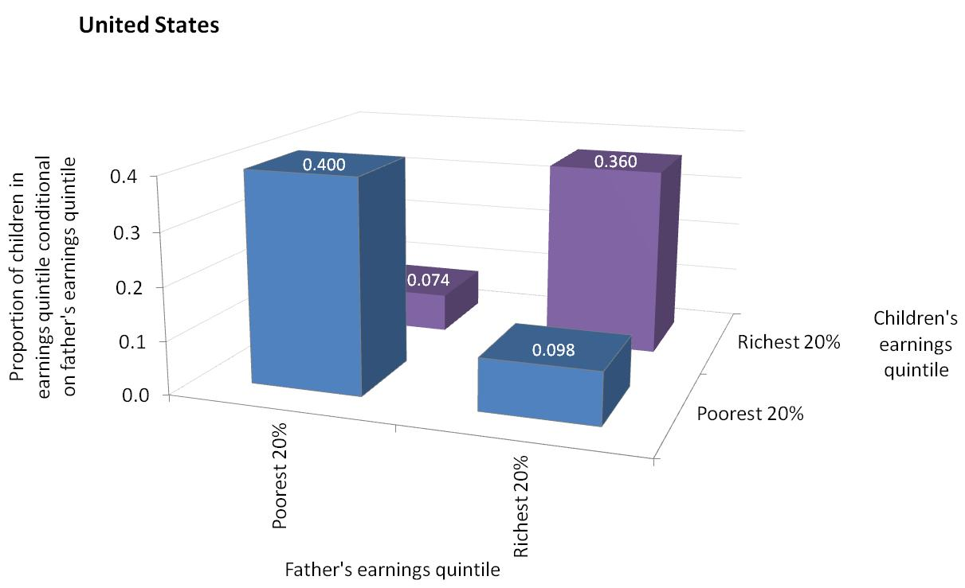
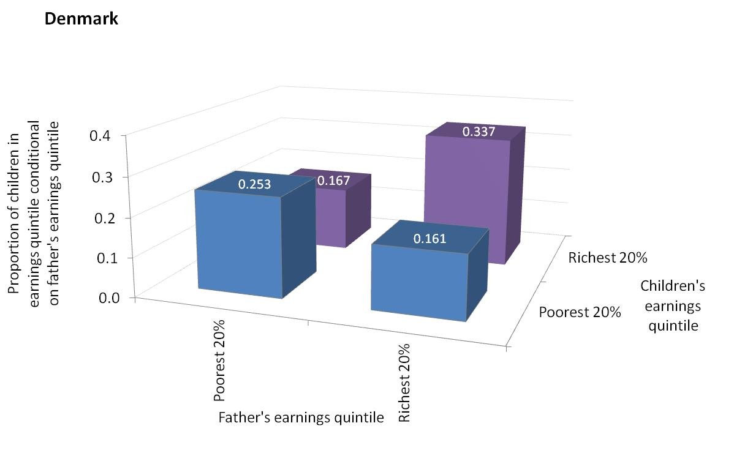
Intergenerational Mobility
www.core-econ.org U21

Slide 22
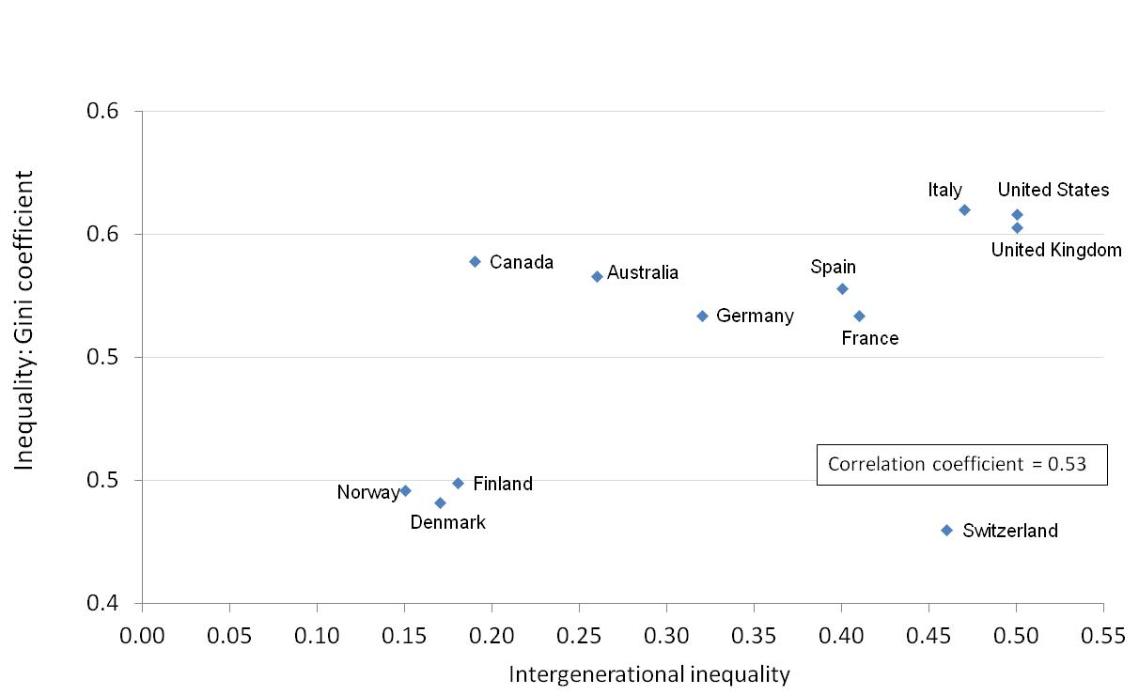
The Great Gatsby Curve.

Slide 23
IGE
Classic Becker-Tomes (1979) regression
log yc = b log yp +Xa + e
Focus on b “Intergenerational elasticity of income”
Problem: Often want “lifetime income” or “wealth”
Control for age polynomials in X
Identification?
Often use education as proxy.

Slide 24
OLS confounds variance with covariance.
Chetty et al. 2014 recommend using rank-rank regression.
Use linked tax records (47 x 10^6)
Calculate income ranks by cohort using multiple years of data.
Estimate absolute and relative mobility by commuting zones.
Results available online.

Slide 25
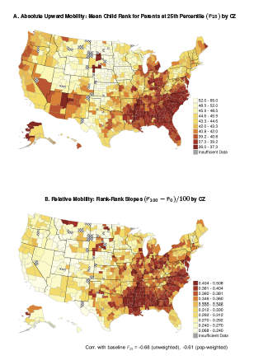
From: Chetty et al. 2015

Slide 26
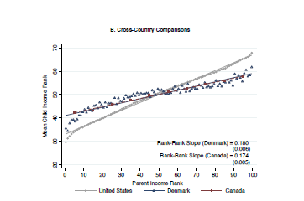
From: Chetty et al. 2015

Slide 27
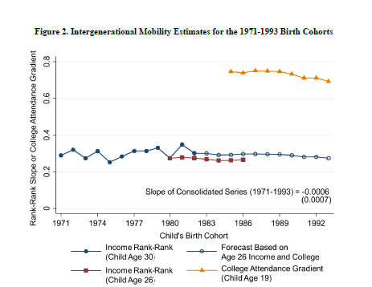
From: Chetty et al. 2014

Slide 28
Stability of intergenerational mobility?
Clark (2014) argues that intergenerational persistence robustly high.
  Argues for genetics + assortative mating.
  Argues even big revolutions, like Chinese, have no effect.
Uses surname frequencies. (See also Olivetti and Paserman 2014).
But surname frequencies also reflect other transmitted variables.

Slide 29
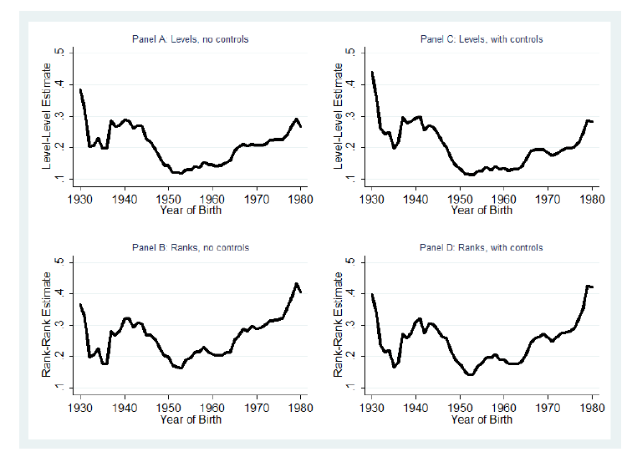
With actual linked data from China.
From
Chen, Naidu, Yu, and Yuchtman 2016

Slide 30
Paper: Bleakley and Ferrie 2014
1832 Georgia land lottery.
All adult men entered.
Authors link lottery records to 1850 census and 1880 children.
  Use Ancestry.com
But now 1850-1940 census microdata all available via NBER.
  Lots of opportunities here.

Slide 31
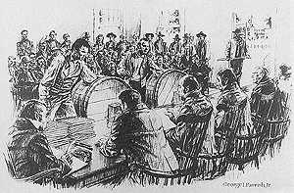
19th Century Randomization

Slide 32
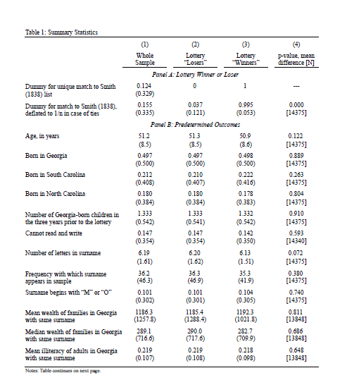

Slide 33
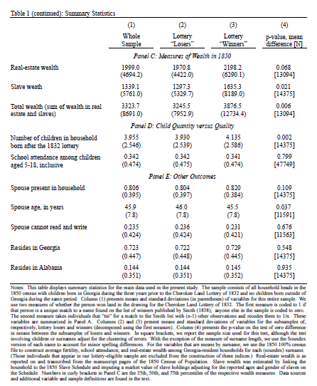

Slide 34
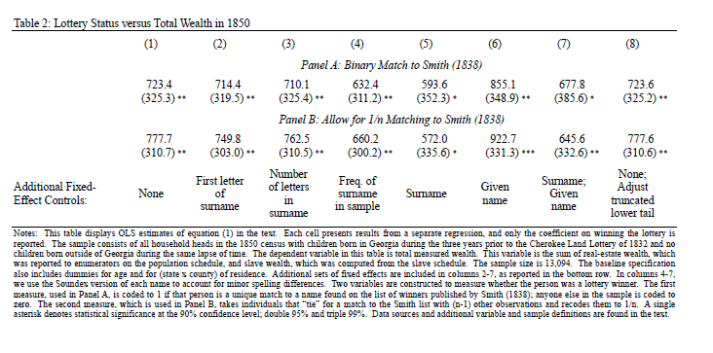
Matching in historical data
Phonetic distance of names + age/BPL/PBPL.
How to match names optimally active area of research.

Slide 35
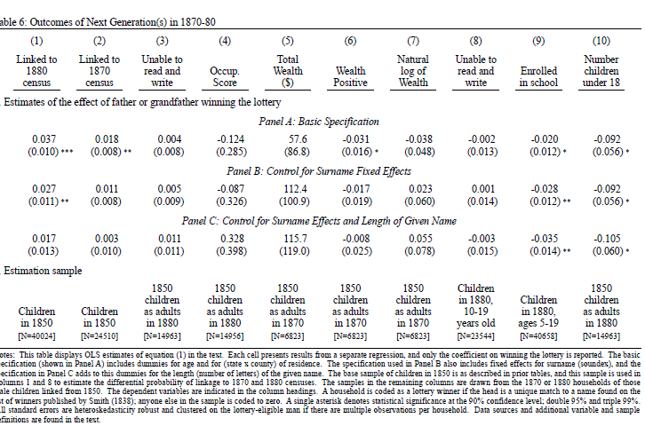

Slide 36
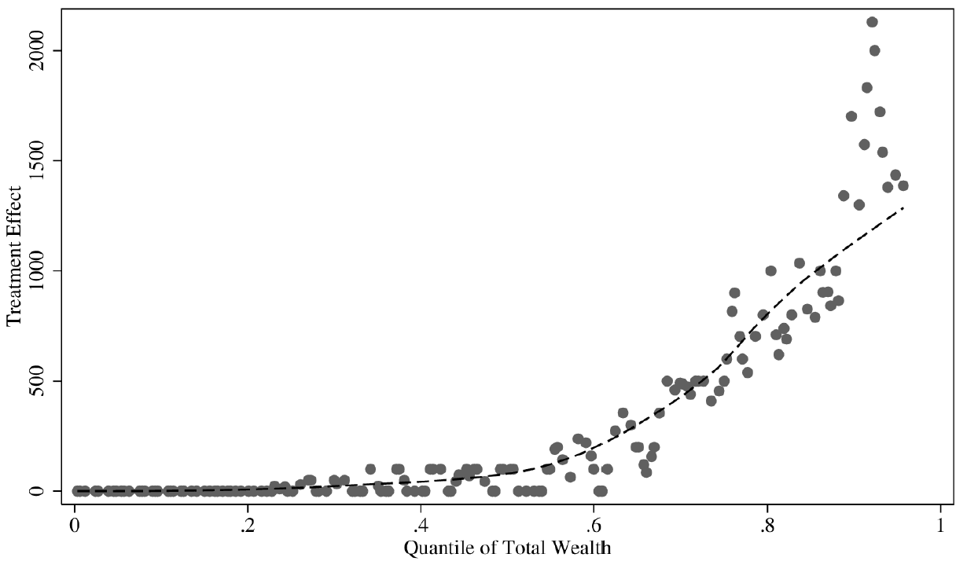
Companion paper: no effect on lower tail

Slide 37
Bolgerhoff-Mulder et al 2009
42 pre-industrial societies.
Measure parent-child measures of status.
Categorize status type as “Embodied”, “Relational” or “Material”.
Categorize share of each society’s production in each type of wealth (α).
Calculate IGE (β) and gini for each.

Slide 38
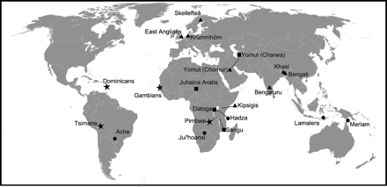

Slide 39
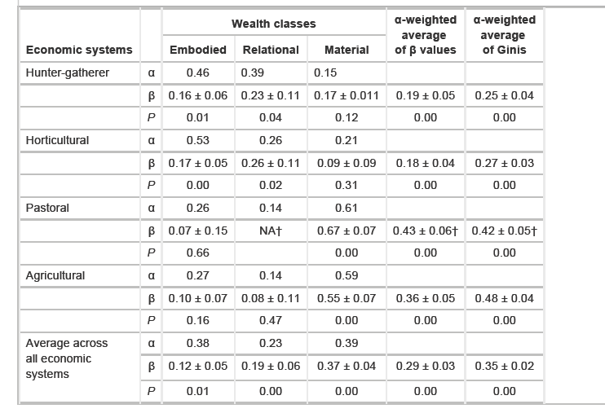

Slide 40
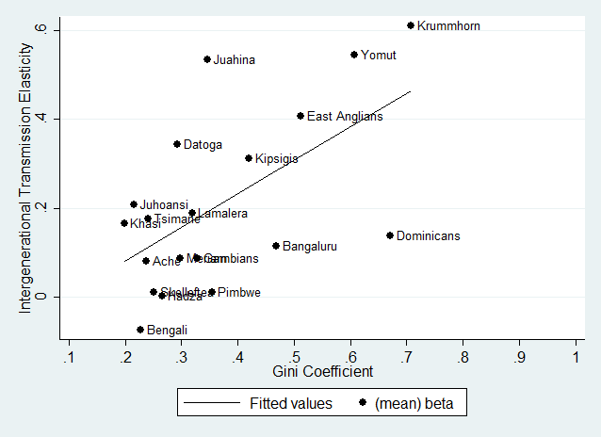

Slide 41
inequality across countries
Basically: underdevelopment.
  What do we think are the causes of underdevelopment?
Two questions:
  How does the causes of underdevelopment affect obligations rich countries (and their citizens) have.
  Opens up some interesting issues:
    International aid.
    Global climate change.
      Also useful to talk about inequality across generations.
    International migration.

Slide 42
Historical causes of cross-country inequality.
  The big shock is the industrial revolution and its uneven diffusion.
  So what caused the industrial revolution?
    Coal and colonies.
      High wages, cheap energy.
      Ate up the world carbon budget?
    Ideas and science.
      “Industrial Enlightenment”
    Capitalist institutions.
      Markets for products, capital, and labor.
  And what caused its unequal diffusion?
    This you’ve probably already studied.
      Geography/Institutions/Culture.
      Capitalism.
        Development of country A can cause underdevelopment of country B

Slide 43
The past causes of cross-country inequality
Influence the arguments countries make today.
  On climate change.
  On trade agreements
  On development assistance.
Should they?

Slide 44
Slavery and Capitalism: Williams hypothesis.
Old Argument: 1) slavery underdeveloped Africa (2) and parts of the New World) and 3) helped develop Europe.
Solid evidence on 1 and 2. Less evidence on 3.
Basis for international reparations?

Slide 47
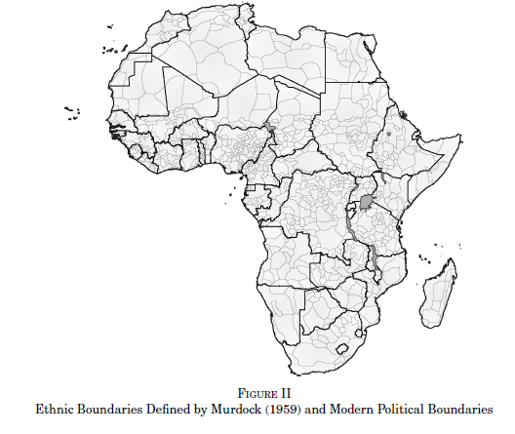
Slavery in Africa
Nunn (QJE 2008) uses slave ship records of last names and maps of ethnicity in Africa to reconstruct how many slaves were exported from each country. Creates index of “state development” in 19th century.

Slide 48
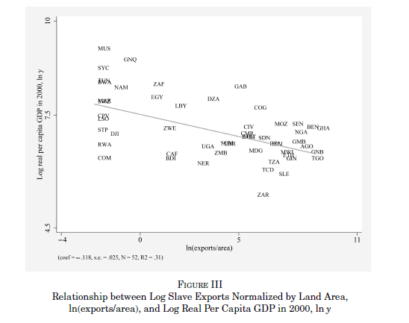
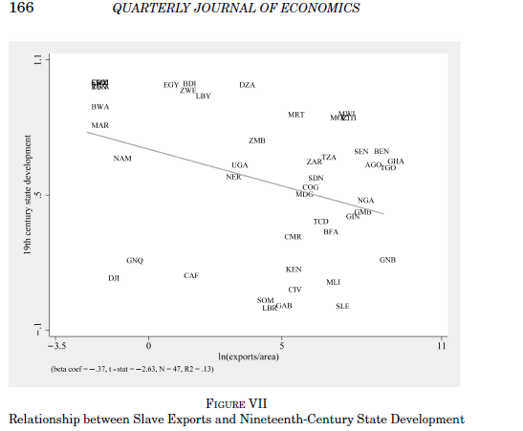
Slavery in Africa
Checks results by looking at the gap in slave exports between those countries closer and farther from slave shipping ports

Slide 49
Derenoncourt (2016) Working paper

Slide 51
Colonial Institutions (AJR 2001, and see Why Nations Fail)
Two kinds of colonial institutional setups:
Extractive (e.g. Bolivia)
Settler (e.g. New Zealand)
What determined which colony got which?
Extent to which settlers died.

Slide 52
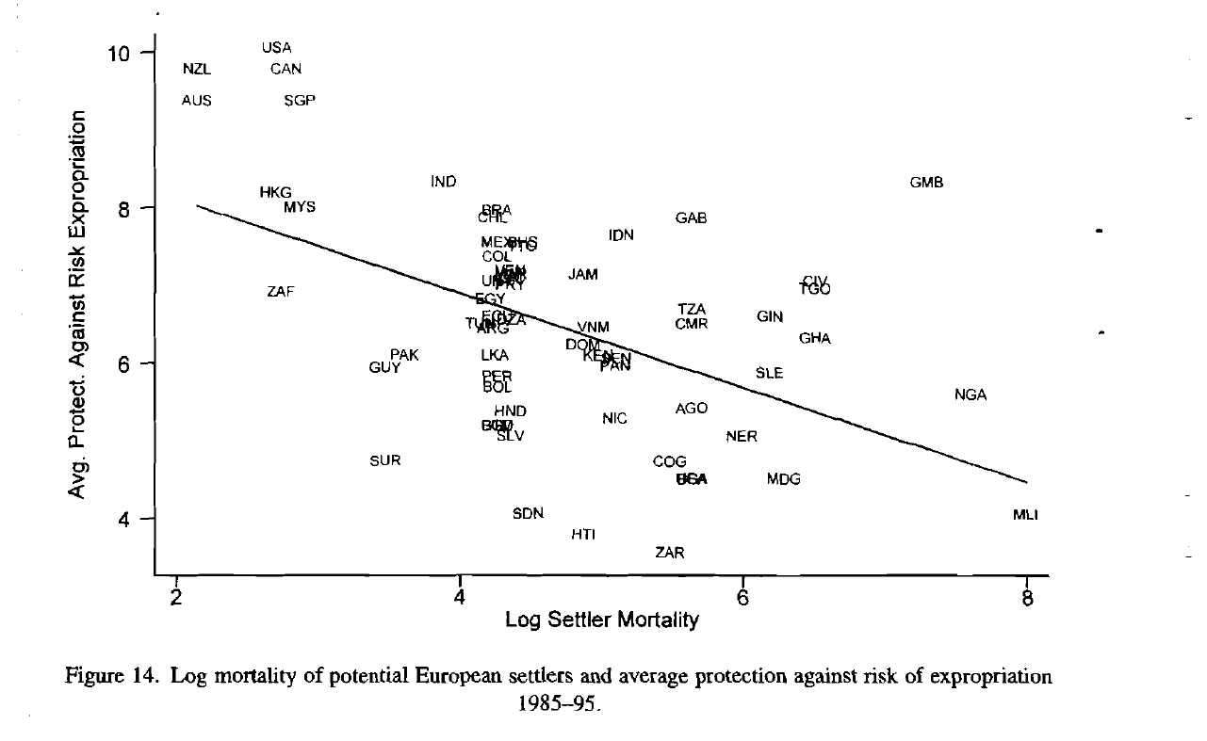
Persistence of Colonial Institutions

Slide 53
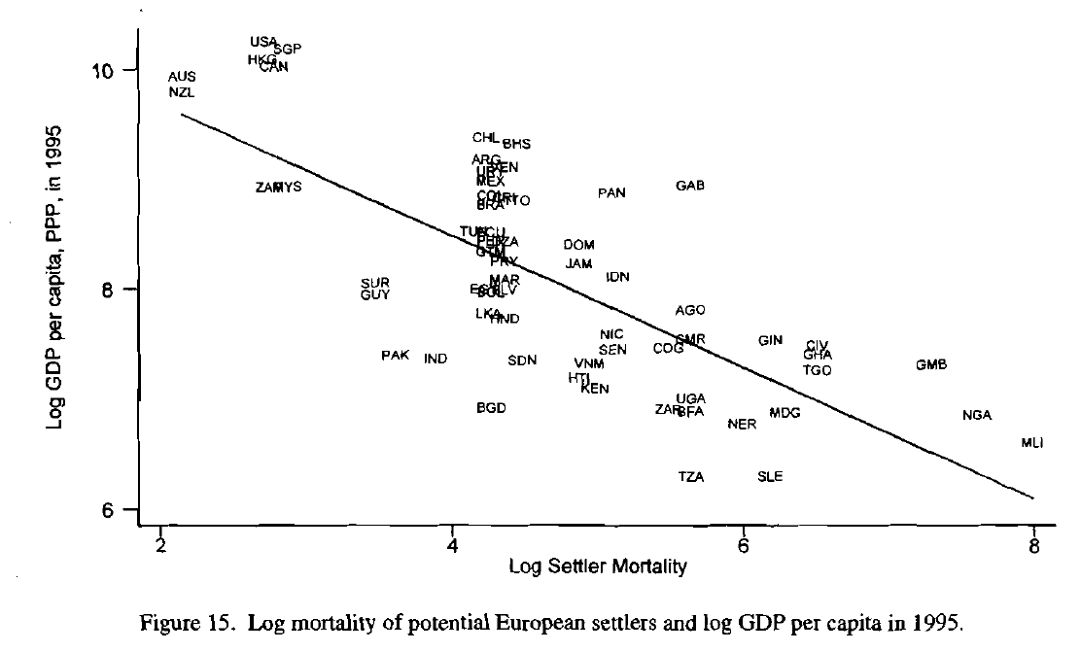
Settler Mortality and GDP

Slide 54
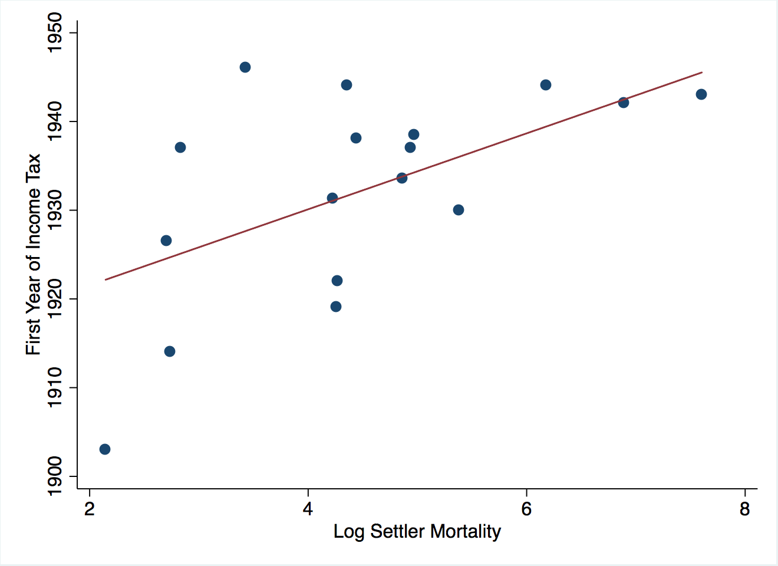
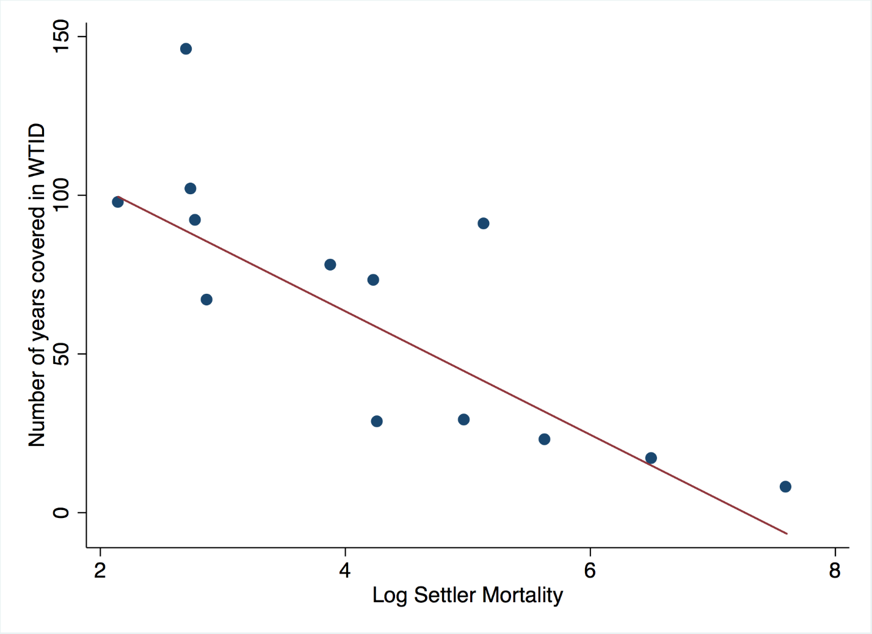
Derenencourt (2016): Colonial Origins matters for fiscal capacity and data quality

Slide 55
So what?
History should be irrelevant: justice shouldn’t be backward looking, but instead forward looking.
We care about reducing the enormous gaps between countries for their own sake, not because there is:
  A historical link between our wealth and their poverty.
  A contemporary link between our wealth and their poverty.
What do we think about that?

Slide 56
Immigration and Global Inequality
One of the biggest sources of inequality is inequality across countries.
Probably biggest determinant of international IGE.
Passport-based apartheid systems.
Many egalitarians favor loosening the immigration regime.
From open-borders to guest worker programs.
Trade-off political rights for higher income.

Slide 57
Country vs Class over time (Milanovic 2005)

Slide 58
That said: Many people from poor countries want to come.

Slide 59
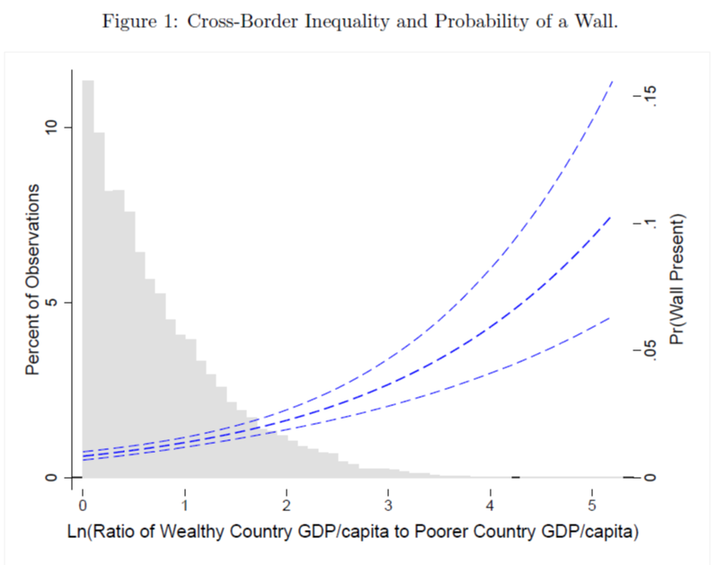
And many want to keep them out.
From Carter and Poast (2015)

Slide 60
Migration can have complicated effects:
Swedish Emigration and Politics of Welfare State (Karadja and Prawitz 2015)
Coefficient on county outmigration from 1867 to year

