Slide 1
Trends in global income inequality and their political implications
Branko Milanovic
LIS Center; Graduate School City University of New York
Spring 2015

Slide 2
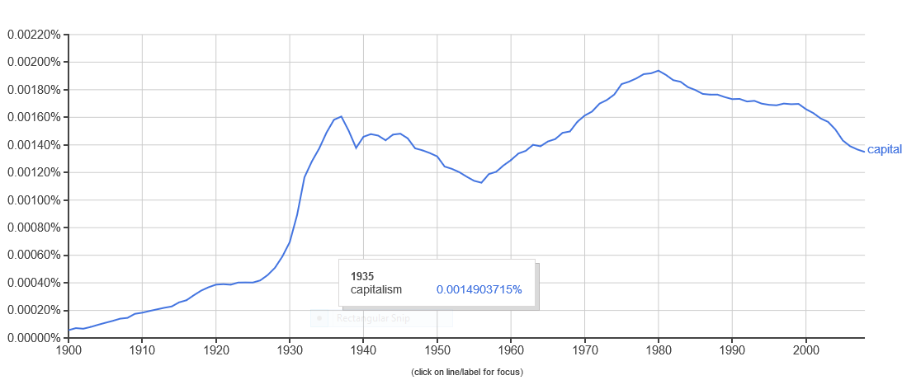
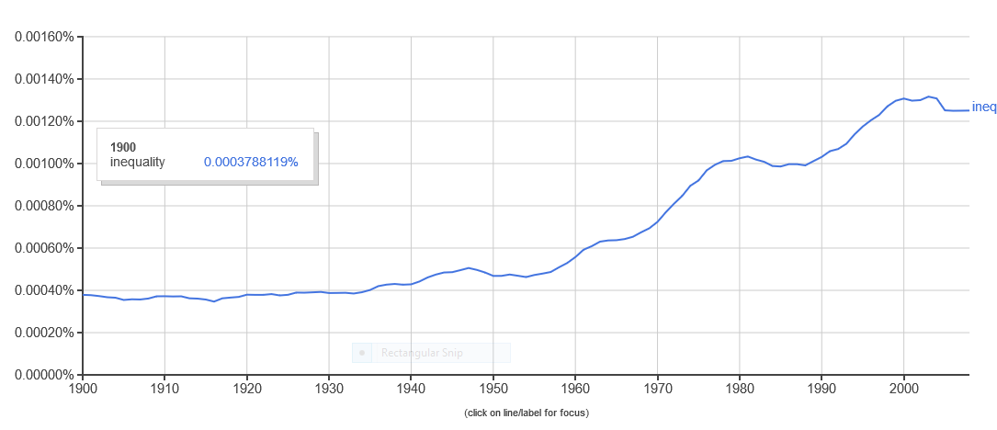
Google book search: capitalism, 1900-2008
Google book search: inequality
From https://books.google.com/ngrams/graph?content=capitalism&year_start=180&year_end=2000&corpus=15&smoothing=3&share=&direct_url=t1%3B%2Ccapitalism%3B%2Cc0

Slide 3
A. National inequalities mostly increased

Slide 4
Ginis in the late 1980s and around now
 | 1985-90 | After 2008 | Change
Average Gini | 36.3 | 38.8 | +2.5
Pop-weighted Gini | 33.9 | 37.3 | +3.4
GDP-weighted Gini | 32.2 | 36.4 | +4.2
Countries with higher Ginis | 32.0 | 36.2 | +4.5
Countries with lower Ginis | 42.8 | 39.5 | -3.3
From final-complete3.dta and key_variables_calcul2.do (lines 2 and 3; rest from AlltheGinis)

Slide 5
Ginis in the late 1980s and around now
twoway (scatter bbb aaa if year==2000, mlabel(contcod) msize(vlarge)) (function y=x, range(20 60) legend(off) xtitle(Gini between 1985 and 1990) ytitle(Gini after 2008)) using allginis.dta

Slide 6
Ginis in 1988 and 2008 (population-weighted countries)
From twenty_years/… key_variables_calcul3.do

Slide 7
Convergence of countries’ Ginis: an empirical observation without theoretical explanation
twoway (scatter change_gini gini_pre1980 if nvals==1, mlabel(contcod)) (lfit change_gini gini_pre1980, yline(0, lpattern(dash)) ytitle(change in Gini after 1980) legend(off))
Using Allthe Ginis.dta

Slide 8
Comparison between WENAO, LAC and ECA
From calcul11.ado

Slide 9
Market, gross and disposable income Ginis in the US and Germany
Define_variables.do using data_voter_checked.dta

Slide 10
Issues raised by growing national inequalities
Social separatism of the rich
Hollowing out of the middle classes
Inequality as one of the causes of the global financial crisis
Perception of inequality outstrips real increase because of globalization, role of social media and political (crony) capitalism (example of Egypt)
Hidden assets of the rich

Slide 11
Some long-term examples set in the Kuznets framework

Slide 12
From ydisrt/us_and_uk.xls

Slide 13
Kuznets and Piketty “frames”
From uk_and_usa.xls

Slide 14
Contemporary examples of Brazil and China: moving on the descending portion of the Kuznets curve
Brazil 1960-2010
China, 1967-2012
twoway (scatter Giniall lngdpppp if contcod=="BRA", connect(l) ylabel(40(10)60) xtitle(2000 6000 12000) ytitle(Gini) xtitle(ln GDP per capita)) (qfit Giniall lngdpppp if contcod=="BRA", lwidth(thick))
From gdppppreg4.dta
twoway (scatter Giniall lngdpppp if contcod=="CHN" & year>1960, connect(l) ylabel(40(10)60) xtitle(2000 6000 12000) ytitle(Gini) xtitle(ln GDP per capita)) (qfit Giniall lngdpppp if contcod=="CHN" & year>1960, lwidth(thick))
From gdppppreg4.dta

Slide 15
B. Between national inequalities remained very high even if decreasing

Slide 16
Distribution of people by income of the country where they live: emptiness in the middle (year 2013; 2011 PPPs)
From defines.do in interyd

Slide 17
Different countries and income classes in global income distribution in 2008
100
90
USA
80
Brazil
70
60
percentile of world income distribution
50
40
Russia
30
China
20
10
India
1
1
20
40
60
80
100
country percentile
From calcu08.dta

Slide 19
From summary_data.xls

Slide 20
C. Global inequality is the product of within- and between-county inequalities
How did it change in the last 60 years?

Slide 21
Essentially, global inequality is determined by three forces
What happens to within-country income distributions?
Is there a catching up of poor countries?
Are mean incomes of populous & large countries (China, India) growing faster or slower that the rich world?

Slide 22
Global and international inequality after World War II
Within-national inequalities
Concept2: 1960-1980 from Bourguignon & Morrisson
Defines.do using gdppppreg5.dta

Slide 23
Concept 2 inequality with 2011 PPPs and without China and India
47
Defines.do using gdppppreg5.dta

Slide 24
From thepast.xls

Slide 25
Population coverage
 | 1988 | 1993 | 1998 | 2002 | 2005 | 2008 | 2011
Africa | 48 | 76 | 67 | 77 | 78 | 78 | 70
Asia | 93 | 95 | 94 | 96 | 94 | 98 | 96
E.Europe | 99 | 95 | 100 | 97 | 93 | 92 | 87
LAC | 87 | 92 | 93 | 96 | 96 | 97 | 97
WENAO | 92 | 95 | 97 | 99 | 99 | 97 | 96
World | 87 | 92 | 92 | 94 | 93 | 94 | 92
Non-triviality of the omitted countries (Maddison vs. WDI)

Slide 26
Three important technical issues in the measurement of global inequality
The ever-changing PPPs in particular for populous countries like China and India
The increasing discrepancy between GDP per capita and HS means, or more importantly consumption per capita and HS means
Inadequate coverage of top 1% (related also to the previous point)

Slide 27
The issue of PPPs

Slide 28
The effect of the new PPPs on countries’ GDP per capita
C:\Branko\worldyd\ppp\2011_icp\define

Slide 29
The effect of new PPPs
Country | GDP per capita increase (in %) | GDP per capita increase population-weighted (in %)
Indonesia | 90 | ---
Pakistan | 66 | ---
Russia | 35 | ---
India | 26 | ---
China | 17 | ---
Africa | 23 | 32
Asia | 48 | 33
Latin America | 13 | 17
Eastern Europe | 16 | 24
WENAO | 3 | 2

Slide 30
Global income inequality using nominal dollars
63
From two_concepts_exrate.do using Global_new5.dta

Slide 31
The gap between national accounts and household surveys

Slide 32
Both the level and change: Use of GDP per capita gives a lower lever and a faster decrease of global inequality
Defines.do based on gdppppreg5.dta

Slide 33
How global inequality changes with different definitions of income
Step 2

Slide 34
Step 1 driven by low consumption shares in China and India
(although on an unweighted base C/GDP decreases with GDP)
USA
India
China
twoway scatter cons_gdp gdpppp if group==1 & cons_gdp<1.4 [w=totpop], xscale(log) xtitle(GDP per capita in ppp) xlabel(1000 10000 50000) ytitle(share of consumption in GDP) title(C/GDP from national accounts in year 2008)
using final08,dta

Slide 35
Step 2. No clear (weighted) relationship between survey capture and NA consumption
China
USA
India
twoway scatter scale2 gdpppp if group==1 & scale2<1.5 [w=totpop], xscale(log) xtitle(GDP per capita in ppp) xlabel(1000 10000 50000) ytitle(survey mean over NA consumption) title(survey mean/consumption from national account in year 2008)

Slide 36
The issue of top underestimation

Slide 37
Rising HS/NA gap and top underestimation
If these two problems are really just one & the same problem.
Assign the entire positive (NA consumption – HS mean) gap to national top deciles
Use Pareto interpolation to “elongate” the distribution
No a priori guarantee that global Gini will increase

Slide 38
Gini: accounting for missing top incomes
 | 1988 | 1993 | 1998 | 2003 | 2008
Surveys only | 72.5 | 71.8 | 71.9 | 71.9 | 69.6
NAC instead of survey mean | 71.5 | 70.5 | 70.6 | 70.7 | 67.6
NAC with Pareto | 71.8 | 70.8 | 71.0 | 71.1 | 68.0
NAC with top-heavy Pareto | 76.3 | 76.1 | 77.2 | 78.1 | 75.9

Slide 39
The results of various adjustments
Replacing HS survey mean with private consumption from NA reduces Gini by 1 to 2 points
Elongating such a distribution (that is, without changing the consumption mean) adds less than ½ Gini point
But doing the top-heavy adjustment (NA-HS gap ascribed to top 10% only) adds between 5 and 7 Gini points
It also almost eliminates the decrease in global Gini between 1988 and 2008

Slide 40
How Global Gini in 2008 changes with different adjustments (baseline=HSs only)

Slide 41
With full adjustment (allocation to the top 10% + Pareto) Gini decline almost fully disappears
Top-heavy allocation of the gap + Pareto adjustment
Survey data only

Slide 42
D. How has the world changed between the fall of the Berlin Wall and the Great Recession
[based on joint work with Christoph Lakner]

Slide 43
Real income growth at various percentiles of global income distribution, 1988-2008 (in 2005 PPPs)
X “China’s middle class”
$PPP2
$PPP 110
$PPP4.5
$PPP12
X“US lower middle class”
From twenty_years\final\summary_data
Estimated at mean-over-mean

Slide 44
World

Slide 45
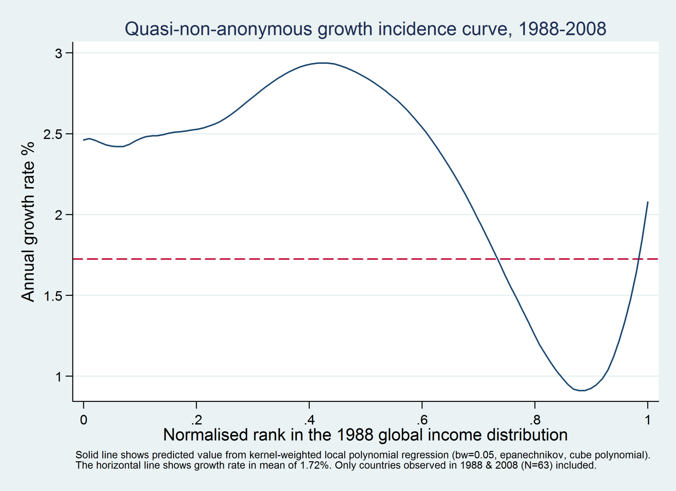
Quasi non-anonymous GIC: Average growth rate 1988-2008 for different percentiles of the 1988 global income distribution

Slide 46
Growth incidence curve (1988-2008) estimated at percentiles of the income distribution
Using my_graphs.do
Mean-on-mean

Slide 47
From summary_data.xls

Slide 48
The effects after 2008 (and inclusive of the Crisis, up to 2011)

Slide 50
From summary_data.xls

Slide 51
US and China’s growth at the same income level
(GDPpc in Maddison’s 1990 $PPP)
2011
1980
1940
1800
twoway (lowess growth gdpppp if contcod=="CHN" & year>1980) (lowess growth gdpppp if contcod=="USA" & gdpppp<8000, text(0.07 1980 "China") text(0.015 1950 "USA") legend(off))
Using Polity_Maddison_2013.dta

Slide 52
Global income distributions in
1988 and 2011
Emerging global “middle class” between $3 and $16
twoway (kdensity loginc [w=popu] if loginc>2 & year==1988) (kdensity loginc [w=popu] if loginc>2 & year==2011) , legend(off) xtitle(log of annual PPP real income) ytitle(density) text(0.95 2.5 "1988") text(0.55 3.5 "2011") xlabel(2.477"300" 3"1000" 3.477"3000" 4"10000" 4.699"50000", labsize(small) angle(90))
Using twenty_years\data\combine8808_11.dta

Slide 53
Increasing gains for the rich with a widening urban-rural gap
Urban and rural China
Urban and rural Indonesia
urban
urban
rural
rural
From key_variables_calcul2.do

Slide 54
E. Issues of justice and politics
1. Citizenship rent
2. Migration
3. Hollowing out of the middle classes

Slide 55
Global inequality of opportunity
Regressing (log) average incomes of 118 countries’ percentiles (11,800 data points) against country dummies “explains” 77% of variability of income percentiles
Where you live is the most important determinant of your income; for 97% of people in the world: birth=citizenship.
Citizenship rent.

Slide 56
Is citizenship a rent?
If most of our income is determined by citizenship, then there is little equality of opportunity globally and citizenship is a rent (unrelated to individual desert, effort)
Key issue: Is global equality of opportunity something that we ought to be concerned or not?
Does national self-determination dispenses with the need to worry about GEO?

Slide 57
The logic of the argument
Citizenship is a morally-arbitrary circumstance, independent of individual effort
It can be regarded as a rent (shared by all members of a community)
Are citizenship rents globally acceptable or not?
Political philosophy arguments pro (social contract; statist theory; self-determination) and contra (cosmopolitan approach)

Slide 58
The Rawlsian world
For Rawls, global optimum distribution of income is simply a sum of national optimal income distributions
Why Rawlsian world will remain unequal?

Slide 59
Global inequality in Real World, Rawlsian World, Convergence World…and Shangri-La World (Theil 0; year 2008)
 | All equal | Different (as now)
All equal
Different (as now)
Mean country incomes
Individual incomes within country
0
68
(all country Theils=0; all mean incomes as now)
30 (all mean incomes equalized; all country Ginis as now)
98

Slide 60
Conclusion
Working on equalization of within-national inequalities will not be sufficient to significantly reduce global inequality
Faster growth of poorer countries is key and also…

Slide 61
Migration….

Slide 62
Migration: a different way to reduce global inequality and citizenship rent
A new view of development: Development is increased income for poor people regardless of where they are, in their countries of birth or elsewhere
Migration and LDC growth thus become the two equivalent instruments for development

Slide 63
Distribution-neutral growth rate needed to make people from a given income fractile indifferent between growth and favorable distributional change (= mean +1 standard deviation)

Slide 64
Trade-off between country’s mean income and income inequality
From interyd..\ventil_vs_country.xls

Slide 65
Political issue: Global vs. national level
Our income and employment is increasingly determined by global forces
But political decision-making still takes place at the level of the nation-state
If stagnation of income of rich countries’ middle classes continues, will they continue to support globalization?
Two dangers: populism and plutocracy
To avert both, need for within-national redistributions: those who lose have to be helped

Slide 66
Final conclusion
To reduce global inequality: fast growth of poor countries + migration
To preserve good aspects of globalization: redistribution within rich countries

Slide 67
Additional slides

Slide 68
H. Global inequality over the long-run of history

Slide 69
Global income inequality, 1820-2008
(Source: Bourguignon-Morrisson and Milanovic; 1990 PPPs )
twoway (scatter Gini year, c(l) xlabel(1820(40)2020) ylabel(0(20)100) msize(vlarge) clwidth(thick)) (scatter Theil year, c(l) msize(large) legend(off) text(90 2010 "Theil") text(70 2010 "Gini"))

Slide 71
A non-Marxist world
Over the long run, decreasing importance of within-country inequalities despite some reversal in the last quarter century
Increasing importance of between-country inequalities (but with some hopeful signs in the last five years, before the current crisis),
Global division between countries more than between classes

Slide 72
Composition of global inequality changed: from being mostly due to “class” (within-national), today it is mostly due to “location” (where people live)
Based on Bourguignon-Morrisson (2002), Maddison data, and Milanovic (2005)
From thepast.xls

Slide 73
Very high but decreasing importance of location in global inequality
From thepast.xls under c:\history

