Slide 1
Inequality, Racial Disparity, and Stratification Economics
by
Darrick Hamilton
Associate Professor of Economics and Urban Policy Director, Doctoral Program in Public and Urban Policy

Slide 2
The Importance of Wealth
Wealth indicates economic opportunity, security & overall wellbeing
Wealth provides for a human capabilities approach to economic development
Primary source is intergenerational – Structural not behavioral
The economic indicator in which whites & communities of color are most disparate

Slide 3
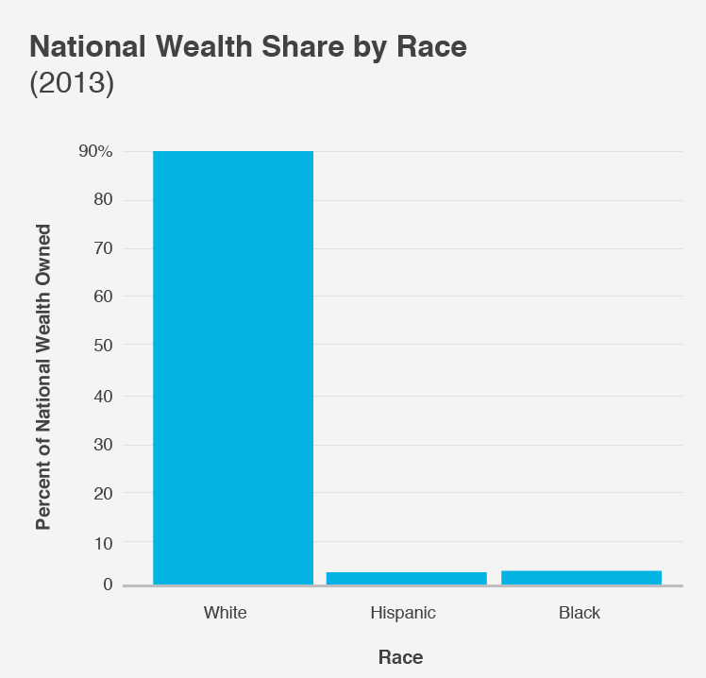
Calculated by Matt Bruenig Demos

Slide 4
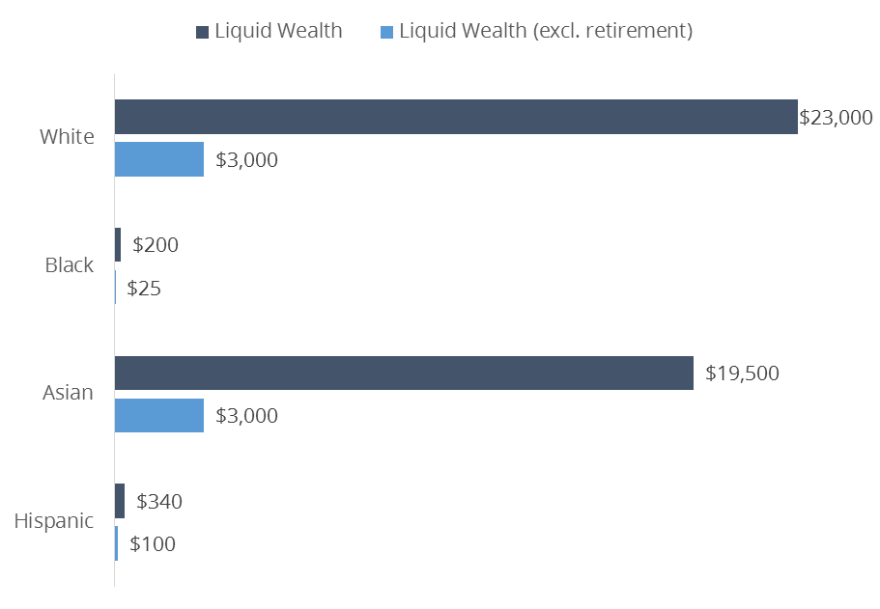
Median Liquid Asset Value: Assets Easily Converted to Cash (SIPP 2011)
Median Liquid Wealth Holdings, 2011 SIPP

Slide 5
Rhetoric
“We are post-racial”
America has largely transcended the racial divide
A shift from social responsibility for the conditions of black America
Blacks are enjoined to;
“get over it”
“stop playing the victim role”
“stop making excuses”
“take personal responsibility”
Study hard, graduate from college and get a good job

Slide 7
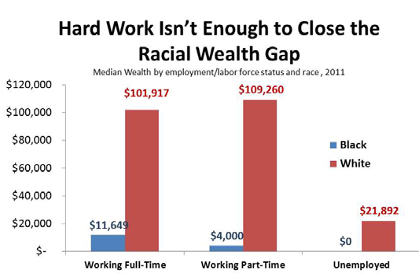
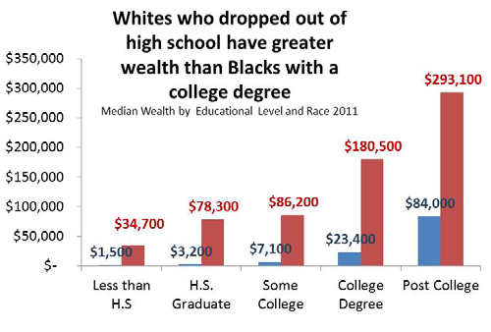
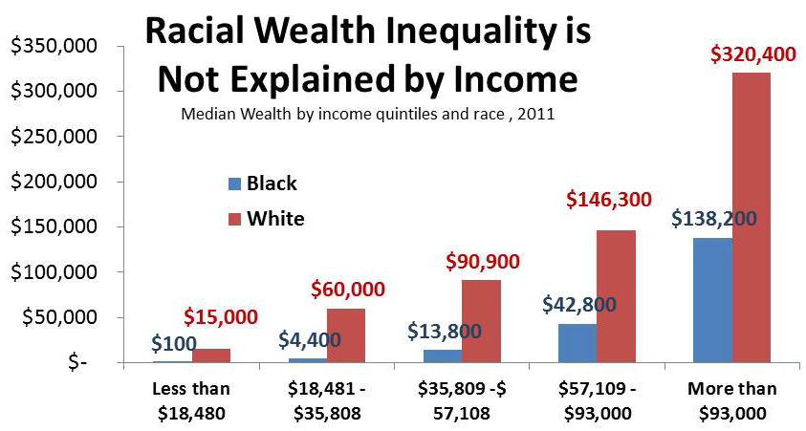
Studying hard is not enough

Slide 8
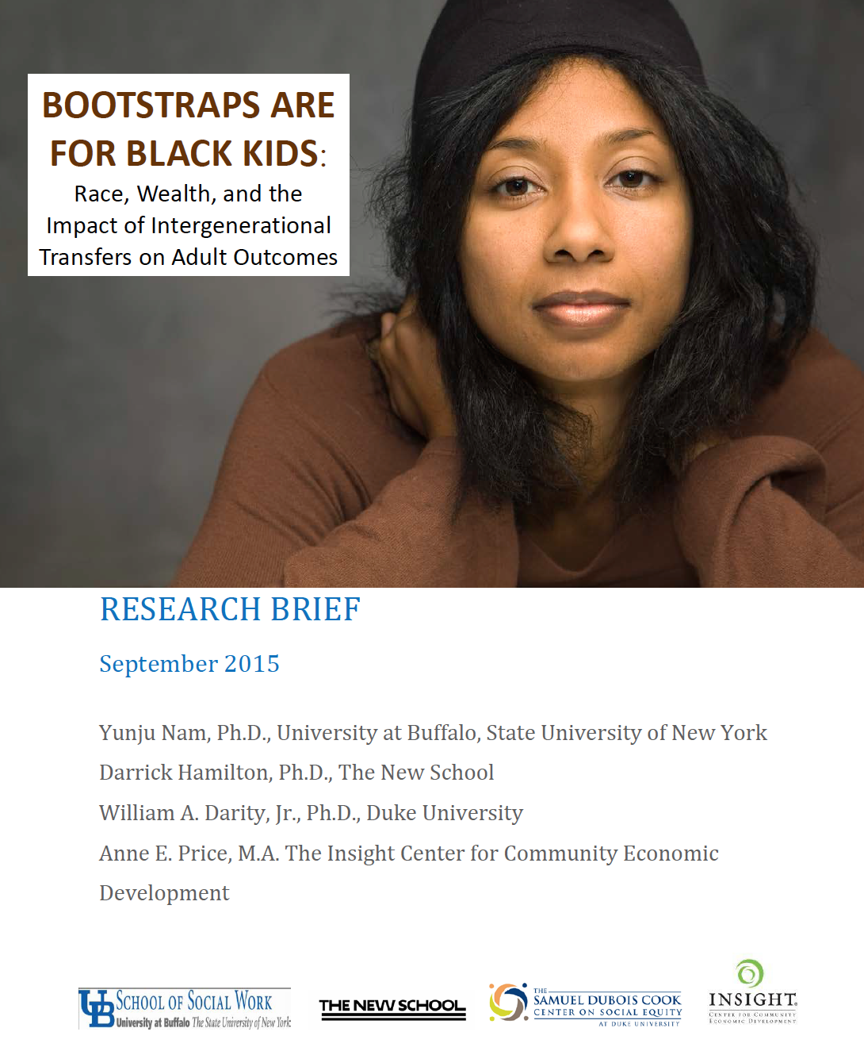

Slide 9
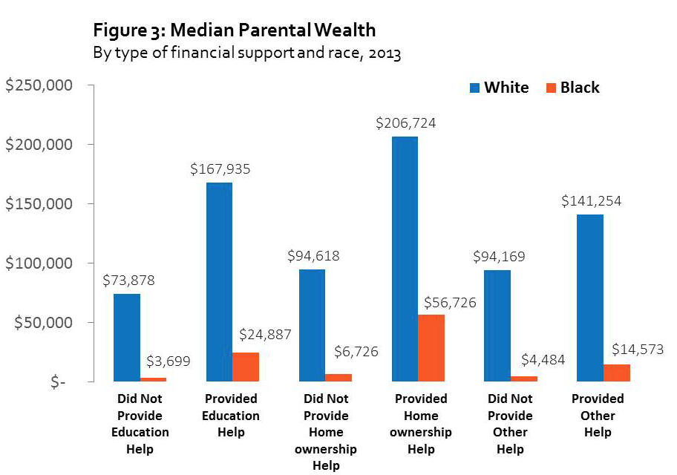
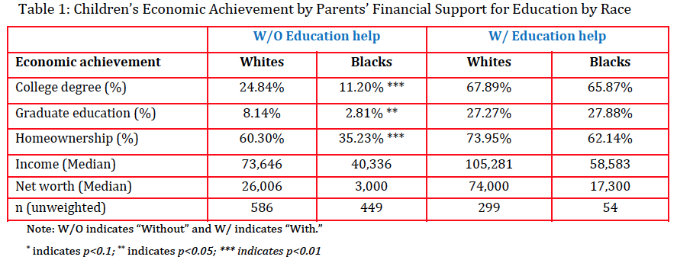

Slide 10
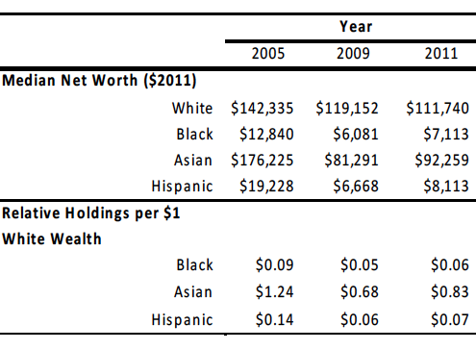
The Great Recession and The Racial Wealth Gap (SIPP Data)

Slide 11
Lessons Learned in the aftermath of the Great Recession
Black & Latino families have little liquid assets to take risk, or deal with financial emergency or shocks
Communities of color suffered the most
The racial wealth gap was extreme before the recession, and worsened after
Asians suffered the largest absolute loss in home values and wealth
Most likely to reside in states that benefited from the housing boom & suffered most from the housing bust

Slide 12
An Incomplete Narrative
Asset markets are local
e.g. the geographic maldistributive effects of the housing crisis
The wealth position of many communities of color remains unknown
Aggregate categories like “Asian” mask the asset position for certain groups like those immigrating from Southeast Asia
Indigenous groups are often hidden altogether in nebulous catchall category of “other”

Slide 13
Goals:
provide implicit control of asset and debt pricing and products
analyze the wealth of groups hidden in broadly defined “non-white” categories
examine asset and debt attributes particular to communities of color
Provide a template for a more permanent data collection infrastructure
Limitations: (1) Statistical Power, (2) External validity and (3) Examines only Private Assets

Slide 14
Some Lessons Across Five Cities
Variation within broadly defined ethnic categories
Income inequality pales in comparison to wealth inequality
An ethnic group’s relative asset position may vary across city
Homeownership varied across city and may not be the only driver of wealth
Substantial asset variation across and within cities with Blacks and Mexicans persistently at the bottom

Slide 15
Race is still a defining attribute of one’s life chances
Wealth is the single best indicator of economic opportunity, security & human capability
The primary source of wealth is inheritance, in-vivo transfers -- seed money to purchase an appreciating asset
Education, hard work, income, and active savings do little to address the racial wealth gap
The racial wealth gap is structural not behavioral

Slide 16
What can we do? Baby bonds “social security over the life course”
Federal Trust accounts endowed based on family wealth position at birth
Estimated to cost about 2% of current federal expenditures per annum
Brake the cruel link between race, inheritance & economic advantage or disadvantage
Provide opportunity for upward mobility & economic security for all Americans regardless of the family in which they are born

Slide 17
From Dark to Light: The Role of Skin Shade in Determining Life Outcomes

Slide 18
Media Images of Beauty presented by Margret Hunter, Colorism Conference, Duke University, March 2008

Slide 19
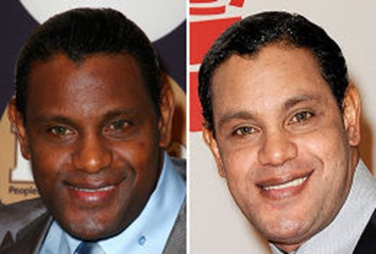
Sammy Sosa on May 13, 2009 in New York and on November 4, 2009 in Las Vegas after using a cosmetic facial cream

Slide 20
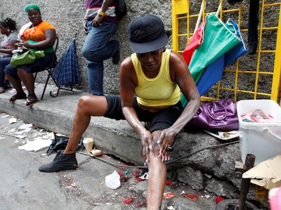
Headline from April 11, 2011 article in theGrio from AP article by David McFadden “Skin bleaching a growing problem in Jamaica slums”
In this photo taken Feb. 15, 2011, a woman applies skin lightening cream to her legs as she sits on a curb in downtown Kingston, Jamaica. (AP Photo/Caterina Werner

Slide 21
From Dark to Light Skin Color and Wages Among African Americans Journal of Human Resources, 2007
by
Arthur Goldsmith, Darrick Hamilton, and William Darity, Jr.

Slide 22
Labor Market Findings
In the wake of the Civil Rights Movement skin shade differentials (colorism) remain an important determinant of socioeconomic status
The conventional “One-Drop” view ignores the heterogeneity of the labor market experiences of black sub-groups.
The U.S. context may not be so different from Latin America
The penalties attached to skin shade are not strictly imposed internally
The significance ascribed to cultural factors in explaining racial differences should be re-examined in light of the evidence of skin shade differences

Slide 23
Shedding “Light” on Marriage The Influence of Skin Shade on Marriage for Black Females Journal of Economic Behavior and Organization, 2009
by
Darrick Hamilton, Arthur Goldsmith, and William Darity, Jr.

Slide 24
Marriage Market Findings
An intra-racial marriage gap based on skin shade exists among young black females
Young light skinned black females are about 14 percent more likely to marry than their darker skinned counterpart
The relationship between skin shade and marriage appears to be exacerbated by the paucity of “marriageable” black males
Mixed race black females have access to a larger pool and better “quality” of males
The pool of “marriageable” black males is further diminished by better “quality” black males marrying outside their race
Marriage promotion policies directed at the female demand (attitudes and desires) for marriage may have the unintended consequence of generating more colorism in the black community

Slide 25
Data
Multi City Study of Urban Inequality (MCSUI) 1992
National Survey of Black Americans (NSBA) 1979
Likert Scale Interviewer Coded Skin Shade Measures
Surveys have a rich array of economic, demographic, workplace, neighborhood and family background information

Slide 26
Summary Statistics
Whites earned $1.52, $2.71, $4.22 more per hour than light, medium and dark skinned black males
Whites had better human capital, family background and neighborhood characteristics
Although light skinned blacks had better human capital, they had similar family background, and neighborhood characteristics as their darker counterparts
Result is similar to Hughes and Hertel (1990) findings

Slide 27
 | Data Source: MCSUI Dependent Variable: ln hrwage rate
Variables | Model 1 (n=968) | Model 2 (n=948) | Model 3 (n=948) | Model 4 (n=921) | Model 5 (n=921)
Black | -0.262*** (0.033) | -0.155*** (0.028) | -0.100*** (0.030) | -0.121*** (0.029) | -0.072** (0.031)
 | Rainbow Model
Variables | Model 1 (n=968) | Model 2 (n=948) | Model 3 (n=948) | Model 4 (n=921) | Model 5 (n=921)
Light Black | -0.134* (0.075) | -0.076 (0.060) | -0.031 (0.061) | -0.036 (0.060) | -0.001 (0.060)
Medium Black | -0.246*** (0.044) | -0.166*** (0.037) | -0.112*** (0.039) | -0.153*** (0.037) | -0.106*** (0.038)
Dark Black | -0.305*** (0.041) | -0.168*** (0.036) | -0.110*** (0.037) | -0.116*** (0.036) | -0.063* (0.038)
H₀: Light Blk – Dark Blk = 0 | 4.58** | 2.02 | 1.52 | 1.55 | 1.02
H₀: Light Blk – Med Blk = 0 | 1.91 | 1.94 | 1.59 | 3.32* | 2.85*
H₀: Med Blk – Dark Blk = 0 | 1.91 | 0.00 | 0.00 | 0.75 | 1.02
Human Capital & Demographics |  | yes | yes | yes | yes
Work Place Characteristics |  | yes | yes | yes | yes
Family and Neighborhood |  |  | yes |  | yes
Occupation |  |  |  | yes | yes

Slide 28
 | Data Source: National Survey of Black Americans Dependent Variable: ln hrwage rate
 | Rainbow Model
Variables | Model 1 (n=347) | Model 2 (n=331) | Model 3 (n=331) | Model 4 (n=331) | Model 5 (n=331)
Light Black | 0.183** (0.077) | 0.107* (0.061) | 0.126** (0.062) | 0.107* (0.059) | 0.133* (0.060)
Dark Black | 0.011 (0.050) | 0.0123 (0.0340 | 0.030 (0.042) | -0.003 (0.038) | -0.013 (0.040)
H₀: Light Blk – Dark Blk = 0 | 4.91** | 2.37 | 2.23 | 3.50* | 3.85*
Controls for:
Human Capital & Demographics |  | yes | yes | yes | yes
Work Place Characteristics |  | yes | yes | yes | yes
Family and Neighborhood |  |  | yes |  | yes
Occupation |  |  |  | yes | yes

Slide 29
Pre-Market Factors Only | Data Source: MCSUI Dependent Variable: ln wage rate
Variables | Model 1 (n=968) | Model 2 (n=968) | Model 3 (n=968) | Model 4 (n=968) | Model 5 (n=968)
Black | -0.259*** (0.033) | -0.224*** (0.031) | -0.255*** (0.031) | -0.222*** (0.031) | -0.158*** (0.032)
 | Rainbow Model
Variables | Model 1 (n=968) | Model 2 (n=968) | Model 3 (n=968) | Model 4 (n=968) | Model 5 (n=968)
Light Black | -0.104 (0.071) | -0.090 (0.068) | -0.097 (0.071) | -0.086 (0.069) | -0.020 (0.069)
Medium Black | -0.233*** (0.042) | -0.214*** (0.041) | -0.229*** (0.042) | -0.212*** (0.041) | -0.150*** (0.041)
Dark Black | -0.318*** (0.039) | -0.266*** (0.039) | -0.313*** (0.039) | -0.264*** (0.039) | -0.200*** (0.040)
H₀: Light Blk – Dark Blk = 0 | 8.07*** | 5.75** | 8.30*** | 5.94*** | 6.16**
H₀: Light Blk – Med Blk = 0 | 2.83* | 2.75* | 3.00* | 2.87* | 3.17*
H₀: Med Blk – Dark Blk = 0 | 3.05* | 1.21 | 2.99* | 1.23 | 1.12
Age | yes | yes | yes | yes | yes
Completion of HS by Age 19 |  | yes |  | yes | yes
Poor HS performance |  |  | yes | yes | yes
Family Background |  |  |  |  | yes

Slide 30
Median Regression: Includes the Unemployed | Data Source: MCSUI Dependent Variable: ln wage rate
Variables | Model 1 (n=1170) | Model 2 (n=1170) |  | Model 4 (n=1170)
Black | -0.336*** (0.058) | -0.205*** (0.055) |  | -0.157*** (0.046)
 | Rainbow Model
Variables | Model 1 (n=1170) | Model 2 (n=1170) |  | Model 4 (n=1170)
Light Black | -0.285** (0.131) | -0.064 (0.105) |  | -0.115 (0.010)
Medium Black | -0.270*** (0.077) | -0.188*** (0.064) |  | -0.190*** (0.064)
Dark Black | -0.403*** (0.071) | -0.240*** (0.061) |  | -0.183*** (0.061)
H₀: Light Blk – Dark Blk = 0 | 0.73 | 2.49 |  | 0.42
H₀: Light Blk – Med Blk = 0 | 0.01 | 1.20 |  | 0.51
H₀: Med Blk – Dark Blk = 0 | 2.28 | 0.51 |  | 0.01
Human Capital & Demographics |  | yes |  | yes
Work Place Characteristics
Family and Neighborhood |  |  |  | yes
Occupation

Slide 31
Pre-Market Factors Only Median Regression | Data Source: MCSUI Dependent Variable: ln wage rate
Variables | Model 1 (n=1171) | Model 2 (n=1171) | Model 3 (n=1171) | Model 4 (n=1171) | Model 5 (n=1171)
Black | -0.371*** (0.057) | -0.272*** (0.045) | -0.384*** (0.051) | -0.267*** (0.046) | -0.226*** (0.059)
 | Rainbow Model
Variables | Model 1 (n=1171) | Model 2 (n=1171) | Model 3 (n=1171) | Model 4 (n=1171) | Model 5 (n=1171)
Light Black | -0.064 (0.126) | -0.065 (0.116) | -0.119 (0.119) | -0.060 (0.108) | -0.057 (0.109)
Medium Black | -0.319*** (0.074) | -0.274*** (0.068) | -0.351*** (0.070) | -0.265*** (0.064) | -0.222*** (0.066)
Dark Black | -0.454*** (0.069) | -0.339*** (0.064) | -0.445*** (0.065) | -0.345*** (0.060) | -0.322*** (0.063)
H₀: Light Blk – Dark Blk = 0 | 8.60*** | 4.96** | 7.20*** | 6.26** | 5.34**
H₀: Light Blk – Med Blk = 0 | 3.55* | 2.78* | 3.29* | 3.13* | 2.00
H₀: Med Blk – Dark Blk = 0 | 2.47 | 0.68 | 1.67 | 1.17 | 1.86
Age | yes | yes | yes | yes | yes
Completion of HS by Age 19 |  | yes |  | yes | yes
Poor HS performance |  |  | yes | yes | yes
Family Background |  |  |  |  | yes

Slide 32
Labor Market Findings
In the wake of the Civil Rights Movement skin shade differentials (colorism) remain an important determinant of socioeconomic status
The conventional “One-Drop” view ignores the heterogeneity of the labor market experiences of black sub-groups.
The U.S. context may not be so different from Latin America
The penalties attached to skin shade are not strictly imposed internally
The significance ascribed to cultural factors in explaining racial differences should be re-examined in light of the evidence of skin shade differences

Slide 33
Shedding “Light” on Marriage The Influence of Skin Shade on Marriage for Black Females Journal of Economic Behavior and Organization, 2009
by
Darrick Hamilton, Arthur Goldsmith, and William Darity, Jr.

Slide 34
MARRIAGE: STYLIZED FACTS
Racial Marriage Gap: Middle of the 20th Century
1950 percentage of never married 24-29 year olds (Mason,2006)
Black women – 16%
White women – 14%
Racial Marriage Gap: End of the 20th Century
1996-98 percentage of never married 24-29 year olds (Mason, 2006)
Black women – 61%
White women – 34%

Slide 35
Why is the Marriage Rate for Black Females so Low?
Sex Ratios: 1991-98 for unmarried civilian individuals aged 23-27 (Mason, 2006)
71 black males : 100 black females
119 white males : 100 white females
45 black males working full-time : 100 black females
90 white males working full-time : 100 white females
Inter-Racial Marriage
In 1990, 97% of married black females aged of 25-34 were married to black males (Farley, 1996)
Too Few “Marriageable” Black Males (Wilson and Neckerman, 1986; Ellwood and Crane, 1990; Darity and Myers, 1995);
Low educational attainment, high drug use, high mortality, and high incidence of incarceration

Slide 36
The Decline in “Marriageable” Males: Erosion of Relative Labor Market Progress
From 1940 to mid to late 1970s, dramatic relative labor market progress for black males (smith and Welch, 1989)
Stagnation thereafter, so “What went wrong?” (Bound and Freeman, 1992)
“(T)he environment for black achievement worsened”
Shift in federal policy away from legislation and enforcement against discrimination

Slide 37
The Decline in “Marriageable” Males: Incarceration
Seven fold increase in prison population from 1970-2007 (The Sentencing Project based on BJS statistics)
1970: 200,000 federal and state prisoners
2007: 1.5 million federal and state prisoners (2.3 million if local jails are included)
Disproportionate share of young black male (aged 25-29) are incarcerated and greater likelihood of black males serving time in prison (Sentencing Project)
10.5 Percent young black males
1.7 percent young white males
32 percent lifetime likelihood of black male serving time
Six percent lifetime likelihood of white male serving time

Slide 38
MARRIAGE PROMOTION POLICIES AND THE LINK BETWEEN SKIN SHADE AND MARRIAGE
Healthy Marriage Initiative (demand side policies)
A hallmark of the George W. Bush Administration
$200 million spent through the Federal Administration for Children and Families to promote marriage, especially targeted towards teenagers
2006 welfare legislation includes a $500 million appropriation over the next 5 years to promote marriage
An alternative approach is to enlarge the supply of marriageable black males (supply side policies)
Improving educational opportunities
Reducing labor market discrimination and barriers to employment
Creating environments that promote personal and healthy development
Initiating policies aimed at reducing the incarceration rate (particularly for non-violent criminals)

Slide 39
Marriage Market Findings
An intra-racial marriage gap based on skin shade exists among young black females
Young light skinned black females are about 14 percent more likely to marry than their darker skinned counterpart
The relationship between skin shade and marriage appears to be exacerbated by the paucity of “marriageable” black males
Mixed race black females have access to a larger pool and better “quality” of males
The pool of “marriageable” black males is further diminished by better “quality” black males marrying outside their race
Marriage promotion policies directed at the female demand (attitudes and desires) for marriage may have the unintended consequence of generating more colorism in the black community

Slide 40
What my work suggests about the conventional wisdom?
In the wake of the Civil Rights Movement, skin shade still remains relevant in labor markets, and marriage markets
The characterization that the U.S. is strictly stratified by genotype and Latin America by phenotype is inaccurate
The claim that skin shade penalties are strictly imposed intra-racially is not consistent with our evidence of labor market discrimination
The significance ascribed to cultural factors in explaining racial differences should be re-examined in light of the evidence of skin shade differences

Slide 42
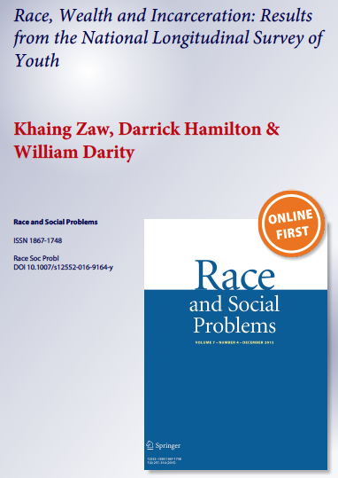

Slide 43
