Slide 1
Inequality in the age of globalization
Branko Milanovic
Spring/Summer 2017
(based on De Vries memorial lecture)

Slide 2
Brief structure of the talk
Global inequality: in the past and now
Technical problems of measurement
How the world has changed between 1988 and 2013
Political implications of the changes
Kuznets waves?
Issues of justice, politics and migration

Slide 3
1. Global inequality

Slide 4
History…/the past.xls

Slide 5
La longue durée: From Karl Marx to Frantz Fanon and back to Marx?
History../the_past.xls

Slide 6
In the long-run inequality is determined by the spread of the technological revolutions: the West in the 19th century, Asia today
In the medium-run global inequality is determined by:
What happens to within-country income distributions?
Is there a catching up of poor countries?
Are mean incomes of populous & large countries (China, India) growing faster or slower that the rich world?

Slide 7
Interyd\...3concepts..xls

Slide 9
Large gaps in mean country incomes raise two important issues
Political philosophy: is the “citizenship rent” morally acceptable? Does global equality of opportunity matter?
Global and national politics: Migration and national welfare state
(will address both at the end)

Slide 10
Different countries and income classes in global income distribution in 2008
100
90
USA
80
Brazil
70
60
percentile of world income distribution
50
40
Russia
30
China
20
10
India
1
1
20
40
60
80
100
country percentile
From calcu08.dta

Slide 11
Different countries and income classes in global income distribution in 2011
India with 2011 income data
Final11.dta using michele_graph.do but with india consumption replaced by india income

Slide 12
Global and rich countries’ income distributions in 2011
twoway (kdensity loginc [w=popu1] if mysample==1 & loginc>2, bwidth(0.2)) (kdensity loginc [w=popu1] if mysample==1 & region==5 & loginc>2), legend(off) text(0.76 3.2 "World") text(0.75 4.85 "Rich countries") xtitle("Disposable per capita income in 2011") ytitle(" ") xlabel(2.477"300" 3"1000" 3.477"3000" 4"10000" 4.699"50000", labsize(small) angle(90)) Using final11_india_inc.dta

Slide 14
2. Technical issues in the measurement of global inequality

Slide 15
Three important technical issues in the measurement of global inequality
The ever-changing PPPs in particular for populous countries like China and India
The increasing discrepancy between GDP per capita and HS means, or more importantly consumption per capita and HS means
Inadequate coverage of top 1% (related also to the previous point)

Slide 16
The issue of PPPs

Slide 17
The effect of the new PPPs on countries’ GDP per capita
C:\Branko\worldyd\ppp\2011_icp\define

Slide 18
The effect of new PPPs
Country | GDP per capita increase (in %) | GDP per capita increase population-weighted (in %)
Indonesia | 90 | ---
Pakistan | 66 | ---
Russia | 35 | ---
India | 26 | ---
China | 17 | ---
Africa | 23 | 32
Asia | 48 | 33
Latin America | 13 | 17
Eastern Europe | 16 | 24
WENAO | 3 | 2

Slide 19
Use of 2011 PPPs reduces global inequality by about 3 Gini points but leaves the trends the same
Using summary_data.xls

Slide 20
The gap between national accounts and household surveys

Slide 21
Global Gini with different definitions of income
Step 2
Step 1
Summary_data.xls

Slide 22
Step 1 driven by low consumption shares in China and India
(although on an unweighted base C/GDP decreases with GDP)
USA
India
China
twoway scatter cons_gdp gdpppp if group==1 & cons_gdp<1.4 [w=totpop], xscale(log) xtitle(GDP per capita in ppp) xlabel(1000 10000 50000) ytitle(share of consumption in GDP) title(C/GDP from national accounts in year 2008)
using final08,dta

Slide 23
Step 2. No clear (weighted) relationship between survey capture and NA consumption
China
USA
India
twoway scatter scale2 gdpppp if group==1 & scale2<1.5 [w=totpop], xscale(log) xtitle(GDP per capita in ppp) xlabel(1000 10000 50000) ytitle(survey mean over NA consumption) title(survey mean/consumption from national account in year 2008)

Slide 24
The issue of top underestimation

Slide 25
Rising NAC/HS gap and top underestimation
If these two problems are really just one & the same problem.
Assign the entire positive (NA consumption – HS mean) gap to national top deciles
Use Pareto interpolation to “elongate” the distribution
No a priori guarantee that global Gini will increase

Slide 26
usa07_13.xls

Slide 27
But the rising gap between fiscal and HS income is not universal

Slide 28
With full adjustment (allocation to the top 10% + Pareto) Gini decline almost vanishes
Top-heavy allocation of the gap + Pareto adjustment
Survey data only
Summary_data.xls

Slide 29
3. How has the world changed between the fall of the Berlin Wall and the Great Recession
[based on joint work with Christoph Lakner]

Slide 30
Number of surveys
 | 1988 | 1993 | 1998 | 2002 | 2005 | 2008 | 2011
Africa | 14 | 30 | 24 | 29 | 32 | 23 | 30
Asia | 19 | 26 | 28 | 26 | 23 | 27 | 22
E.Europe | 27 | 22 | 27 | 25 | 27 | 27 | 24
LAC | 19 | 20 | 22 | 21 | 18 | 18 | 18
WENAO | 23 | 23 | 21 | 21 | 22 | 23 | 21
World | 102 | 121 | 122 | 122 | 122 | 118 | 115

Slide 31
Population coverage
 | 1988 | 1993 | 1998 | 2002 | 2005 | 2008 | 2011
Africa | 48 | 76 | 67 | 77 | 78 | 78 | 70
Asia | 93 | 95 | 94 | 96 | 94 | 98 | 96
E.Europe | 99 | 95 | 100 | 97 | 93 | 92 | 87
LAC | 87 | 92 | 93 | 96 | 96 | 97 | 97
WENAO | 92 | 95 | 97 | 99 | 99 | 97 | 96
World | 87 | 92 | 92 | 94 | 93 | 94 | 92
Non-triviality of the omitted countries

Slide 32
GDI (US dollar) coverage
 | 1988 | 1993 | 1998 | 2002 | 2005 | 2008 | 2011
Africa | 49 | 85 | 71 | 71 | 70 | 71 | 63
Asia | 94 | 93 | 96 | 95 | 90 | 93 | 83
E. Europe | 99 | 96 | 100 | 99 | 99 | 98 | 94
LAC | 90 | 93 | 95 | 95 | 98 | 98 | 94
WENAO | 99 | 96 | 96 | 100 | 100 | 97 | 95
World | 96 | 95 | 96 | 98 | 97 | 95 | 90

Slide 33
Global median
Absolute poverty
Global mean
Median of WENAO
10%
50%
73%
91%
twoway (kdensity loginc_11_11 [w=popu] if loginc_11_11>2 & bin_year==2011, bwidth(0.2)) , legend(off) title(Global income distribution in 2011 with 2011 PPPs) xtitle(log of annual PPP real income) ytitle(density) xlabel(2.8"600" 3.3"2100" 3.74"5500" 4.2"14600", labsize(small) angle(90))
Using combine88_11.dta

Slide 34
Real income growth at various percentiles of global income distribution, 1988-2008 (in 2005 PPPs)
X “China’s middle class”
$PPP2
$PPP 180
$PPP4.5
$PPP12
X“US lower middle class”
From twenty_years\final\summary_data
Estimated at mean-over-mean

Slide 35
Parts of the distribution that gained the most are dominantly from Asia, parts that stagnated are mostly from mature economies
Quasi-non-anonymous growth incidence curve (1988-2008)
population-weighted, including population distribution in base-year
90
100
90
80
80
70
70
60
60
Cumulative growth rate (%)
Share of region in ventile population (%)
50
50
40
40
30
20
30
10
20
0
0
.2
.4
.6
.8
1
Normalised rank in the 1988 global income distribution
Asia
Mature economies
GIC
Solid line shows predicted value from kernel-weighted local polynomial regression (bw=0.05, epanechnikov, cube polynomial).
Only countries observed in 1988 & 2008 (N=63) included.
From analysis horizontal quasinonanon gic pop 2do

Slide 36
Quasi non-anonymous growth between 1988 and 2008: real absolute per capita gains at different fractiles of the 1988 distribution

Slide 38
Global income distributions in
1988 and 2011
Emerging global “middle class” between $3 and $16
twoway (kdensity loginc_11_11 [w=popu] if loginc_11_11>2 & bin_year==1988, bwidth(0.14) title("Figure 3. Global income distribution in 1988 and 2011")) (kdensity loginc_11_11 [w=popu] if loginc_11_11>2 & bin_year==2011, bwidth(0.2)) , legend(off) xtitle(log of annual PPP real income) ytitle(density) text(0.78 2.5 "1988") text(0.65 3.5 "2011") xlabel(2.477"300" 3"1000" 3.477"3000" 4"10000" 4.699"50000", labsize(small) angle(90))
Using Branko\Income_inequality\final11\combine88_08_11_new.dta

Slide 39
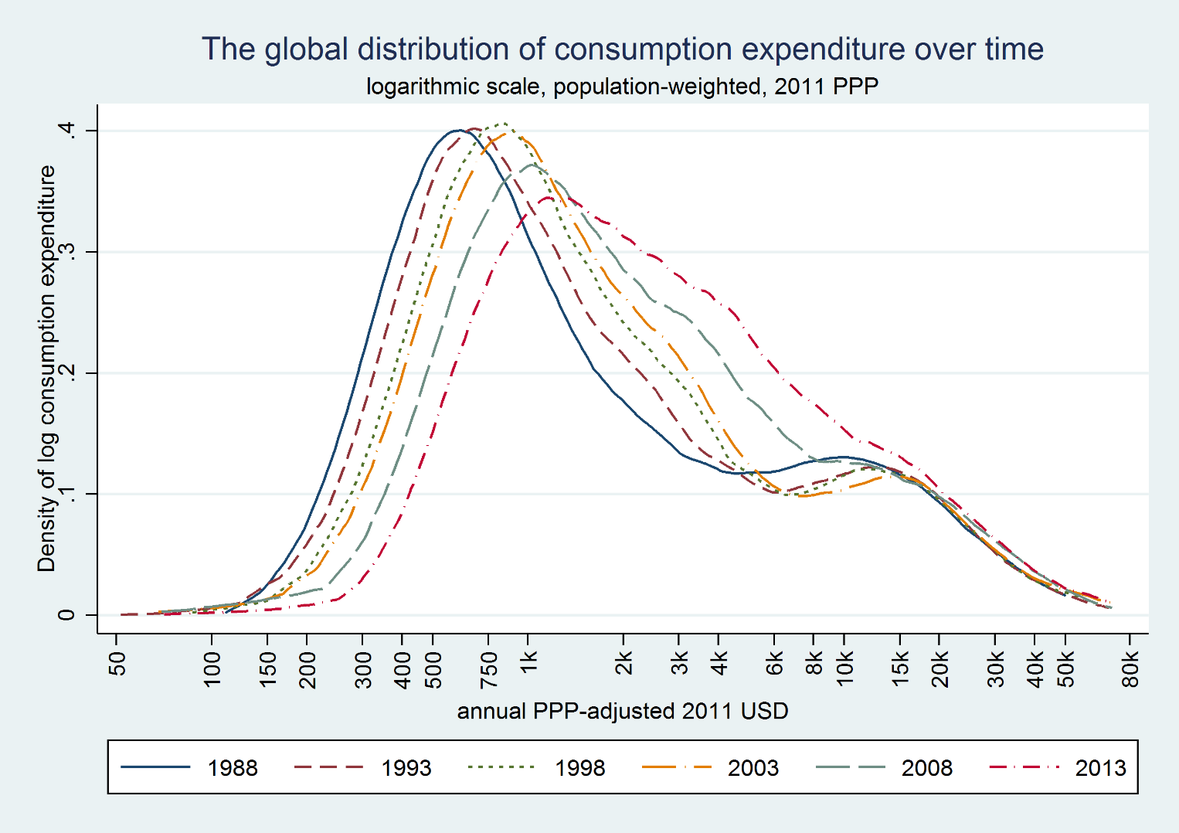
From Christoph Lakner

Slide 40
4. Political implications

Slide 41
The contradiction of inequality changes during Globalization II
Most countries displayed an upward sloping GIC (US, China, India urban, Indonesia…)
Perception that the rich are doing better than anybody else (true)
But growth rates of countries are uneven; those that grew the fastest were in the lower middle of global income distribution, and they were also most populous
This led to the “elephant-shaped” global GIC and decreasing global inequality

Slide 42
The issues
Are growth (1) along the entire Chinese income distribution and (2) stagnation around the median in the rich world as well as stagnation across most of income distribution in E. Europe and LAC, related?
In other words, is the hump in middle related to the dip around the 70-80th percentile?
Marching of China and India through the ranks reduces global inequality and the importance of the between-country component in global inequality
But it might “cause” increases in within-national inequalities (thus offsetting global inequality decline)
Can democracy survive if rich countries’ middle classes are hollowed out?

Slide 43
Back to Mandeville…
Can something that is bad nationally (increased inequality) be good globally (decreased inequality) ?
Can national vices produce global virtue?

Slide 44
Political implications
Possible crowding out of national middle classes, and the creation of a global one
But the middle class is presumably a force for stability when there is a political community. There is no political community at the global level. What does global middle class mean?
Would global middle class create a global polity?
Or, global plutocracy: in the longer-term, reversal to the pre World War I situation

Slide 45
Are we at the end of capitalism’s long “el periodo especial” or going upward the second modern era Kuznets curve?
Three challengers to global capitalism were beaten off in the 20th century: depression (by reinventing gov’t), war (by marshalling resources), Communism (through Welfare State)
Neither of these threats is any longer present; so is this the reason capitalism is becoming more unequal?
Or is the period after 1980, the second modern era Kuznets curve driven by the technological revolution and globalization?

Slide 46
Focus on point B of the “elephant graph”
(income stagnation and erosion of the middle class in advanced economies)

Slide 47
c:\branko\voter\dofils\define_variables using data_voter_checked.dta

Slide 48
The middle class defined as population with income between +/-25% of national median income (all in per capita basis; disposable income; LIS data)

Slide 50
5. How to think of within-national inequalities:
Introducing the Kuznets waves

Slide 51
Kuznets waves defined
Kuznets saw just one curve. We now know there may be many more.
Distinguish the waves in pre-industrial and modern societies (those with sustained increase in mean income)
Kuznets waves in pre-industrial societies are visible when plotted against time only (because mean income is stagnant)
Kuznets cycles in industrial societies are visible when plotted against income per capita=> proxy for structural changes
Inequality waves are too complex for formal modelling => need to use inductive reasoning and analytic narrative
The waves in modern era reflect economic forces of technological innovation and structural transformation. But also wars and policy changes.

Slide 52
Malign and benign forces reducing inequality (downward portion of the Kuznets wave)
 | Malign | Benign
Societies with stagnant mean income | Idiosyncratic events: wars (though destruction), epidemics, civil conflict | Cultural and ideological (e.g. Christianity?)
Societies with a rising mean income | Wars (through destruction and higher taxation: War and Welfare), civil conflict | •Widespread education (reflecting changing returns) •Social pressure through politics (socialism, trade unions) •Aging (demand for social protection) •Low-skill biased TC •Cultural and ideological (pay norms?)

Slide 53
Cyclical nature of the Kuznets curve:
Land rental/wage ratio over the long-term in Spain, 1282-1842
From Prados de la Escosura & Alvarez-Nogal, “The rise and fall of Spain 800-1850”

Slide 54
Kuznets curve here? No.
From Prados de la Escosura & Alvarez-Nogal, “The rise and fall of Spain 800-1850”

Slide 58
Downswing of Kuznets first wave and upswing of the second Kuznets wave in advanced economies
 | Level of maximum inequality (peak of Wave 1) Gini points (year) | Level of minimum inequality (trough of Wave 1) (year) | Approximate number of years of downswing of the Kuznets wave | Reduction in inequality (Gini points) | GDP increased (how many times) during the downswing | The second Kuznets wave (increase in Gini points)
United States | 51 (1933) | 35 (1979) | 50 | 16 | 4 | Strong (+8)
UK | 57 (1867) | 27 (1978) | 110 | 30 | >4 | Strong (+11)
Spain | 53 (1918) | 31 (1985) | 70 | 22 | <5 | Modest (+3)
Italy | 51 (1851) | 30 (1983) | 120 | 21 | <9 | Strong (+5)
Japan | 55 (1937) | 31 (1981) | 45 | 24 | 6 | Modest (+1)
Netherlands | 61 (1732) | 28 (1982) | 250 | 33 | 7 | Modest(+2)
Table2_data.xls

Slide 60
Where are now China and the US?
Gini
First Kuznets wave
Second Kuznets wave
China 2013
United States 2013
GDP per capita

Slide 61
What might drive the 2nd Kuznets cycle down?
Progressive political change (endogenous: political demand)
Dissipation of innovation rents
Low-skilled biased technological progress (endogenous)
Reduced gap in education (but it is not a silver bullet)
Global income convergence: Chinese wages catch up with American wages: the hollowing-out process stops
Note that all are all endogenous

Slide 62
6. Issues of justice and politics
1. Citizenship rent
2. Migration and national welfare state
3. Hollowing out of the rich countries’ middle classes

Slide 63
Global inequality of opportunity
Regressing (log) average incomes of 118 countries’ percentiles (11,800 data points) against country dummies “explains” 77% of variability of income percentiles
Where you live is the most important determinant of your income; for 97% of people in the world: birth=citizenship.
Citizenship rent.

Slide 64
Is citizenship a rent?
If most of our income is determined by citizenship, then there is little equality of opportunity globally and citizenship is a rent (unrelated to individual desert, effort)
Key issue: Is global equality of opportunity something that we ought to be concerned or not?
Does national self-determination dispenses with the need to worry about GEO?

Slide 65
The logic of the argument
Citizenship is a morally-arbitrary circumstance, independent of individual effort
It can be regarded as a rent (shared by all members of a community)
Are citizenship rents globally acceptable or not?
Political philosophy arguments pro (social contract; statist theory; self-determination) and contra (cosmopolitan approach)

Slide 66
Rawls’ views on inter-generational transmission of wealth
Group | Inter-generational transmission of collectively acquired wealth | Argument | Policy
Family | Not acceptable Or at least to be limited | Threatens equality of citizens | Moderate to very high inheritance tax
Nation | Acceptable | Affirms national self-determination (moral hazard) | International aid

Slide 67
The Rawlsian world
For Rawls, global optimum distribution of income is simply a sum of national optimal income distributions
Why Rawlsian world will remain unequal?

Slide 68
Global inequality in Real World, Rawlsian World, Convergence World…and Shangri-La World (Theil 0; year 2011)
 | All equal | Different (as now)
All equal
Different (as now)
Mean country incomes
Individual incomes within country
0
54
(all country Theils=0; all mean incomes as now)
23 (all mean incomes equalized; all country Ginis as now)
77

Slide 69
Conclusion
Working on equalization of within-national inequalities will not be sufficient to significantly reduce global inequality
Faster growth of poorer countries is key and also…

Slide 70
Migration….

Slide 71
Migration: a different way to reduce global inequality and citizenship rent
How to view development: Development is increased income for poor people regardless of where they live, in their countries of birth or elsewhere
Migration and LDC growth thus become two equivalent instruments for development

Slide 72
Growing inter-country income differences and migration: Key seven borders today

Slide 73
The logic of the migration argument
Population in rich countries enjoys the citizenship premium
They are unwilling to share, and thus possibly reduce (at least “locally”) this premium with migrants
Currently, the premium is full or 0 because citizenship is (in terms of rights as well as financially) a binary variable
Introduce various levels of citizenship (tax discrimination of migrants; obligation to return; no family etc.) to reduce the premium
Temporary work
Doing this should make native population more acceptant of migrants

Slide 74
Trade-off between citizenship rights and extent of migration
Full citizen rights
Seasonal workers (almost 0 rights)
0
13% of world population*
Migration flow
* People who would like to migrate according to a world-wide Gallup poll

Slide 75
Political issue: Global vs. national level
Our income and employment is increasingly determined by global forces
But political decision-making still takes place at the level of the nation-state
If stagnation of income of rich countries’ middle classes continues, will they continue to support globalization?
Two dangers: populism and plutocracy
To avert both, need for within-national redistributions: those who lose have to be helped

Slide 76
Final conclusion
To reduce global inequality: fast growth of poor countries + migration
To have migration, discriminate the migrants
To preserve good aspects of globalization: reduced inequality within rich countries via equalization of human and financial assets (i.e. focus on pre-redistribution)

