Slide 1
Inequality and the Care Penalty
Nancy Folbre
Political Economy Research Institute
University of Massachusetts Amherst
folbre@econs.umass.edu

Slide 2
Theory: Why a Care Penalty?
Empirics: Measuring Care Work and Care Penalties
Policy: Why the Care Penalty Matters

Slide 3
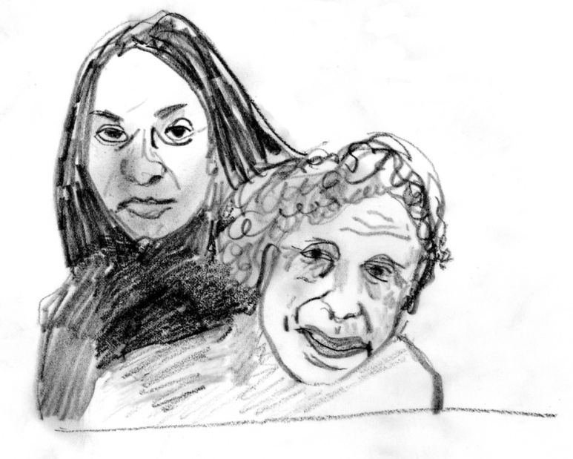
Theory
Emotional attachments and moral commitments help
solve contracting problems that require non-market solutions.

Slide 4
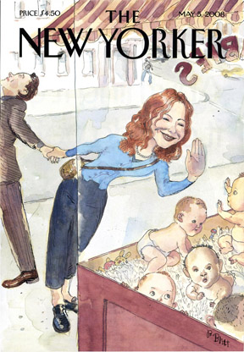
Attachments and commitments are costly.
They limit “exit” and bargaining power.

Slide 6
This Approach Emphasizes:
Links between the weak bargaining power of caregivers in the family and in the labor market.
Similarities between the supply of care services in both unpaid and paid work.

Slide 7
Care Work: Concern for the well-being of the care recipient is likely to affect the quality of the services provided.
For Love and Money: Care Provision in the U.S.
Edited by Nancy Folbre
(New York: Russell Sage, 2012)

Slide 8
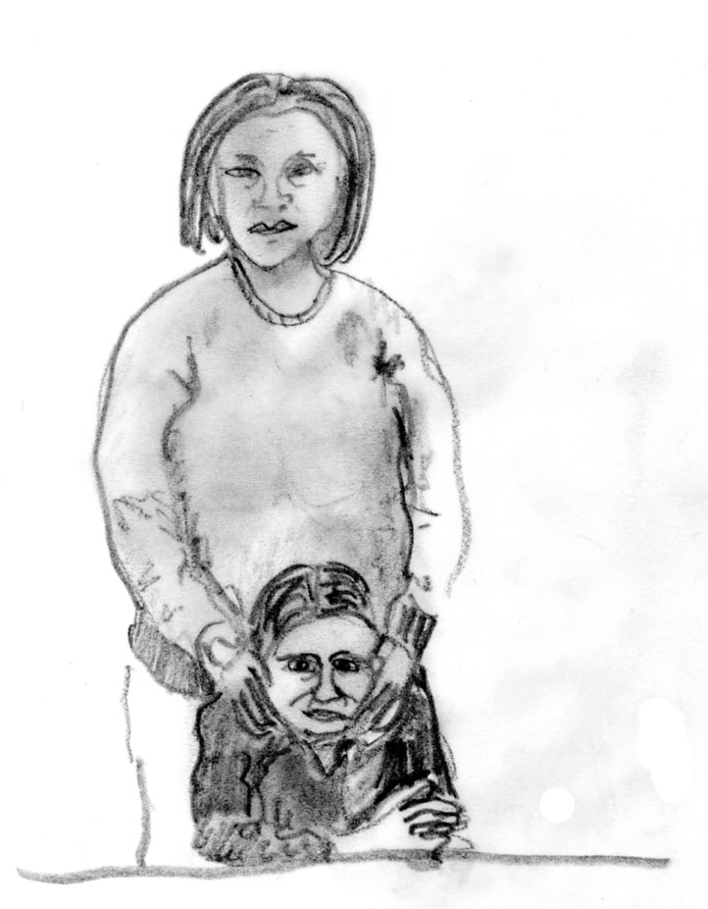
Common Characteristics of Unpaid and Paid Care
difficulty measuring output
(information problems, externalities, team production)
significant intrinsic motivation
(concern for well-being; warm-glow altruism)
lack of consumer sovereignty
(inability to choose; third party decision-making and/or payment, information problems)
highly gendered norms
(including asymmetries between marriage market and labor market )

Slide 9
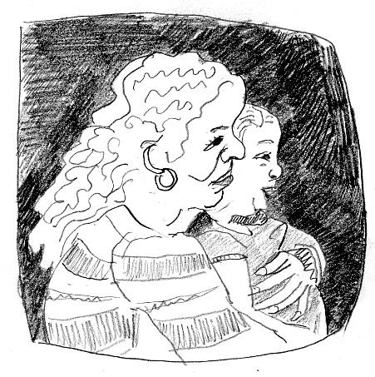
Endogenous Preferences
“I didn’t expect this and I didn’t want it, but my heart’s involved now.”
(A grandmother, describing her care for her grandson.)
“I love them. That’s all, you can’t help it.”
(Paid caregivers, describing their feelings toward many of their clients.)
In psychological terms, “attachment.”

Slide 10
Consequences for Bargaining
Hold up, “prisoner of love”; chicken game,
lack of property rights, inelastic supply

Slide 11
Bargaining in the Home
The more altruistic parent (or child) assumes greater burdens.
Family care entails person-specific skills that are not fungible in the labor market.
Relationship dissolution more costly for women than for men.

Slide 12
Bargaining in the Labor Market
Efficiency wages—higher wages elicit more effort or quality --therefore cost-effective
Not in care work! Quality of “output” difficult to measure and charge for.
“Pay for performance” is problematic (and contested) in care work.

Slide 13
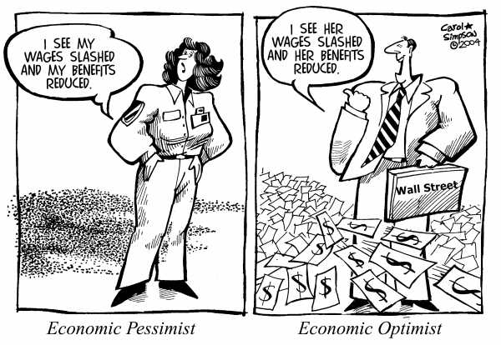

Slide 14
The Supply of Caring Labor
S
S’
W*
W_{c}
D
Q
Supply of unpaid labor
Quantity of paid workers
(between 2 arrows)

Slide 15
Wages Affect Supply of Unpaid Care
Price effect—increases opportunity cost
Income effect—unpaid or informal care a normal or a superior good
Coordination effect—scheduling inflexibility is surprisingly important
Normative effect—”devaluation” of care work affects norms
The Supply of Unpaid Care Affects Wages
Lowers wages for paid care
Exacerbates class/race differences-- affluent women can purchase substitutes
and bargain more effectively for work/family flexibility

Slide 16
Empirics:
Measuring Care Work and Care Penalties
(especially those relevant to inequality)
Resistance to economic valuation of unpaid care.
Policy “discrimination” against caregivers.
Family responsibility discrimination in the workplace
Direct measurement of care penalty

Slide 17
Resistance to Valuation of Unpaid Care
Conventional measures of “family income” ignore the value of non-market work.
Valuation of non-market work has an equalizing effect in the cross-section,
but most likely a disequalizing effect over time as women increase participation in paid employment, where inequality is greater.
NEED MORE EMPIRICAL RESEARCH!

Slide 18
“Policy” Discrimination
Swapping children from 9 to 5 would increase eligibility for EITC
Foster parents get substantially more public support than other parents.
In many states, foster parents pay a “kin” penalty.
Many states make inadequate provision for home care (as opposed to
institutional care) for the elderly and people with disabilities due to fears
of a “woodwork effect.”
In many states, consumer-directed home care programs exclude spouses
from eligibility for payment.
Gender bias in compensation for the families of victims of 9-11

Slide 19
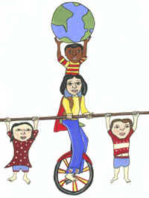
Family Responsibility Discrimination
Audit studies and legal cases show that employers prefer not to hire or promote
mothers of young children and also penalize men with heavy care responsibilities.
Is this discrimination based on norms/preferences or “statistical discrimination” based on perception that those with family responsibilities will invest less heavily in job performance?
NEED MORE EMPIRICAL RESEARCH!

Slide 20
Direct Measurement of Care Penalty
MANY POSSIBLE DEFINITIONS!
Impact of children on earnings net of all other human capital and employment
Characteristics.
Impact of children on earnings net of all other human capital and employment characteristics and individual fixed effects
Impact of care provision for children and parents (controlling or NOT) for these characteristics.
Impact of entering employment in the paid care sector.
Impact on lifetime earnings (controlling or NOT) of all of the above.
Impact on lifetime INCOME (controlling or NOT) of all of the above.
NEED MORE EMPIRICAL RESEARCH

Slide 21
Care Penalty Findings
Penalty for motherhood net of everything else that can be controlled for
(but seems to have diminished in recent years).
Penalty for motherhood differs significantly across countries and is clearly
related to public policy. Employment and promotion effects differ.
Penalty for motherhood in U.S.—greatest at the “top” or at the “bottom”?
Unresolved!
Care for elderly parents reduces labor supply and earnings
(but may be partially endogenous)
Effect of hours worked on earnings seems to be increasing over time.
VERY LITTLE RESEARCH ON EFFECTS ON LIFETIME INCOME!

Slide 22
Care Policies to Reduce Inequality
Provide more public support for low-income care givers.
Encourage gender neutrality in care provision.
Combine paid family leaves from work with child care, early education, and
home and community-based services for the elderly .
Reduce penalties for part-time work, discourage “overtime,” give workers more
control over scheduling.
Increase pay and benefits in care occupations.

